Slide 1
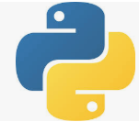
6 Database
Peter H. Chen

Slide 2
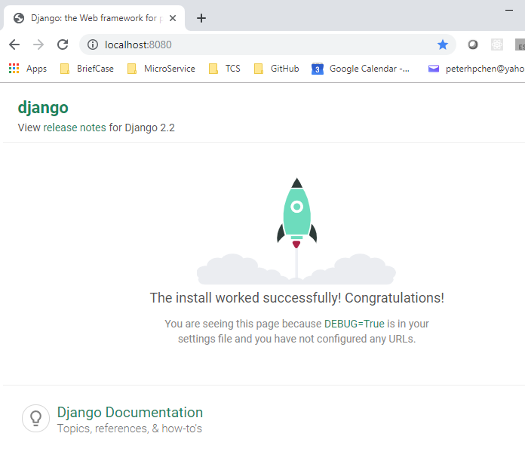
6 Database
https://www.youtube.com/watch?v=IU3LbtbmXXI&list=PL6gx4Cwl9DGBlmzzFcLgDhKTTfNLfX1IK&index=6
This section discusses Database of Django.
> django-admin startproject Database05
> cd Database05
Make sure directory contains manage.py
> python manage.py runserver 8080
Open chrome and enter
> localhost:8080
Enter
> localhost:8080/admin

Slide 3
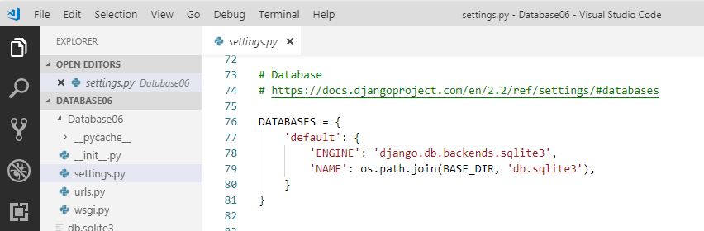
6 Database
https://www.youtube.com/watch?v=IU3LbtbmXXI&list=PL6gx4Cwl9DGBlmzzFcLgDhKTTfNLfX1IK&index=6
Before we create the album or add any songs, we need to setup the database.
How dot we do that?
We need to know a few things:
First, a couple core concepts of Django. Whenever you setup your project to use Django, it came with the default database and that database SQL Lite.
Open “Database06/settings.py”, by default, the Databases engine is set to “sqlite3”.

Slide 4
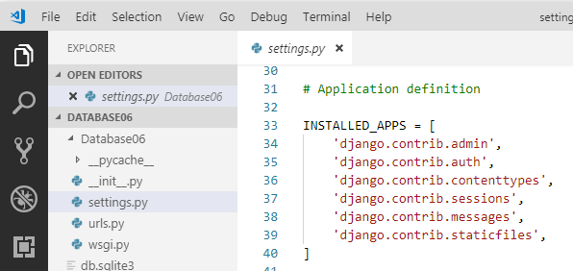
6 Database
https://www.youtube.com/watch?v=IU3LbtbmXXI&list=PL6gx4Cwl9DGBlmzzFcLgDhKTTfNLfX1IK&index=6
Django database can be Postgre or MySQL. These are used in production.
The SQLite3 can be used for testing. We do not need to do all the hard stuff of settings.
We web site may have the video app, profile app, photo viewer app, and etc.
Django already came with a bunch of default apps: Admin, authentication, session, messages, and etc. We will get into these later on.
Some of these apps need to access database. They need to setup tables in order to work.

Slide 5
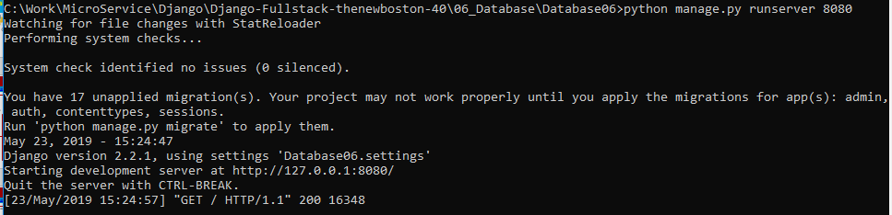
6 Database
https://www.youtube.com/watch?v=IU3LbtbmXXI&list=PL6gx4Cwl9DGBlmzzFcLgDhKTTfNLfX1IK&index=6
When we start the Django server, we see some error messages here.
The error message means that the database is not in sync. This is not good.

Slide 6
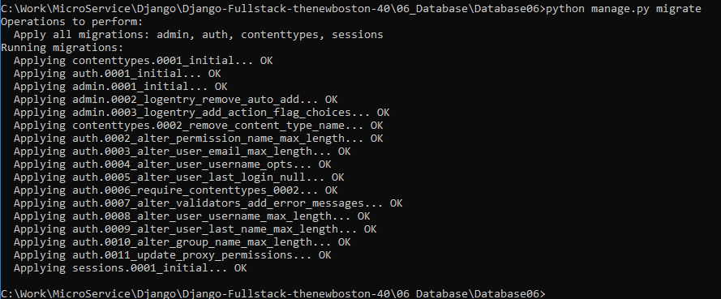
6 Database
https://www.youtube.com/watch?v=IU3LbtbmXXI&list=PL6gx4Cwl9DGBlmzzFcLgDhKTTfNLfX1IK&index=6
We need to in sync the database:
> python manage.py migrate

Slide 7
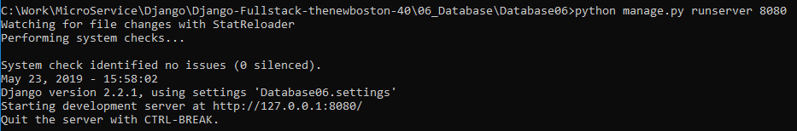
6 Database
https://www.youtube.com/watch?v=IU3LbtbmXXI&list=PL6gx4Cwl9DGBlmzzFcLgDhKTTfNLfX1IK&index=6
After we do the migration (> pyhton manage.py migrate), the error messages are cleared.
We do not have any issues, no warning after we run the command (pyhton manage.py migrate).
The python migrate it and setup all our code with our database. We are noew good to go.

Slide 8
6 Database
https://www.youtube.com/watch?v=IU3LbtbmXXI&list=PL6gx4Cwl9DGBlmzzFcLgDhKTTfNLfX1IK&index=6
When we start the Django, Django will look up the settings.py and check what tables are needed to work with this app. Each app has its own tables that is requires. For example, in our music app, we need a table for albums, and we need another table for song, and etc.
They need migrate somewhere. We will make a small database.

Slide 9
End of Chapter

