Slide 1

3 Linear Regression: Part 2
Peter H. Chen

Slide 2
3 Linear Regression: Part 2
https://techwithtim.net/tutorials/machine-learning-python/linear-regression-2/
In section, we will implement the linear regression algorithm.
We will discuss some math equation of linear regression.
Linear regression will transform the scatter data into a equation with regression form looks as follow. We can see some correlation of data and line and get the best fit of the line with data.
Y
X

Slide 3
3 Linear Regression: Part 2
https://techwithtim.net/tutorials/machine-learning-python/linear-regression-2/
Another data set, it is randomize and not easy to fit.
You don’t know what exactly line looks like.
Y
X

Slide 4
3 Linear Regression: Part 2
https://techwithtim.net/tutorials/machine-learning-python/linear-regression-2/
Go back to the first example, we have line equation: y = mx + b
The y = m x + b is obtained from linear regression.
We will get the predict value (G3) by input value (G1).
y = m x + b
p2
G3 = m G1 + b
Y
p1
G3
Y will generate the predict value
m = (y2-y1)/(x2-x1)
b
X
G1

Slide 5
3 Linear Regression: Part 2
https://techwithtim.net/tutorials/machine-learning-python/linear-regression-2/
We have multiple value to create X and Y. The best fit is multi-dimensional space for us.
We can only show a simple 3 D space.
We can create a best fit line, go through the coordinate space from left down to the right.
G3
G1
G2

Slide 6
3.1 Implement Linear Regression
Peter H. Chen

Slide 7
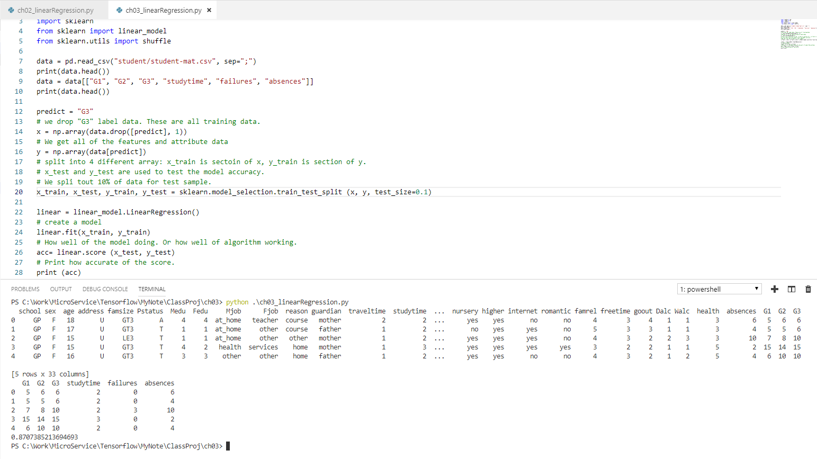
3.1 Implement Linear Regression
https://techwithtim.net/tutorials/machine-learning-python/linear-regression-2/
Now, we move into the actual coding.
We have predict around 0.87.

Slide 8
3.2 Print Coefficient and Intercept
Peter H. Chen

Slide 9
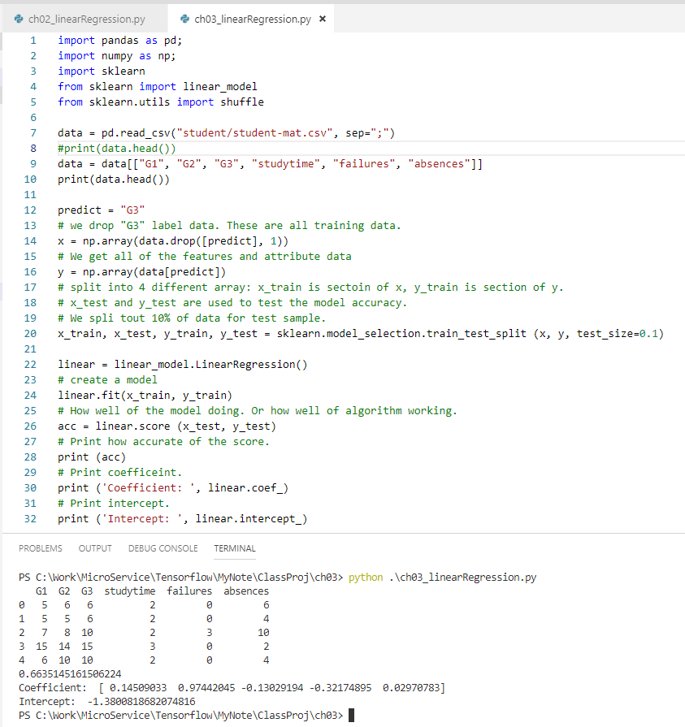
3.2 Print Coefficient and Intercept
https://techwithtim.net/tutorials/machine-learning-python/linear-regression-2/
Print the coefficient and intercept of the linear regression model.
There are five coefficients here with five-dimensional space.
The y = m x + b is two-dimensional space.
The five coefficients corresponds to five coordinate space.
You can think of y = m1 * x1 + m2 * x2 + m3 * x3 + m4 * x4 + m5 * x5
x1 can be dependency and combination of other dependent or indenpdent variables, for example, x1 = x2 * x3 * x5, x2 = x2 + x3 + x5. etc.
You can use expand the dependencies.
The front are the higher order.
The coefficient approximate to zero are less important and can be removed.

Slide 10
3.3 Print Each Individual Prediction
Peter H. Chen

Slide 11
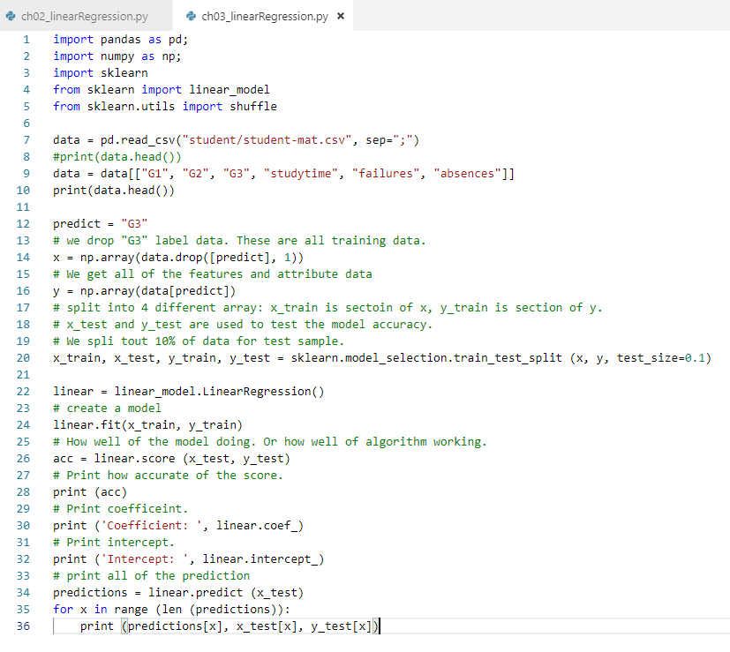
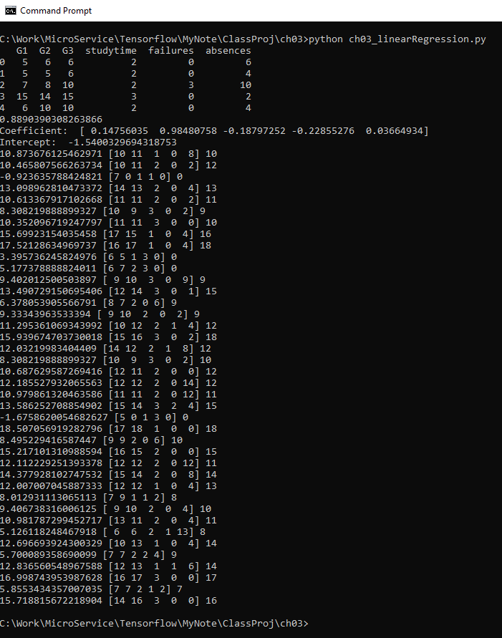
3.3 Print Each Individual Prediction
https://techwithtim.net/tutorials/machine-learning-python/linear-regression-2/
Use range function and for loop to print each individual prediction.

Slide 12
3.3 Print Each Individual Prediction
https://techwithtim.net/tutorials/machine-learning-python/linear-regression-2/
The prediction value of based on input test X and output Y test value are very close.
Predict Value
Real Y Test value

Slide 13
End of Chapter

