Slide 1

12 K-Mean Cluster Implement (Part 2)
Peter H. Chen

Slide 2
12 K-Mean Cluster Implement (Part 2)
https://www.youtube.com/watch?v=g1Zbuk1gAfk&list=PLzMcBGfZo4-mP7qA9cagf68V06sko5otr&index=11s
This section implement K-Mean Clustering algorithm implementation.
K-Mean Clustering is an unsupervised algorithm. As we move into the unsupervised algorithm, there is another series of neural network will be coming out.
Unsupervised is more difficult to test the accuracy and validity of data set.

Slide 3
12.1 Implement K-Mean Benchmark
Peter H. Chen

Slide 4
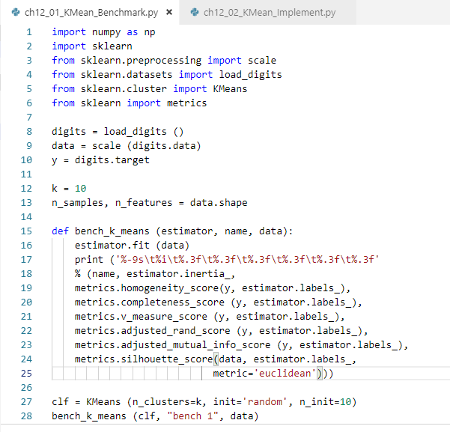
12.1 Implement K-Mean Benchmark
https://www.youtube.com/watch?v=g1Zbuk1gAfk&list=PLzMcBGfZo4-mP7qA9cagf68V06sko5otr&index=11s
Load the data:
from sklearn.datasets import load_digits
digits = load_digits ()
The digit data by default have large values. It maybe the RGB value or grayscale values. They scaled down by scale() function. Scale down the value will save the computation time.
Especially, we are doing the Euclidean distance between the point. The small values is better for computation and have less outliers.
data = scale (digits.data)
The y = digitis.target is the final feature going to be displayed.

Slide 5
12.1 Implement K-Mean Benchmark
https://www.youtube.com/watch?v=g1Zbuk1gAfk&list=PLzMcBGfZo4-mP7qA9cagf68V06sko5otr&index=11s
We have K = 10 for 10 classes (we have 10 digits from 0 to 9) for the data sets.
Then we want to test our samples and features of our data:
n_samples, n_features = data.shape

Slide 6
12.1 Implement K-Mean Benchmark
https://www.youtube.com/watch?v=g1Zbuk1gAfk&list=PLzMcBGfZo4-mP7qA9cagf68V06sko5otr&index=11s
Then, we setup the unsupervised K-Mean algorithm: Completeness score, v-measure score, adjusted rand score, mutual info score, and silhouette score.
They have a large amount of score to grade the model to get the best accuracy.
All scores represent the different meaning to evaluate the accuracy of the model.

Slide 7
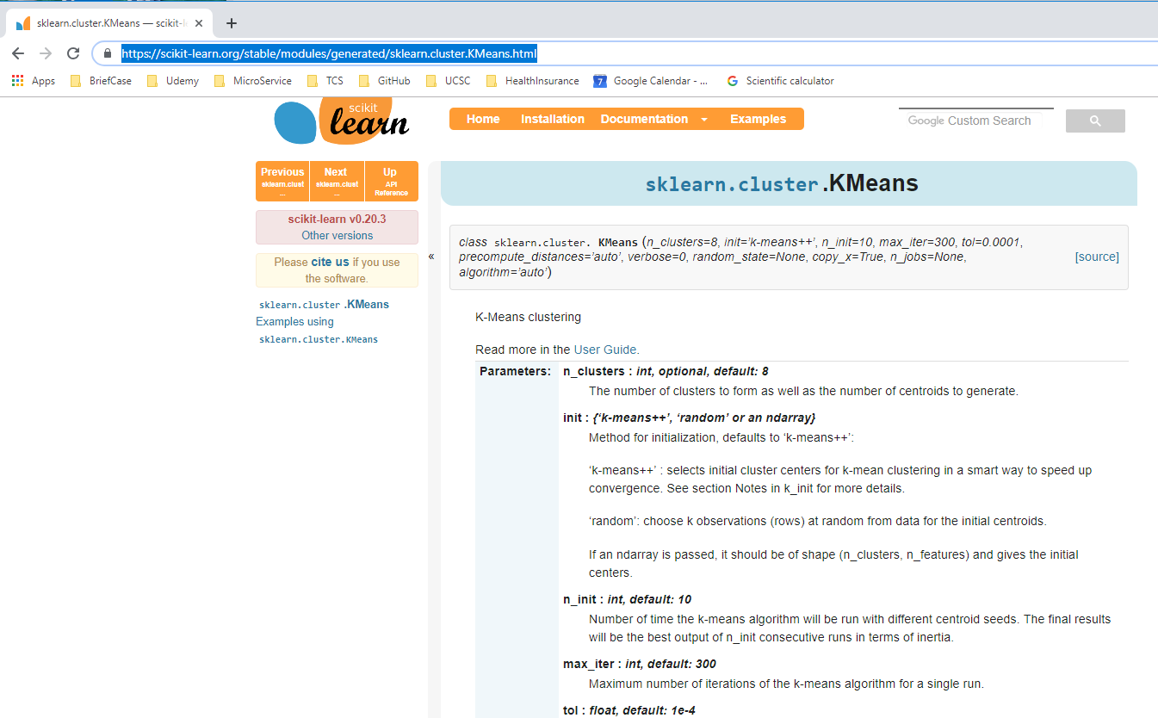
12.1 Implement K-Mean Benchmark
https://www.youtube.com/watch?v=g1Zbuk1gAfk&list=PLzMcBGfZo4-mP7qA9cagf68V06sko5otr&index=11s
The scikit-learn.org web-site:
https://scikit-learn.org/stable/modules/generated/sklearn.cluster.KMeans.html
contains the parameter information for k-means clustering.

Slide 8
12.1 Implement K-Mean Benchmark
https://www.youtube.com/watch?v=g1Zbuk1gAfk&list=PLzMcBGfZo4-mP7qA9cagf68V06sko5otr&index=11s
We will bench k-means by using the k-means++ and random for the data set.
The Kmeans has the init= {‘k-means++’ , ‘random’, or an ndarray}
The ‘k-means++’ selects initial cluster centers for k-mean clustering in a smart way to speed up convergence and run faster.
The ‘random’ choose k observations (rows) at random for the initial centroids.
We choose ‘random’ for our bench mark.

Slide 9
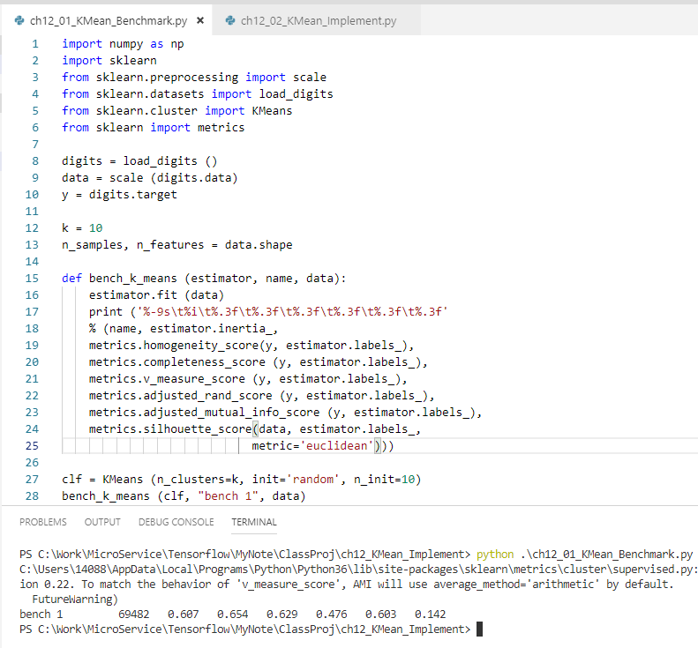
12.1 Implement K-Mean Benchmark
https://www.youtube.com/watch?v=g1Zbuk1gAfk&list=PLzMcBGfZo4-mP7qA9cagf68V06sko5otr&index=11s
> python ch12_01_Kmean_Benchmark.py
You can see different score for selecting random with initial cluster = 10.
Inertia = 69482, homogeneity = 0.607, completeness = 0.654, adjusted rand score = 0.629, etc. The higher the better.

Slide 10
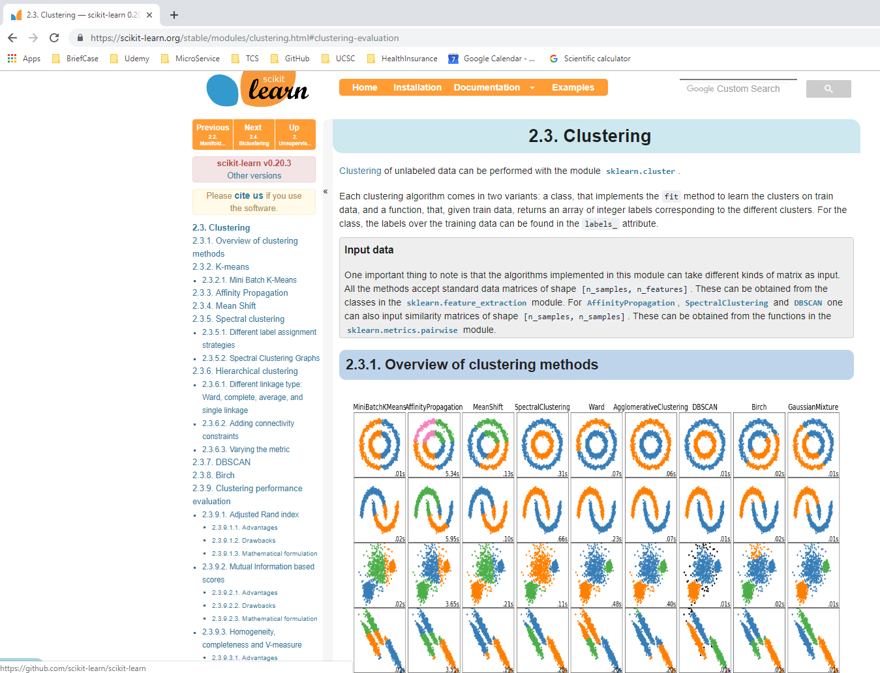
12.1 Implement K-Mean Benchmark
https://www.youtube.com/watch?v=g1Zbuk1gAfk&list=PLzMcBGfZo4-mP7qA9cagf68V06sko5otr&index=11s
Web Site: https://scikit-learn.org/stable/modules/clustering.html#clustering-evaluation

Slide 11
12.2 K-Mean Cluster for Digits
Peter H. Chen

Slide 12
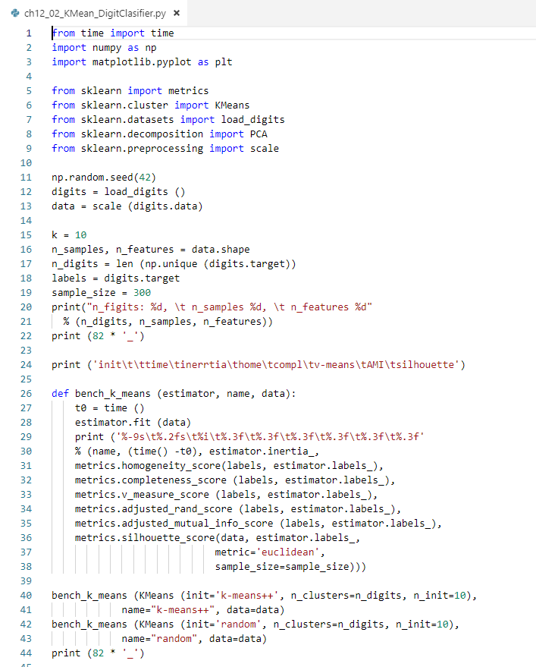
12.2 K-Mean Cluster for Digits
https://www.youtube.com/watch?v=g1Zbuk1gAfk&list=PLzMcBGfZo4-mP7qA9cagf68V06sko5otr&index=11s
The following example show the implementation of digit classifier.
It benchmarks kmeans++ and random.
It then displays the classification results by plot.

Slide 13
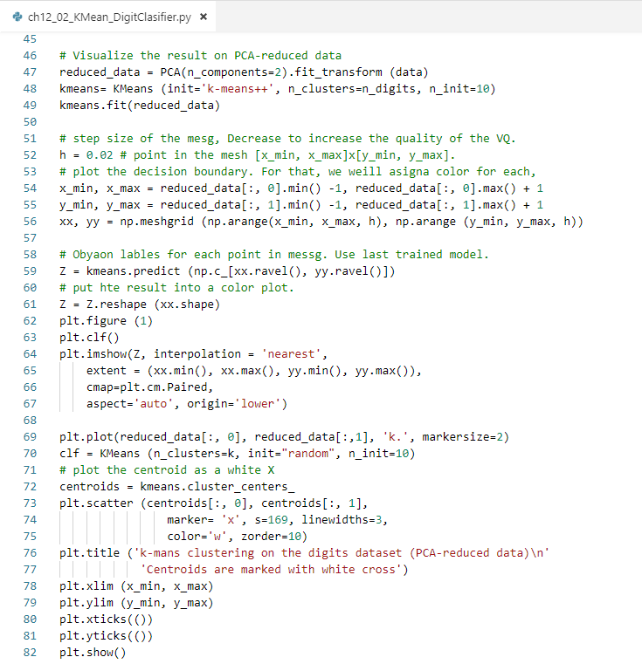
12.2 K-Mean Cluster for Digits
https://www.youtube.com/watch?v=g1Zbuk1gAfk&list=PLzMcBGfZo4-mP7qA9cagf68V06sko5otr&index=11s
Plot the final 10 digit classification.

Slide 14
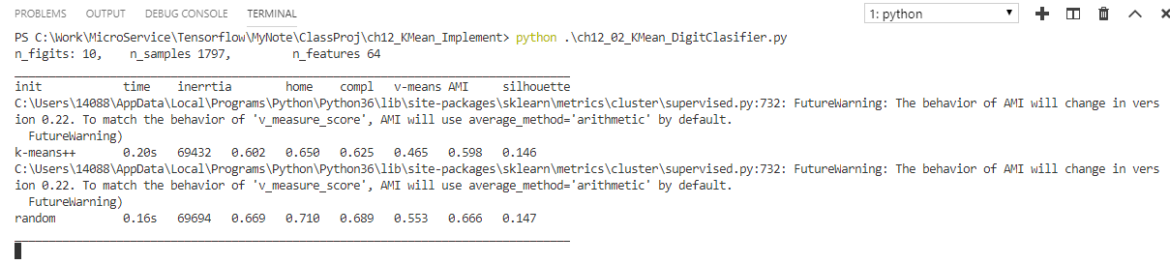
12.2 K-Mean Cluster for Digits
https://www.youtube.com/watch?v=g1Zbuk1gAfk&list=PLzMcBGfZo4-mP7qA9cagf68V06sko5otr&index=11s
> pyhton ch12_02_Kmean_DigitClassifier.py
Display the benchmark result:

Slide 15
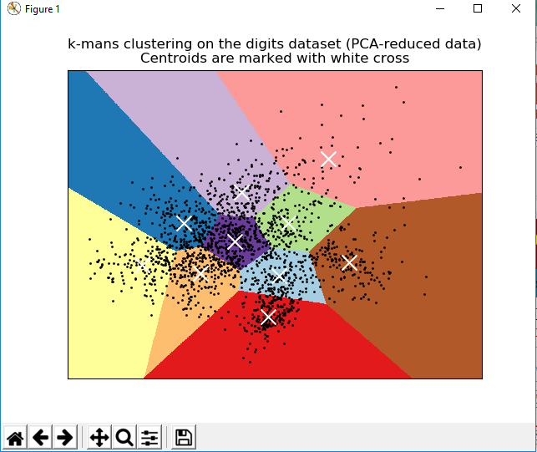
12.2 K-Mean Cluster for Digits
https://www.youtube.com/watch?v=g1Zbuk1gAfk&list=PLzMcBGfZo4-mP7qA9cagf68V06sko5otr&index=11s
> pyhton ch12_02_Kmean_DigitClassifier.py
Display the 10 digit classifier

Slide 16
End of Chapter

