Slide 1

1 Python Machine Learning
Peter H. Chen

Slide 2
1 Python Machine Learning
https://techwithtim.net/tutorials/machine-learning-python/introduction/
Setup up for Machine Learning
This setup is very important. We will not write any code in the section.
Next section, we will start very standard and very basic machine learning algorithm.
We should understand and learn before we moving into the deep learning and neural network.
The setup is not as exciting as deep learning and neural network parts but they all fundamentals and required to move into more complicated and understand what is going on.
Very basic level why these thing work. These very simple algorithm are used for deep learning and neural networks that you have the fundamental understanding of linear algebra and calculus to be able to understand the math behind the formulas and the computing that actually goes into the neural network.
It is actually like math professors and professionals that have kind of created that thing.
Now, essentially machine learning is really like feeding in data and getting some kind of output.
You are giving a test data set for a machine to train and learn.
Hopefully based on that data, you can new data that have never seen to predict the certain outcomes or to classify images or do things along those lines.
So, it is a basic of what is going on throughout these series of sections.
We will do the installation in this section.

Slide 3
1 Python Machine Learning
https://techwithtim.net/tutorials/machine-learning-python/introduction/
We will use the tensorflow for these series of sections.
Tensorflow is a library for scientific computing and machine learning in python.
You can install tensorflow by “pip install tensorflow”.
If you have NVIDIO GPU, check “How to install Tensorflow of GPU on Window”.
This section, we only install Tensorflow for CPU.
First, we install JetBrain PyCharm, we will use PyCharm IDE. We are not using Spyder for these sections.
PyCharm community Edition is completely free.
We need to install Anaconda. Check “conda --version” Install and add the Anaconda to path, otherwise, it will be very hard for you.

Slide 4
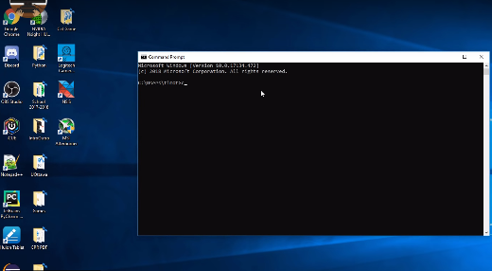
1 Python Machine Learning
https://techwithtim.net/tutorials/machine-learning-python/introduction/
We open the command prompt terminal and setup a virtual environment

Slide 5
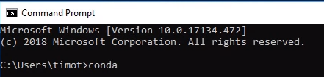
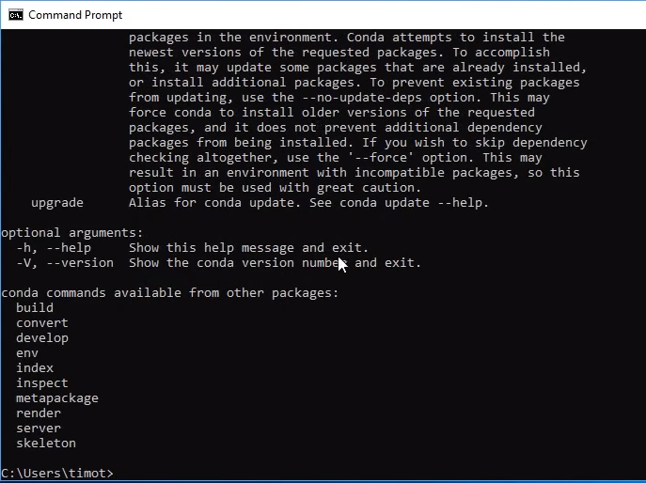
1 Python Machine Learning
https://techwithtim.net/tutorials/machine-learning-python/introduction/
First, make sure the “conda” is install and working properly.
Simply type “conda” and enter.

Slide 6
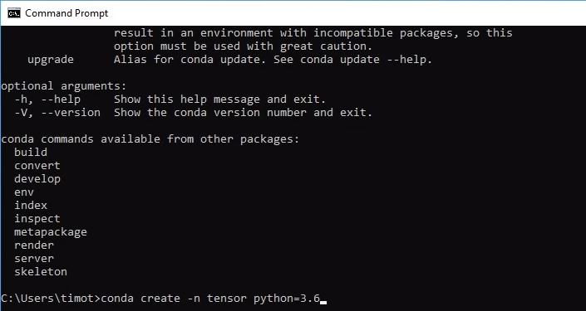
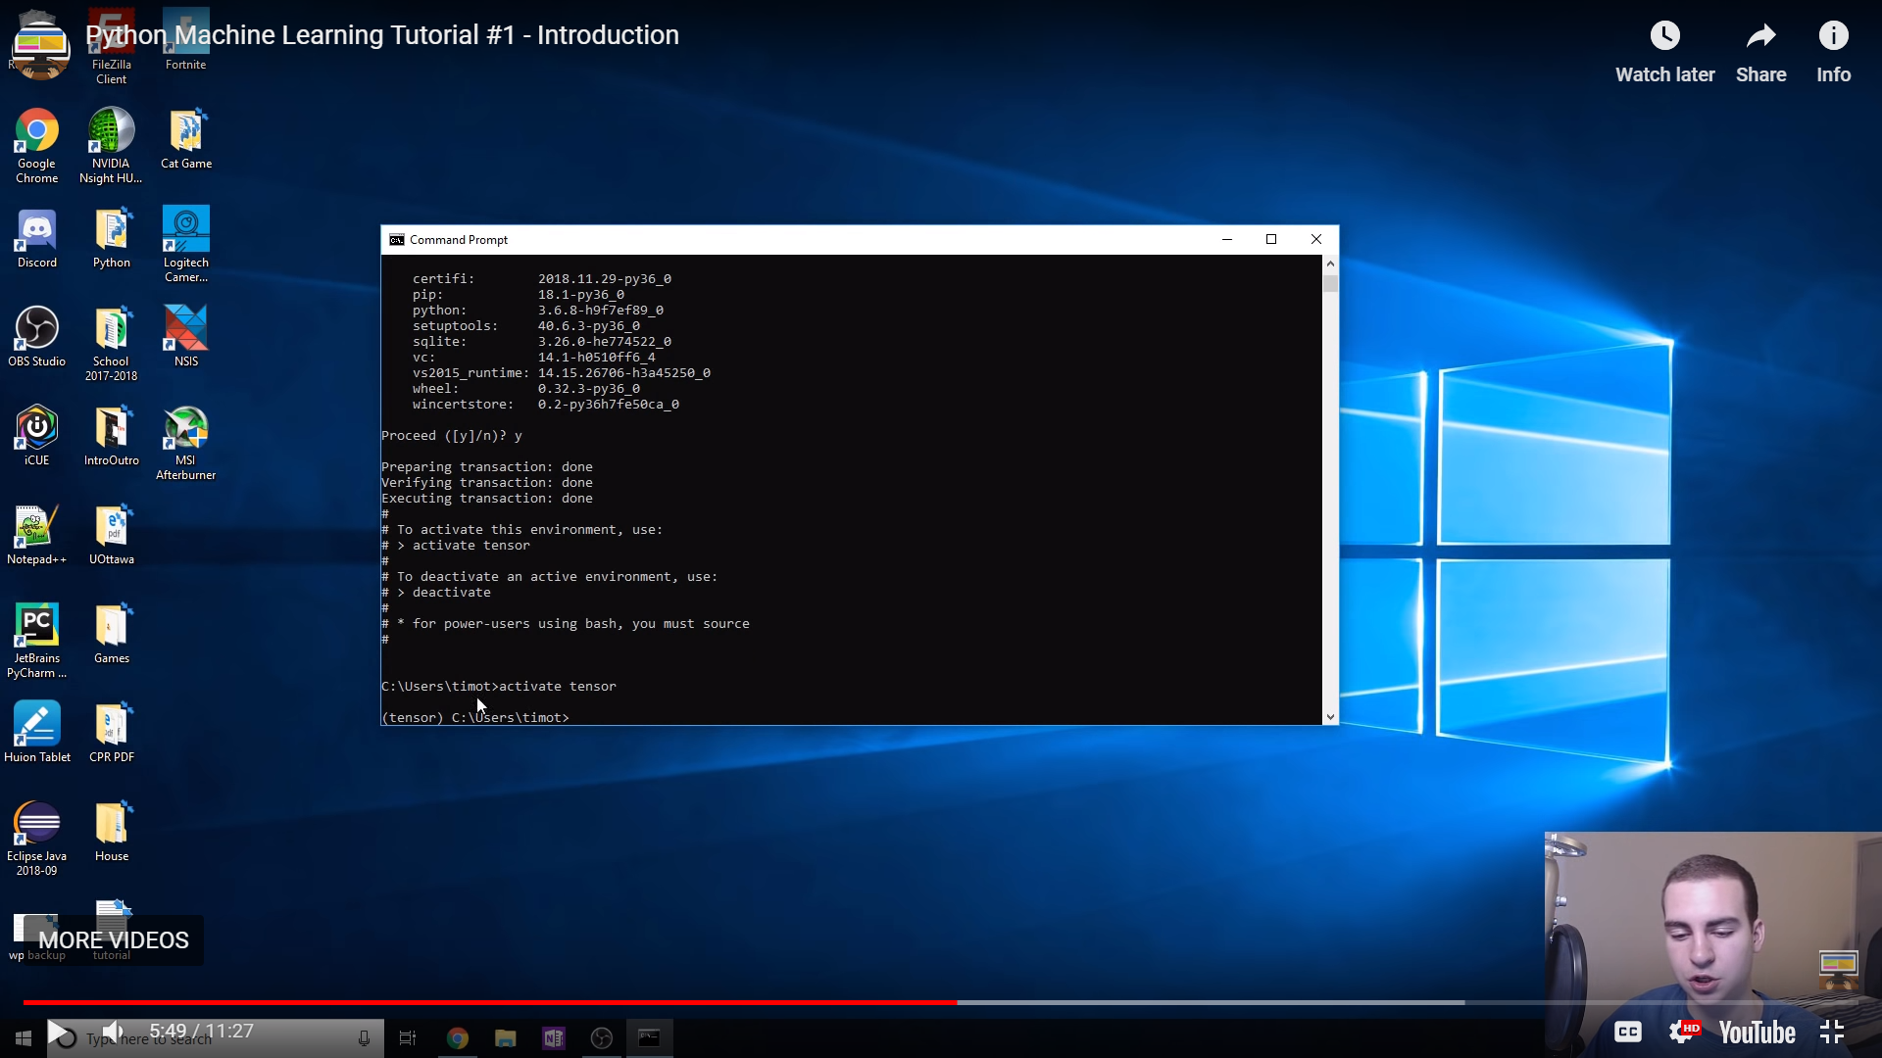
1 Python Machine Learning
https://techwithtim.net/tutorials/machine-learning-python/introduction/
> conda create -n tensorflow pip python=3.6
You can name “tensorflow” whatever you want. Use “python=3.6”. Do use any other version of python. Tensorflow will not support python 3.7
> activate tensorflow

Slide 7
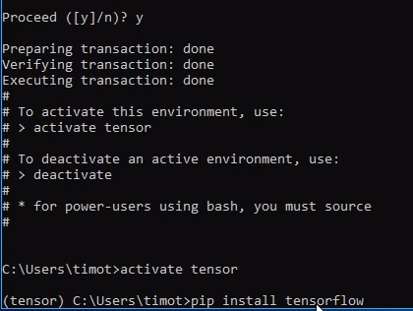
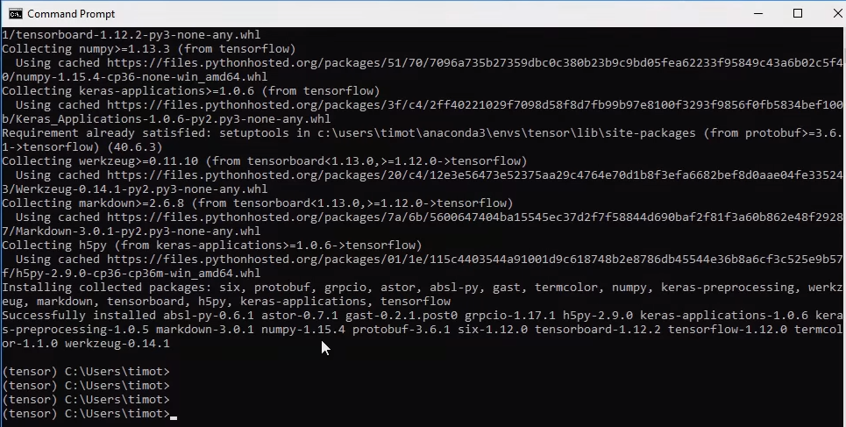
1 Python Machine Learning
https://techwithtim.net/tutorials/machine-learning-python/introduction/
Install the tensorflow under the anaconda environment
(tensor) C:\users\4088> pip install tensorflow

Slide 8
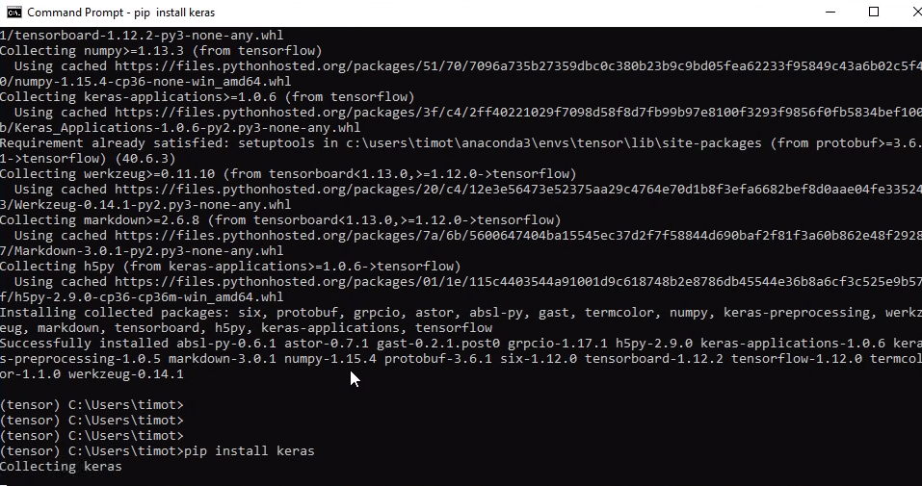
1 Python Machine Learning
https://techwithtim.net/tutorials/machine-learning-python/introduction/
We are going to use a bunch of dataset called Keras
(tensor) C:\users\4088> pip install keras

Slide 9
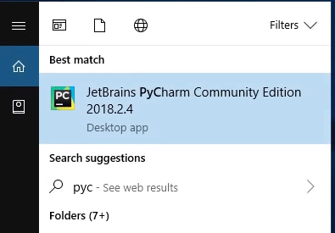

1 Python Machine Learning
https://techwithtim.net/tutorials/machine-learning-python/introduction/
Now, we have keras
We are going to install pyCharm.
We close the command prompt. Start the PyCharm.

Slide 10
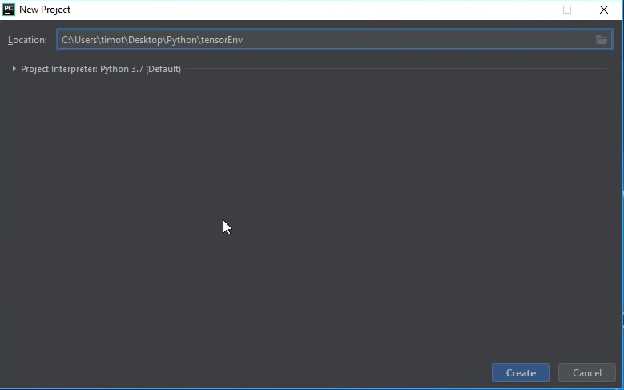
1 Python Machine Learning
https://techwithtim.net/tutorials/machine-learning-python/introduction/
New PyCharm Project: TensorEnv

Slide 11

1 Python Machine Learning
https://techwithtim.net/tutorials/machine-learning-python/introduction/
New PyCharm Project Navigator.

Slide 12
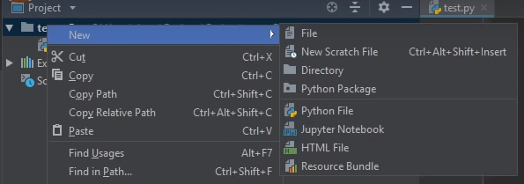
1 Python Machine Learning
https://techwithtim.net/tutorials/machine-learning-python/introduction/
Create a new Python file test.py inside the tensorEnv.

Slide 13
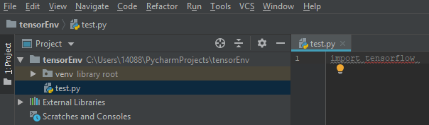
1 Python Machine Learning
https://techwithtim.net/tutorials/machine-learning-python/introduction/
It has the error of tensorflow.
That is because we have not get the project interpreter and have not got those packages inside the environment into PyCharm.

Slide 14
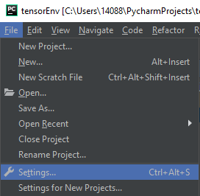
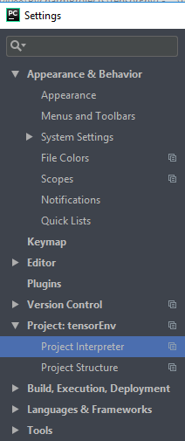
1 Python Machine Learning
https://techwithtim.net/tutorials/machine-learning-python/introduction/
To do this, we got to File > setting ...
Go to Project: tensorEnv > Project Interpreter

Slide 15
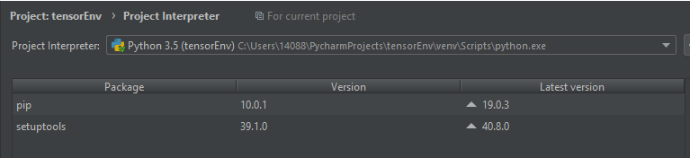
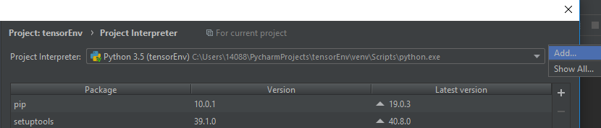
1 Python Machine Learning
https://techwithtim.net/tutorials/machine-learning-python/introduction/
We should see the default project interpreter.
If you can not see the selection, you can add the new interpreter. Click “Add”

Slide 16
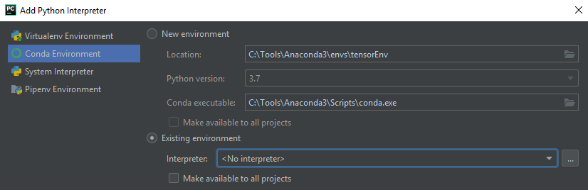
1 Python Machine Learning
https://techwithtim.net/tutorials/machine-learning-python/introduction/
Select the “Conda Environment”

Slide 17
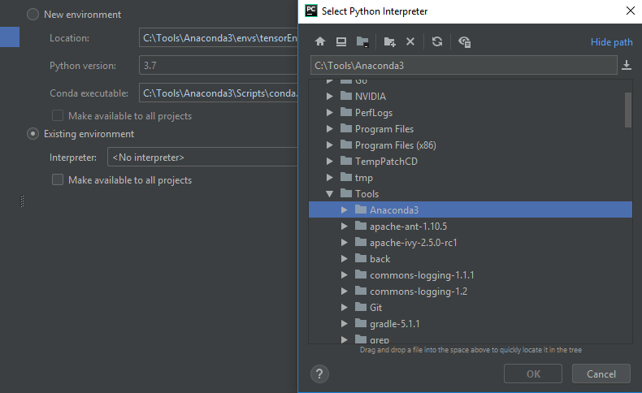
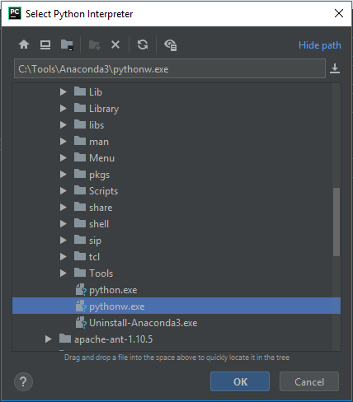
1 Python Machine Learning
https://techwithtim.net/tutorials/machine-learning-python/introduction/
Select the “Existing environment”, in my case, “C:\Tools\Anaconda3”
Find the “pyhtonw.exe” and click OK.

Slide 18
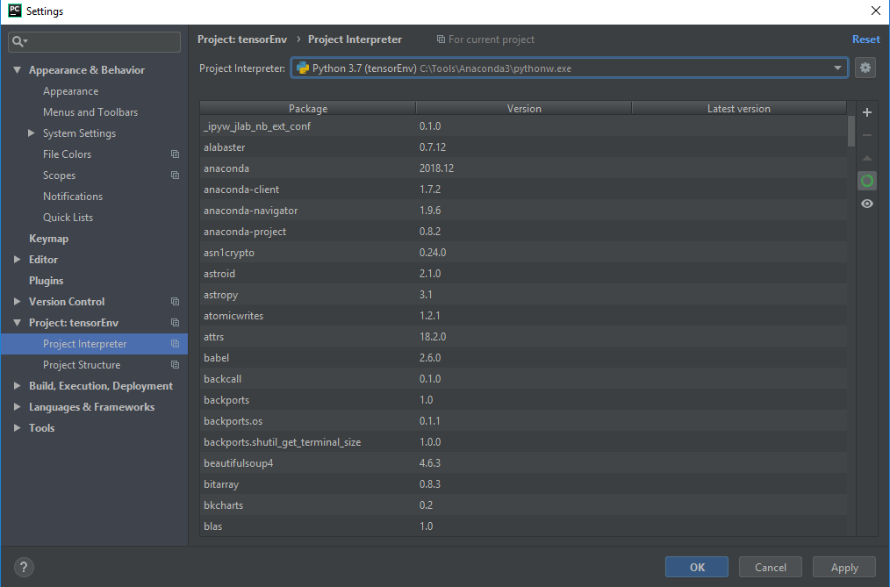
1 Python Machine Learning
https://techwithtim.net/tutorials/machine-learning-python/introduction/
Now, I have all the pyhtonw.exe environment for PyCharm.

Slide 19
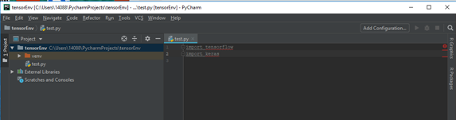
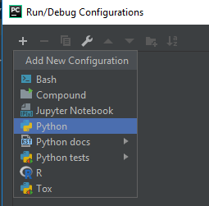
1 Python Machine Learning
https://techwithtim.net/tutorials/machine-learning-python/introduction/
Add Configuration
+ > Add Pyhton

Slide 20
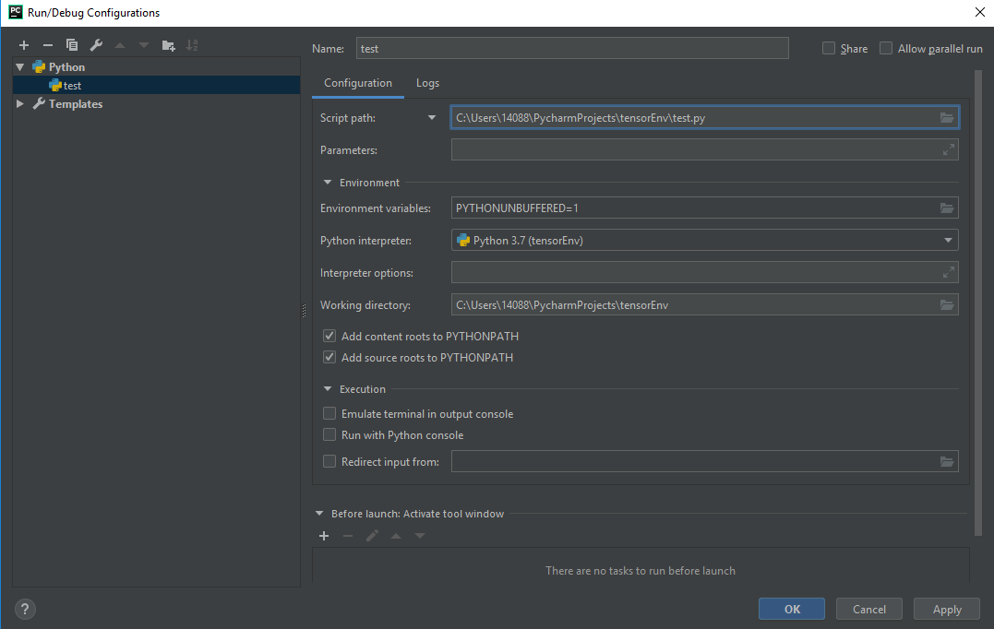
1 Python Machine Learning
https://techwithtim.net/tutorials/machine-learning-python/introduction/
Add tensorEnv/test.py

Slide 21
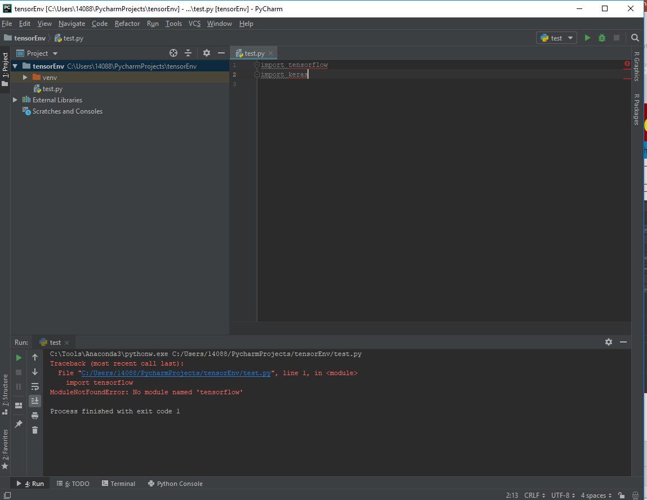
1 Python Machine Learning
https://techwithtim.net/tutorials/machine-learning-python/introduction/
Click run to run the pyhtonw.exe

Slide 22

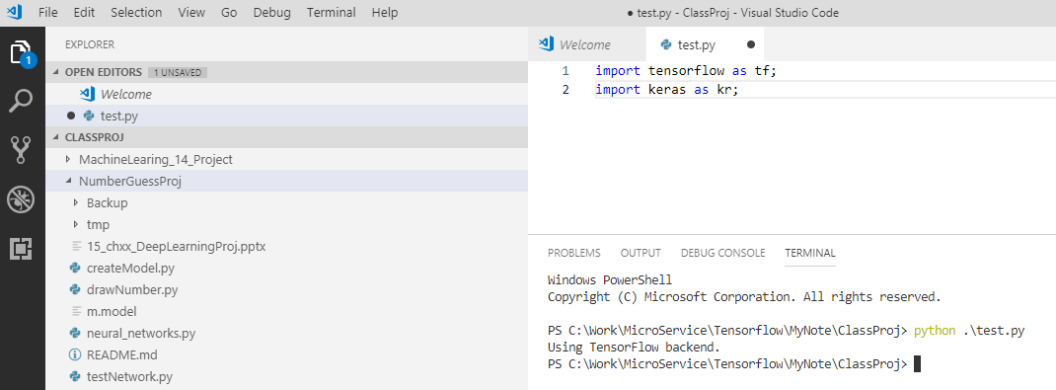
1 Python Machine Learning
https://techwithtim.net/tutorials/machine-learning-python/introduction/
You can use VS Code to create test.py and run python test.py.
If cannot find the keras, try on command prompt. Restart VS Code and try again.

Slide 23
End of Chapter

