Slide 1

10 SVM Implementation (Part 3)
Peter H. Chen

Slide 2
10 SVM Implementation (Part 3)
https://techwithtim.net/tutorials/machine-learning-python/svm-1/
In this section, we are going to implement SVM (Support Vector Machine) algorithm.
We are going to use SVC (Support Vector Classification). SVC is part of Support Vector Machines.
SVC is exactly what we discussed in the last section.
We will talk K-Mean clustering algorithm in next section. K-Mean is unsupervised learning algorithm.
We will know the difference between the supervised and unsupervised learning algorithm. So far, we only discussed about the supervised learning algorithm.

Slide 3
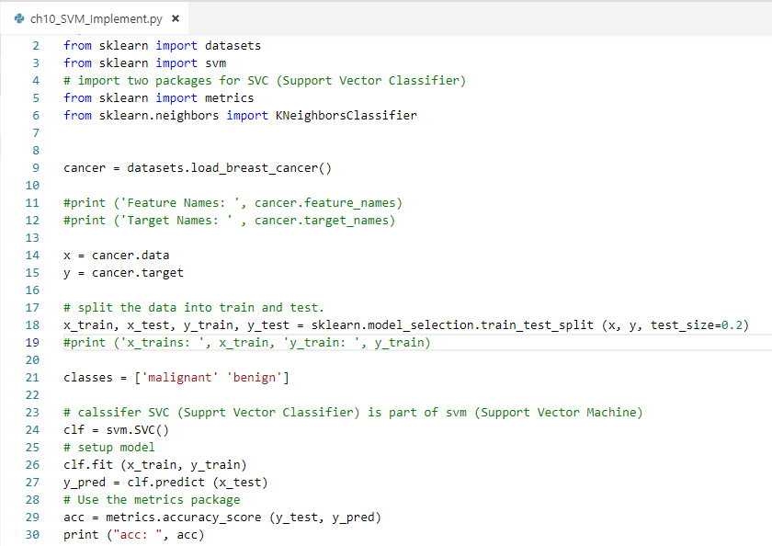
10 SVM Implementation (Part 3)
https://techwithtim.net/tutorials/machine-learning-python/svm-1/
Import metrics and KNeighborsClassifer Packages.
Setup model, prediction, calculate the accuracy.

Slide 4
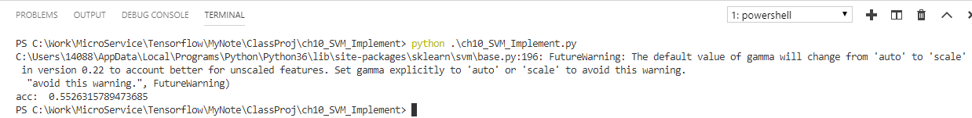
10 SVM Implementation (Part 3)
https://techwithtim.net/tutorials/machine-learning-python/svm-1/
Run it, we have 55% of accuracy.
This is too low for our expecting.
We need to tweaked the parameters to get the higher accuracy.
People who do not how the SVM work and get only 55% accuracy and will give up.

Slide 5
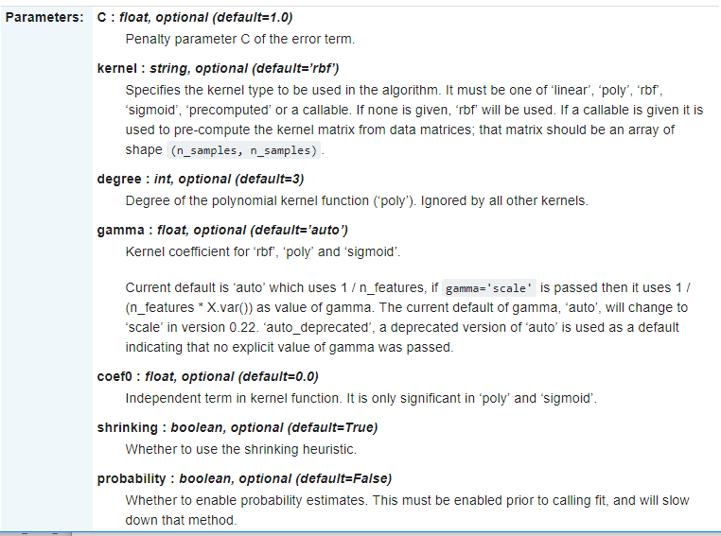
10 SVM Implementation (Part 3)
https://techwithtim.net/tutorials/machine-learning-python/svm-1/
Let’s tweak the parameters of SVC.
Tklearn.svm.SVC(): https://scikit-learn.org/stable/modules/generated/sklearn.svm.SVC.html
There are kernel parameter and default is ‘rbf’. We need to setup. There are linear, polynomial, rbf, sigmoid, precompute, or callable. Unless you are math expert, you choose linear.

Slide 6
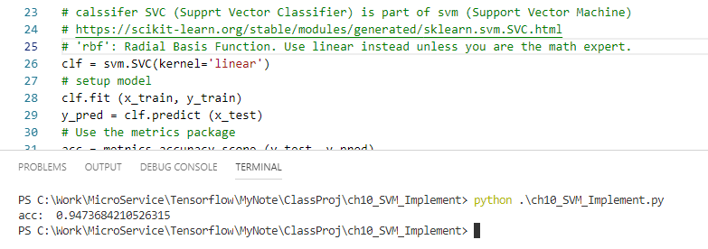
10 SVM Implementation (Part 3)
https://techwithtim.net/tutorials/machine-learning-python/svm-1/
Change thee SVC kernel from default = ‘rbf’ (Radial Basis Function) into linear.
Unless you are the math expert or professor, otherwise, you choose kernel= ‘linear’ instead of default ‘rbf’.
In the case, we improve the accuracy from 55% to 95%. That is great improvement.

Slide 7
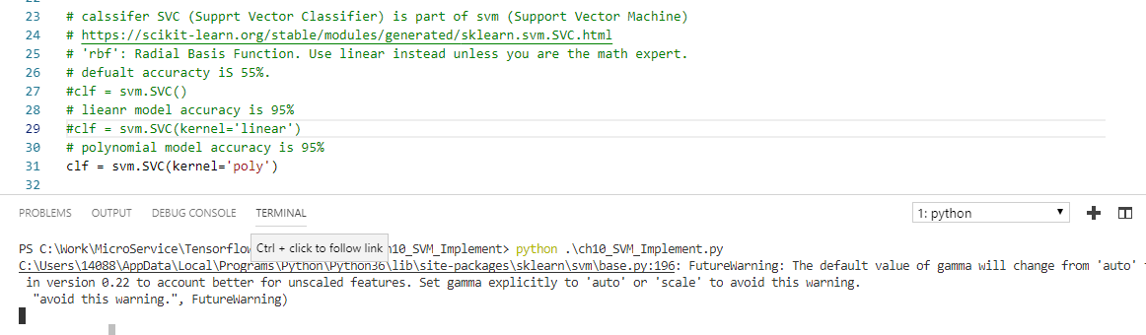
10 SVM Implementation (Part 3)
https://techwithtim.net/tutorials/machine-learning-python/svm-1/
You tweak one parameter to give us the hyperplane that is much better classification.
We can change parameter to ‘ploy’ for polynomial.
It takes several hours to run. We stop it since it takes to long.

Slide 8
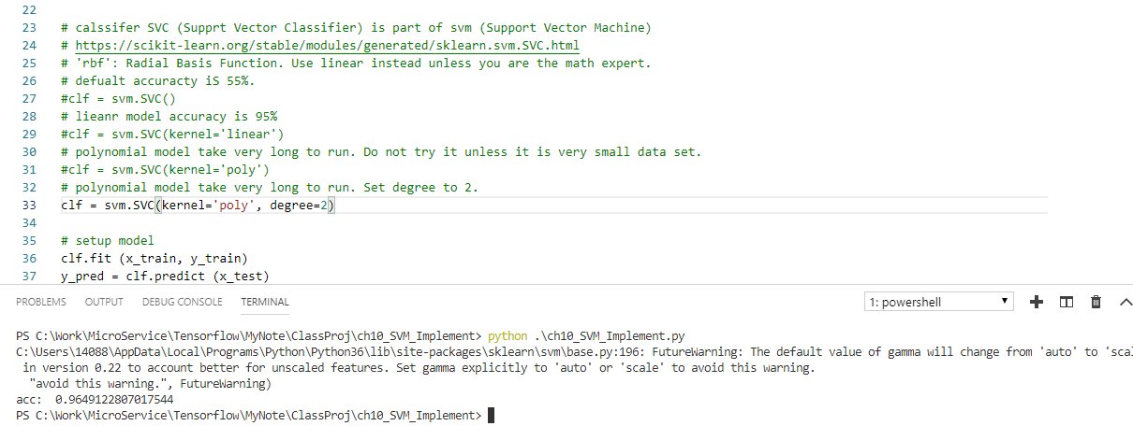
10 SVM Implementation (Part 3)
https://techwithtim.net/tutorials/machine-learning-python/svm-1/
Change to kernel=‘poly’ and degree=2.
It takes 20 seconds to run.
The accuracy improve to 96%.

Slide 9
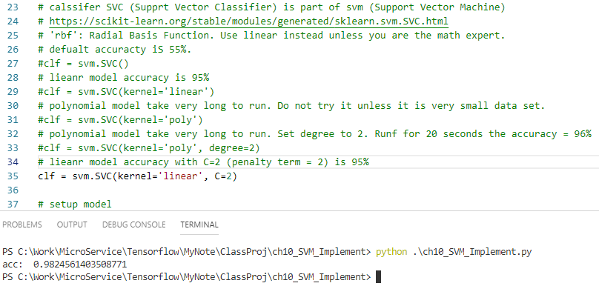
10 SVM Implementation (Part 3)
https://techwithtim.net/tutorials/machine-learning-python/svm-1/
Change to kernel=‘linear’ and C=2. C is the penalty term.
We have accuracy = 98%.

Slide 10
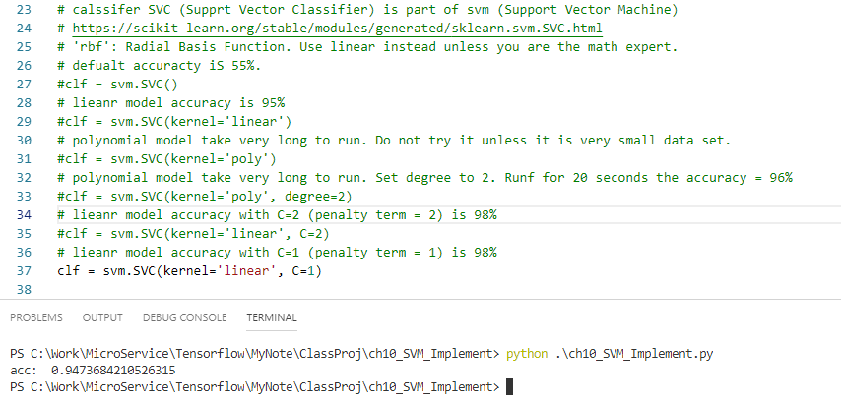
10 SVM Implementation (Part 3)
https://techwithtim.net/tutorials/machine-learning-python/svm-1/
Change to kernel=‘linear’ and C=1. C is the penalty term.
We have accuracy = 95%.

Slide 11
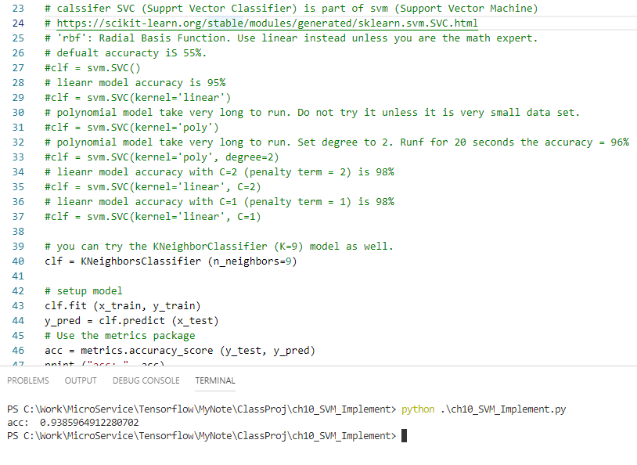
10 SVM Implementation (Part 3)
https://techwithtim.net/tutorials/machine-learning-python/svm-1/
You can try KNeighborsClassifiler (n_neighbors=9), the accuracy = 94%.
Typical Kneighbors does not work well in hug dimensional data set.

Slide 12
10 SVM Implementation (Part 3)
https://techwithtim.net/tutorials/machine-learning-python/svm-1/
SVM typically is the best way to test different kinds of models interms of accuracy by high dimensional data set.
Using linear kernel with different penalty term.
Now, we have discussed linear regression, K Nearest Neighbor, and Support Vector Machines. They are fundamental algorithm.
Next section, we will discuss the K-Mean Learning algorithm.

Slide 13
End of Chapter

