Slide 1

13 Number Guesser
Peter H. Chen

Slide 2
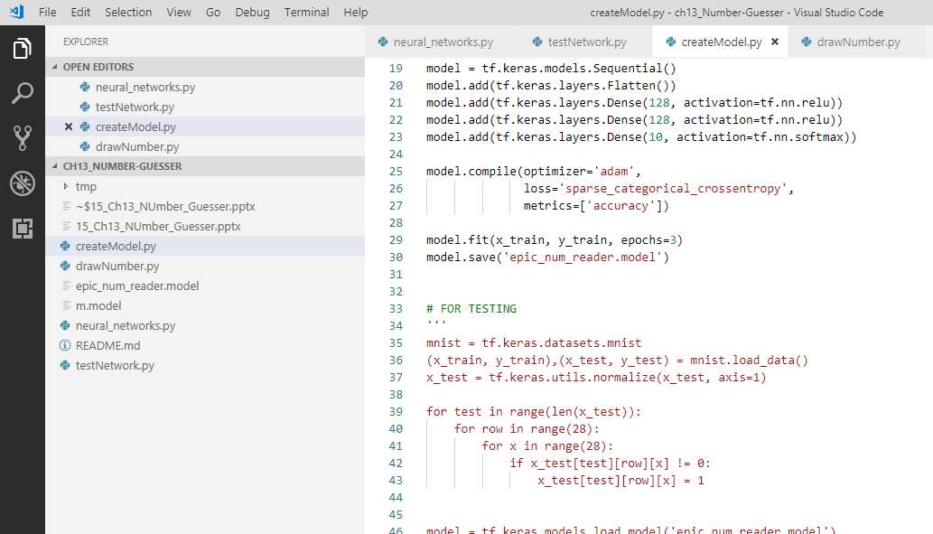
13 Number Guesser
https://www.youtube.com/watch?v=jNW97izstLg&t=13s
In the folder, we have the python files: createModel.py, drawNumber.py, neural_network.py, and testNetwok.py.
They are written in tensorflow for deep learning.

Slide 3
13.1 ch13_01_createModel.py
Peter H. Chen

Slide 4
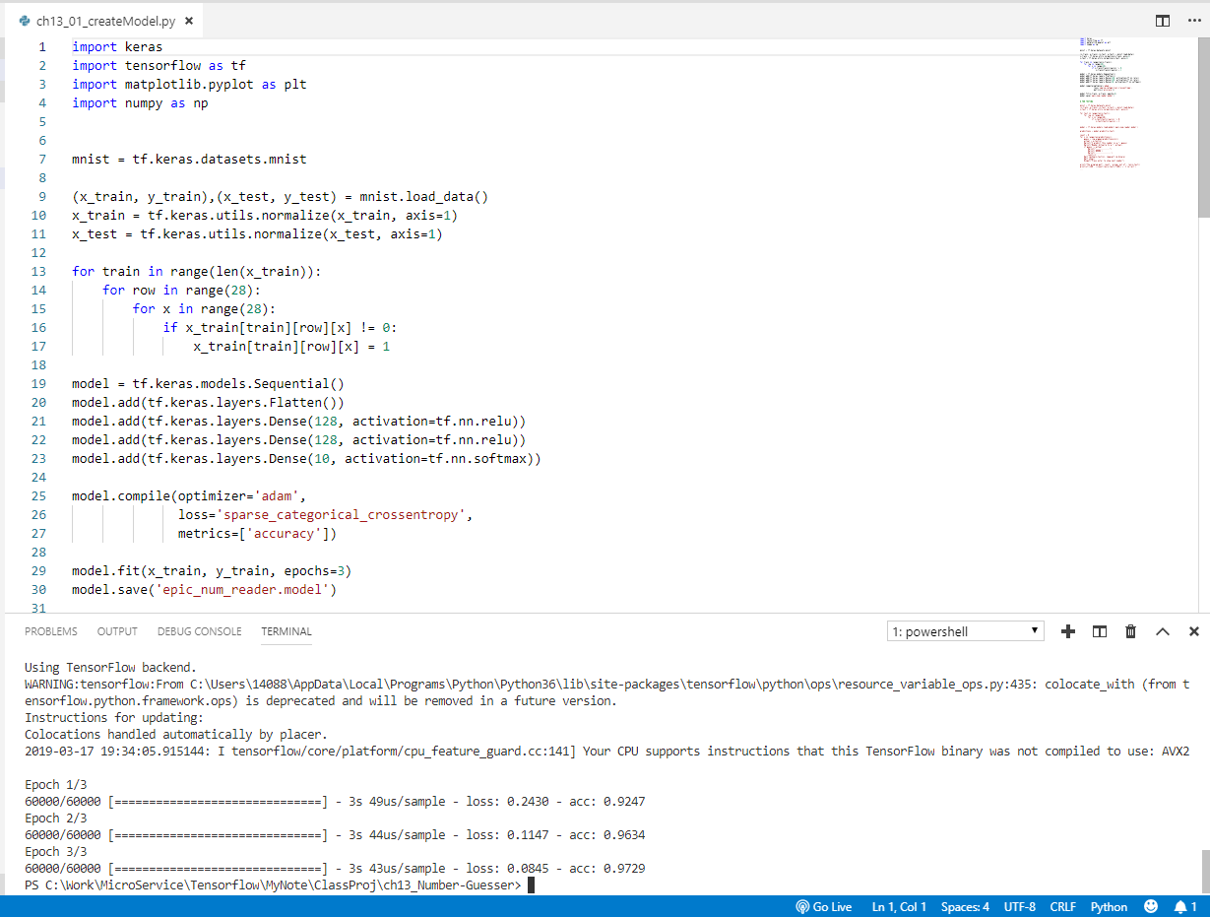
13.1 ch13_01_createModel.py
https://www.youtube.com/watch?v=jNW97izstLg&t=13s
Ch13_01_createModel.py is used to create the model.
> python ch13_01_createModel.py

Slide 5
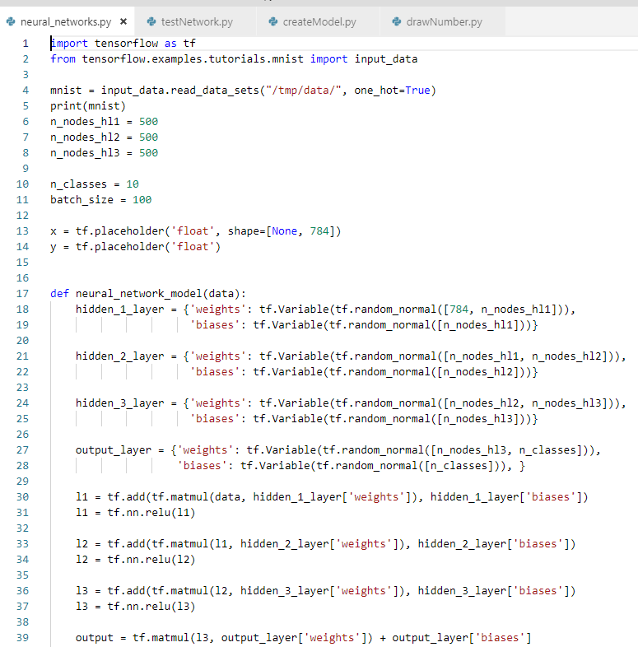
13 Number Guesser
https://www.youtube.com/watch?v=jNW97izstLg&t=13s
Neural_network.py

Slide 6
13.2 ch13_02_testNetwork.py
Peter H. Chen

Slide 7
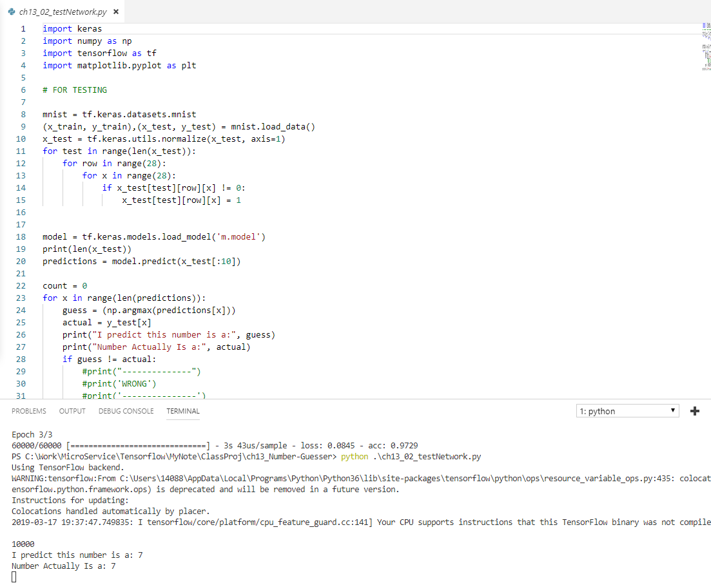
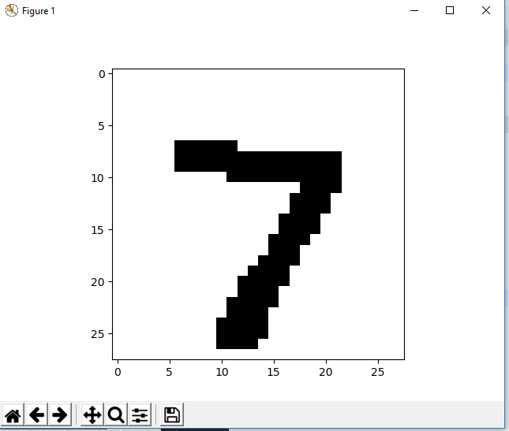
13.2 ch13_02_testNetwork.py
https://www.youtube.com/watch?v=jNW97izstLg&t=13s
> python testNetwork.py
Display the first number 7 and predict 7.
Click x to close and display the next number.

Slide 8
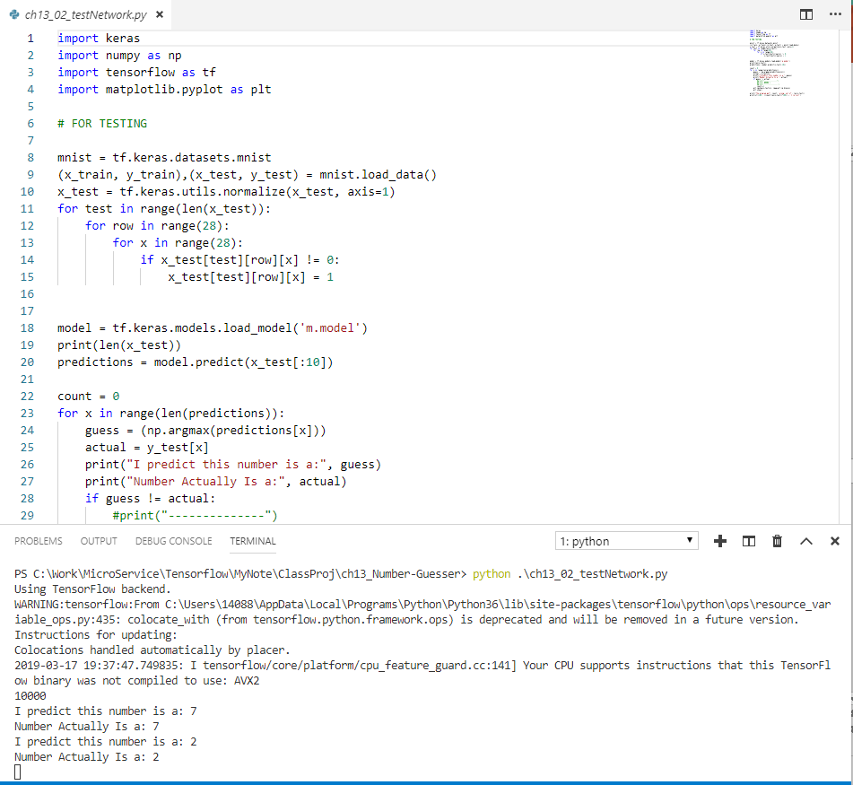
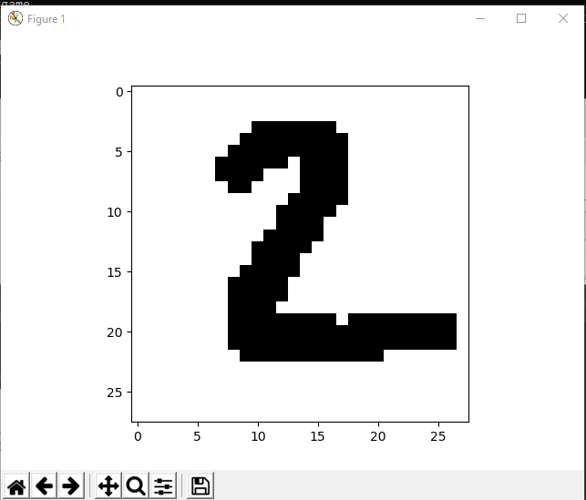
13.1 TestNetwork.py
https://www.youtube.com/watch?v=jNW97izstLg&t=13s
Close the first number 7 and
Continue display the second number 2 and predict the number 2.

Slide 9
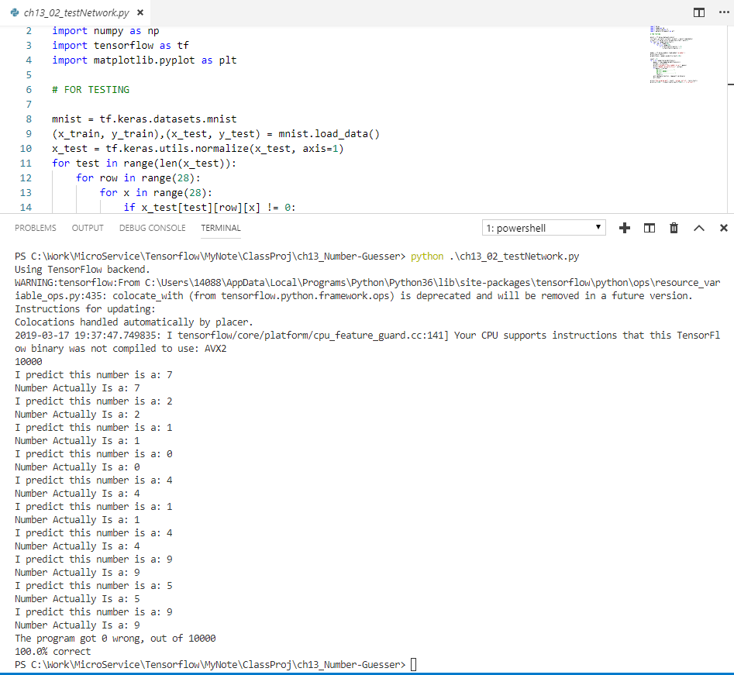
13.1 TestNetwork.py
https://www.youtube.com/watch?v=jNW97izstLg&t=13s
Keep on going.
There are totally 10 digits for guessing.
We are lucky to have 100% guessing correct.

Slide 10
13.3 ch13_03_drawNumber.py
Peter H. Chen

Slide 11
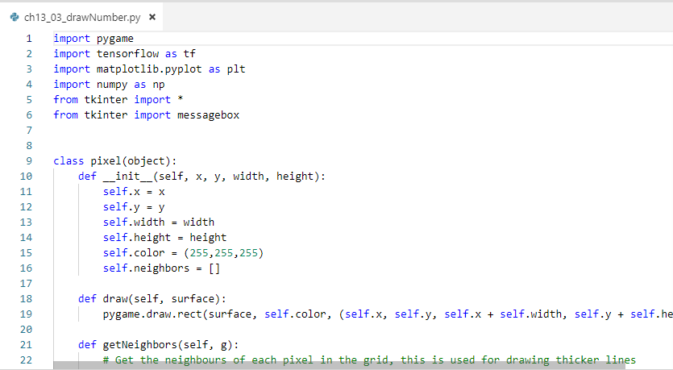
13 Number Guesser
https://www.youtube.com/watch?v=jNW97izstLg&t=13s
> pip3 install pygame

Slide 12
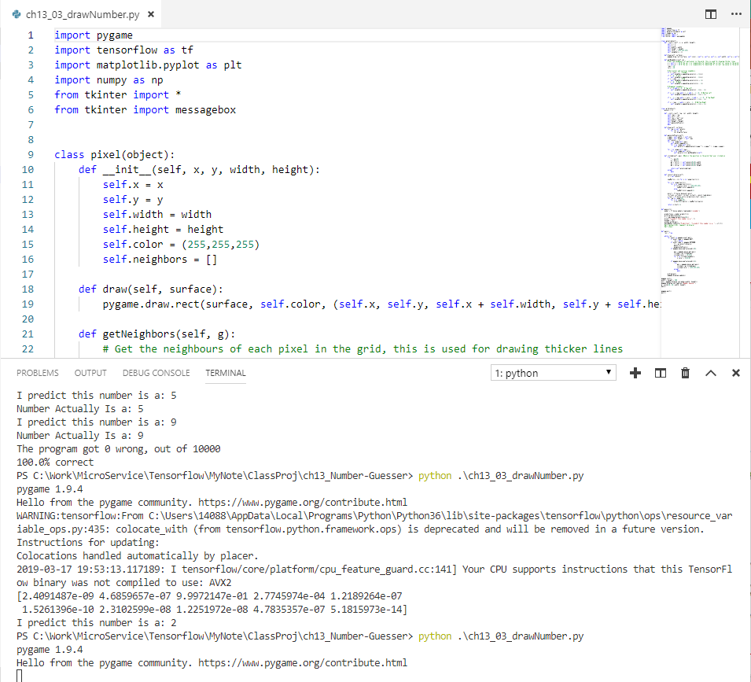
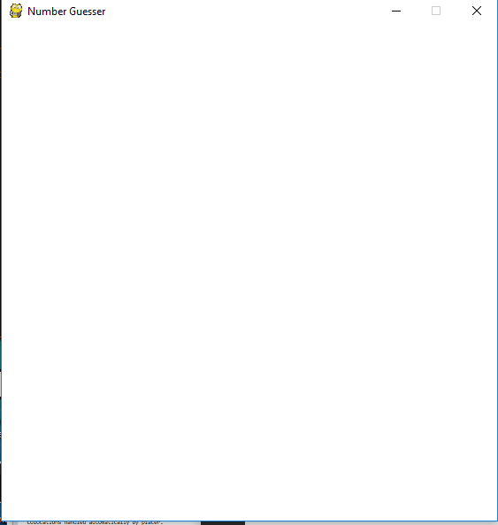
13.3 ch13_03_drawNumber.py
https://www.youtube.com/watch?v=jNW97izstLg&t=13s
> python ch13_03_drawNumber.py
Display the empty screen.

Slide 13
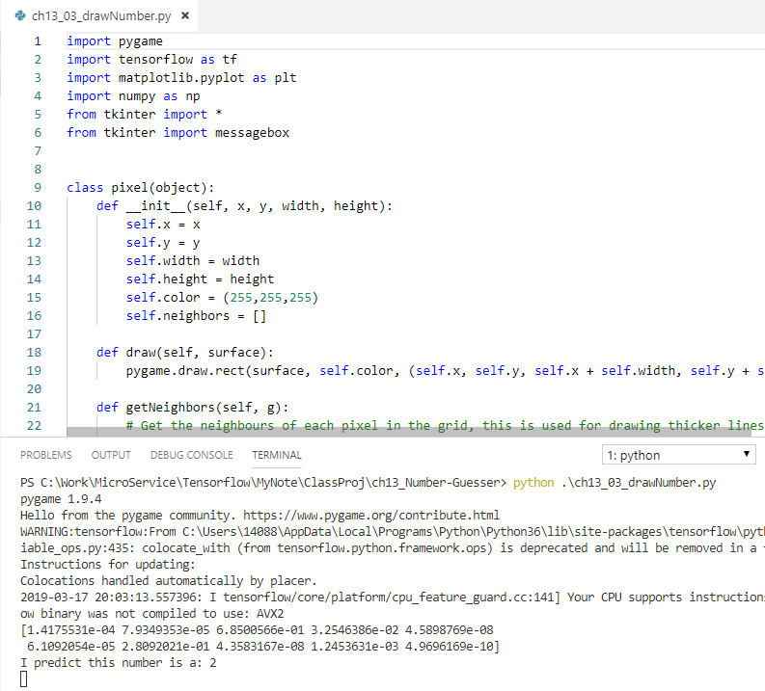
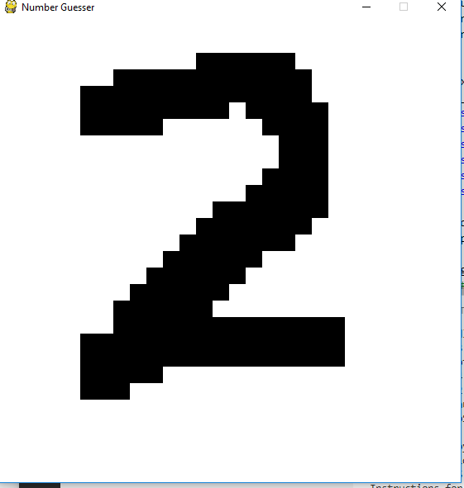
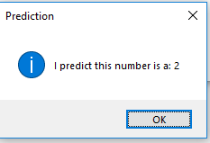
13.3 ch13_03_drawNumber.py
https://www.youtube.com/watch?v=jNW97izstLg&t=13s
Draw a digit
Enter Space bar to predict.

Slide 14
13.3 ch13_03_drawNumber.py
https://www.youtube.com/watch?v=jNW97izstLg&t=13s
This program is not hard code but sometimes get incorrect prediction.

Slide 15
13.4 ch13_04_neuralNetwork.py
Peter H. Chen

Slide 16
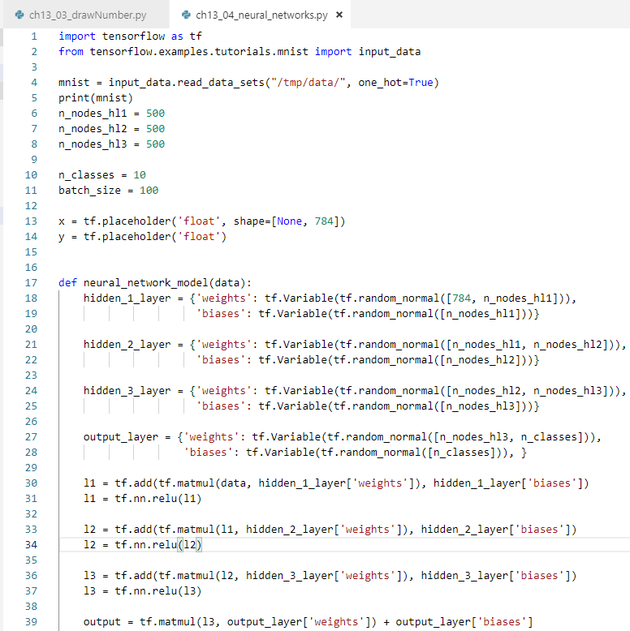
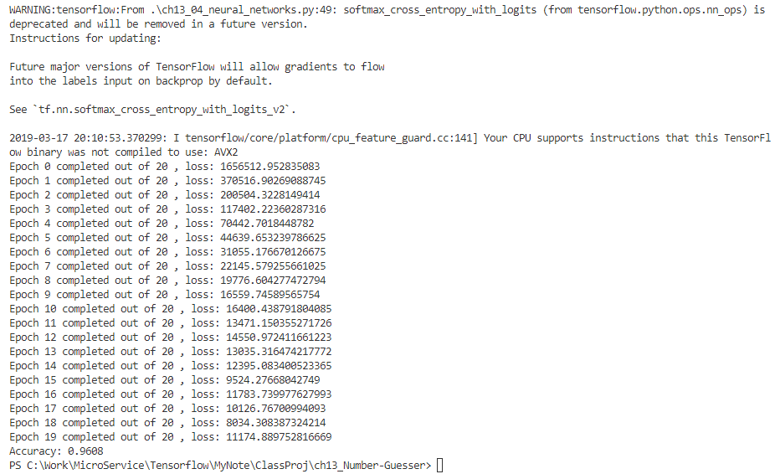
13.4 ch13_04_nerualNetwork.py
https://www.youtube.com/watch?v=jNW97izstLg&t=13s
This program uses tensorflow for three layers of neural network

Slide 17
13.5 Summary
Peter H. Chen

Slide 18
13.4 ch13_04_nerualNetwork.py
https://www.youtube.com/watch?v=jNW97izstLg&t=13s
This section shows write model data, digit predict, hand writing prediction, and tensorflow neural network.

Slide 19
End of Chapter

