Slide 1

5 KNN: Irregular Data (Part 1)
Peter H. Chen

Slide 2
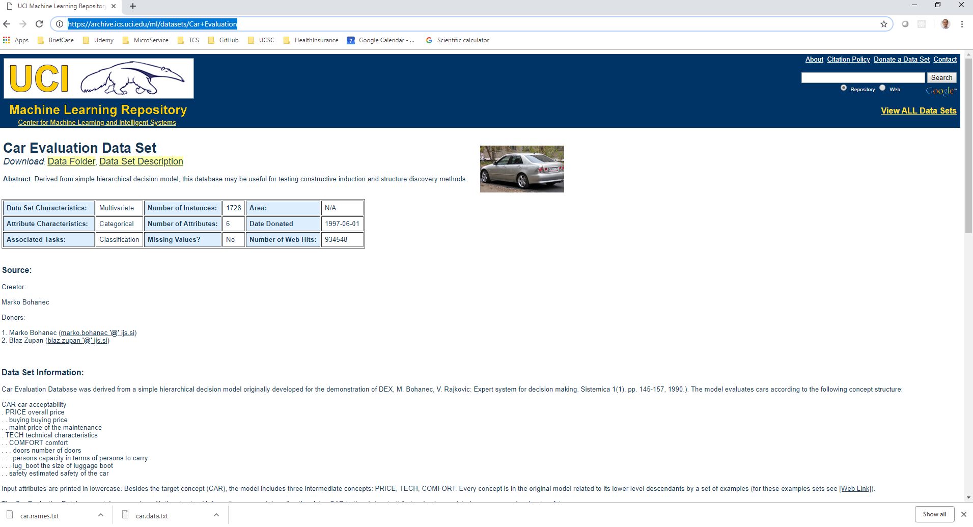
5 KNN: Irregular Data (Part 1)
https://techwithtim.net/tutorials/machine-learning-python/saving-models/
In section, we are going to discuss algorithm called KNN.
The following web site contains the car evaluation data:
https://archive.ics.uci.edu/ml/datasets/Car+Evaluation
We are going to classify some car data.

Slide 3
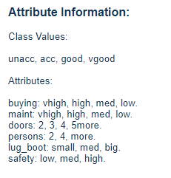
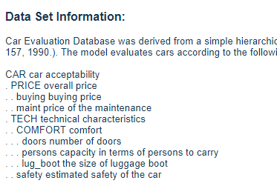
5 KNN: Irregular Data (Part 1)
https://techwithtim.net/tutorials/machine-learning-python/saving-models/
Car Evaluation Database was derived from a simple hierarchical decision model originally developed for the demonstration of DEX, M. Bohanec, V. Rajkovic: Expert system for decision making. Sistemica 1(1), pp. 145-157, 1990.).
The model evaluates cars according to the following concept structure:
We are going to classify the car based on the car attribute here.

Slide 4
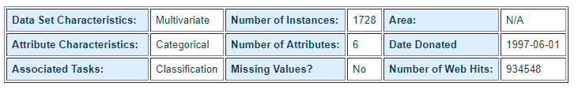
5 KNN: Irregular Data (Part 1)
https://techwithtim.net/tutorials/machine-learning-python/saving-models/
The task is based on classification.
We have 1728 Car instances.
We have 6 attributes.

Slide 5
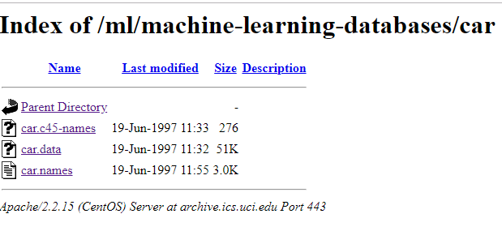
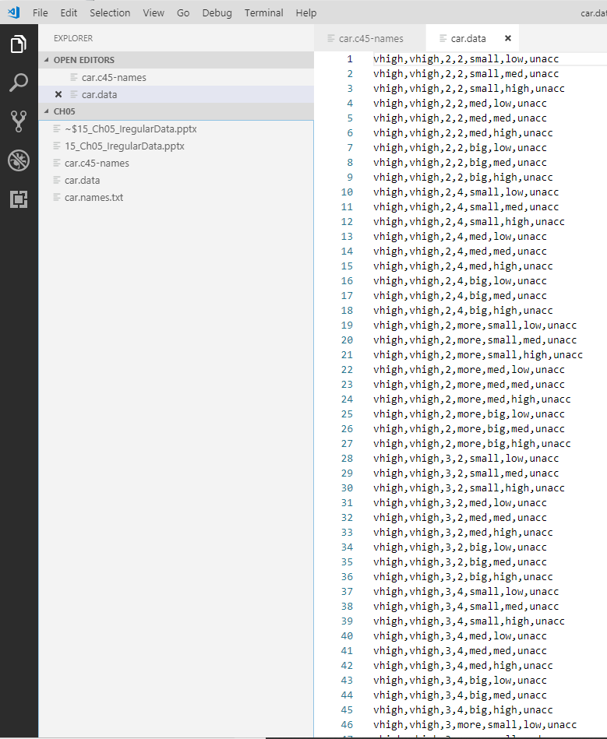
5 KNN: Irregular Data (Part 1)
https://techwithtim.net/tutorials/machine-learning-python/saving-models/
We have car data set.
Download the car.data.

Slide 6
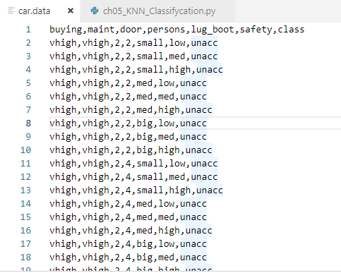
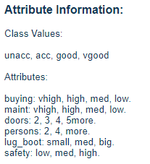
5 KNN: Irregular Data (Part 1)
https://techwithtim.net/tutorials/machine-learning-python/saving-models/
Add the following top line to your car.data:
buying, maint, door, persons, lug_boot,safety, class
We use the first line of text as our labels of attributes of our data set.
These attributes are taken out of the attribute information of the web site of data set.
Note: there is no space between the coma (,).

Slide 7
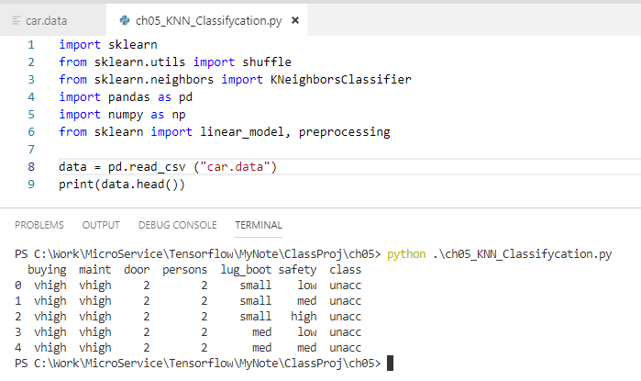
5 KNN: Irregular Data (Part 1)
https://techwithtim.net/tutorials/machine-learning-python/saving-models/
First create a ch05_KNN_Classificaiton.py.
Import the following packages.
Read data.
Print 5 rows of data.

Slide 8
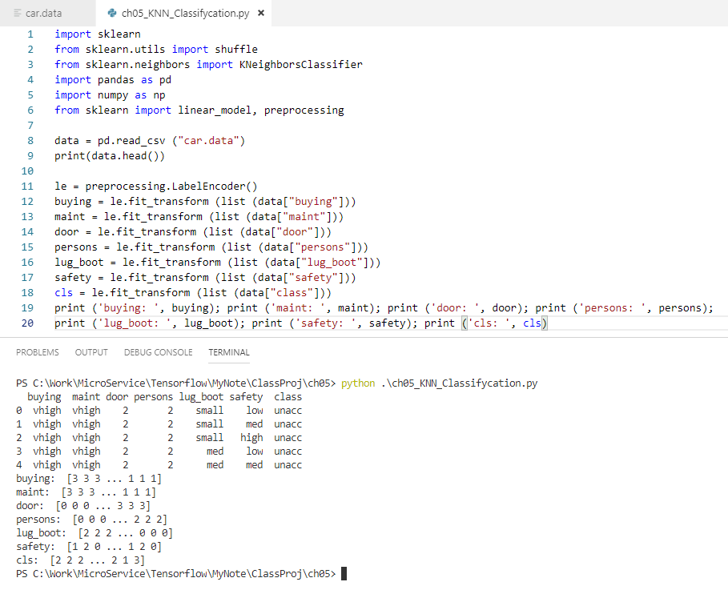
5 KNN: Irregular Data (Part 1)
https://techwithtim.net/tutorials/machine-learning-python/saving-models/
We cannot use non-numerical data. All the data low should be converted into 0, medium into 1, and high into 2.
The preprocessing module will help us to do the conversion.

Slide 9
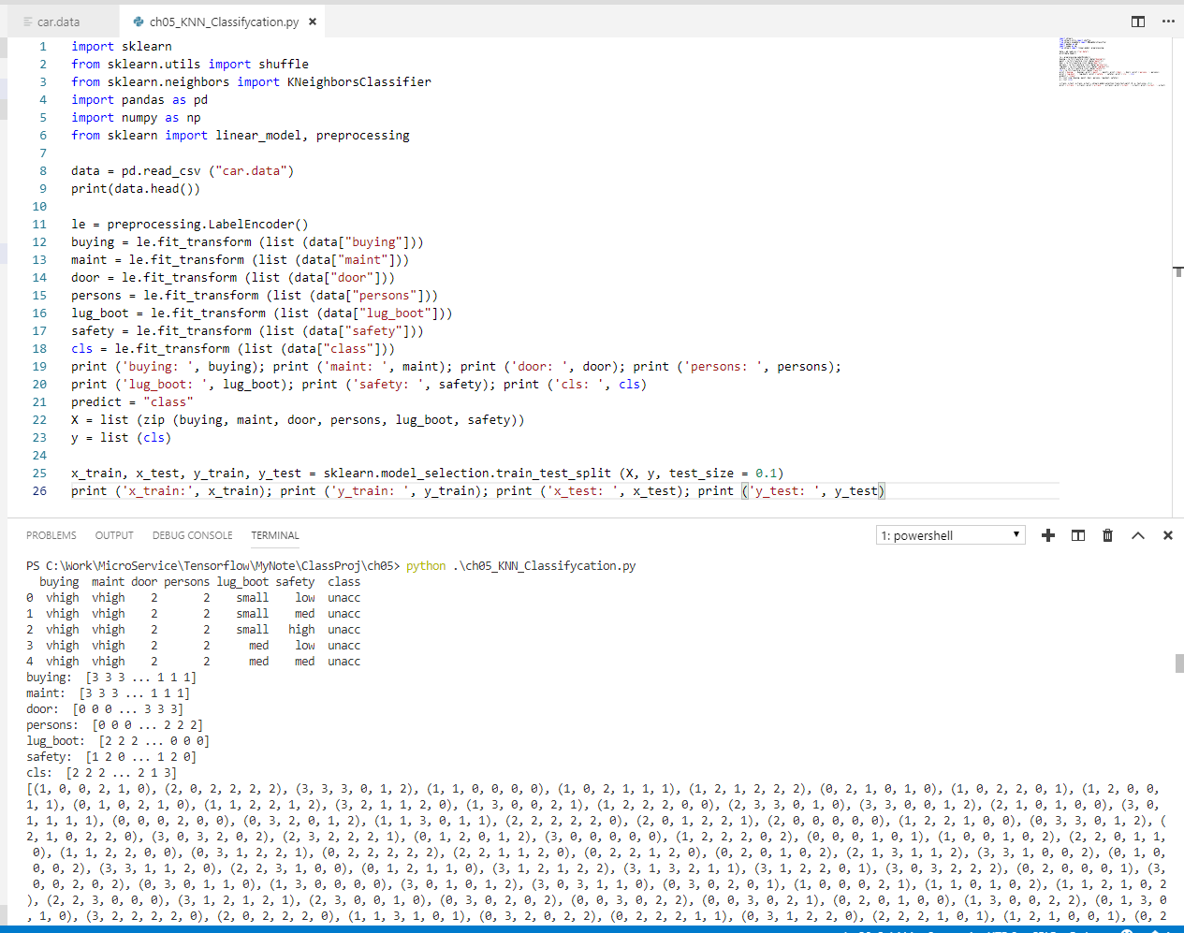
5 KNN: Irregular Data (Part 1)
https://techwithtim.net/tutorials/machine-learning-python/saving-models/
Let X be our features and Y is out label.
X = list (zip (buying, …, safety)
Y = list (cls).
Separate the data into training and test.
Print the training and test data.
The zip() in python map similar index of multiple containers so that they can be used just as single entity.

Slide 10
5 KNN: Irregular Data (Part 1)
https://techwithtim.net/tutorials/machine-learning-python/saving-models/
Summary:
In this section, we discus how to prepare the data.
We add the attributes to the first line with separate coma. Note: there is no spaces between attribute and coma.
we read in the non-py array and transform into numerical value by preprocessing module and then then put values into list.
How to use zip () to put different containers into a single entity.

Slide 11
End of Chapter

