Slide 1

4 Save Training Model
Peter H. Chen

Slide 2
4 Save Training Model
https://techwithtim.net/tutorials/machine-learning-python/saving-models/
In section, we are going to save our model and plot data on grid and visualize some of the stuff.
We are going to create several models and save the best possible one to use in the future.
We are going to plot graphs that we can look at.
First thing we actually do I to import module or install another module.
> pip install matplotlib
If you find some model is very high accuracy, you might want to save the model for future dataset.

Slide 3
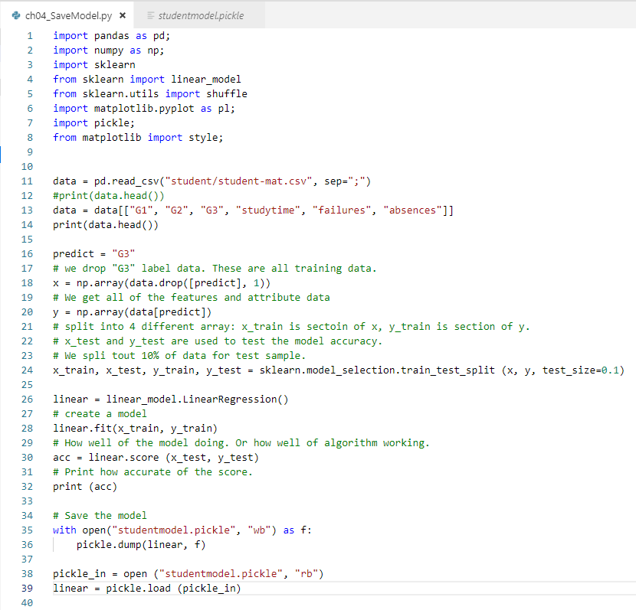
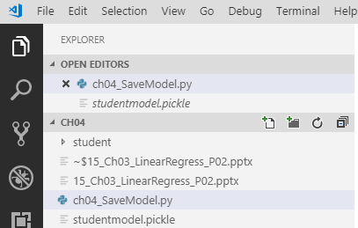
4 Save Training Model
https://techwithtim.net/tutorials/machine-learning-python/saving-models/
Now, we save the file.
When we run it. We can see the new file “studentmodel.pickle” generated.

Slide 4
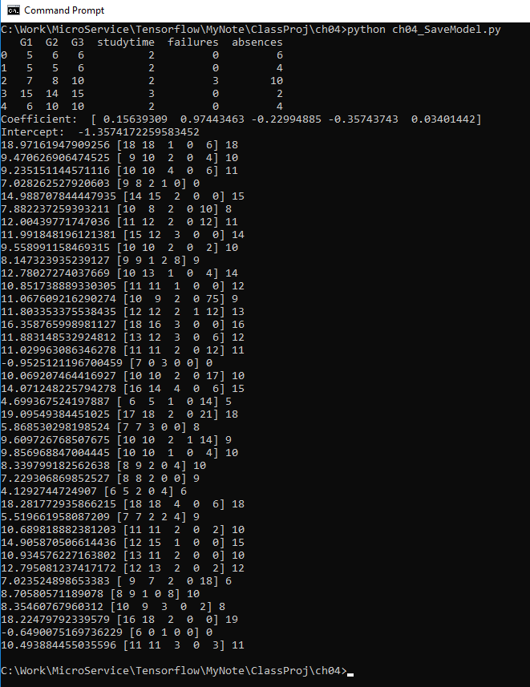
4 Save Training Model
https://techwithtim.net/tutorials/machine-learning-python/saving-models/
Now, we have the data.
We can comment out the linear model and writing data.
Just read the data from “studentmodel.pickle” the result should be the same.

Slide 5
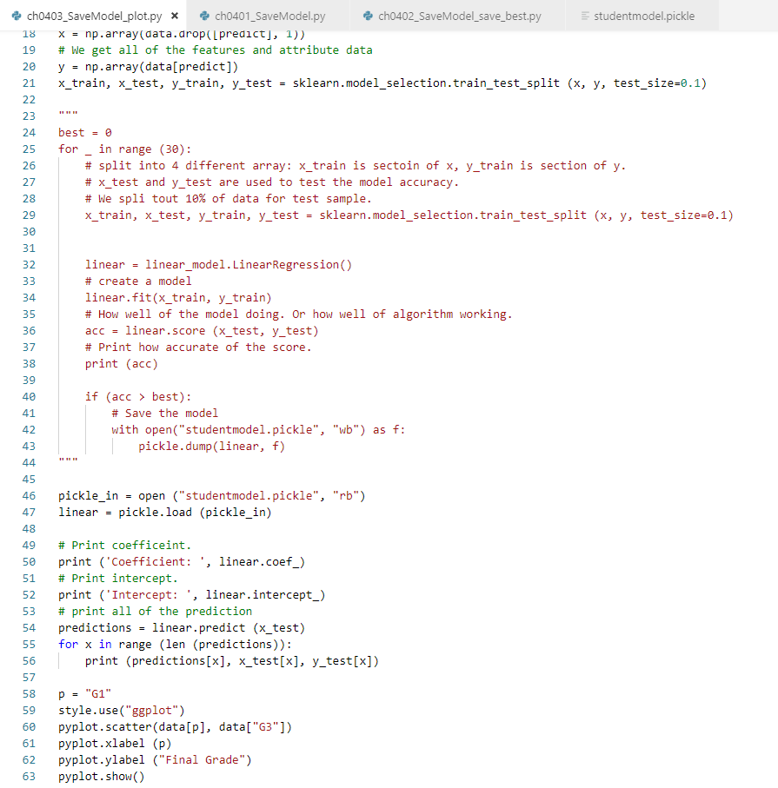
4 Save Training Model
https://techwithtim.net/tutorials/machine-learning-python/saving-models/
Add pyplot.scatter (data[p], data[“G3”])
Add xlabel and ylabel.

Slide 6
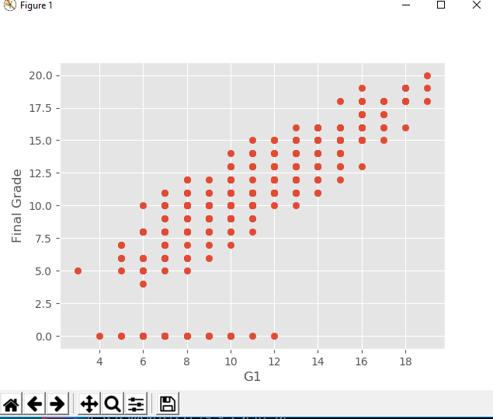
4 Save Training Model
https://techwithtim.net/tutorials/machine-learning-python/saving-models/
> python ch0403_SaveModel_plot.py

Slide 7
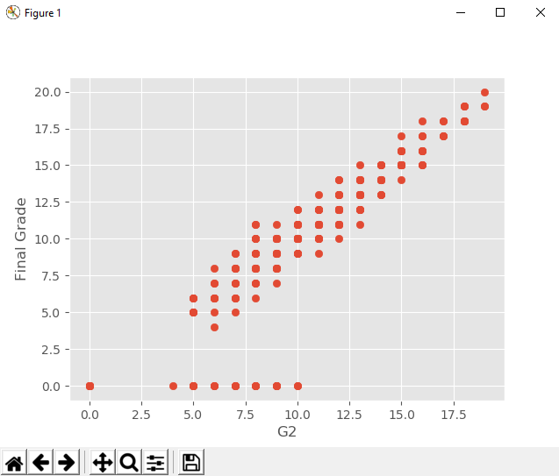
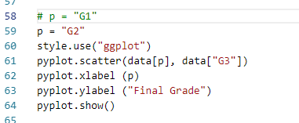
4 Save Training Model
https://techwithtim.net/tutorials/machine-learning-python/saving-models/
If we change p = “G1” into p = “G2”

Slide 8
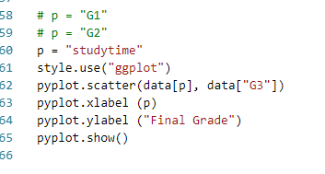
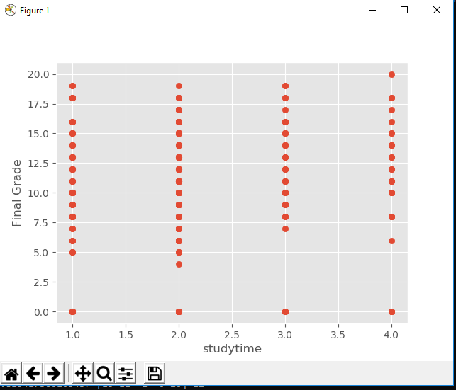
4 Save Training Model
https://techwithtim.net/tutorials/machine-learning-python/saving-models/
If we change p = “G2” into p = “studytime”
More studytime shift up the final grade.

Slide 9
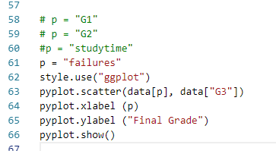
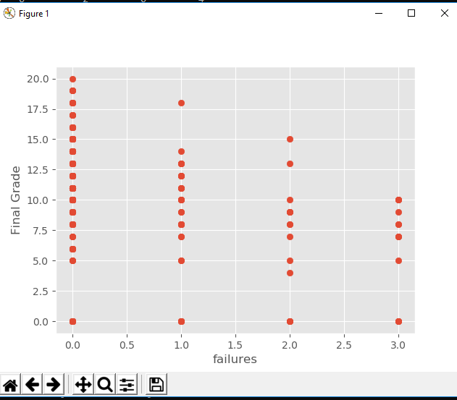
4 Save Training Model
https://techwithtim.net/tutorials/machine-learning-python/saving-models/
If we change p = “G2” into p = “failures”
Fail more time, the grade shift down.

Slide 10
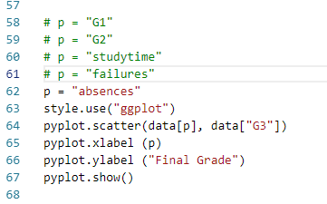
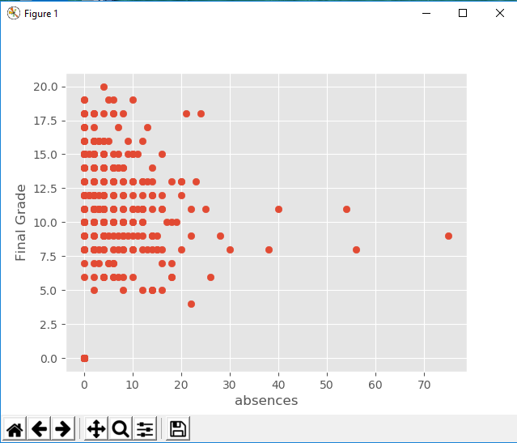
4 Save Training Model
https://techwithtim.net/tutorials/machine-learning-python/saving-models/
If we change p = “G2” into p = “absences”
Fail more absences, the grade shift down.

Slide 11
End of Chapter

