Slide 1

10 Number Guesser
Peter H. Chen
(408)858-7657
Peter.hp.chen@gmail.com
https://github.com/peterhchen

Slide 2
10 Number Guesser
https://www.youtube.com/watch?v=jNW97izstLg&t=10s
In this project, we create a number guessing program or model whatever you wan to call it.
Given a handwritten digit and the program is able to guess what number you write with a fair degree of accuracy.

Slide 3
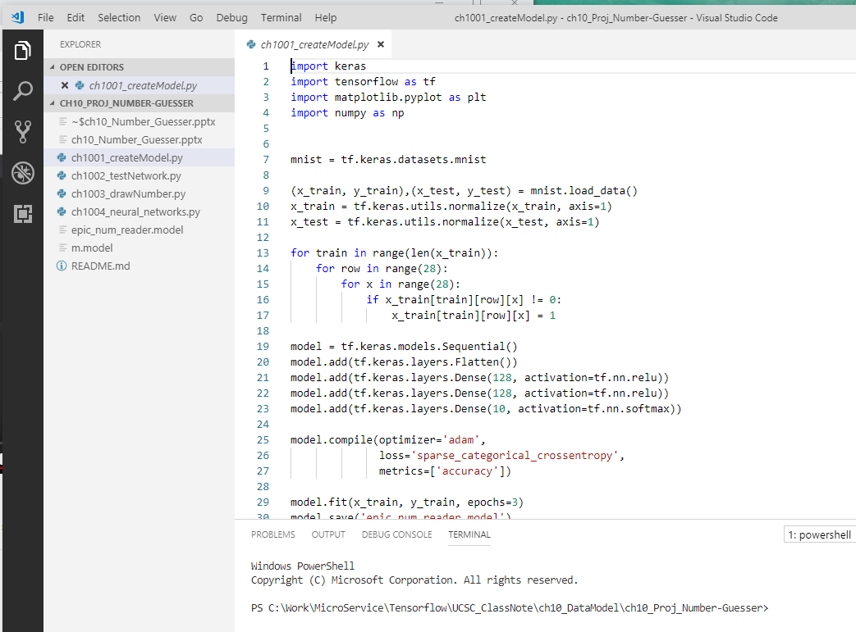
10 Number Guesser
https://www.youtube.com/watch?v=jNW97izstLg&t=10s
In this project, I use Visual Studio Code for Editor.
The explorer shown here include four programs: ch1001_createModel.py, ch1002_testNetwork.py, ch1003_drawNumber.py, and ch1004_neural_network.py.

Slide 4
10 Number Guesser
https://www.youtube.com/watch?v=jNW97izstLg&t=10s
The createModel.py is used to create a model.
The neuralNetwork.py is very basic neural network.
The testNetwork.py is used to test the neural network. This program test the number of from 0 to 9 handwritten digits one-by-one for the entire test data set. This is just for test only. This predict has around 98% accuracy.
The drawNumber.py has a GUI interface for handwritten drawing. After the draw, you can press the space bar to perform the prediction and continue to the next handwritten guessing.
This project uses tensorflow to run.

Slide 5
10.1 ch1001_createModel.py
Peter H. Chen

Slide 6
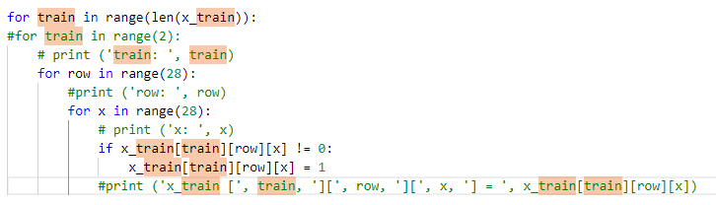
10.1 ch1001_createModel.py
https://www.youtube.com/watch?v=jNW97izstLg&t=10s
ch1001_createModel.py is used to create the model.
> python ch1001_createModel.py
row = 28
x (col) = 28
Training Data
Digit ‘7’ Example
row = 28
x (col) = 28
28
row = 28
x (col) = 28
0
1
1
1
1
1
28
len (x_train) = 60000
1
1

Slide 7
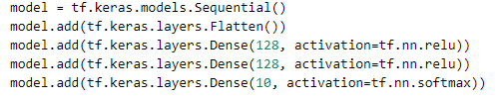
10.1 ch1001_createModel.py
https://www.youtube.com/watch?v=jNW97izstLg&t=10s
ch1001_createModel.py is used to create the model: image batch size = 100 images.
https://i.stack.imgur.com/8FzdQ.png
Output = 128
Output = 128
Output = 10
Fatten Input = 28x28
…
…
…
…

Slide 8
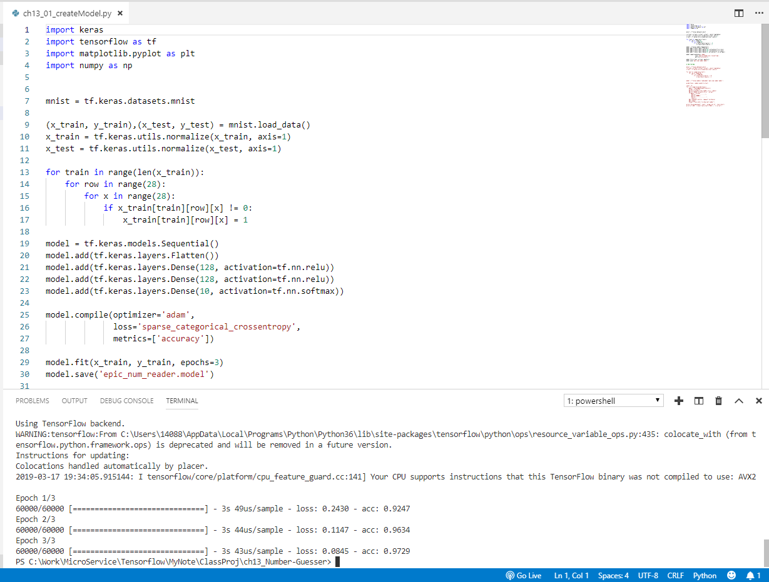
10.1 ch1001_createModel.py
https://www.youtube.com/watch?v=jNW97izstLg&t=10s
ch1001_createModel.py is used to create the model.
> python ch1001_createModel.py
Load the Dataset and normalize Data.
Train the model and save the model data
for many class classification select: Categorical_cross_entropy

Slide 9
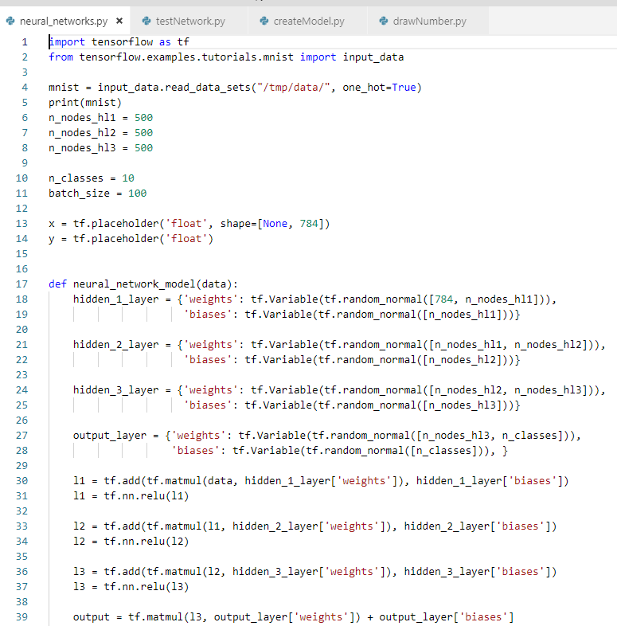
10 Number Guesser
https://www.youtube.com/watch?v=jNW97izstLg&t=10s
Neural_network.py

Slide 10
10.2 ch1002_testNetwork.py
Peter H. Chen

Slide 11
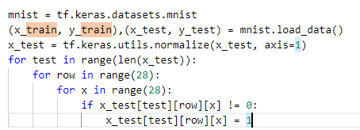
10.2 ch1002_testNetwork.py
https://www.youtube.com/watch?v=jNW97izstLg&t=10s
> python testNetwork.py
row = 28
x (col) = 28
Test Data
Digit ‘7’ Example
row = 28
x (col) = 28
28
row = 28
x (col) = 28
0
1
1
1
1
1
28
len (x_train) = 10000
1
1

Slide 12
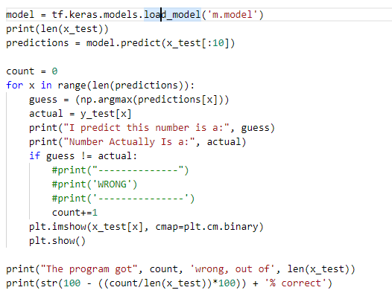
10.2 ch1002_testNetwork.py
https://www.youtube.com/watch?v=jNW97izstLg&t=10s
> python testNetwork.py
Array[start:stop: step] ====> x_test [:10] means x_test[0], x_test[1], …, x_test[9]
row = 28
x (col) = 28
row = 28
x (col) = 28
x_test[9]
row = 28
x (col) = 28
…
…
x_test[1]
x_test[0]
Predict the Result
Correct or Wrong

Slide 13
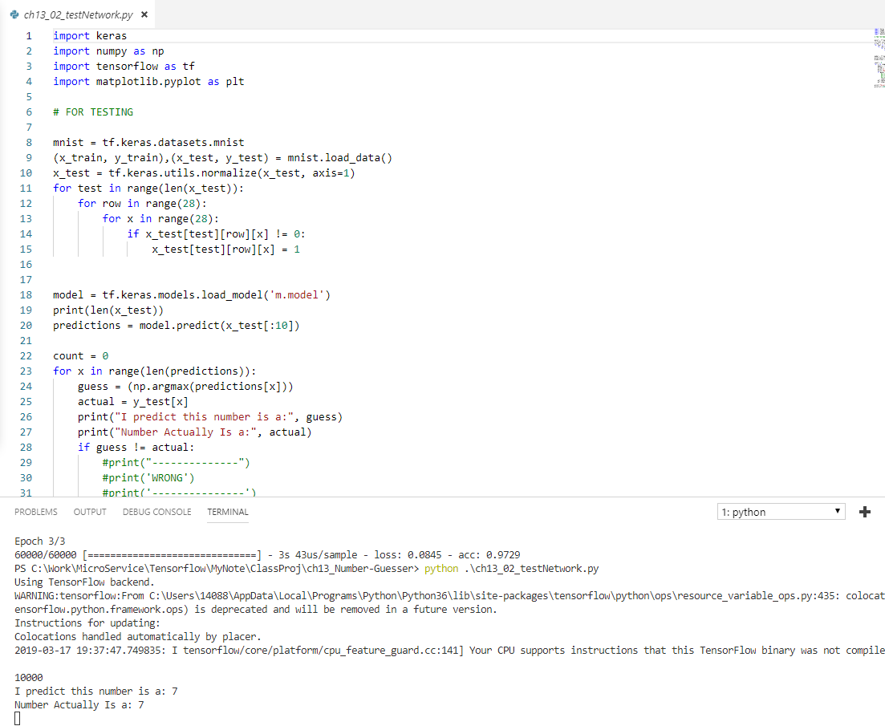
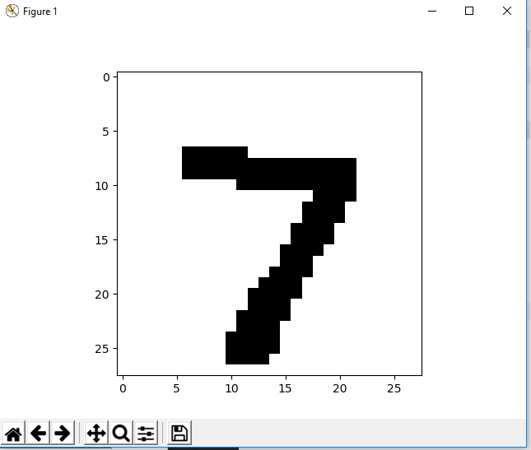
10.2 ch1002_testNetwork.py
https://www.youtube.com/watch?v=jNW97izstLg&t=10s
> python testNetwork.py
Display the first number 7 and predict 7.
Click x to close and display the next number.

Slide 14
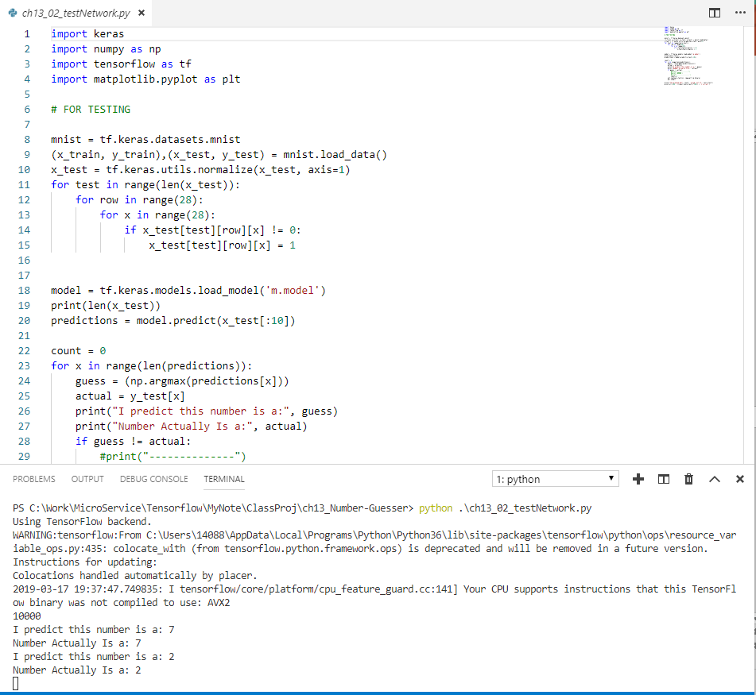
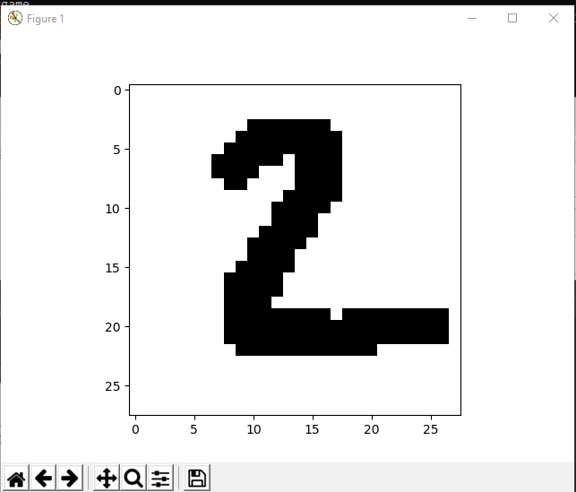
10.1 TestNetwork.py
https://www.youtube.com/watch?v=jNW97izstLg&t=10s
Close the first number 7 and
Continue display the second number 2 and predict the number 2.

Slide 15
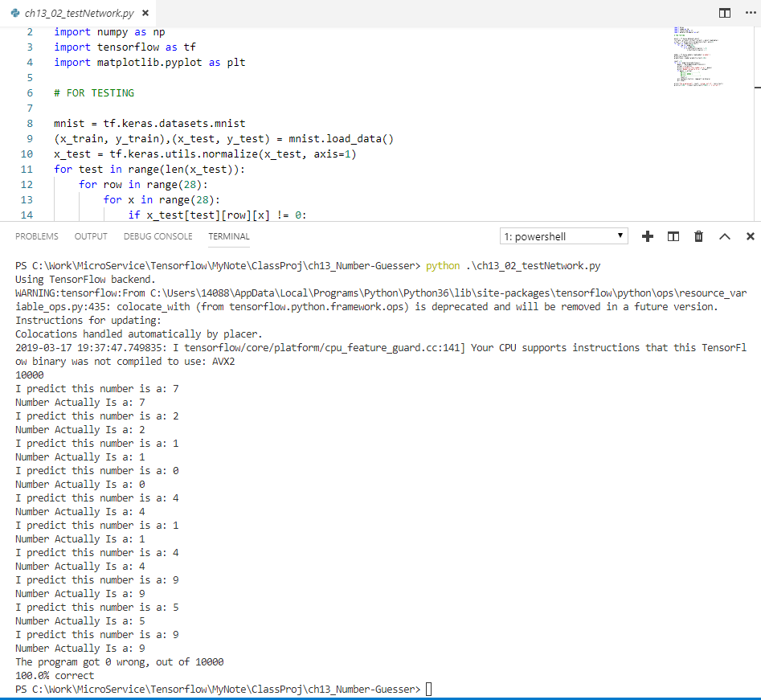
10.1 TestNetwork.py
https://www.youtube.com/watch?v=jNW97izstLg&t=10s
Keep on going.
There are totally 10 digits for guessing.
We are lucky to have 100% guessing correct.

Slide 16
10.3 ch1003_drawNumber.py
Peter H. Chen

Slide 17
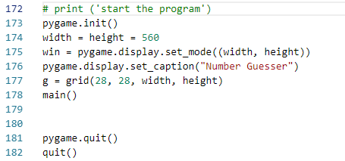
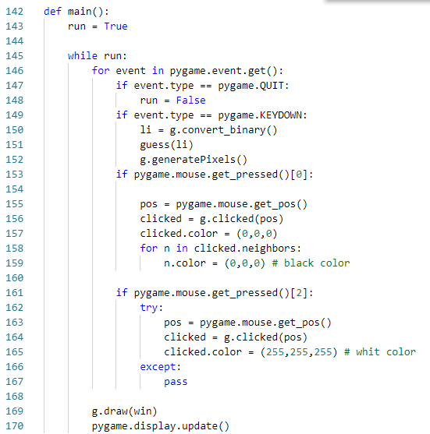
10 Number Guesser
https://www.youtube.com/watch?v=jNW97izstLg&t=10s
Pygame is a cross-platform set of Python modules designed for writing video games. It includes computer graphics and sound libraries designed to be used with the Python programming language.
Start the GUI program
Guess the input drawing Number

Slide 18
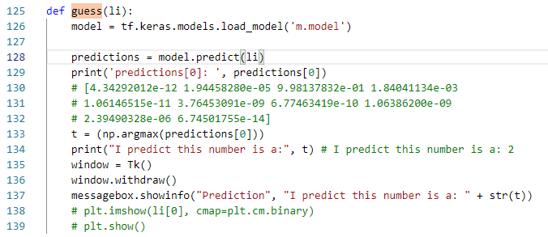
10 Number Guesser
https://www.youtube.com/watch?v=jNW97izstLg&t=10s
Start the Guessing of the drawing Number
Get the prediction array
Guess the input drawing Number
Use argmax to find the maximum possibility index. Index = 2 in the above case. The corresponding number for index 2 is digit ‘2’

Slide 19
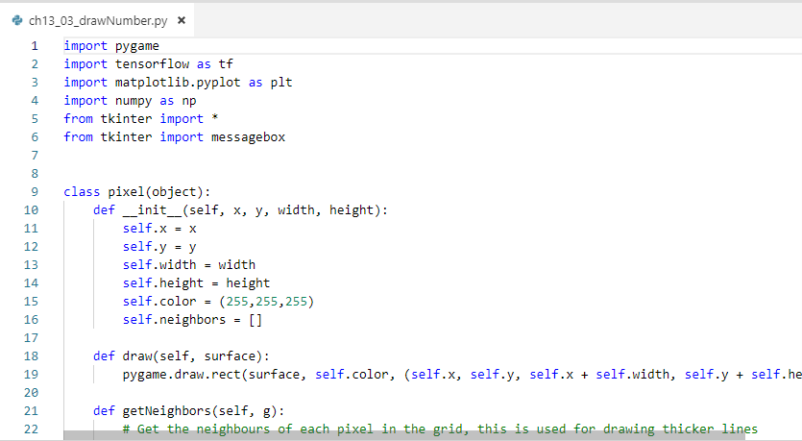
10 Number Guesser
https://www.youtube.com/watch?v=jNW97izstLg&t=10s
> pip3 install pygame

Slide 20
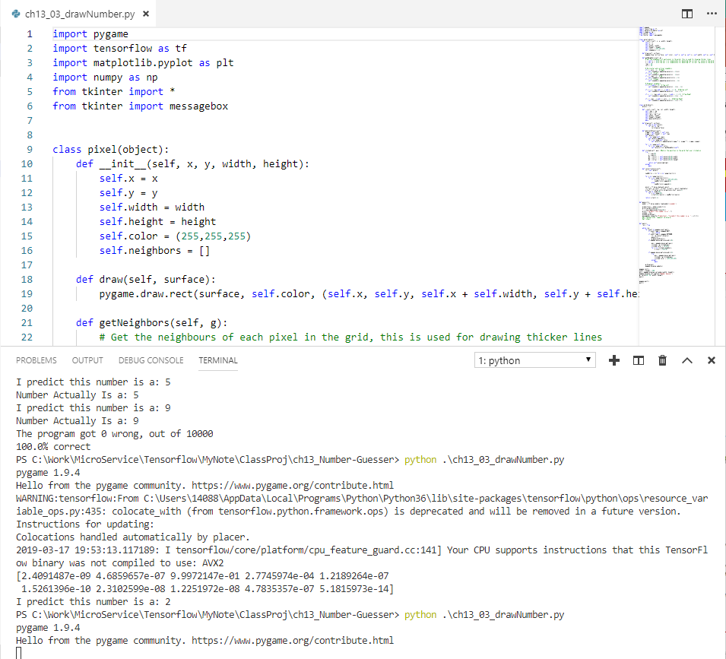
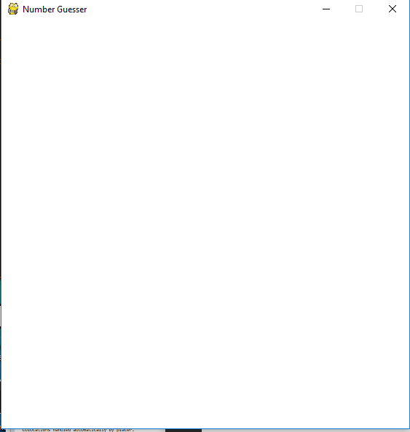
10.3 ch1003_drawNumber.py
https://www.youtube.com/watch?v=jNW97izstLg&t=10s
> python ch1003_drawNumber.py
Display the empty screen.

Slide 21
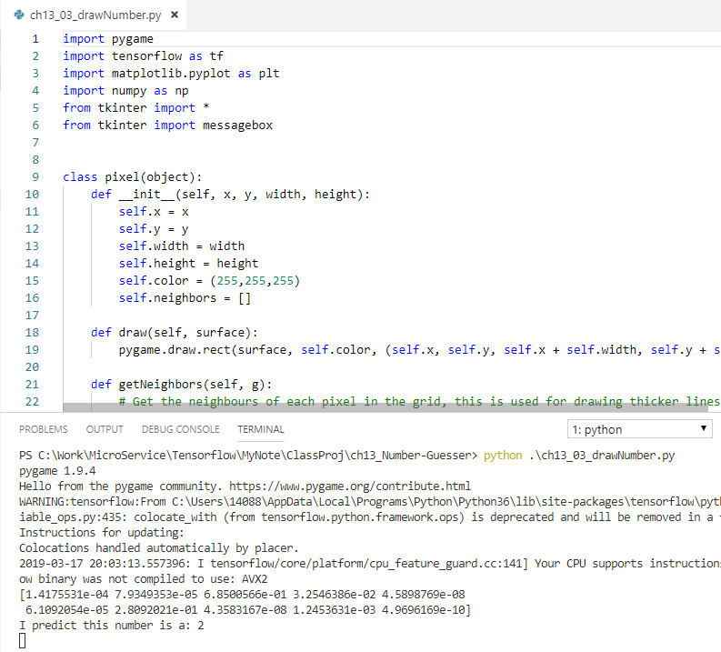
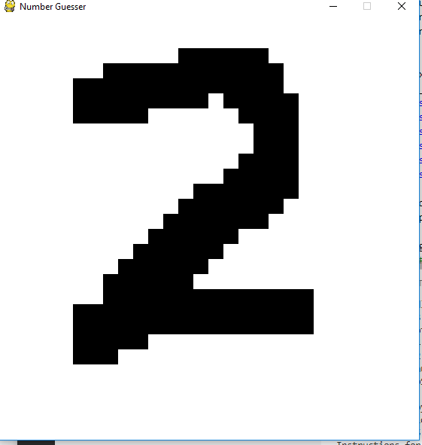
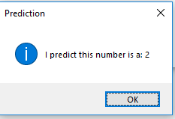
10.3 ch1003_drawNumber.py
https://www.youtube.com/watch?v=jNW97izstLg&t=10s
Draw a digit
Enter Space bar to predict.

Slide 22
10.3 ch1003_drawNumber.py
https://www.youtube.com/watch?v=jNW97izstLg&t=10s
This program is not hard code but sometimes get incorrect prediction.

Slide 23
10.4 ch1004_neuralNetwork.py
Peter H. Chen

Slide 24
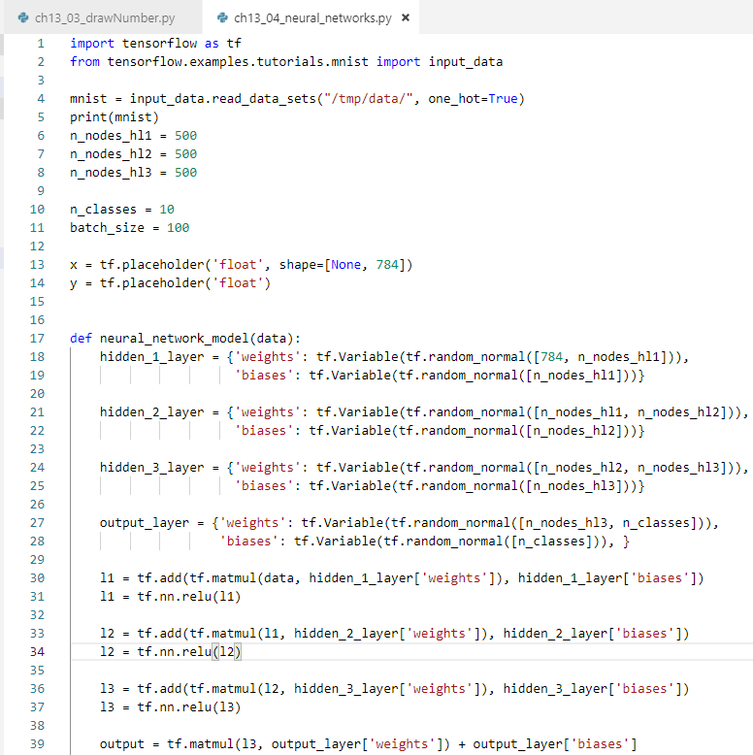
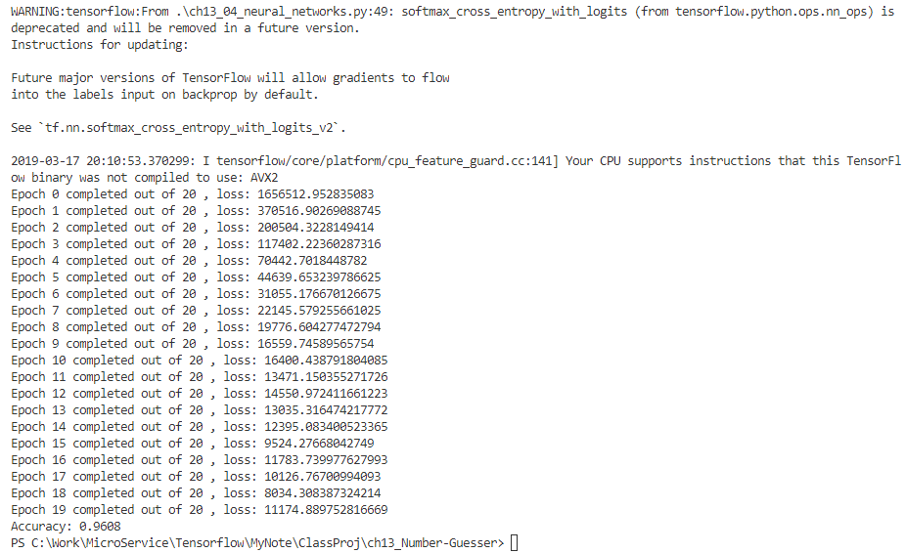
10.4 ch1004_nerualNetwork.py
https://www.youtube.com/watch?v=jNW97izstLg&t=10s
This program uses tensorflow for three layers of neural network

Slide 25
10.5 Summary
Peter H. Chen

Slide 26
10.4 ch1004_nerualNetwork.py
https://www.youtube.com/watch?v=jNW97izstLg&t=10s
This section shows write model data, digit predict, hand writing prediction, and tensorflow neural network.

Slide 27
End of Chapter

