Slide 1

11 K-Mean Cluster Principle (Part 1)
Peter H. Chen

Slide 2
11 K-Mean Cluster Principle (Part 1)
https://www.youtube.com/watch?v=g1Zbuk1gAfk&list=PLzMcBGfZo4-mP7qA9cagf68V06sko5otr&index=11s
In this section, we are going to discuss Unsupervised Learning Algorithm which is called K-Means Clustering.
The K-Means Cluster is different from the previous one. In K-Means Clustering, we do not need to feed the labels for our data point when we trains the model. We just give a bunch of features that made up one point. We do not say which points are going to classify the handwritten digits. We do not say digit five or digit six. We just say this is a digit. The computer has to figure out what match that digit.
We will see what make up the digit and how we give the digit.
We will give some data, what digit is doing and our job is a lot of easier than actually determine what features make up.

Slide 3
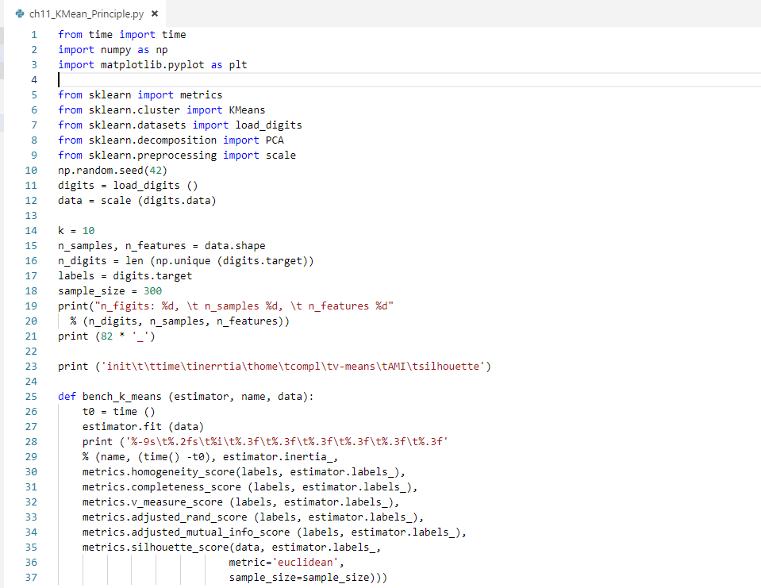
11 K-Mean Cluster Principle (Part 1)
https://www.youtube.com/watch?v=g1Zbuk1gAfk&list=PLzMcBGfZo4-mP7qA9cagf68V06sko5otr&index=11
The following example got from sklearn web site. It give us a really good visualization of K-Means cluster works.
Code Sample (1):

Slide 4
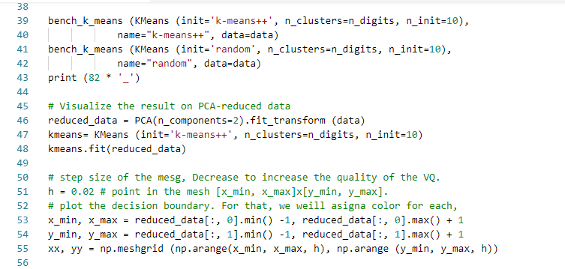
11 K-Mean Cluster Principle (Part 1)
https://www.youtube.com/watch?v=g1Zbuk1gAfk&list=PLzMcBGfZo4-mP7qA9cagf68V06sko5otr&index=11
Code Sample (2):

Slide 5
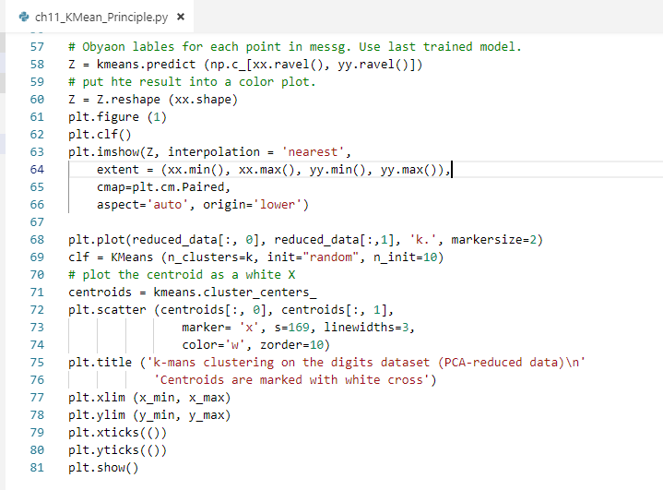
11 K-Mean Cluster Principle (Part 1)
https://www.youtube.com/watch?v=g1Zbuk1gAfk&list=PLzMcBGfZo4-mP7qA9cagf68V06sko5otr&index=11
Code Sample (3):

Slide 6
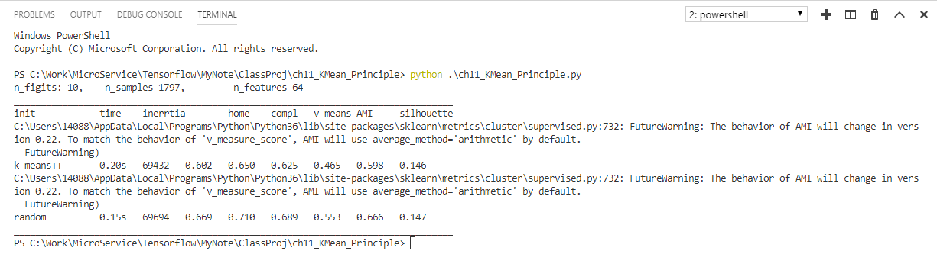
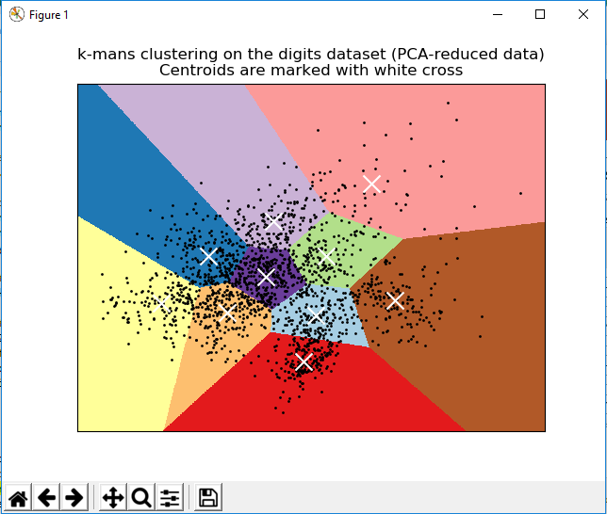
11 K-Mean Cluster Principle (Part 1)
https://www.youtube.com/watch?v=g1Zbuk1gAfk&list=PLzMcBGfZo4-mP7qA9cagf68V06sko5otr&index=11
> python .\ch11_KMean_Principle.py

Slide 7
11 K-Mean Cluster Principle (Part 1)
https://www.youtube.com/watch?v=g1Zbuk1gAfk&list=PLzMcBGfZo4-mP7qA9cagf68V06sko5otr&index=11
The following discussed the centroids:
We have data points which randomly choose a place to put two centroids (K = 2) on graph.
We are going to put a red triangle centroid and blue triangle centroid with random positions.
We may put two triangles next each other, it does not matter since the centroids are placed with completely random positions.
K = 2
x2
x1

Slide 8
11 K-Mean Cluster Principle (Part 1)
https://www.youtube.com/watch?v=g1Zbuk1gAfk&list=PLzMcBGfZo4-mP7qA9cagf68V06sko5otr&index=11
We will repeat the process with a bunch of times.
We draw a straight line between our two centroids.
We are going to divide all of the points here to be either part of this red centroid or this blue centroid group.
We draw a black line through the mid-point of the red centroid and the blue centroid group.
K = 2
x2
x1

Slide 9
11 K-Mean Cluster Principle (Part 1)
https://www.youtube.com/watch?v=g1Zbuk1gAfk&list=PLzMcBGfZo4-mP7qA9cagf68V06sko5otr&index=11
Any point below the black line is part of red centroid group.
Any point above the black line is part of blue centroid group.
K = 2
x2
Any point on this side is part of blue centroid
Any point on this side is part of red centroid
x1

Slide 10
11 K-Mean Cluster Principle (Part 1)
https://www.youtube.com/watch?v=g1Zbuk1gAfk&list=PLzMcBGfZo4-mP7qA9cagf68V06sko5otr&index=11
We mark the red and blue for red and blue centroids.
K = 2
x2
Any point on this side is part of blue centroid
Any point on this side is part of red centroid
x1

Slide 11
11 K-Mean Cluster Principle (Part 1)
https://www.youtube.com/watch?v=g1Zbuk1gAfk&list=PLzMcBGfZo4-mP7qA9cagf68V06sko5otr&index=11
Now, we want to find the centroid of red and blue points.
Move the centroid to the middle of blue points. The centroid is the average of all the blue point locations, i.e., sum of all blue points location divided by amount of blue points.
K = 2
x2
(x1+x2+…+xn)/n
We take the average of red point for red centroid
x1

Slide 12
11 K-Mean Cluster Principle (Part 1)
https://www.youtube.com/watch?v=g1Zbuk1gAfk&list=PLzMcBGfZo4-mP7qA9cagf68V06sko5otr&index=11
Then, draw a line to reconnect two centroids.
Find a mid-point of this line.
Draw a 90 degree to separate the red and blue group.
We reassign the blue and red points.
K = 2
K = 2
x2
x2
x1
x1

Slide 13
11 K-Mean Cluster Principle (Part 1)
https://www.youtube.com/watch?v=g1Zbuk1gAfk&list=PLzMcBGfZo4-mP7qA9cagf68V06sko5otr&index=11
The blue and red centroid move to new centroid (due to the reassignments of new red and blue point). We reconnect the new centroids, find the mid-point, and draw 90 degrees separation line.
New, there is no change in the red and blue points. We officially clustered points into two separate clusters.
K = 2
x2
x1

Slide 14
11 K-Mean Cluster Principle (Part 1)
https://www.youtube.com/watch?v=g1Zbuk1gAfk&list=PLzMcBGfZo4-mP7qA9cagf68V06sko5otr&index=11
This is that essentially how K-mean algorithm works.
We keep on a bunch of iteration creating the centroids, find the mod-point, draw 90 degree separate line for clusters.
We can keep on K = 3, 4, and etc.
If we have tons of feature and tons of data points and will take a long time to calculate.
K = 2
x2
x1

Slide 15
11 K-Mean Cluster Principle (Part 1)
https://www.youtube.com/watch?v=g1Zbuk1gAfk&list=PLzMcBGfZo4-mP7qA9cagf68V06sko5otr&index=11
> python .\ch11_KMean_Principle.py
Run again and check the centroid point. The centroids are AT the middle of cluster points.

Slide 16
End of Chapter

