Slide 1

2 Linear Regression: Part 1
Peter H. Chen

Slide 2
2 Linear Regression: Part 1
https://techwithtim.net/tutorials/machine-learning-python/linear-regression/
In section, we are going to write code to read in data.
We are going to get a big data set and we will minimize the data set to use the valuable information out of it.
This is very important and probably the hardest thing with machine learning is getting your data in the right form and using a proper and valid data.
Next section, we are going to implement the linear regression algorithm to predict grade based on student behavior in student past grades.

Slide 3
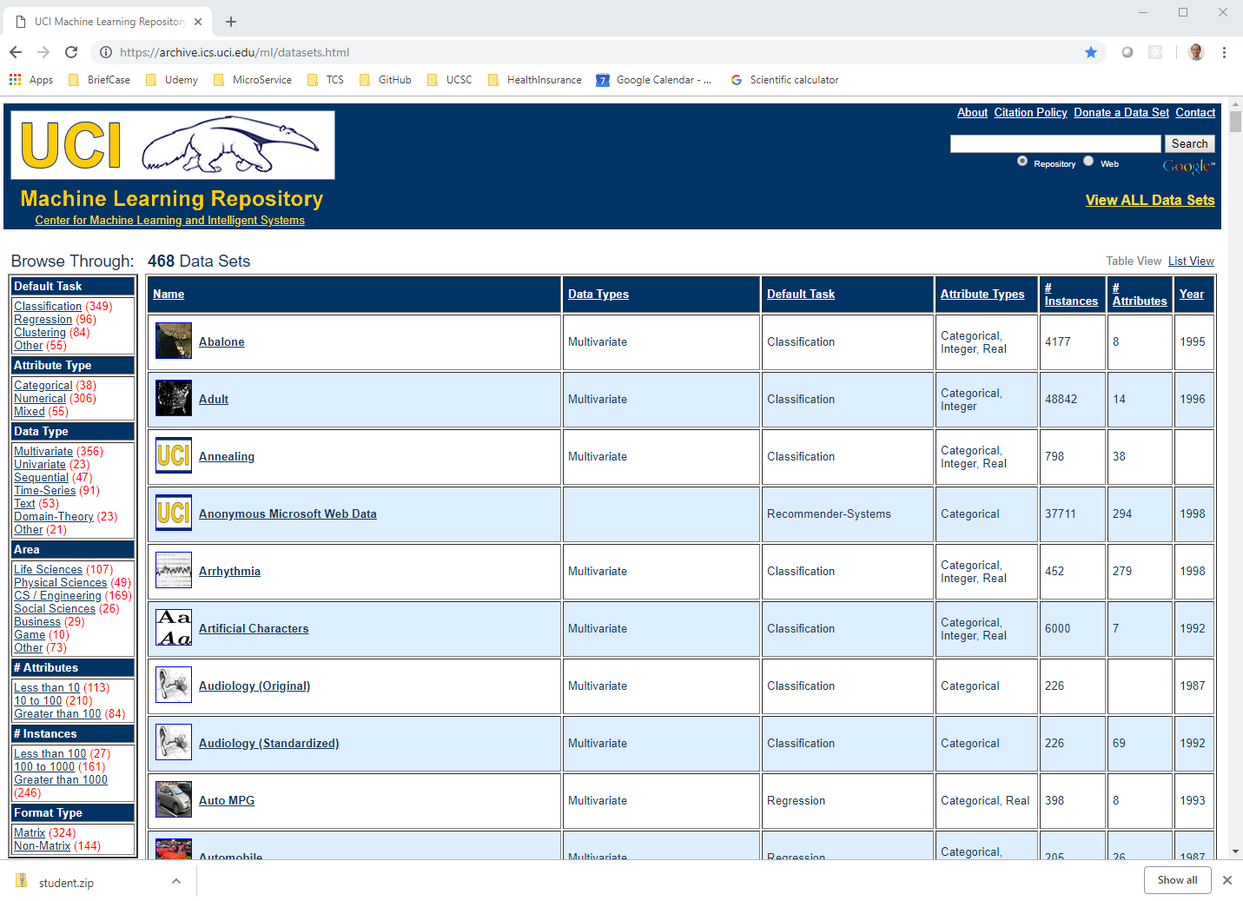
2 Linear Regression: Part 1
https://techwithtim.net/tutorials/machine-learning-python/linear-regression/
The data has to be correct form and valid data. The UCI has tons of data set as below:
https://archive.ics.uci.edu/ml/datasets.html

Slide 4
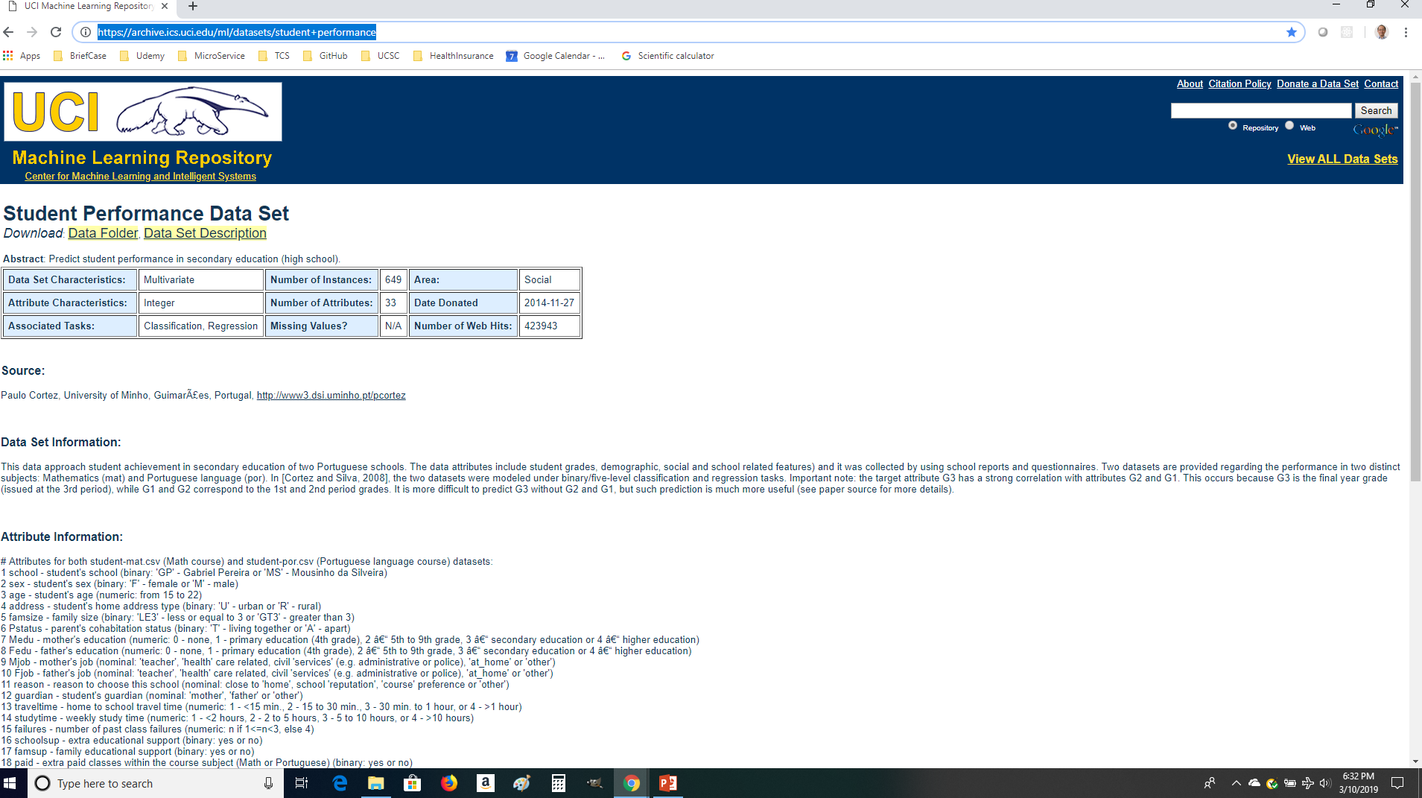
2 Linear Regression: Part 1
https://techwithtim.net/tutorials/machine-learning-python/linear-regression/
Just pick up the student performance data set. The data has to correct form and make sense.
The Data set link: https://archive.ics.uci.edu/ml/datasets/student+performance

Slide 5
2 Linear Regression: Part 1
https://techwithtim.net/tutorials/machine-learning-python/linear-regression/
This data set characteristic is multivariate. It means more than two variables. It is not just have one variable just depends on another variable.
Do not worry about attribute characteristics integer. Associated tasks for algorithm in classification and regression. The number of 649 student instances are actually in this data set.
There are around 33 attributes for each single instance.
The data set information described data set.
Studytime means how many study time per week.
Failures mean the number fail in the past classes.
The attribute information described the details of each attributes. G1 is grade for period 1, G2 is grade for period 2, and G3 are grade for period 3.

Slide 6
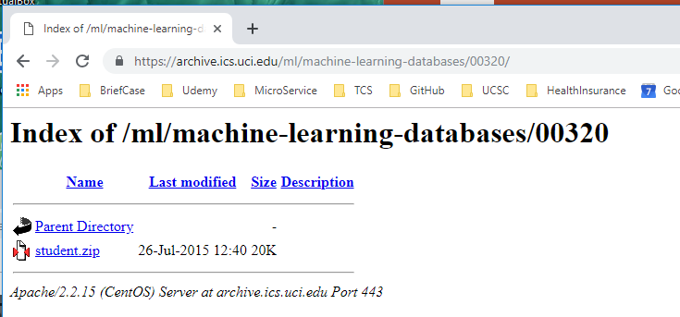
2 Linear Regression: Part 1
https://techwithtim.net/tutorials/machine-learning-python/linear-regression/
Select “Data Folder” to download the data set student.zip.

Slide 7
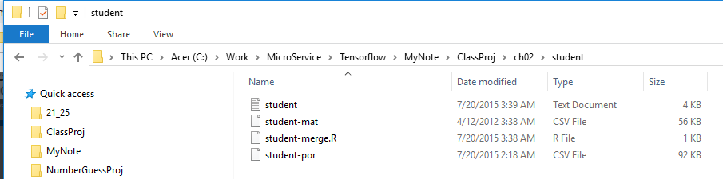
2 Linear Regression: Part 1
https://techwithtim.net/tutorials/machine-learning-python/linear-regression/
Unzip the student.zip. The folder looks like this.

Slide 8
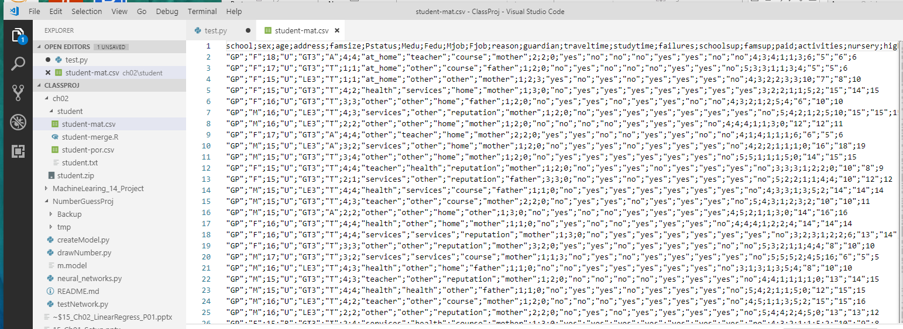
2 Linear Regression: Part 1
https://techwithtim.net/tutorials/machine-learning-python/linear-regression/
The student-mat.csv is as follow. This is the students’ math grades.

Slide 9
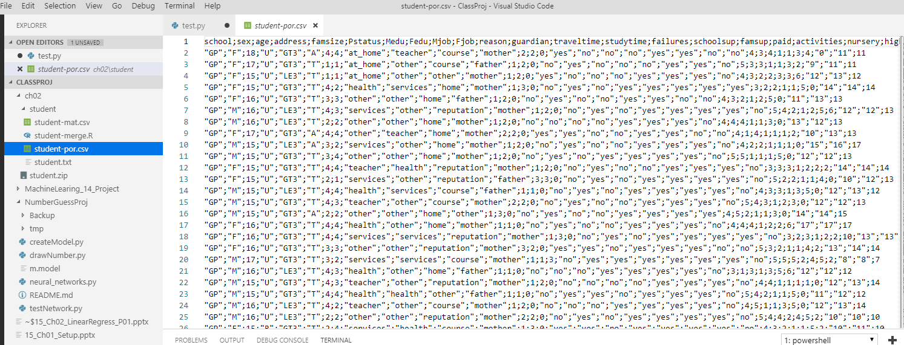
2 Linear Regression: Part 1
https://techwithtim.net/tutorials/machine-learning-python/linear-regression/
The student-por.csv is as follow. This is the students’ Portuguese grades:

Slide 10
2 Linear Regression: Part 1
https://techwithtim.net/tutorials/machine-learning-python/linear-regression/
We will import the following modules:
import pandas as pd;
import numpy as np;
import sklearn
from sklearn import linear_model
from sklearn.utils import shuffle
We need to install the following for the linear regression:
> pip pandas
> pip install numpy
> pip install sklearn
The first thing, we need to read in the data. The data is in “student/student-mat.csv”. All the data are separate by semicolon (;). The csv stands for Coma Separate Value. We have to specify sep=“;” for separabtor is semicolon.
We have 33 attributes, we do not want all the 33 attributes. We just need to use some of them.
print (data.head()) will print first 5 rows of all data.
We just need “G1”, “G2”, “G3”, “studytime”, “failures”, “absences”
> python ch02_linearRegression.py

Slide 11
2 Linear Regression: Part 1
https://techwithtim.net/tutorials/machine-learning-python/linear-regression/
We will import the following modules:
import pandas as pd;
import numpy as np;
import sklearn
from sklearn import linear_model
from sklearn.utils import shuffle
We need to install the following for the linear regression:
> pip pandas
> pip install numpy
> pip install sklearn
The first thing, we need to read in the data. The data is in “student/student-mat.csv”. All the data are separate by semicolon (;). The csv stands for Coma Separate Value. We have to specify sep=“;” for separabtor is semicolon.
We have 33 attributes, we do not want all the 33 attributes. We just need to use some of them.
print (data.head()) will print first 5 rows of all data.
We just need “G1”, “G2”, “G3”, “studytime”, “failures”, “absences”

Slide 12
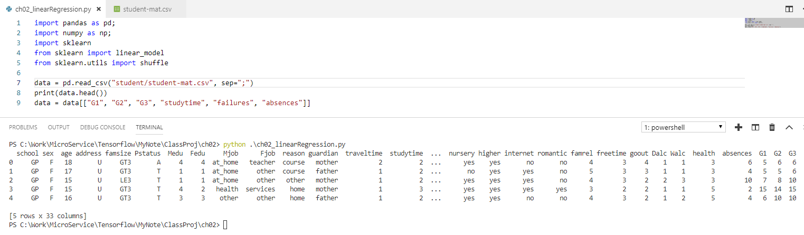
2 Linear Regression: Part 1
https://techwithtim.net/tutorials/machine-learning-python/linear-regression/
> python ch02_linearRegression.py
Will print out the first 5 row of data with 33 columns.

Slide 13
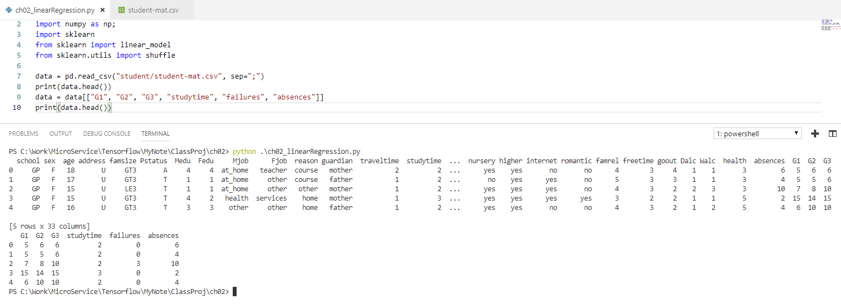
2 Linear Regression: Part 1
https://techwithtim.net/tutorials/machine-learning-python/linear-regression/
> python ch02_linearRegression.py
We print data again after cut down from 33 columns into 6 columns: “G1”, “G2”, “G3”, “studytime”, “failures”, “absences”

Slide 14
2 Linear Regression: Part 1
https://techwithtim.net/tutorials/machine-learning-python/linear-regression/
Now, we are going to define what we are going to predict.
What values are we actually want. In this case, we want G3. G3 grade is the final grade.
Label is g3: predict = “G3”
We want to determine what “G3” is. This predict is also called a Label. We can have multiple labels.
We define two arrays: One array for all our attributes. Another array is the Label.
predict = "G3"
# we drop "G3" label data. These are all training data.
x = np.array(data.drop([predict], 1))
# We get all of the features and attribute data
y = np.array(data([predict]))
# split into 4 different array: x_train is sectoin of x, y_train is section of y.
# x_test and y_test are used to test the model accuracy.
# We spli tout 10% of data for test sample.
x_train, y_train, x_test, y_test = sklearn.model_selection.train_test_split (x, y, test_size=0.1)

Slide 15
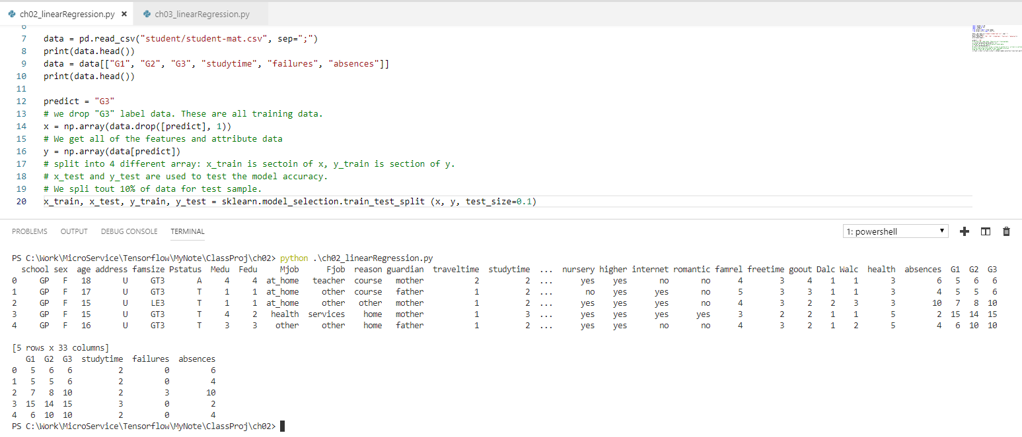
2 Linear Regression: Part 1
https://techwithtim.net/tutorials/machine-learning-python/linear-regression/
This section read the data as follow.
The next section will do the linear regression part 2.

Slide 16
End of Chapter

