Slide 1

7 KNN Implement (Part 3)
Peter H. Chen

Slide 2
7 KNN Implement (Part 3)
https://www.youtube.com/watch?v=TQKI0KE-JYY
In this section, we are going to discuss KNN Implementation.

Slide 3
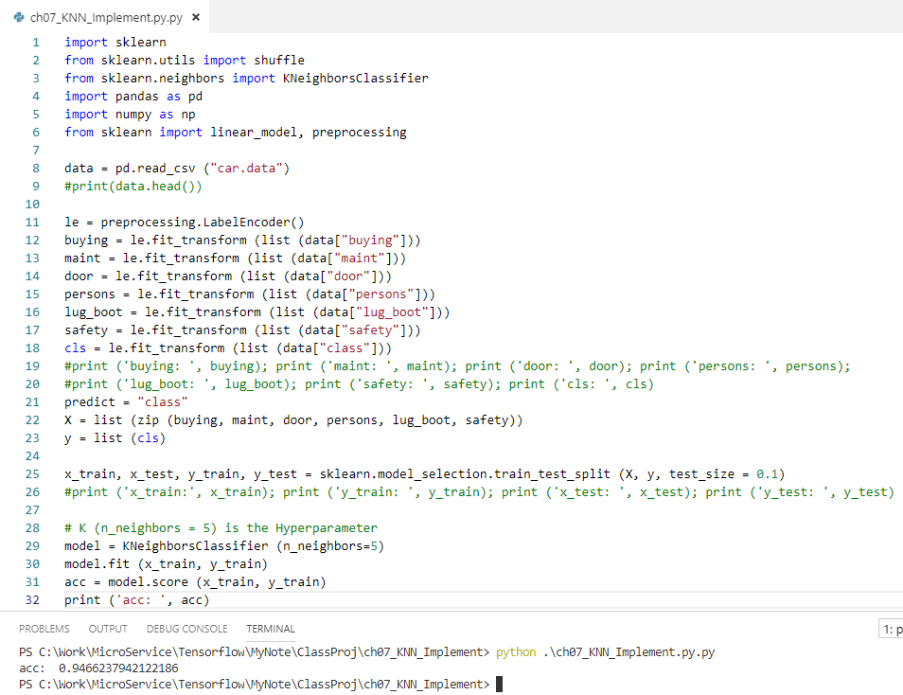
7 KNN Implement (Part 3)
https://www.youtube.com/watch?v=TQKI0KE-JYY
First step: We use model KNeighborClassifier (K = 5)
Then, we fit the model
Print the accuracy = 0.94

Slide 4
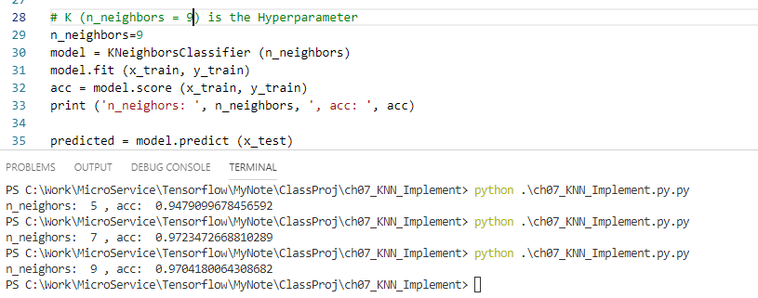
7 KNN Implement (Part 3)
https://www.youtube.com/watch?v=TQKI0KE-JYY
Second step: Try different K (K = 5, 7, 9)
K = 7 or 9 get the better accuracy = 0.97. We will use K = 9.

Slide 5
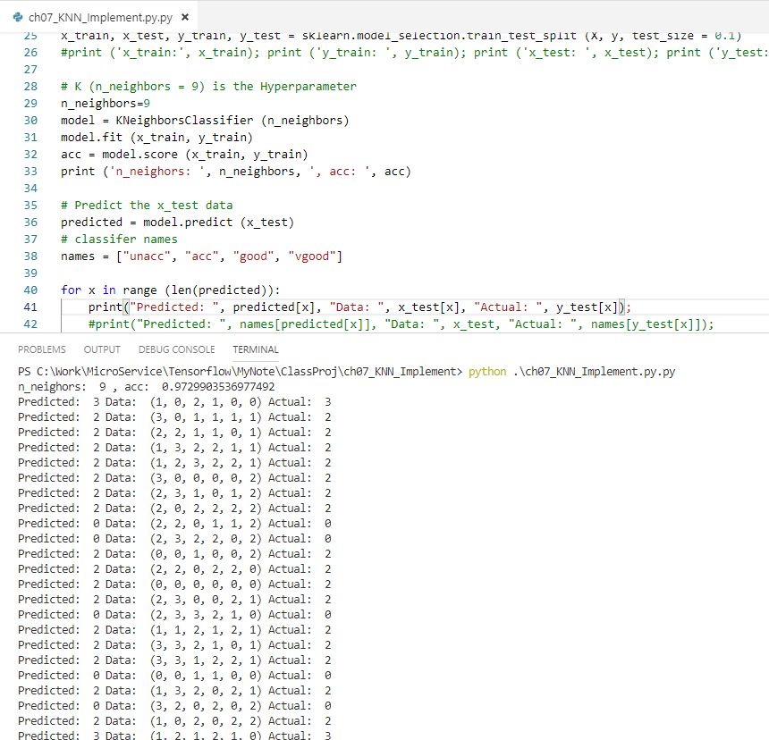
7 KNN Implement (Part 3)
https://www.youtube.com/watch?v=TQKI0KE-JYY
Third step: Make the prediction and compare the actual output.
Predicted: 2 (good)
Actual: 2 (good)
For most of the cases, it is accurate (0.97)

Slide 6
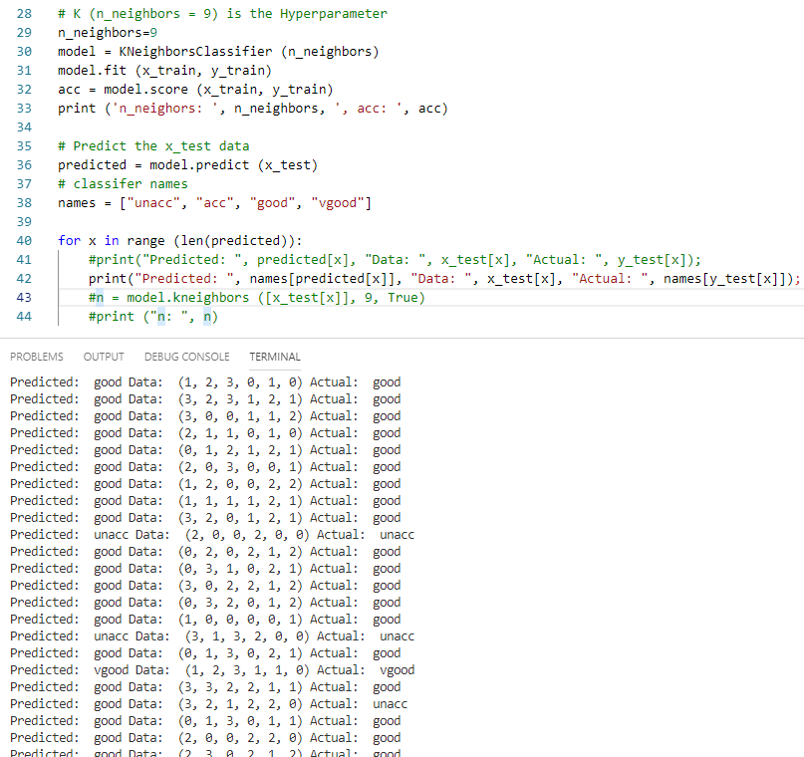
7 KNN Implement (Part 3)
https://www.youtube.com/watch?v=TQKI0KE-JYY
Four step: Make the prediction with text and compare the actual output with text.
Predicted: good
Actual: good
For most of the cases, it is accurate (0.97)

Slide 7
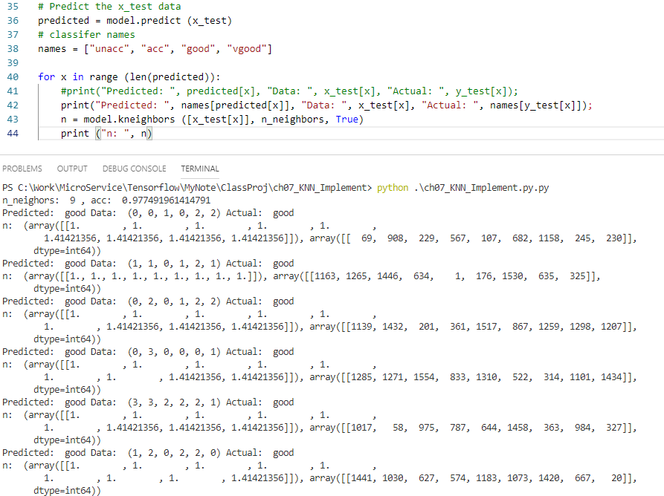
7 KNN Implement (Part 3)
https://www.youtube.com/watch?v=TQKI0KE-JYY
Fifth step: Dump the test data
Predicted: 2 (good)
Actual: 2 (good)
Test Data output: test[x].
These Data are not pretty with huge array.
These are nine different neighbor with index.

Slide 8
End of Chapter

