Slide 1

8 SVM Data Set (Part 1)
Peter H. Chen

Slide 2
8 SVM Data Set (Part 1)
https://techwithtim.net/tutorials/machine-learning-python/svm-1/
In this section, we are going to move into SVM (Support Vector Machine).
We will not talk what is SVM in this section.
We will study the Data Set first. In real application, we need to understand completely and reformat before we do the modeling.
The mathematics getting more complex after SVM when we move into neural network.

Slide 3
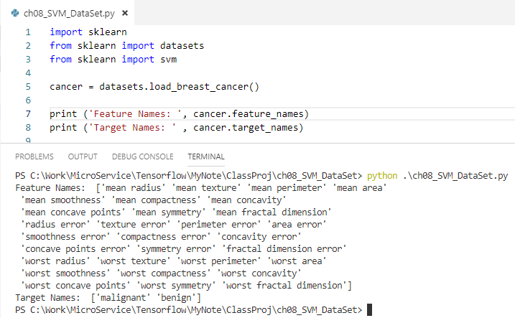
8 SVM Data Set (Part 1)
https://techwithtim.net/tutorials/machine-learning-python/svm-1/
We will load the cancer data set.
You can see the Features: radius, texture, perimeter, area, smoothness, compactness, concavity, and etc. and you also see the target is malignant or benign.

Slide 4
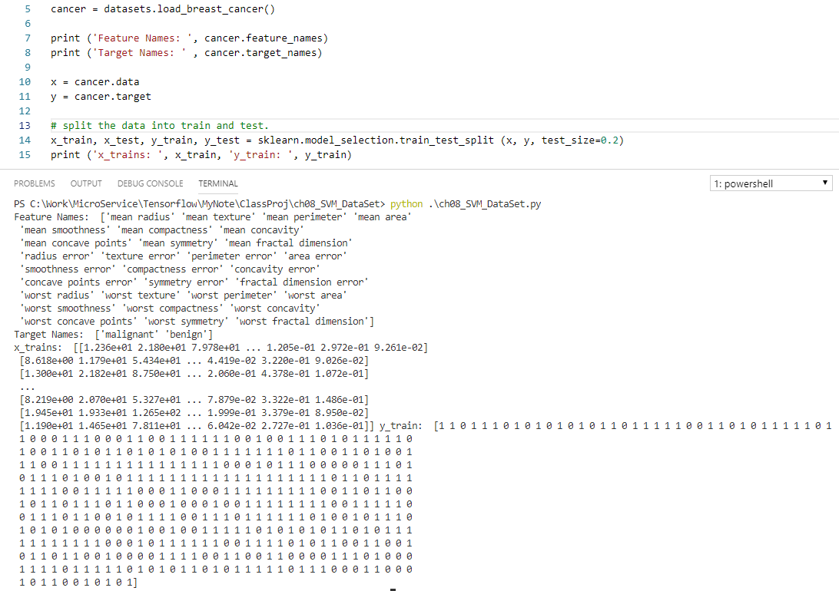
8 SVM Data Set (Part 1)
https://techwithtim.net/tutorials/machine-learning-python/svm-1/
Now, we are going to set up. Split the data and target into x_train, x_test, y_train, and y_test.
We see the y_trains, 1 represent the malignant, 0 represent benign.

Slide 5
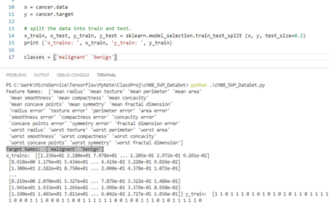
8 SVM Data Set (Part 1)
https://techwithtim.net/tutorials/machine-learning-python/svm-1/
Copy the cancer.target_names = [‘malignant’, ‘benign’] to classes = [‘malignant’, ‘benign’] for next section.

Slide 6
End of Chapter

