Slide 1

13 NLTK
Peter H. Chen

Slide 2
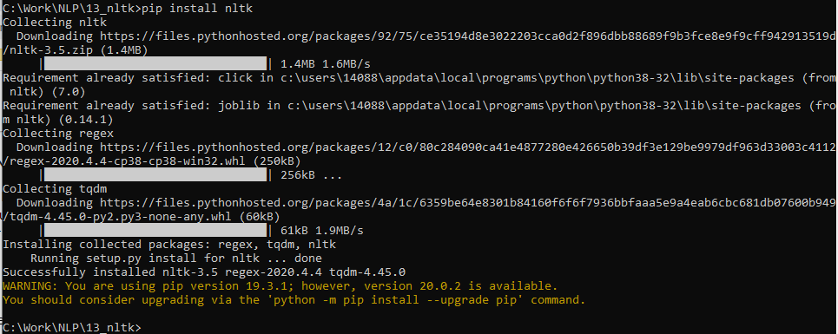
13 NLTK
https://www.tutorialspoint.com/natural_language_processing/natural_language_processing_python.htm
We discuss Python NLTK (Natural Language Took Kit) for NLP (Natural Language Processing).
Install Python NLTK
> pip install nltk

Slide 3
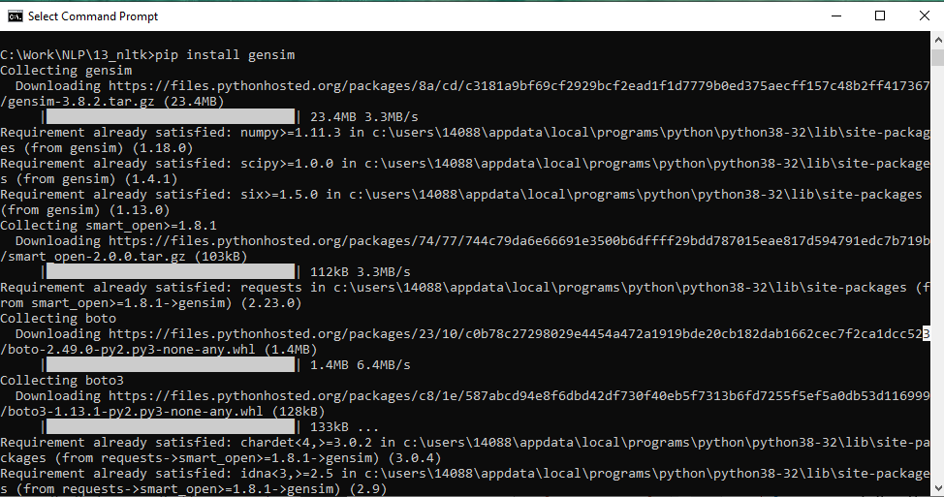
13 NLTK
https://www.tutorialspoint.com/natural_language_processing/natural_language_processing_python.htm
Install some packages
> pip install genism

Slide 4
13 NLTK
https://www.tutorialspoint.com/natural_language_processing/natural_language_processing_python.htm
Install some packages
> pip install pattern

Slide 5
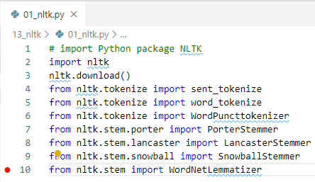
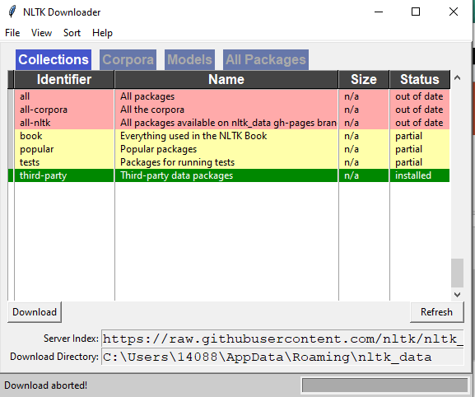
13 NLTK
https://www.tutorialspoint.com/natural_language_processing/natural_language_processing_python.htm
> import NLTK packages
> nltk.download ()
> python 01_nltk.py

Slide 6
13.1 NLTK Example
Peter H. Chen

Slide 7
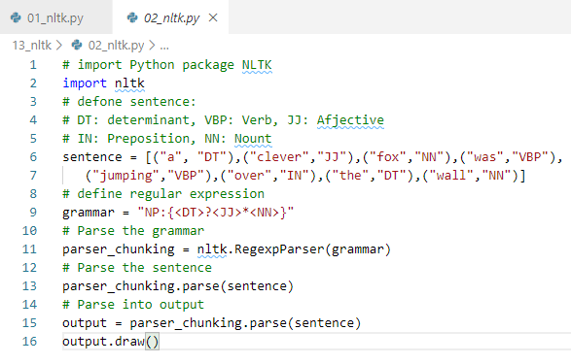
13.1 NLTK Example
https://www.tutorialspoint.com/natural_language_processing/natural_language_processing_python.htm
Define the sentence.
DT is the determinant
VBP is the verb
JJ is the adjective
IN is the preposition
NN is the noun.

Slide 8
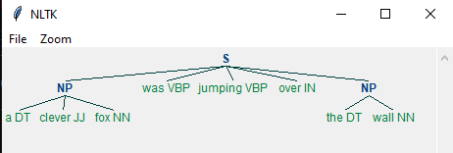
13.1 NLTK Example
https://www.tutorialspoint.com/natural_language_processing/natural_language_processing_python.htm
NLTK Example
> python 02_nltk.py

Slide 9
End of Chapter

