Slide 1

17 TF-IDF
Peter H. Chen

Slide 2
17 TF-IDF
https://www.youtube.com/watch?v=ZeQgNhc0vag&list=PL1w8k37X_6L-fBgXCiCsn6ugDsr1Nmfqk&index=17
TF-IDF (Term Frequency-Inverse Document Frequency)
We have discussed the Count Vectorization and N-Grams Vectorization.
We discuss the TF-IDF here.
Raw Data
Tokenization
Text Cleaning
Stem Texts
Spam Filter
ML Algorithm
Vectorization
Numbers

Slide 3

17 TF-IDF
https://www.youtube.com/watch?v=ZeQgNhc0vag&list=PL1w8k37X_6L-fBgXCiCsn6ugDsr1Nmfqk&index=17
TF-IDF (Term Frequency-Inverse Document Frequency)
Create Document-Term Matrix:
Columns are individual unique words
Cells contains a weight which signifies how important a word is, for an individual text message:
total number of documents
$$wi,j={tf}_{i,j}×log⁡(\frac{N}{dfi})$$
number of documents containing i
tf: term frequency, i: term, j: document (row).
number of times a term i occurs in a document j divided by total number of terms in document j.
If we have a sentence which contains five words and a word occurred two times in that sentence, then it will be 2/5.

Slide 4
17 TF-IDF
https://www.youtube.com/watch?v=ZeQgNhc0vag&list=PL1w8k37X_6L-fBgXCiCsn6ugDsr1Nmfqk&index=17
TF-IDF (Term Frequency-Inverse Document Frequency)
If word occurred very often, the frequency will be high.
If corpus has 10,000 sentences and we are looking at particular sentence.
If some term is occurring, we see that is not very frequent in other terms that means that word is rarely used, that is not commonly used.
That is not present in other documents. It will be smaller and the overall term will be larger.
If the word appears more number of times in a given sentence but it is a rare word, then this complete term will be large. So, wij denotes how important the word is.

Slide 5
17 TF-IDF
https://www.youtube.com/watch?v=ZeQgNhc0vag&list=PL1w8k37X_6L-fBgXCiCsn6ugDsr1Nmfqk&index=17
TF-IDF (Term Frequency-Inverse Document Frequency)
J: “I am studying NLP”
tf_{am,j} = ?
N = 200
df_{am} = 2
w_{am,j} = tf_{am,j} x log (N/df_{am})
Ans:
First, we have to calculate tf_{am,j} . Here, i = “am”. Total number of terms = 4 (I, am, studying, NLP).
Therefore, tf_{am,j} = 1/4 = 0.25.
N = 200, we have 200 documents.
w_{am,j} = tf_{am,j} x log (N/df_{am}) = 0.25 x log (200/2) = 0.5

Slide 6
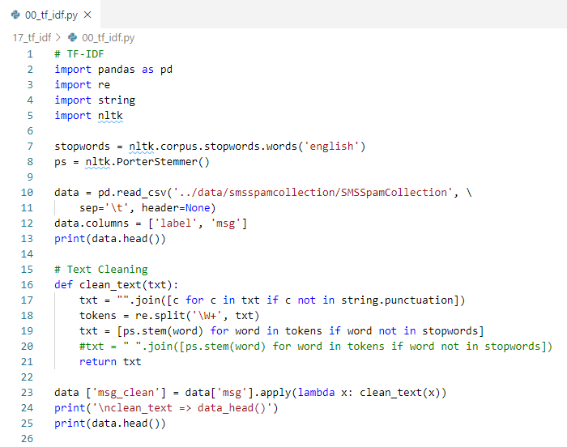
17 TF-IDF
https://www.youtube.com/watch?v=ZeQgNhc0vag&list=PL1w8k37X_6L-fBgXCiCsn6ugDsr1Nmfqk&index=17
TF-IDF (Term Frequency-Inverse Document Frequency)
read_csv(), Text Cleaning.

Slide 7
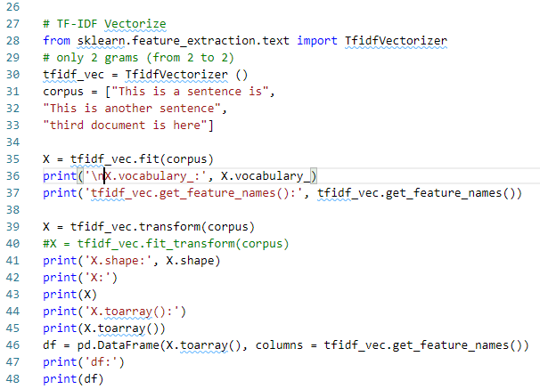
17 TF-IDF
https://www.youtube.com/watch?v=ZeQgNhc0vag&list=PL1w8k37X_6L-fBgXCiCsn6ugDsr1Nmfqk&index=17
TF-IDF (Term Frequency-Inverse Document Frequency)
IF-IDF Vectorize, Transform, Data Frame.

Slide 8
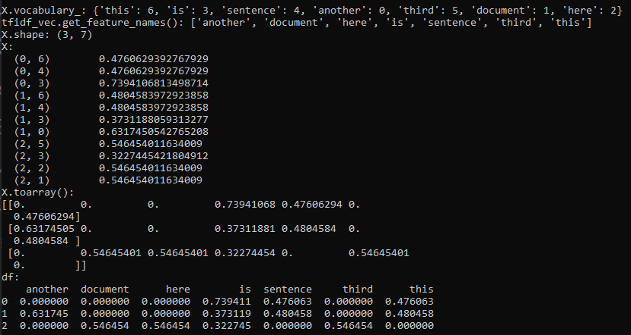
17 TF-IDF
https://www.youtube.com/watch?v=ZeQgNhc0vag&list=PL1w8k37X_6L-fBgXCiCsn6ugDsr1Nmfqk&index=17
TF-IDF (Term Frequency-Inverse Document Frequency)

Slide 9
17.1 TF-IDF for SMS Spam Message

Slide 10
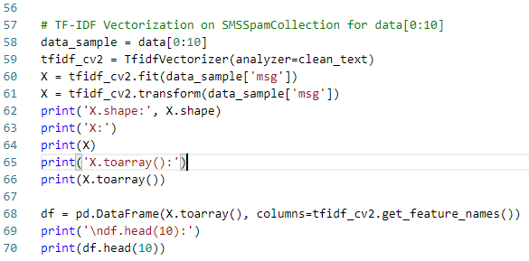
17.1 TF-IDF for SMS Spam Message
https://www.youtube.com/watch?v=ZeQgNhc0vag&list=PL1w8k37X_6L-fBgXCiCsn6ugDsr1Nmfqk&index=17
TF-IDF (Term Frequency-Inverse Document Frequency)
TF-IDF for data[0:10]

Slide 11
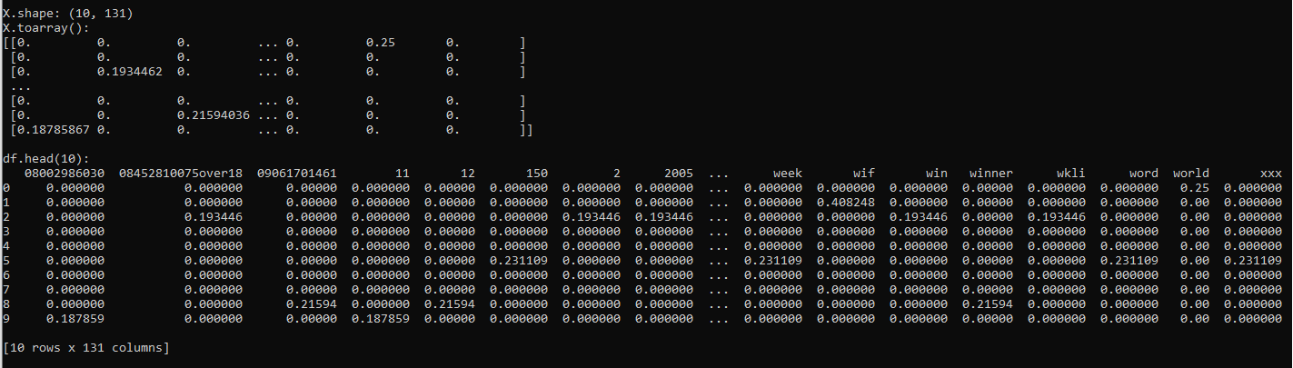
17.1 TF-IDF for SMS Spam Message
https://www.youtube.com/watch?v=ZeQgNhc0vag&list=PL1w8k37X_6L-fBgXCiCsn6ugDsr1Nmfqk&index=17
TF-IDF (Term Frequency-Inverse Document Frequency)
TF-IDF for data[0:10]

Slide 12
17.2 Quiz

Slide 13
17.2 Quiz
https://www.youtube.com/watch?v=ZeQgNhc0vag&list=PL1w8k37X_6L-fBgXCiCsn6ugDsr1Nmfqk&index=17
Quiz
1. What is TF-IDF stand for?
Ans: TF-IDF (Term Frequency-Inverse Document Frequency)
2. How to import TF-IDF?
Ans: from sklearn.feature_extraction.text import TfidfVectorizer
2. How to use TF-IDF Vectorization Function to setup clean_text?
Ans: tfidf_cv1 = TfidfVectorizer(analyzer=clean_text)
3. Given data_sample[‘msg’], how to fit and transform data?
Ans: X = tfidf_cv2.fit_tarnsform(data_sample['msg’])

Slide 14
End of Chapter

