Slide 1

7 Remove Punctuation
Peter H. Chen

Slide 2
7 Remove Punctuation
https://www.youtube.com/watch?v=9CpID8ZL1IQ&list=PL1w8k37X_6L-fBgXCiCsn6ugDsr1Nmfqk&index=7
Remove Punctuation
We combine the Tokenization and Text Cleaning into one step.
We called this step pre-processing.
Pre-Processing
Raw Data
Tokenization
Text Cleaning
Token Array
Stem Texts
Spam Filter
ML Algorithm
Vectorization

Slide 3
7 Remove Punctuation
https://www.youtube.com/watch?v=9CpID8ZL1IQ&list=PL1w8k37X_6L-fBgXCiCsn6ugDsr1Nmfqk&index=7
Text Pre-processing
Remove punctuation: Remove single quote, double quote, dollar sign, percentage, coma, period, exclamation, and etc.
Tokenization: Convert the character strings into words array.
Remove Stop Words: Remove stop words, these word are the most common words. They are filtered out in the NLP, such as, I, am, is, are, were, the, which, although, and etc.
Stemming/Lemmatizing: Convert words into roots, such as, code, coder, coders into code.

Slide 4
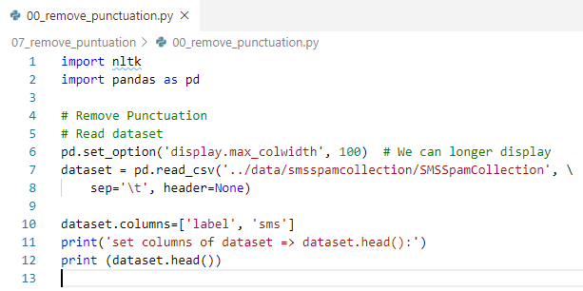
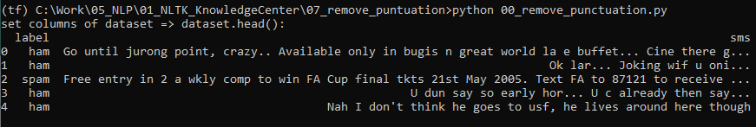
7 Remove Punctuation
https://www.youtube.com/watch?v=9CpID8ZL1IQ&list=PL1w8k37X_6L-fBgXCiCsn6ugDsr1Nmfqk&index=7
Text Pre-processing
Increase the display to 100 width to have better understanding of message.

Slide 5

7 Remove Punctuation
https://www.youtube.com/watch?v=9CpID8ZL1IQ&list=PL1w8k37X_6L-fBgXCiCsn6ugDsr1Nmfqk&index=7
String punctuation

Slide 6
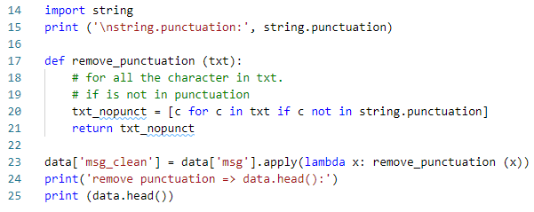
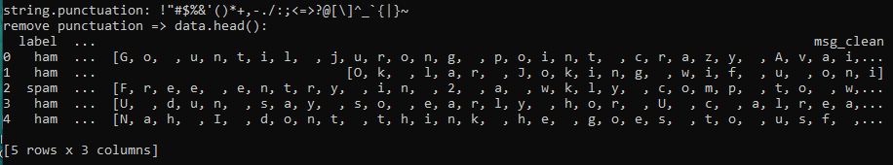
7 Remove Punctuation
https://www.youtube.com/watch?v=9CpID8ZL1IQ&list=PL1w8k37X_6L-fBgXCiCsn6ugDsr1Nmfqk&index=7
Remove String punctuation
The words are separated, we need to join the characters into words.

Slide 7
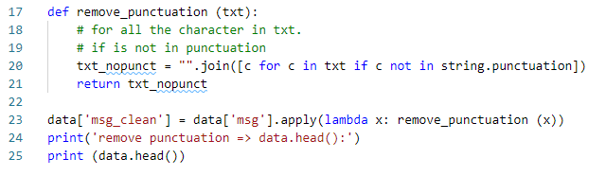
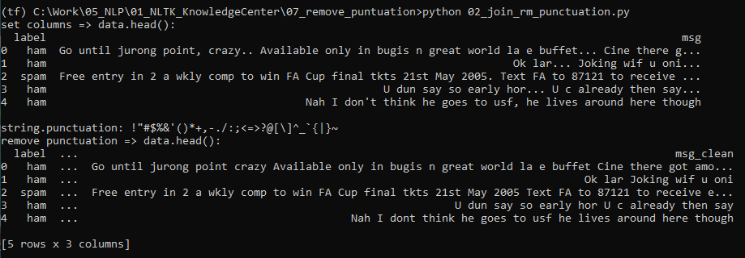
7 Remove Punctuation
https://www.youtube.com/watch?v=9CpID8ZL1IQ&list=PL1w8k37X_6L-fBgXCiCsn6ugDsr1Nmfqk&index=7
Join the Remove String punctuation
Join all the characters with space included.

Slide 8
7.1 Quiz

Slide 9
7.1 Quiz
https://www.youtube.com/watch?v=9CpID8ZL1IQ&list=PL1w8k37X_6L-fBgXCiCsn6ugDsr1Nmfqk&index=7
Quiz
1. What is pre-processing?
Ans: Pre-processing include tokenization and text clean up.
2. What is tring.punctuation?
Ans: string.punctuation: !"#$%&'()*+,-./:;<=>?@[\]^_`{|}~
3. What is text clean up?
Ans:
a) Remove punctuation character by character.
b) join the characters into words.

Slide 10
End of Chapter

