Slide 1

9 Remove Stop Word
Peter H. Chen

Slide 2
9 Remove Stop Word
https://www.youtube.com/watch?v=ob6IlbV13IM&list=PL1w8k37X_6L-fBgXCiCsn6ugDsr1Nmfqk&index=9
Remove Stop Words
Get rid of commonly used words which do not add much meaning.
Those commonly used words, such as, am, is, the, and etc., are called the Stop Words.
Remove these stop words, we give Python very less words.
Pre-Processing
Raw Data
Tokenization
Text Cleaning
Token Array
Stem Texts
Spam Filter
ML Algorithm
Vectorization

Slide 3
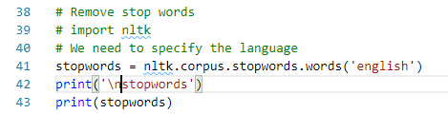
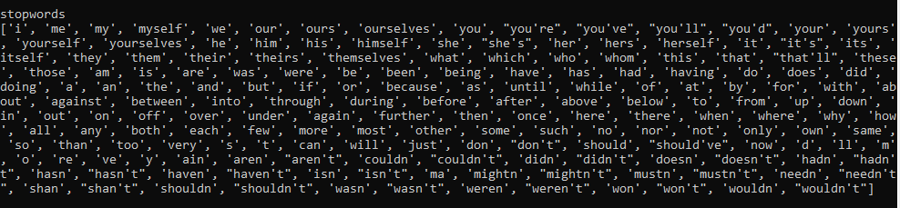
9 Remove Stop Word
https://www.youtube.com/watch?v=ob6IlbV13IM&list=PL1w8k37X_6L-fBgXCiCsn6ugDsr1Nmfqk&index=9
What is the Stop Words?

Slide 4
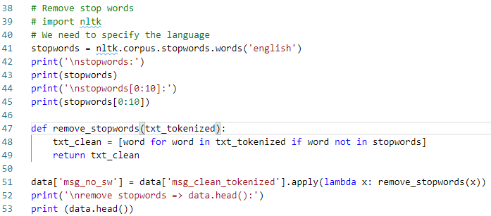
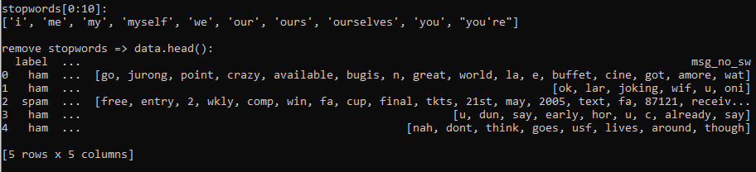
9 Remove Stop Word
https://www.youtube.com/watch?v=ob6IlbV13IM&list=PL1w8k37X_6L-fBgXCiCsn6ugDsr1Nmfqk&index=9
Remove Stop word

Slide 5
9.1 Quiz

Slide 6
9.1 Quiz
https://www.youtube.com/watch?v=ob6IlbV13IM&list=PL1w8k37X_6L-fBgXCiCsn6ugDsr1Nmfqk&index=9
Quiz
1. What is stop words?
Ans:
stopwords = nltk.corpus.stopwords.words('english’)
stopwords[0:10]:
['i', 'me', 'my', 'myself', 'we', 'our', 'ours', 'ourselves', 'you', "you're"]
2. How to remove the stop word?
Ans: txt_clean = [word for word in txt_tokenized if word not in stopwords]
3. Lambda function to call the remvoe_stopwords() function?
Ans:
data['msg_no_sw'] = \
data['msg_clean_tokenized'].apply(lambda x: remove_stopwords(x))

Slide 7
End of Chapter

