Slide 1

13 Lemmatizer with WordNet
Peter H. Chen

Slide 2
13 Lemmatizer with WordNet
https://www.youtube.com/watch?v=8q-7FeQi8us&list=PL1w8k37X_6L-fBgXCiCsn6ugDsr1Nmfqk&index=13
Lemmatizer with WordNet
We discuss the Lemmatizer to analyze the words, in particularly, we use package WordNet.
Pre-Processing
Raw Data
Tokenization
Text Cleaning
Token Array
Stem Texts
Spam Filter
ML Algorithm
Vectorization

Slide 3
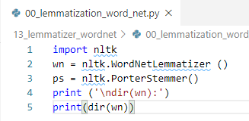
13 Lemmatizer with WordNet
https://www.youtube.com/watch?v=8q-7FeQi8us&list=PL1w8k37X_6L-fBgXCiCsn6ugDsr1Nmfqk&index=13
WordNetLemmatizer
> import nltk
# Very similar to nltk.PorterStem()
> wn = nltk.WordNetLemmatizer ()
# Pass in <word>: (‘coder’, ‘code’, ‘coding’)
> wn.lemmatize (<word>)
> print (dir(wn))

Slide 4
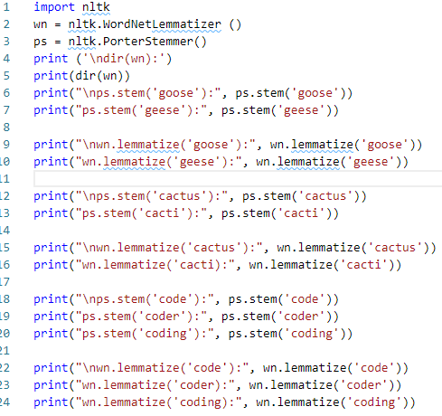
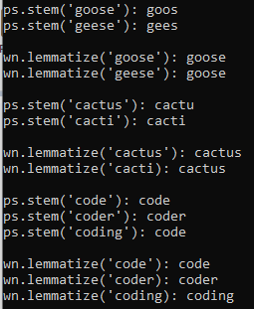
13 Lemmatizer with WordNet
https://www.youtube.com/watch?v=8q-7FeQi8us&list=PL1w8k37X_6L-fBgXCiCsn6ugDsr1Nmfqk&index=13
WordNetLemmatizer
We will use lemmatize() function.

Slide 5
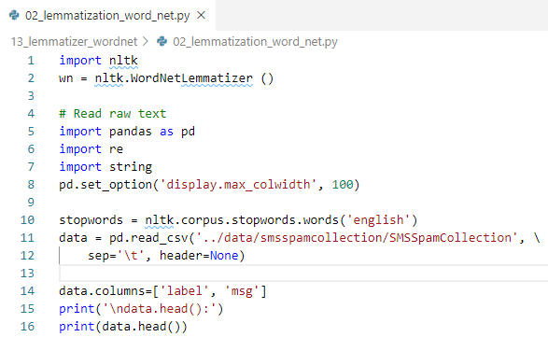
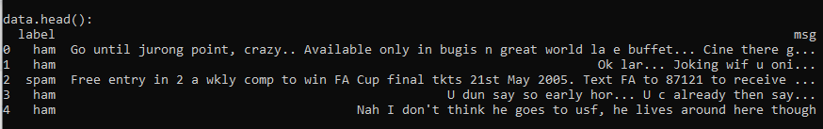
13 Lemmatizer with WordNet
https://www.youtube.com/watch?v=8q-7FeQi8us&list=PL1w8k37X_6L-fBgXCiCsn6ugDsr1Nmfqk&index=13
Read raw text

Slide 6
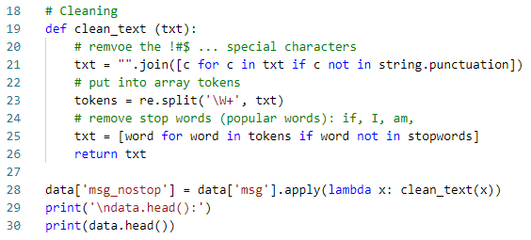
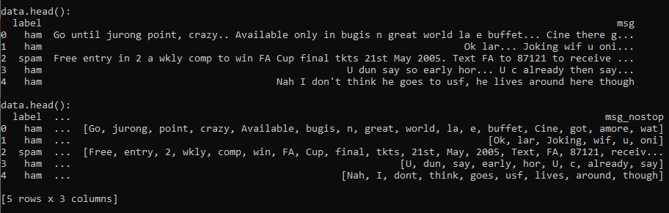
13 Lemmatizer with WordNet
https://www.youtube.com/watch?v=8q-7FeQi8us&list=PL1w8k37X_6L-fBgXCiCsn6ugDsr1Nmfqk&index=13
Cleaning

Slide 7
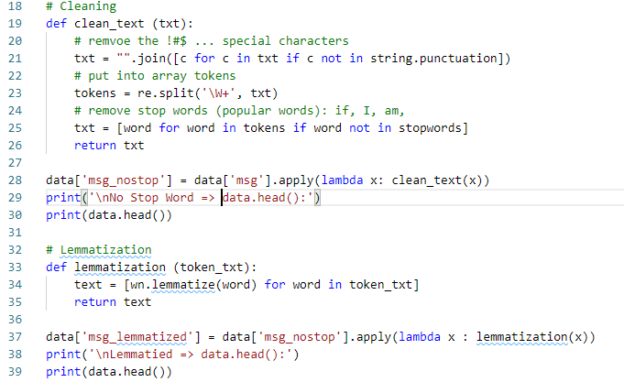
13 Lemmatizer with WordNet
https://www.youtube.com/watch?v=8q-7FeQi8us&list=PL1w8k37X_6L-fBgXCiCsn6ugDsr1Nmfqk&index=13
Lemmatizer

Slide 8
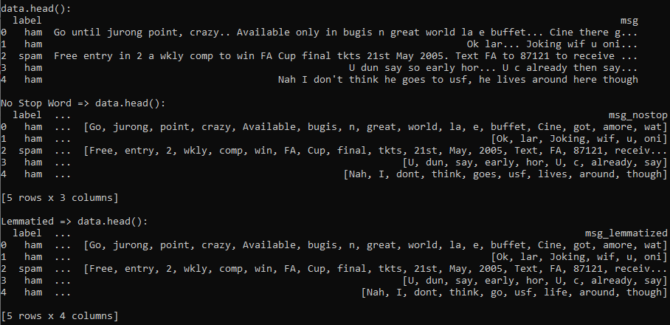
13 Lemmatizer with WordNet
https://www.youtube.com/watch?v=8q-7FeQi8us&list=PL1w8k37X_6L-fBgXCiCsn6ugDsr1Nmfqk&index=13
Lemmatizer: You can see some of the words are shorten or removed

Slide 9
13.1 Quiz

Slide 10
13.1 Quiz
https://www.youtube.com/watch?v=8q-7FeQi8us&list=PL1w8k37X_6L-fBgXCiCsn6ugDsr1Nmfqk&index=13
Quiz
1. What are differences between NLTK lemmatization and stem?
Ans:
a) wn = nltk.WordNetLemmatizer ()
b) ps = nltk.PorterStemmer()

Slide 11
13.1 Quiz
https://www.youtube.com/watch?v=8q-7FeQi8us&list=PL1w8k37X_6L-fBgXCiCsn6ugDsr1Nmfqk&index=13
Quiz
2. What are the outputs?
a) print("\nps.stem('goose'):", ps.stem('goose’))
b) print("ps.stem('geese'):", ps.stem('geese’))
c) print("\nwn.lemmatize('goose'):", wn.lemmatize('goose’))
d) print("wn.lemmatize('geese'):", wn.lemmatize('geese’))
Ans:
a) ps.stem('goose'): goos
b) ps.stem('geese'): gees
c)wn.lemmatize('goose'): goose
d) wn.lemmatize('geese'): goose

Slide 12
13.1 Quiz
https://www.youtube.com/watch?v=8q-7FeQi8us&list=PL1w8k37X_6L-fBgXCiCsn6ugDsr1Nmfqk&index=13
Quiz
3. What are the outputs?
a) print("\nps.stem('cactus'):", ps.stem('cactus’))
b) print("ps.stem('cacti'):", ps.stem('cacti’))
c) print("\nwn.lemmatize('cactus'):", wn.lemmatize('cactus’))
d) print("wn.lemmatize('cacti):", wn.lemmatize('cacti’))
Ans:
a) ps.stem('cactus'): cactu
b) ps.stem('cacti'): cacti
c) wn.lemmatize('cactus'): cactus
d) wn.lemmatize('cacti): cactus

Slide 13
13.1 Quiz
https://www.youtube.com/watch?v=8q-7FeQi8us&list=PL1w8k37X_6L-fBgXCiCsn6ugDsr1Nmfqk&index=13
Quiz
4. How to lemmatize the word tokens?
Ans: text = [wn.lemmatize(word) for word in token_txt]
5. How to use lambda function to lemmatize?
Ans:
data['msg_lemmatized'] = \
data['msg_nostop'].apply(lambda x : lemmatization(x))

Slide 14
End of Chapter

