Slide 1

16 N-Grams Vectorization
Peter H. Chen

Slide 2
16 N-Grams Vectorization
https://www.youtube.com/watch?v=YU0m0r9u2sA&list=PL1w8k37X_6L-fBgXCiCsn6ugDsr1Nmfqk&index=16
N-Grams Vectorization
We discuss the N-Grams Vectorization.
Raw Data
Tokenization
Text Cleaning
Stem Texts
Spam Filter
ML Algorithm
Vectorization
Numbers

Slide 3
16 N-Grams Vectorization
https://www.youtube.com/watch?v=YU0m0r9u2sA&list=PL1w8k37X_6L-fBgXCiCsn6ugDsr1Nmfqk&index=16
N-Grams Vectorization
N-Grams also creates a document-term matrix,
Columns represent columns of adjacent words of length n
Cells represent count
For example:
 | “I am studying NLP”
Bigram (n = 2) | “I am”, “am studying”, “Studying NLP”
Trigram (n = 3) | “I am studying”, “am studying NLP”,
4-gram (n = 4) | “I am studying NLP”

Slide 4
16 N-Grams Vectorization
https://www.youtube.com/watch?v=YU0m0r9u2sA&list=PL1w8k37X_6L-fBgXCiCsn6ugDsr1Nmfqk&index=16
N-Grams Vectorization
N-Grams also creates a document-term matrix,
Columns represent columns of adjacent words of length n
Cells represent count
For example:

Slide 5
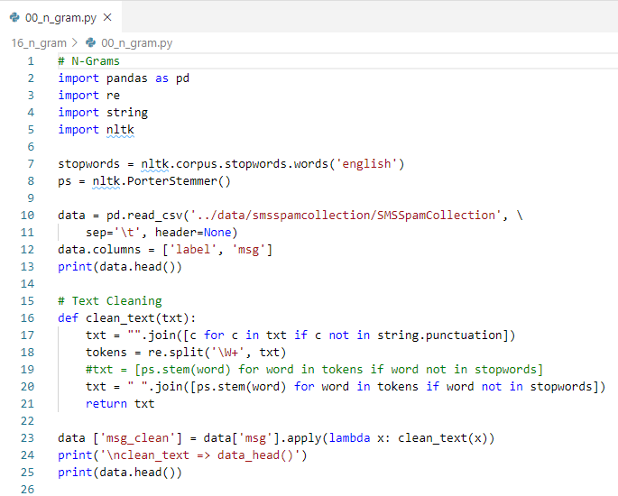
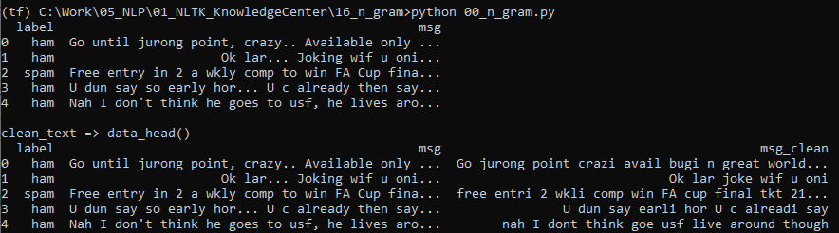
16 N-Grams Vectorization
https://www.youtube.com/watch?v=YU0m0r9u2sA&list=PL1w8k37X_6L-fBgXCiCsn6ugDsr1Nmfqk&index=16
N-Grams Vectorization
The results is incorrect.

Slide 6
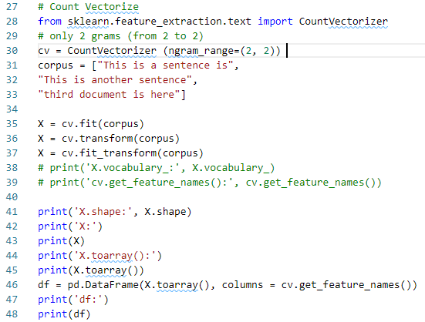

16 N-Grams Vectorization
https://www.youtube.com/watch?v=YU0m0r9u2sA&list=PL1w8k37X_6L-fBgXCiCsn6ugDsr1Nmfqk&index=16
N-Grams Vectorization
The results is incorrect.

Slide 7
16.1 N-Grams Vectorization: 2-3

Slide 8
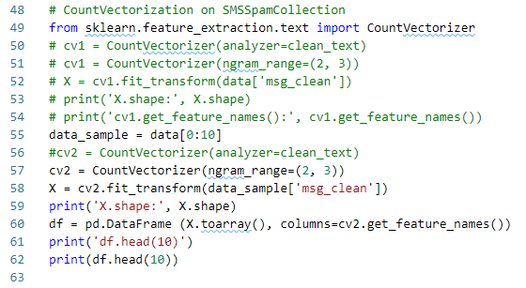
16.1 N-Grams Vectorization: 2-3
https://www.youtube.com/watch?v=YU0m0r9u2sA&list=PL1w8k37X_6L-fBgXCiCsn6ugDsr1Nmfqk&index=16
N-Grams Vectorization
N grams: 2-3 for data[0:10]

Slide 9
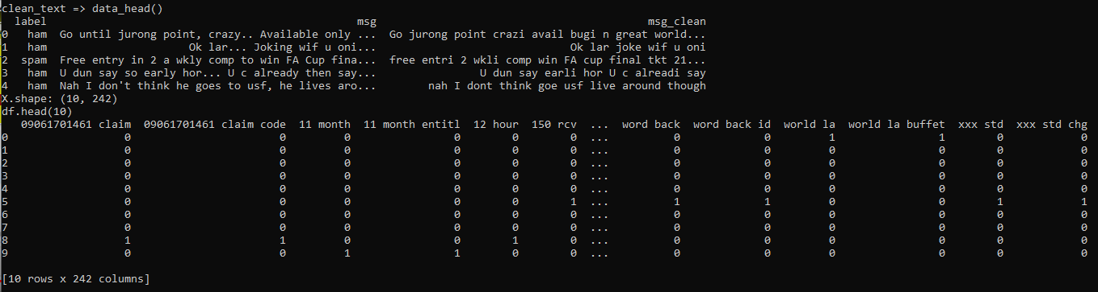
16.1 N-Grams Vectorization: 2-3
https://www.youtube.com/watch?v=YU0m0r9u2sA&list=PL1w8k37X_6L-fBgXCiCsn6ugDsr1Nmfqk&index=16
N-Grams Vectorization
N grams: 2-3. The results is too many columns and contains numbers.

Slide 10
16.2 Quiz

Slide 11
16.2 Quiz
https://www.youtube.com/watch?v=YU0m0r9u2sA&list=PL1w8k37X_6L-fBgXCiCsn6ugDsr1Nmfqk&index=16
Quiz
1. How to setup N Grams from 2-3 words?
Ans: cv2 = CountVectorizer(ngram_range=(2, 3))

Slide 12
End of Chapter

