Slide 1

2 NLTK
Peter H. Chen

Slide 2
2 NLTK
https://www.youtube.com/watch?v=_cJgK7k56VA&list=PL1w8k37X_6L-fBgXCiCsn6ugDsr1Nmfqk&index=2
NLTK
NLTK (NLP Toolkit): Suite (a set of programs) of open-source tools created to make NLP processes in Python easier to build.
NLTK can be in parts of speech tagging, sentence translation, text generation, and many more applications.
There are many built-in of functions and libraries that are included inside the NLTK libraries.
For example, NLTK have the stem function can identify stems for words, such as, coder, coding, corders, and etc. Those words have the same stem ‘code’. You can write complicated code for stem. NLTK will help you.
If you want to tokenize a list of words, you do not need to write the functions by yourself.
There are stop words and my more applications which are built in NLTK and many more are added continuously due to NLTK is open source.
NLTK is a very useful library and can speed up your development.

Slide 3
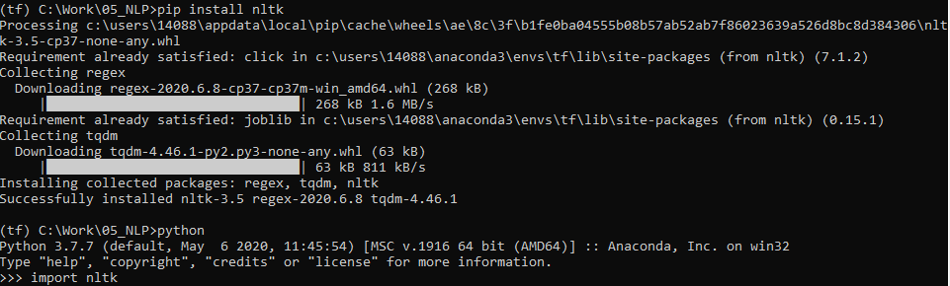
2 NLTK
https://www.youtube.com/watch?v=_cJgK7k56VA&list=PL1w8k37X_6L-fBgXCiCsn6ugDsr1Nmfqk&index=2
Install acnacoda3 and nltk
https://www.nltk.org/install.html
> conda activate tf
(tf) > pip install nltk
http://www.nltk.org/
> python
>>> import nltk

Slide 4
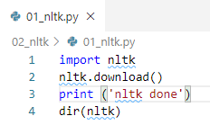

2 NLTK
https://www.youtube.com/watch?v=_cJgK7k56VA&list=PL1w8k37X_6L-fBgXCiCsn6ugDsr1Nmfqk&index=2
Install acnacoda3 and nltk
> python 01_nltk.py
showing info https://raw.githubusercontent.com/nltk/nltk_data/gh-pages/index.xml

Slide 5
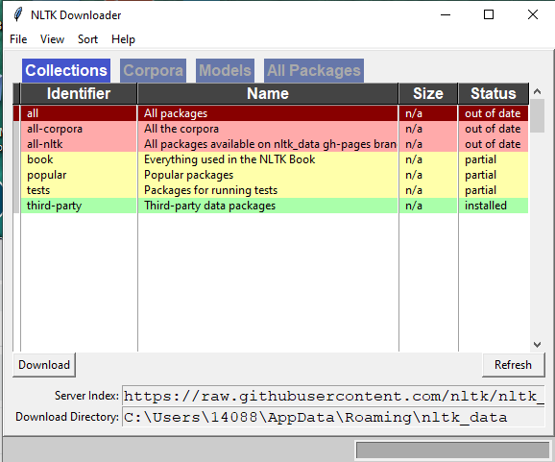
2 NLTK
https://www.youtube.com/watch?v=_cJgK7k56VA&list=PL1w8k37X_6L-fBgXCiCsn6ugDsr1Nmfqk&index=2
Install acnacoda3 and nltk
It gives you a list of packages.
https://raw.githubusercontent.com/nltk/nltk_data/gh-pages/index.xml

Slide 6
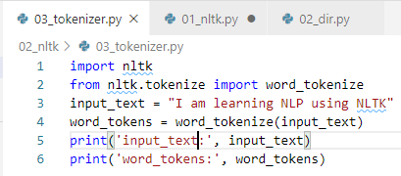

2 NLTK
https://www.youtube.com/watch?v=_cJgK7k56VA&list=PL1w8k37X_6L-fBgXCiCsn6ugDsr1Nmfqk&index=2
Sentence Tokenize Function
It separate the sentence into a list of words.

Slide 7
2.1 Quiz

Slide 8
2.1 Quiz
https://www.youtube.com/watch?v=_cJgK7k56VA&list=PL1w8k37X_6L-fBgXCiCsn6ugDsr1Nmfqk&index=2
Quiz
1. What command to install the nltk?
Ans: > pip install nltk
2. What python command to import nltk?
Ans: import nltk
3. What funciton to display a list of download package?
Ans: nltk.download()
4. What command is used to see all the methods of nltk?
Ans: dir(nltk)
5. What command to see the location of nltk download information?
Ans: dir(nltk)
6. Given a sentence_text, What nltk function to tokenize a sentence?
Ans: word_tokenize (sentence_text)

Slide 9
End of Chapter

