Slide 1

4 Read Text Data
Peter H. Chen

Slide 2
4 Read Text Data
https://www.youtube.com/watch?v=8gd-3VFPvBQ&list=PL1w8k37X_6L-fBgXCiCsn6ugDsr1Nmfqk&index=4
Read Text Data
We discuss how to read the text data which is unstructured.

Slide 3
4.1 Load Dataset
Peter H. Chen

Slide 4
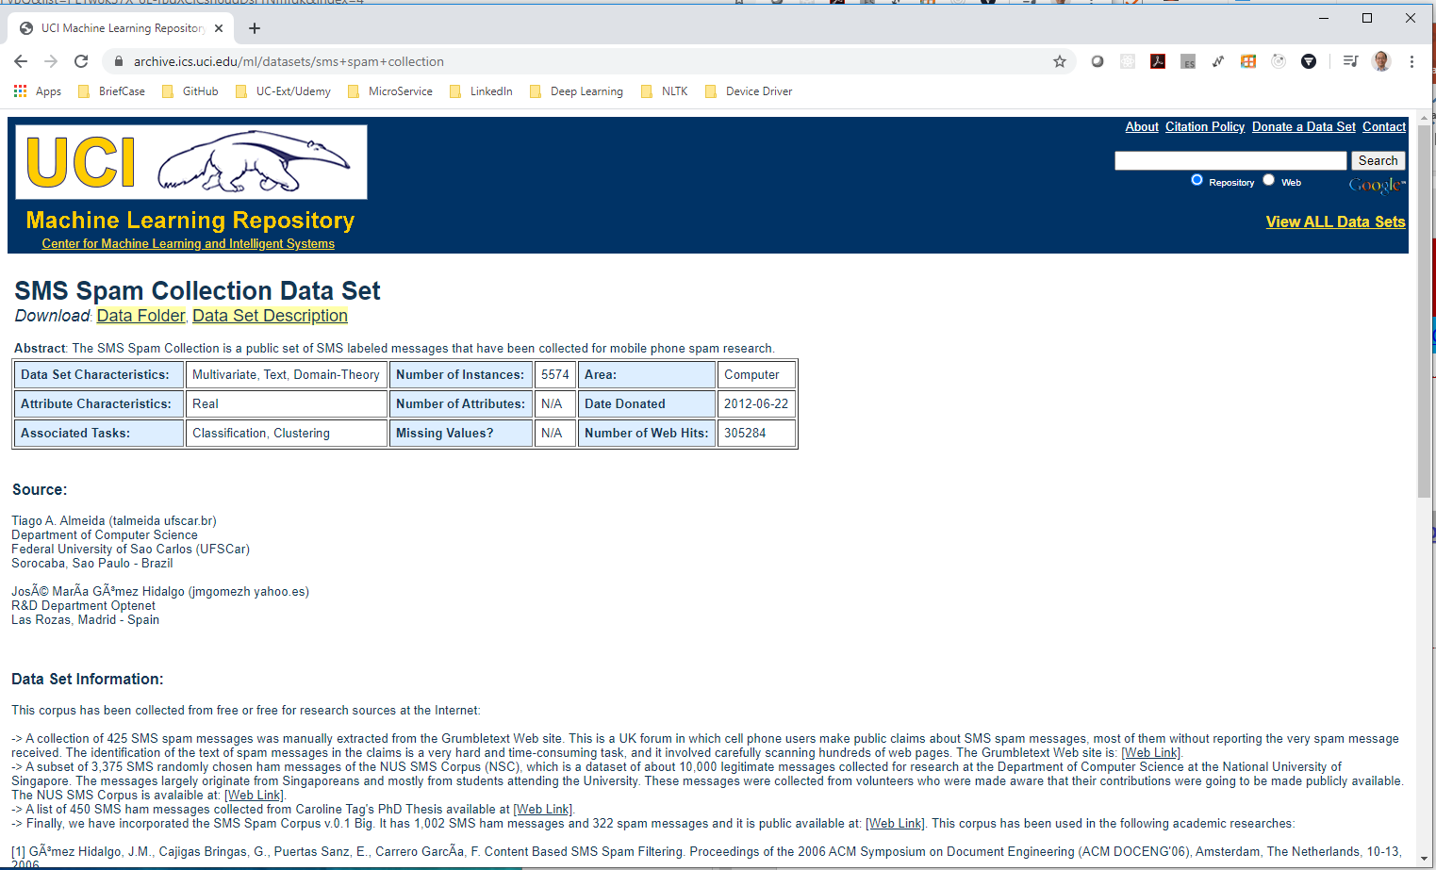
4.1 Load Dataset
https://www.youtube.com/watch?v=8gd-3VFPvBQ&list=PL1w8k37X_6L-fBgXCiCsn6ugDsr1Nmfqk&index=4
Read Text Data
Very popular UCI SMS (Short Message Service) Spam Collection Dataset:
https://archive.ics.uci.edu/ml/datasets/sms+spam+collection

Slide 5
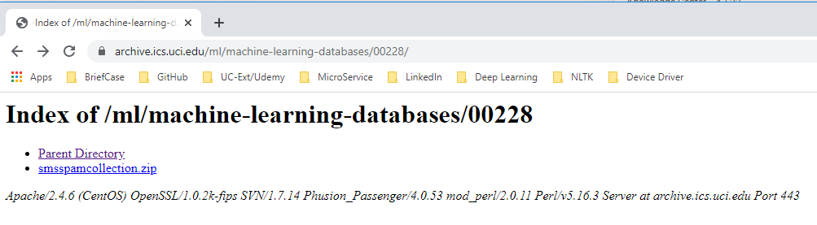
4.1 Load Dataset
https://www.youtube.com/watch?v=8gd-3VFPvBQ&list=PL1w8k37X_6L-fBgXCiCsn6ugDsr1Nmfqk&index=4
Read Text Data
Click Data Folder and download the zip file.

Slide 6
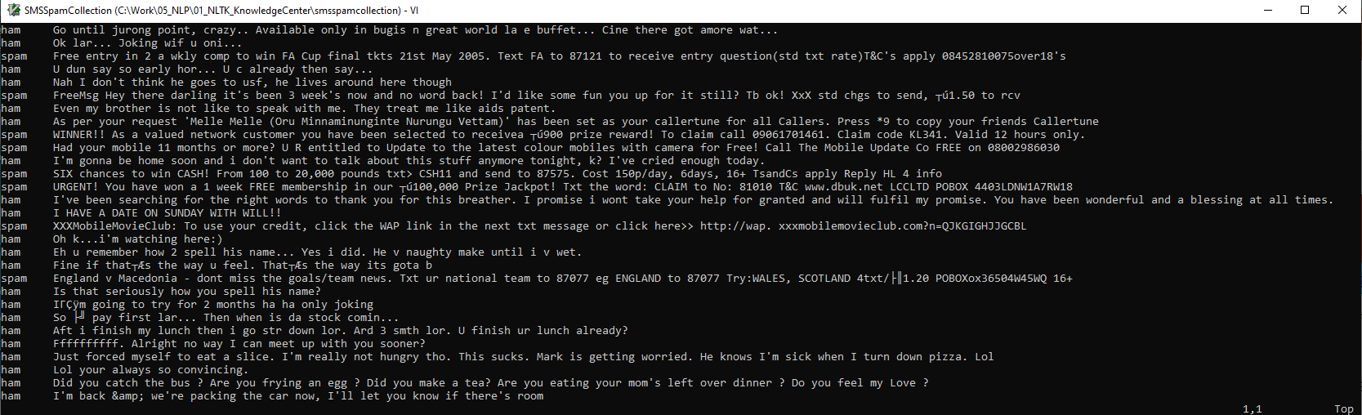
4.1 Load Dataset
https://www.youtube.com/watch?v=8gd-3VFPvBQ&list=PL1w8k37X_6L-fBgXCiCsn6ugDsr1Nmfqk&index=4
Read Text Data
Unzipped the download file, go inside the folder, and find the file SMSSpamCollection. Used vi editor to browse the file: Column 1 is ham or spam, column 2 is the messages.
Once we read the dataset, we can categorize the spam or non-spam message.

Slide 7
4.2 open and pandas
Peter H. Chen

Slide 8
4.2 open and pandas
https://www.youtube.com/watch?v=8gd-3VFPvBQ&list=PL1w8k37X_6L-fBgXCiCsn6ugDsr1Nmfqk&index=4
Open and Pandas
To read this file, we can use
Method 1: Use open() function
Method 2: pandas read_csv() function.
This file contains the <tab> for separate columns. It is not totally unstructured.
The column one is either ham or spam, followed by <tab>, and then messages.
Method 1: The first way is to use open() function and put into the pandas dataFrame.
Method 2: The second way is directly read by pandas read_csv() function.
The pandas read_csv() is very easy to read <tab> separated data.

Slide 9
4.3 Read with Open
Peter H. Chen

Slide 10
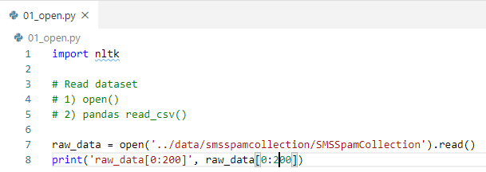
4.3 Read with Open
https://www.youtube.com/watch?v=8gd-3VFPvBQ&list=PL1w8k37X_6L-fBgXCiCsn6ugDsr1Nmfqk&index=4
Read Text Data
Display 200 characters.

Slide 11
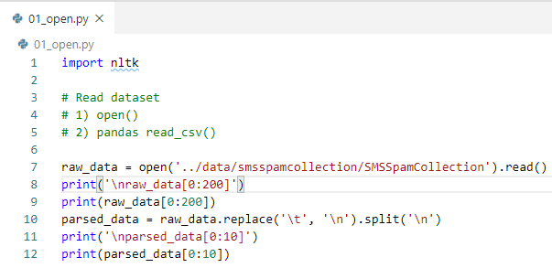
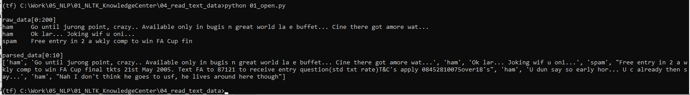
4.3 Read with Open
https://www.youtube.com/watch?v=8gd-3VFPvBQ&list=PL1w8k37X_6L-fBgXCiCsn6ugDsr1Nmfqk&index=4
Read Text Data
Parsed raw_data into parsed_data arrays.

Slide 12
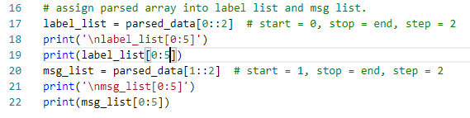
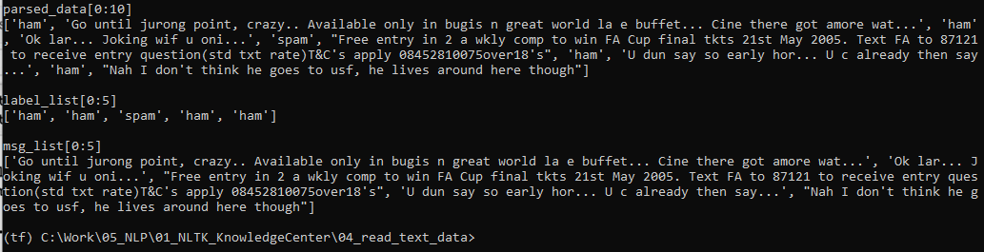
4.3 Read with Open
https://www.youtube.com/watch?v=8gd-3VFPvBQ&list=PL1w8k37X_6L-fBgXCiCsn6ugDsr1Nmfqk&index=4
Read Text Data
Separated parsed_data into label_list and message list.
Parsed_data [0],[2], … into label list.
Parsed_data [1],[3], … into message list.

Slide 13
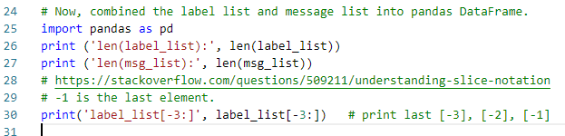

4.3 Read with Open
https://www.youtube.com/watch?v=8gd-3VFPvBQ&list=PL1w8k37X_6L-fBgXCiCsn6ugDsr1Nmfqk&index=4
Read Text Data
Now, we combined the label_list and msg_list into pandas DataFrame.
There is an error show the label and message sizes are different.
The label_list has extra empty (‘’). The [-1] should not be appended.

Slide 14
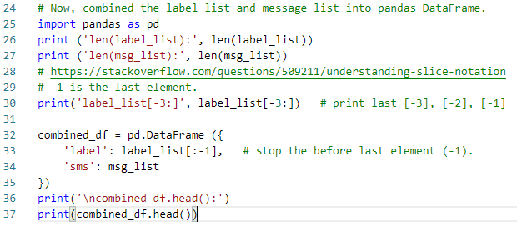
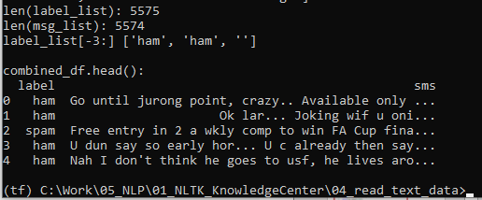
4.3 Read with Open
https://www.youtube.com/watch?v=8gd-3VFPvBQ&list=PL1w8k37X_6L-fBgXCiCsn6ugDsr1Nmfqk&index=4
Read Text Data
Now, combined label list (before the last empty (‘’) element [-1]) and message list.
Display the firs five data frame.
Now, we have cleaner version of semi-structure data.

Slide 15
4.4 Read with Pandas
Peter H. Chen

Slide 16
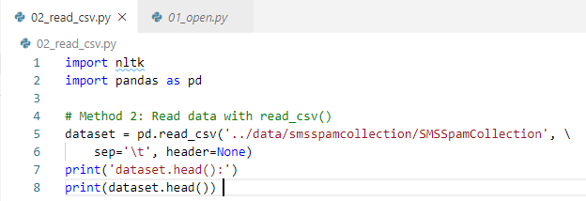
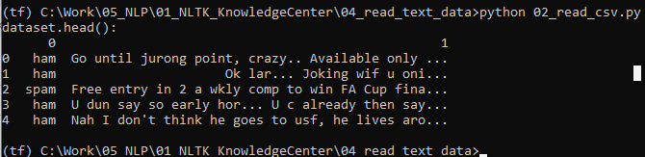
4.4 Read with Pandas
https://www.youtube.com/watch?v=8gd-3VFPvBQ&list=PL1w8k37X_6L-fBgXCiCsn6ugDsr1Nmfqk&index=4
Read Text Data
New, we use pandas to read the data.
Pandas.read_csv() require sep=‘\t’ and header=None

Slide 17
4.4 Read with Pandas
https://www.youtube.com/watch?v=8gd-3VFPvBQ&list=PL1w8k37X_6L-fBgXCiCsn6ugDsr1Nmfqk&index=4
Read Text Data
We have the same data but the header of columns are missing.
This can be very easy to fix.
Now, we have all the data we want.

Slide 18
4.5 Quiz

Slide 19
4.5 Quiz
https://www.youtube.com/watch?v=8gd-3VFPvBQ&list=PL1w8k37X_6L-fBgXCiCsn6ugDsr1Nmfqk&index=4
Quiz
1. Give example of very popular spam collection dataset.
Ans: UCI SMS (Short Message Service) Spam Collection Dataset:
https://archive.ics.uci.edu/ml/datasets/sms+spam+collection
2. What is two ways to read dataset?
Ans: open() and pandas.read_csv()
3. How to read with open()?
Ans: open(file_name).read()
4. How to parsed raw_data with tab and parsed into array parse_data?
Ans: parsed_data = raw_data.replace('\t', '\n').split('\n’)

Slide 20
4.5 Quiz
https://www.youtube.com/watch?v=8gd-3VFPvBQ&list=PL1w8k37X_6L-fBgXCiCsn6ugDsr1Nmfqk&index=4
Quiz
4. How to combined the label_list without last element and msg_list into a pd.DataFrame?
Ans:
combined_df = pd.DataFrame ({
'label': label_list[:-1], # stop the before last element (-1).
'sms': msg_list
})
5. Given array label_list, print the last three element?
Ans: label_list[-3:], start at -3 (index of last three elements of an array). No steop and increase index are specified, i.e., Stop at the last element and increase index is 1.
6. How to use pandas.read_csv() with tab separator and without header?
Ans: pandas.read_csv(file_name, sep=‘\t’, header=None)

Slide 21
End of Chapter

