Slide 1

26 Random Forest with Holdout Test
Peter H. Chen

Slide 2
26 Random Forest with Holdout Test
https://www.udemy.com/course/natural-language-processingnlp-with-python-and-nltk/learn/lecture/16695820#overview
Random Forest with Holdout Test
We discuss Random Forest Classifier with Holdout Test.
Raw Data
Tokenization
Text Cleaning
Spam Filter
ML Algorithm
Vectorization
Prediction
Transform Data

Slide 3
26 Random Forest with Holdout Test
https://www.udemy.com/course/natural-language-processingnlp-with-python-and-nltk/learn/lecture/16695820#overview
RandomForestClassifier
> rf = RandomForestClassifier (n_estimators=10,
max_depth=None,
n_jobs=None)
n_estimators: Number of trees in forest (default 10)
max_depth: maximum depth of the decision tree. By default, it is None. None means no constraint on their tree and it will go as deep as it required to minimize the loss.
n_jobs: The number of jobs to run in parallel, both for fit and predict. Default is None. None means one. At least one can run one job. In the previous discussion, we set n_jobs = -1. -1 means use all processes.
Return parameter:
rf.feature_importances_: Return the feature importance (the higher, the more importance the feature).

Slide 4
26.1 Split and Setup Model

Slide 5
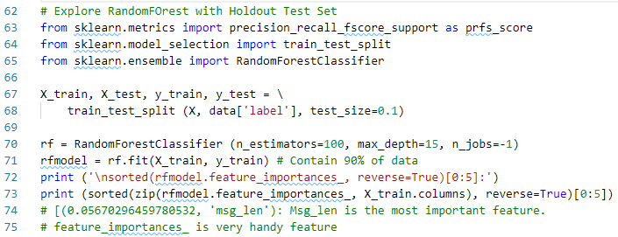
26.1 Split and Setup Model
https://www.udemy.com/course/natural-language-processingnlp-with-python-and-nltk/learn/lecture/16695820#overview
Split and Setup Model
Split the test into 90% train and 10% test.
Setup Random Forest Classifier.
Get the importance Feature: msg_len is the most important feature.

Slide 6
26.2 Make Prediction

Slide 7
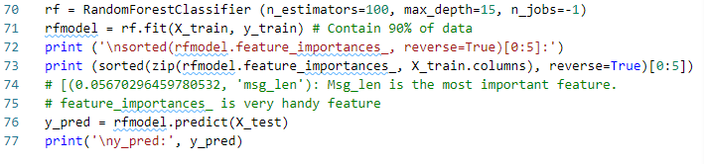
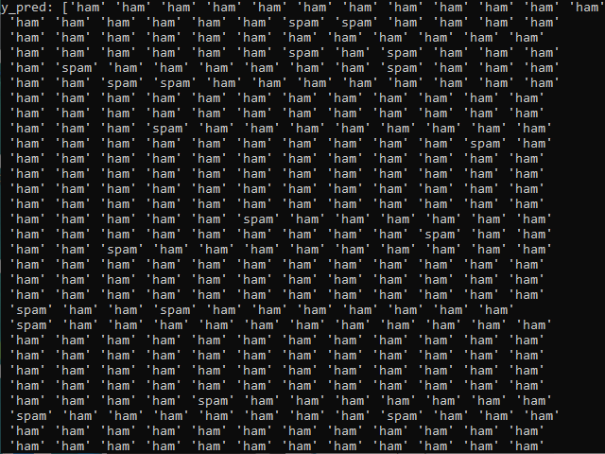
26.2 Make Prediction
https://www.udemy.com/course/natural-language-processingnlp-with-python-and-nltk/learn/lecture/16695820#overview
Make Prediction

Slide 8
26.3 Accuracy, Precision, and Recall

Slide 9



26.3 Accuracy, Precision, and Recall
https://www.udemy.com/course/natural-language-processingnlp-with-python-and-nltk/learn/lecture/16695820#overview
In the last discussion, we have the accuracy, precision, and recall:
False –ve (negative)
(2)
True –ve (negative)
(1)
$Accuracy=\frac{\#(predicted correctly)}{\#(observation)}=$ $\frac{7}{10}$
-
-
-
$Precision=\frac{\#(predicted as Spam correctly)}{\#(Predicted as Spam)}$= $\frac{6}{7}$
-
-
-
-
-
-
-
-
-
+
+
+
+
-
-
+
+
+
+
-
$Recall=\frac{\#(predicted as Spam correctly)}{\#(Actually Spam)}$= $\frac{6}{8}$
+
+
+
-
-
+
-
-
-
-
-
-
True +ve (positive)
(6)
False +ve (positive)
(1)

Slide 10
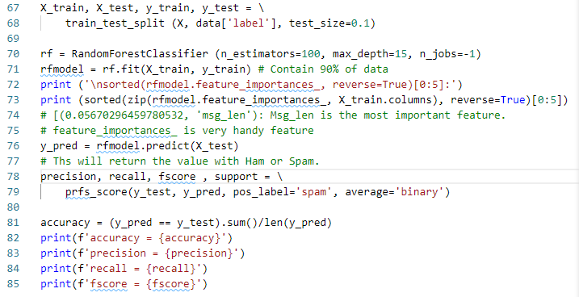

26.3 Accuracy, Precision, and Recall
https://www.udemy.com/course/natural-language-processingnlp-with-python-and-nltk/learn/lecture/16695820#overview
Accuracy, Precision, and Recall

Slide 11
26.4 Summary

Slide 12
26.4 Summary
https://www.udemy.com/course/natural-language-processingnlp-with-python-and-nltk/learn/lecture/16695820#overview
Summary
Split test and setup model
Make prediction
Accuracy, Precision, and Recall

Slide 13
26.5 Quiz

Slide 14
26.5 Quiz
https://www.udemy.com/course/natural-language-processingnlp-with-python-and-nltk/learn/lecture/16695820#overview
Quiz
1. What statement to split the train and test?
Ans: X_train, X_test, y_train, y_test = \
train_test_split (X, data['label'], test_size=0.1)
2. What statement to setup random forest classifier?
Ans: rf = RandomForestClassifier (n_estimators=100, max_depth=15, n_jobs=-1)
3. What statement build the model?
Ans: rfmodel = rf.fit(X_train, y_train)
4. Whats statement reversed sort the important feature?
Ans: sorted(zip(rfmodel.feature_importances_, X_train.columns), reverse=True)

Slide 15
26.5 Quiz
https://www.udemy.com/course/natural-language-processingnlp-with-python-and-nltk/learn/lecture/16695820#overview
Quiz
5. What statement make prediction?
Ans: y_pred = rfmodel.predict(X_test)
6. What statement to calculate accuracy, precision, recall, fscore, and support?
Ans:
precision, recall, fscore , support = \
prfs_score(y_test, y_pred, pos_label='spam', average='binary’)
accuracy = (y_pred == y_test).sum()/len(y_pred)

Slide 16
End of Chapter

