Slide 1

11 Porter Stemmer
Peter H. Chen

Slide 2
11 Porter Stemmer
https://www.youtube.com/watch?v=SOzy8NmV8Qk&list=PL1w8k37X_6L-fBgXCiCsn6ugDsr1Nmfqk&index=11
Porter Stemmer
We discuss the porter stemmer in this discussion.
Pre-Processing
Raw Data
Tokenization
Text Cleaning
Token Array
Stem Texts
Spam Filter
ML Algorithm
Vectorization

Slide 3
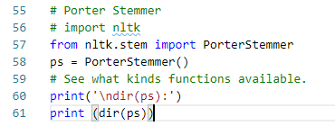
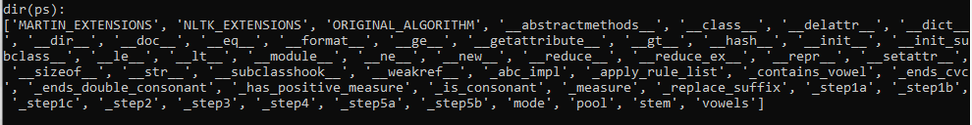
11 Porter Stemmer
https://www.youtube.com/watch?v=SOzy8NmV8Qk&list=PL1w8k37X_6L-fBgXCiCsn6ugDsr1Nmfqk&index=11
Porter Stemmer
Import the PorterStemmer
Use dir(PoerterStemmer) to see the function defined in PorterStemmer.
We mainly interested in “stem”.

Slide 4
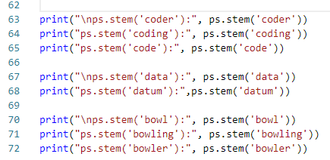
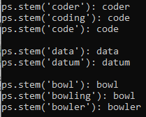
11 Porter Stemmer
https://www.youtube.com/watch?v=SOzy8NmV8Qk&list=PL1w8k37X_6L-fBgXCiCsn6ugDsr1Nmfqk&index=11
Porter Stemmer
We have
coder, coding, and code;
data and datum;
bowl, bowling, and bowler;
for the stem.

Slide 5
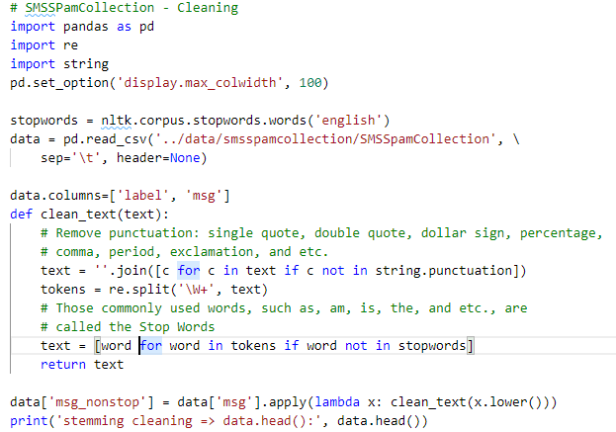
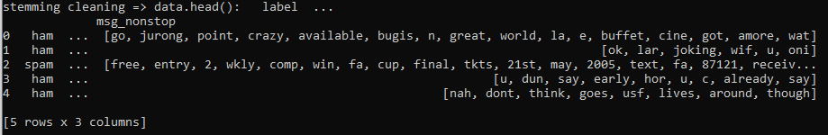
11 Porter Stemmer
https://www.youtube.com/watch?v=SOzy8NmV8Qk&list=PL1w8k37X_6L-fBgXCiCsn6ugDsr1Nmfqk&index=11
Porter Stemmer
Remove punctuation (‘, “, and etc.)
Remove stop words (am, is, and etc.)

Slide 6
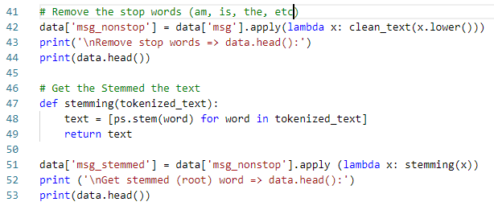
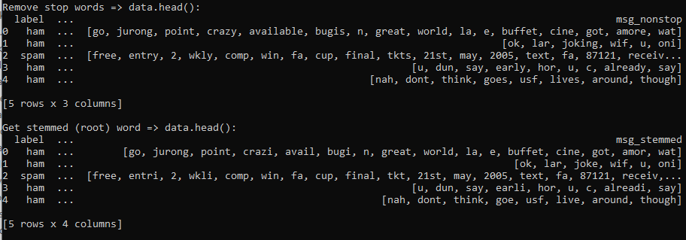
11 Porter Stemmer
https://www.youtube.com/watch?v=SOzy8NmV8Qk&list=PL1w8k37X_6L-fBgXCiCsn6ugDsr1Nmfqk&index=11
Porter Stemmer
Remove punctuation (‘, “, and etc.)
Remove stop words (am, is, and etc.)
Get stemmed words (code, data, bowl, and etc.).

Slide 7
11.1 Quiz

Slide 8
11.1 Quiz
https://www.youtube.com/watch?v=SOzy8NmV8Qk&list=PL1w8k37X_6L-fBgXCiCsn6ugDsr1Nmfqk&index=11
Quiz
1. Given a text. How to remove punctuation?
Ans: text = ''.join([c for c in text if c not in string.punctuation])
2. Given a list of tokens and a list of stopwords. How to remove the stopwords?
Ans: text = [word for in tokens if word not in stopwords]
3. How to get the stemmed word (e.g., code for code, coding, coder, and etc.)?
Ans: text = [ps.stem(word) for word in tokenized_text]

Slide 9
End of Chapter

