Slide 1

5 Explore Data
Peter H. Chen

Slide 2
5 Explore Data
https://www.youtube.com/watch?v=QWnjPv2YfhA&list=PL1w8k37X_6L-fBgXCiCsn6ugDsr1Nmfqk&index=5
Explore Dataset
In this discussion, we explore the dataset.

Slide 3
5 Explore Data
https://www.youtube.com/watch?v=QWnjPv2YfhA&list=PL1w8k37X_6L-fBgXCiCsn6ugDsr1Nmfqk&index=5
Explore Dataset: SMSSPamCollection
For example:
How many rows are there in the dataset?
How many labels: spam/ham (in what ratio)?
Missing data in any column: ignore those rows.
The Dataset contains some message and some labels.
We can explore the total size of the dataset and how many labels are spam and in what ration of spam and ham.
How many columns are missing, i.e., the text messages are not there or message is there but the label is not there. Those data are not be useful for us. SO, we will get rid of them.
Note:
Spam means “Spiced + Ham”. Spam is extended to garbage mail. In the short comedy (2min 6 seconds), “Monty Python”, Spam are mentioned 132 times, 1.05 times per second. In Internet, Spam is extended for unwanted emails. Email is categorized emails into Ham and Spam (Spiced Ham).

Slide 4
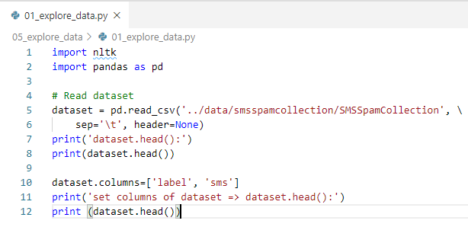
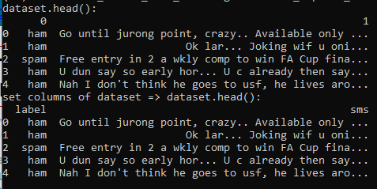
5 Explore Data
https://www.youtube.com/watch?v=QWnjPv2YfhA&list=PL1w8k37X_6L-fBgXCiCsn6ugDsr1Nmfqk&index=5
Explore Dataset: SMSSPamCollection
Set columns title of the dataset.

Slide 5
5.1 Count Row and Column

Slide 6

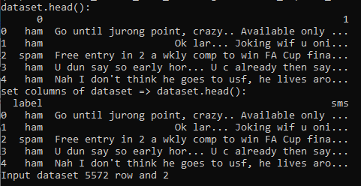
5.1 Count Row and Column
https://www.youtube.com/watch?v=QWnjPv2YfhA&list=PL1w8k37X_6L-fBgXCiCsn6ugDsr1Nmfqk&index=5
Explore Dataset: SMSSPamCollection
Now, explore the data.
Find the number of rows and number of columns.

Slide 7
5.2 Count Ham and Spam

Slide 8
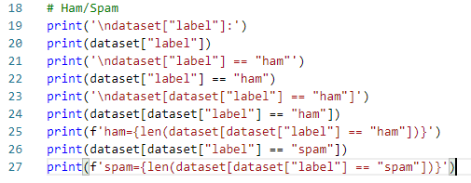
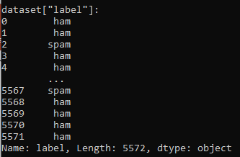
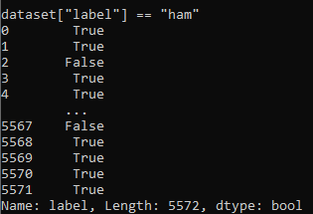
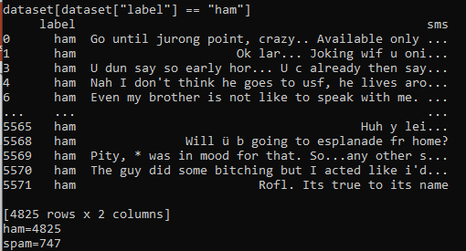
5.2 Count Ham and Spam
https://www.youtube.com/watch?v=QWnjPv2YfhA&list=PL1w8k37X_6L-fBgXCiCsn6ugDsr1Nmfqk&index=5
Explore Dataset: SMSSPamCollection
Now, explore the label. More ham than spam.

Slide 9
5.3 Count Missing Data

Slide 10


5.3 Count Missing Data
https://www.youtube.com/watch?v=QWnjPv2YfhA&list=PL1w8k37X_6L-fBgXCiCsn6ugDsr1Nmfqk&index=5
Explore Dataset: SMSSPamCollection
Count Missing Data

Slide 11
5.4 Summary

Slide 12
5.4 Summary
https://www.youtube.com/watch?v=QWnjPv2YfhA&list=PL1w8k37X_6L-fBgXCiCsn6ugDsr1Nmfqk&index=5
Summary
We explore:
1) Count row/coulmn
2) Count Ham/Spam
3) Count missing data

Slide 13
5.5 Quiz

Slide 14
5.5 Quiz
https://www.youtube.com/watch?v=QWnjPv2YfhA&list=PL1w8k37X_6L-fBgXCiCsn6ugDsr1Nmfqk&index=5
Quiz
1. How to count the row and column?
Ans: print(f'Input dataset {len(dataset)} row and {len(dataset.columns)}')
2. How to count the label with ‘ham’?
Ans: print(f'ham={len(dataset[dataset["label"] == "ham"])}’)
3. How to count the label with ‘spam’?
Ans: print(f'ham={len(dataset[dataset["label"] == “spam"])}’)
4. How to count the missing data of ‘label’?
Ans: print(f"Numbers of missing label = {dataset['label'].isnull().sum()}")
5. How to count the missing data of ‘sms’?
Ans: print(f"Numbers of missing message = {dataset[‘sms'].isnull().sum()}")

Slide 15
End of Chapter

