Slide 1

19 Feature Creation
Peter H. Chen

Slide 2
19 Feature Creation
https://www.youtube.com/watch?v=K92YoR8Vi50&list=PL1w8k37X_6L-fBgXCiCsn6ugDsr1Nmfqk&index=19
Feature Creation
Feature Creation and Feature transformation are very important for feature engineering.
We discuss the Feature Creation here.
Raw Data
Tokenization
Text Cleaning
Spam Filter
ML Algorithm
Vectorization
Transform Feature Data
Numbers

Slide 3
19 Feature Creation
https://www.youtube.com/watch?v=K92YoR8Vi50&list=PL1w8k37X_6L-fBgXCiCsn6ugDsr1Nmfqk&index=19
Feature Creation
Message Length: The feature creation can be the message length.
Punctuation usage: How frequent the punctuation us?.
Stop words usage: How frequent the stop word use?
Capitalization usage: How frequent the capitalization use?
Average word length: what it the average word length?
There can be many more…
We will write code for Message length and Punctuation usage.

Slide 4
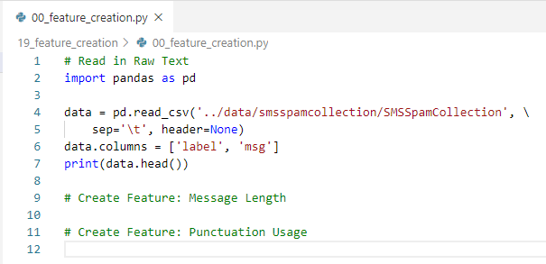
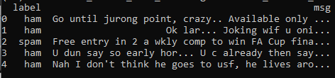
19 Feature Creation
https://www.youtube.com/watch?v=K92YoR8Vi50&list=PL1w8k37X_6L-fBgXCiCsn6ugDsr1Nmfqk&index=19
Feature Creation
First, read in Raw Text.

Slide 5
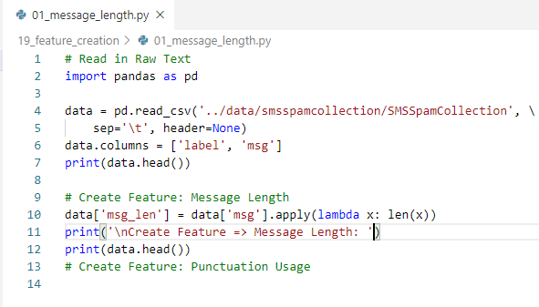
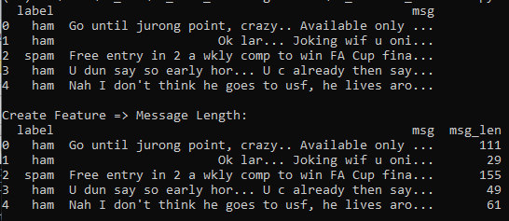
19 Feature Creation
https://www.youtube.com/watch?v=K92YoR8Vi50&list=PL1w8k37X_6L-fBgXCiCsn6ugDsr1Nmfqk&index=19
Feature Creation
Message Length.

Slide 6
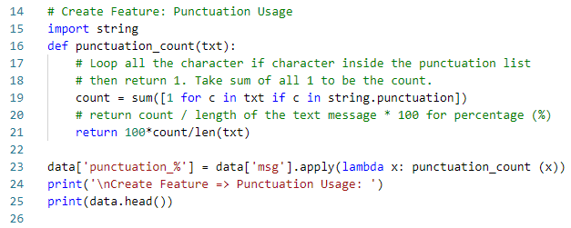
19 Feature Creation
https://www.youtube.com/watch?v=K92YoR8Vi50&list=PL1w8k37X_6L-fBgXCiCsn6ugDsr1Nmfqk&index=19
Feature Creation
Punctuation Usage

Slide 7
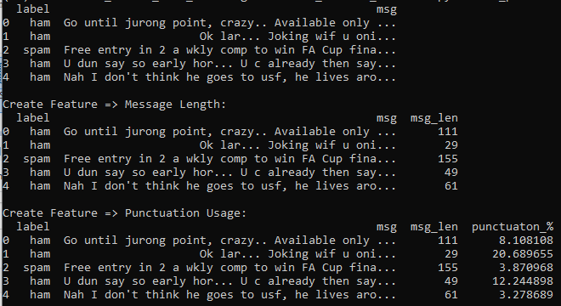
19 Feature Creation
https://www.youtube.com/watch?v=K92YoR8Vi50&list=PL1w8k37X_6L-fBgXCiCsn6ugDsr1Nmfqk&index=19
Feature Creation
Punctuation Usage

Slide 8
19.1 Quiz

Slide 9
19.1 Quiz
https://www.youtube.com/watch?v=K92YoR8Vi50&list=PL1w8k37X_6L-fBgXCiCsn6ugDsr1Nmfqk&index=19
Quiz
1. Explain Feature Creation examples?
Ans:
Message Length: The feature creation can be the message length.
Punctuation usage: How frequent the punctuation us?.
Stop words usage: How frequent the stop word use?
Capitalization usage: How frequent the capitalization use?
Average word length: what it the average word length?
2. How to create message length for the feature msg_len?
Ans: data['msg_len'] = data['msg'].apply(lambda x: len(x))

Slide 10
19.1 Quiz
https://www.youtube.com/watch?v=K92YoR8Vi50&list=PL1w8k37X_6L-fBgXCiCsn6ugDsr1Nmfqk&index=19
Quiz
3. How to create feature punctuation_%?
Ans:
def punctuation_count(txt):
# loop all the character if character is inside the punctuation list
# then return 1. Take sum of all 1 to be the count.
count = sum([1 for c in txt if c in string.punctuation])
# return count / length of the text message * 100 for percentage (%)
return 100*count/len(txt)
data['punctuation_%'] = data['msg'].apply(lambda x: punctuation_count (x))

Slide 11
End of Chapter

