Slide 1

20 Feature Evaluation
Peter H. Chen

Slide 2
20 Feature Evaluation
https://www.youtube.com/watch?v=ZV9DhRktatk&list=PL1w8k37X_6L-fBgXCiCsn6ugDsr1Nmfqk&index=20
Feature Evaluation
We created features for the message length and punctuation percentage on the document.
In this discussion, we compare how good of these features.
Raw Data
Tokenization
Text Cleaning
Spam Filter
ML Algorithm
Vectorization
Transform Feature Data
Numbers

Slide 3
20.1 Evaluate Message Length Feature

Slide 4
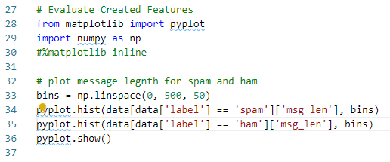
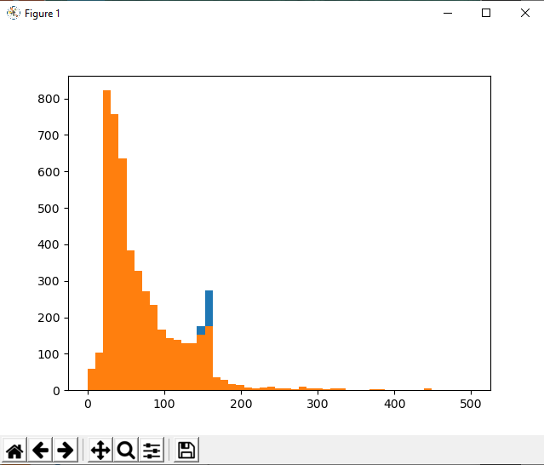
20.1 Evaluate Message Length Feature
https://www.youtube.com/watch?v=ZV9DhRktatk&list=PL1w8k37X_6L-fBgXCiCsn6ugDsr1Nmfqk&index=20
Feature Evaluation
Put the bin size from 0 to 500 with number of interval 50.
We plot histogram of ham and ham for column msg_len, respectively.
We cannot differentiate them. We need to put labels there.

Slide 5
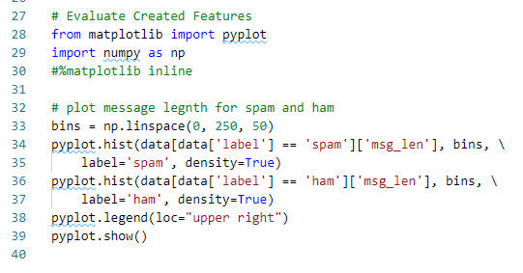
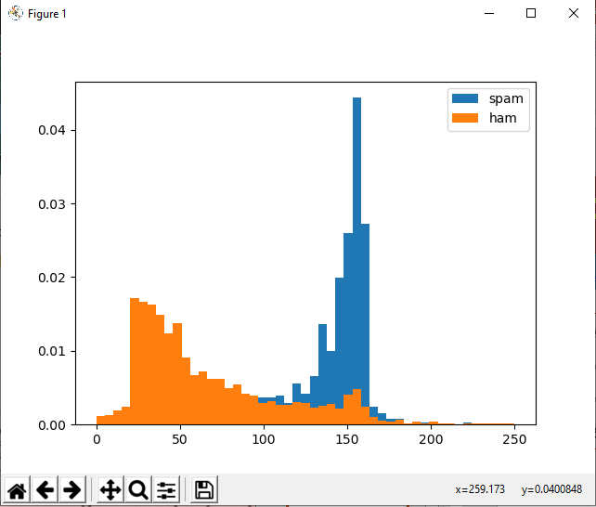
20.1 Evaluate Message Length Feature
https://www.youtube.com/watch?v=ZV9DhRktatk&list=PL1w8k37X_6L-fBgXCiCsn6ugDsr1Nmfqk&index=20
Feature Evaluation
We add labels and legends so that we have differentiate them.
We plot by the density (for normalization) instead of number.
Reduce the maximum message length to from 500 to 250.
From histogram, we know the message length of spam is larger.

Slide 6
20.2 Evaluate Punctuation_% Feature

Slide 7
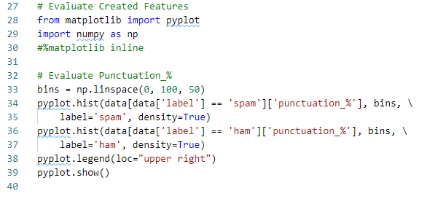
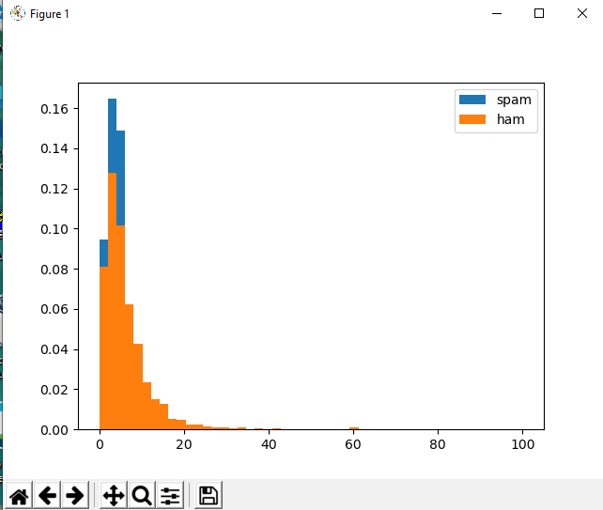
20.2 Evaluate Punctuation_% Feature
https://www.youtube.com/watch?v=ZV9DhRktatk&list=PL1w8k37X_6L-fBgXCiCsn6ugDsr1Nmfqk&index=20
Feature Evaluation
Put the bin size from 0 to 100 with number of number of spaces 50.
We plot histogram of ham and ham for column punctuation_%, respectively.

Slide 8
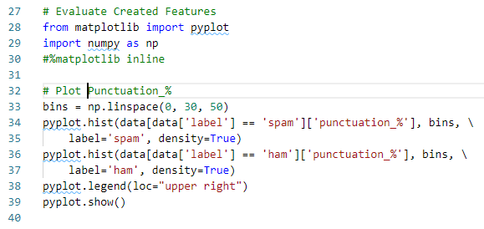
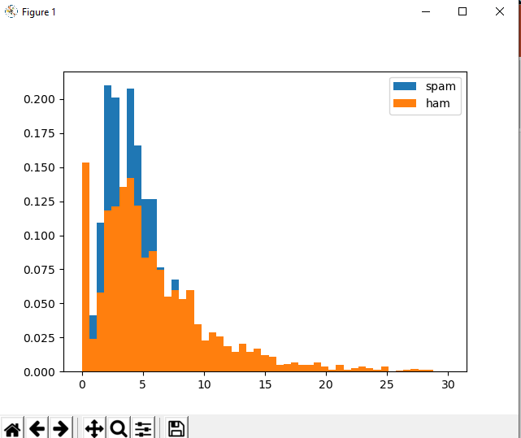
20.2 Evaluate Punctuation_% Feature
https://www.youtube.com/watch?v=ZV9DhRktatk&list=PL1w8k37X_6L-fBgXCiCsn6ugDsr1Nmfqk&index=20
Feature Evaluation
Punctuation number, mostly, below 30. Set maximum punctuation to 30.
We cannot see too much difference in punctuation between spam and ham.
The ham extend to 8 to 30. This may not sufficient to tell the difference between Ham and Spam.

Slide 9
20.3 Quiz

Slide 10
20.1 Quiz
https://www.youtube.com/watch?v=ZV9DhRktatk&list=PL1w8k37X_6L-fBgXCiCsn6ugDsr1Nmfqk&index=20
Quiz
1. From the plot result? Spam or Ham has the longer message length?
Ans: Spam, Spam’s message lengths are around 100 to 200 long. Ham’s message lengths are around 0 to 180.
2. Form the plot result? Spam and Ham has the longer punctuation_%?
Ans: We cannot tell the difference and cannot use by punctuation count. Ham has wider spread from 0 5o 25. Spam has 0 to 10.

Slide 11
End of Chapter

