Slide 1

21 Power Transformation
Peter H. Chen

Slide 2
21 Power Transformation
https://www.youtube.com/watch?v=PKEPmVn7sDM&list=PL1w8k37X_6L-fBgXCiCsn6ugDsr1Nmfqk&index=21
Power Transformation
We discuss how to transform the data.
Raw Data
Tokenization
Text Cleaning
Spam Filter
ML Algorithm
Vectorization
Transform Feature Data
Numbers

Slide 3
21 Power Transformation
https://www.youtube.com/watch?v=PKEPmVn7sDM&list=PL1w8k37X_6L-fBgXCiCsn6ugDsr1Nmfqk&index=21
Power Transformation
Changing each data point in a certain column to make distribution look closer to a normal distribution.
As below diagram, the data may be skewed higher in the lower side and lower in the long right. Or it may be possible with long lower side.
We may transform into more normal distribution.
Standardizing Data:
Transform
Transform
0
10
20
0.1
1
10
0
10
20

Slide 4
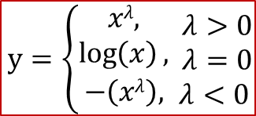


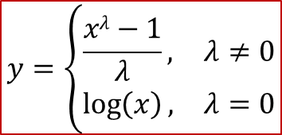
21 Power Transformation
https://www.youtube.com/watch?v=PKEPmVn7sDM&list=PL1w8k37X_6L-fBgXCiCsn6ugDsr1Nmfqk&index=21
Power Transformation
Wen will apply some power transformation for that.
Tukey Transformation
$y=\left\{\begin{matrix}xλ, \\ \log\left(x\right), \\ −\left(xλ\right),\end{matrix}\begin{matrix} λ>0 \\ λ=0 \\ λ<0\end{matrix}\right.$
Similarly, we have Box-Cox Transformation
$$y=\left\{\begin{matrix}\frac{xλ−1}{λ}, & λ≠0 \\ \log\left(x\right), & λ=0\end{matrix}\right.$$
Note:
$$\frac{xλ−1}{λ}=e^{\log\left(xλ\right)}$$
Because
$$e^{\log{eK}}=K$$

Slide 5





21 Power Transformation
https://www.youtube.com/watch?v=PKEPmVn7sDM&list=PL1w8k37X_6L-fBgXCiCsn6ugDsr1Nmfqk&index=21
Power Transformation
Note:
$$xλ =e^{\log\left(xλ\right)}$$
Because
$$e^{\log{eK}}=K$$
Take log_{e} on both side, we have:
$$\log{eK}=\log{e1}$$
Therefore,
$$\frac{xλ−1}{λ}=\frac{e^{\log\left(xλ\right)}−1}{λ}$$
Given,
$$e^{x} =1+x+ e^{x}=1+\frac{x}{1!}+\frac{x^{2}}{2!}+\frac{x^{3}}{3!}+…$$

Slide 6





21 Power Transformation
https://www.youtube.com/watch?v=PKEPmVn7sDM&list=PL1w8k37X_6L-fBgXCiCsn6ugDsr1Nmfqk&index=21
Power Transformation
Given,
$$e^{x} =1+x+ e^{x}=1+\frac{x}{1!}+\frac{x^{2}}{2!}+\frac{x^{3}}{3!}+…$$
Therefore,
$$\frac{xλ−1}{λ}=\frac{1+\log\left(xλ\right)−1}{λ}$$
$$⇒\frac{xλ−1}{λ}=\frac{\log\left(xλ\right)}{λ}$$
$$⇒\frac{xλ−1}{λ}=λ\frac{\log{x}}{λ}$$
$$⇒\frac{xλ−1}{λ}=\log{x}$$

Slide 7
21 Power Transformation
https://www.youtube.com/watch?v=PKEPmVn7sDM&list=PL1w8k37X_6L-fBgXCiCsn6ugDsr1Nmfqk&index=21
Transformation Process
Determine range of exponents to test: for example, (-5, 5)
Apply transformations to each value of the chosen feature: It will look more uniform like normal distribution.
Determine which transformation yields best distribution, e.g., plot histogram and pick which looks closer to a normal distribution

Slide 8
21.1 Plot Message Length Histogram

Slide 9
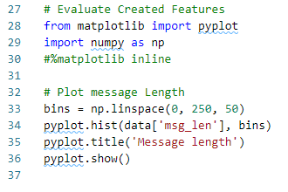
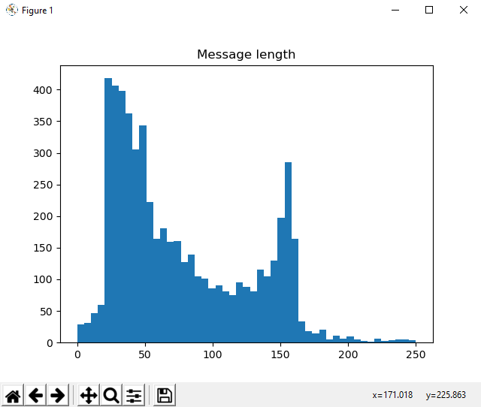
21.1 Plot Message Length Histogram
https://www.youtube.com/watch?v=PKEPmVn7sDM&list=PL1w8k37X_6L-fBgXCiCsn6ugDsr1Nmfqk&index=21
Plot Message Length
Let’s continue the histogram from previous discussion.
Plot message length

Slide 10
21.2 Plot Punctuation % Histogram

Slide 11
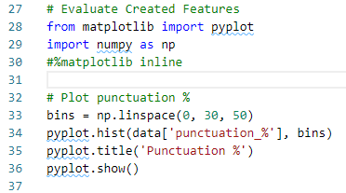
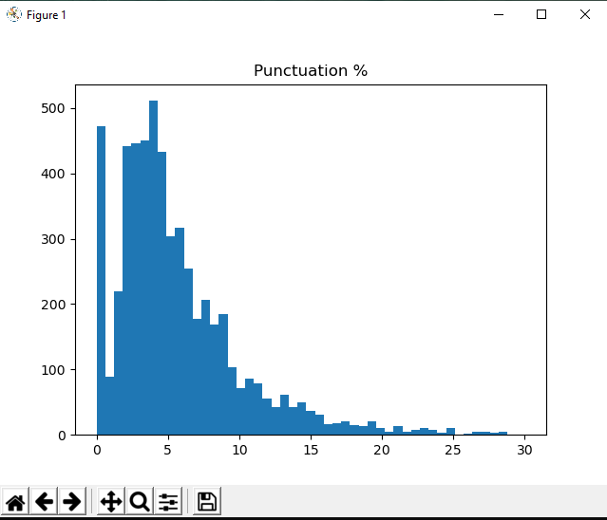
21.2 Plot Punctuation % Histogram
https://www.youtube.com/watch?v=PKEPmVn7sDM&list=PL1w8k37X_6L-fBgXCiCsn6ugDsr1Nmfqk&index=21
Plot Punctuation Percentage Histogram
Plot Punctuation percentage.
Here we can see the data is skewed and we see the long right tail.
So, we will apply some transformation here. We can see the punctuation 5 is around 500.

Slide 12
21.3 Power Transformation

Slide 13
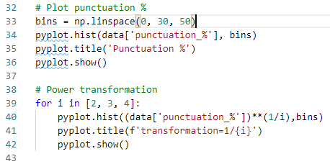
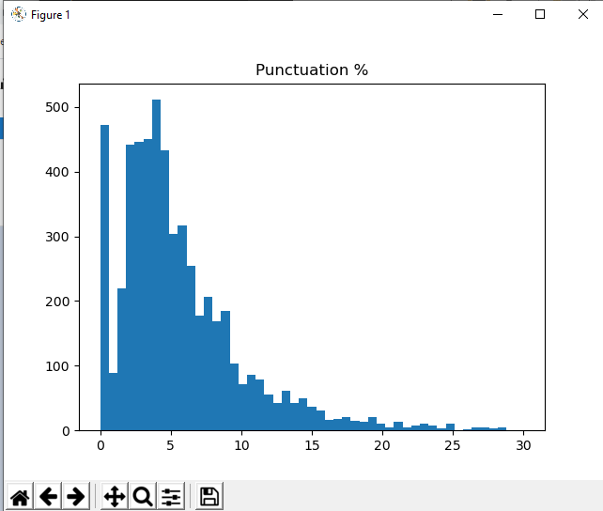
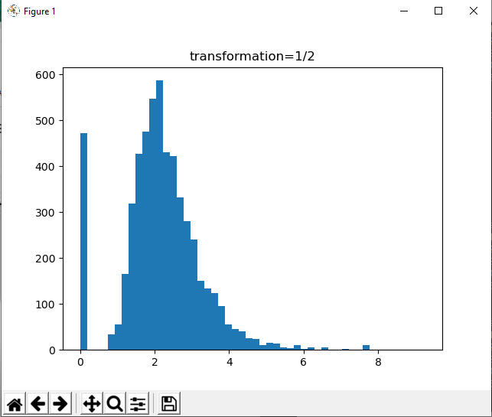
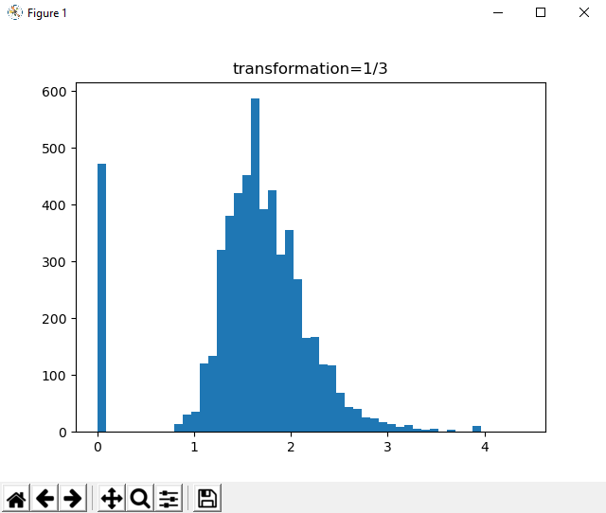
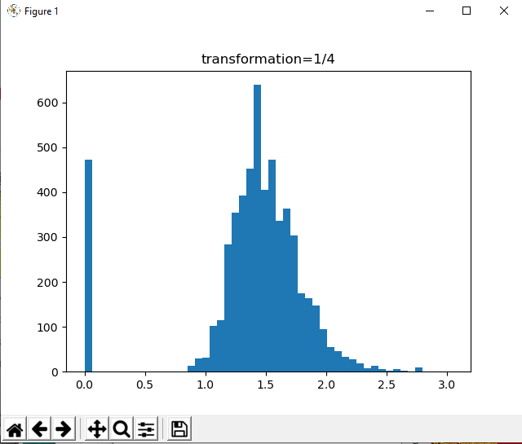
21.3 Power Transformation
https://www.youtube.com/watch?v=PKEPmVn7sDM&list=PL1w8k37X_6L-fBgXCiCsn6ugDsr1Nmfqk&index=21
Power Transformation
Square root of the data. Make the data range smaller.
Original histogram
Square root of punctuation in x-axis
Power 1/3 of punctuation in x-axis
Power ¼ of punctuation in x-axis

Slide 14
21.4 Summary

Slide 15
21.4 Summary
https://www.youtube.com/watch?v=PKEPmVn7sDM&list=PL1w8k37X_6L-fBgXCiCsn6ugDsr1Nmfqk&index=21
Summary
Power Transformation Change skewed data in the selected column to a normal-look distribution.

Slide 16
21.5 Quiz

Slide 17
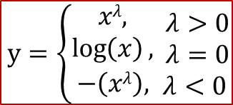
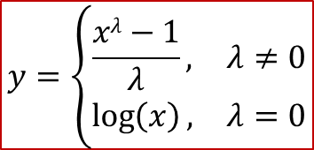
21.5 Quiz
https://www.youtube.com/watch?v=PKEPmVn7sDM&list=PL1w8k37X_6L-fBgXCiCsn6ugDsr1Nmfqk&index=21
Quiz
1. What is power transformation?
Ans: transform the skewed data distribution in the selected column into a normal data distribution.
2. What is Tukey Transformation?
Ans:
$y=\left\{\begin{matrix}xλ, \\ \log\left(x\right), \\ −\left(xλ\right),\end{matrix}\begin{matrix} λ>0 \\ λ=0 \\ λ<0\end{matrix}\right.$
3. What is Box-Cox Transformation?
$$y=\left\{\begin{matrix}\frac{xλ−1}{λ}, & λ≠0 \\ \log\left(x\right), & λ=0\end{matrix}\right.$$

Slide 18
21.5 Quiz
https://www.youtube.com/watch?v=PKEPmVn7sDM&list=PL1w8k37X_6L-fBgXCiCsn6ugDsr1Nmfqk&index=21
Quiz
3. What is the following code doing?
for i in [2, 3, 4]:
pyplot.hist((data['punctuation_%'])**(1/i), bins=50)
Ans: Take square root (1/2), 1/3, 1/4 for number of punctuation. Make the distribution narrow.

Slide 19
21.5 Quiz
https://www.youtube.com/watch?v=PKEPmVn7sDM&list=PL1w8k37X_6L-fBgXCiCsn6ugDsr1Nmfqk&index=21
Quiz
The result plot as follow.
Original histogram
Square root of punctuation in x-axis
Power 1/3 of punctuation in x-axis
Power ¼ of punctuation in x-axis

Slide 20
End of Chapter

