Slide 1

18 Feature Engineering
Peter H. Chen

Slide 2
18 Feature Engineering
https://www.youtube.com/watch?v=digKA-YqAgw&list=PL1w8k37X_6L-fBgXCiCsn6ugDsr1Nmfqk&index=18
Feature Engineering
We have the Tried Feature Data and ready to train out ML (Machine Learning) Algorithm.
Raw Data
Tokenization
Text Cleaning
Spam Filter
ML Algorithm
Vectorization
Numbers

Slide 3
18 Feature Engineering
https://www.youtube.com/watch?v=digKA-YqAgw&list=PL1w8k37X_6L-fBgXCiCsn6ugDsr1Nmfqk&index=18
Feature Engineering
We have the Tried Feature Data and ready to train out ML (Machine Learning) Algorithm. Why Feature Engineering is so important?
We have just created one of the features that the data directly have given us all the unique words and created the document matrix. We have three techniques, i.e., count vectorization, n-grams, and TF-IDF to create document matrix.
Feature Engineering creative New Features of transforming existing features using Domain Knowledge of the data, that makes machine learning algorithm work better.
We make new features out of that.
We emphases on Create New Features and Transform Existing Features.

Slide 4
18 Feature Engineering
https://www.youtube.com/watch?v=digKA-YqAgw&list=PL1w8k37X_6L-fBgXCiCsn6ugDsr1Nmfqk&index=18
Creating Features
There are some important knowledge factors in classifying a text message as a Spam or Ham.
Length of documents: The longer text messages are more likely to be Spam than shorter text messages. It can be one of the feature based on our knowledge.
Average word size within a Document: What is the average size of words in each document? There is some word size relations in document between Spam and Ham.
Use of Punctuation in the Text: The Spam messages use to much of punctuation. We look at what percentage punctuation of text messages is useful to classify Spam or Ham.
Capitalization of words in a document: How frequently the words within the document are capitalized. Are they properly capitalized or not.
There can be many more features that all depends on how well you understand the data.

Slide 5
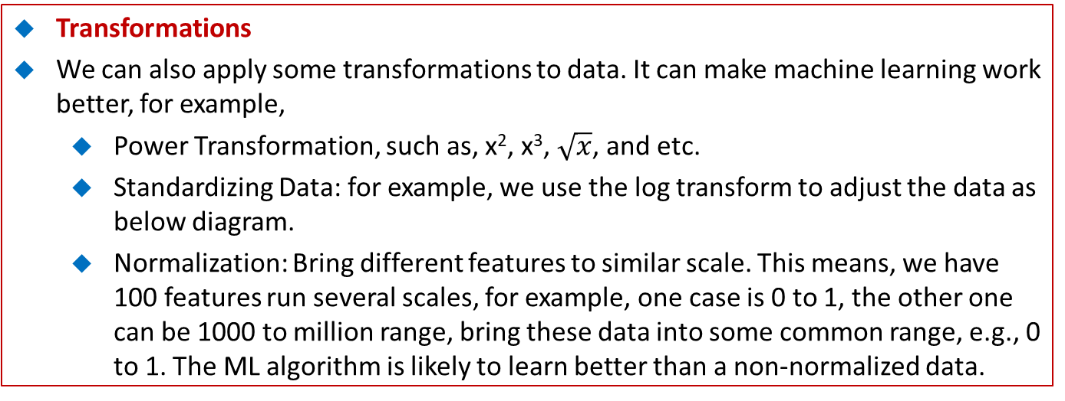
18 Feature Engineering
https://www.youtube.com/watch?v=digKA-YqAgw&list=PL1w8k37X_6L-fBgXCiCsn6ugDsr1Nmfqk&index=18
Transformations
We can also apply some transformations to data. It can make machine learning work better, for example,
Power Transformation, such as, x², x³, $\sqrt{x}$, and etc.
Standardizing Data: for example, we use the log transform to adjust the data as below diagram.
Normalization: Bring different features to similar scale. This means, we have 100 features run several scales, for example, one case is 0 to 1, the other one can be 1000 to million range, bring these data into some common range, e.g., 0 to 1. The ML algorithm is likely to learn better than a non-normalized data.
Standardizing Data:
Log Transform
0
10
20
0.1
1
10

Slide 6
18 Feature Engineering
https://www.youtube.com/watch?v=digKA-YqAgw&list=PL1w8k37X_6L-fBgXCiCsn6ugDsr1Nmfqk&index=18
Feature Engineering
Feature Engineering is a big field. We will see how to create features in code.

Slide 7
18.1 Quiz

Slide 8
18.1 Quiz
https://www.youtube.com/watch?v=digKA-YqAgw&list=PL1w8k37X_6L-fBgXCiCsn6ugDsr1Nmfqk&index=18
Quiz
1. What is Feature Engineering?
Ans: Feature Engineering creative New Features of transforming existing features using Domain Knowledge of the data, that makes machine learning algorithm work better.
2. What is knowledge factors of Spam/Ham classification for Creating New Features?
Ans:
Spam uses large of documents.
Spam uses large word size.
Spam uses a lot of Punctuation.
Spam frequently use capitalization of the words.

Slide 9
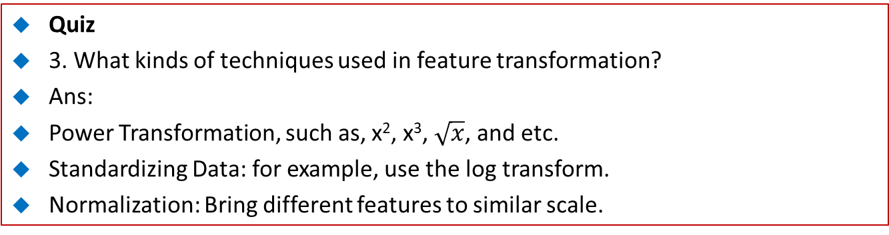
18.1 Quiz
https://www.youtube.com/watch?v=digKA-YqAgw&list=PL1w8k37X_6L-fBgXCiCsn6ugDsr1Nmfqk&index=18
Quiz
3. What kinds of techniques used in feature transformation?
Ans:
Power Transformation, such as, x², x³, $\sqrt{x}$, and etc.
Standardizing Data: for example, use the log transform.
Normalization: Bring different features to similar scale.

Slide 10
End of Chapter

