Slide 1

14 Vectorization
Peter H. Chen

Slide 2
14 Vectorization
https://www.youtube.com/watch?v=xbPXUpRVy_k&list=PL1w8k37X_6L-fBgXCiCsn6ugDsr1Nmfqk&index=14
Vectorization
We are done with the raw text data and clean punctuation, then tokenization into array, and text cleaning with stemming and feminization, we have clean list of words.
But Python only understand the numbers instead of the characters. The vectorization is the process to convert the words into numbers.
Raw Data
Tokenization
Text Cleaning
Stem Texts
Spam Filter
ML Algorithm
Vectorization
Numbers

Slide 3
14 Vectorization
https://www.youtube.com/watch?v=xbPXUpRVy_k&list=PL1w8k37X_6L-fBgXCiCsn6ugDsr1Nmfqk&index=14
Vectorization
Vectorization is the process of taking the clean words and convert into the numbers, the numerical representation of feature vectors.
We will see how can we represent the each of these words converting into the feature vectors.
Raw Data
Tokenization
Text Cleaning
[‘w1’, ‘w2’, …]
Spam Filter
ML Algorithm
Vectorization
[…]: Feature vectors

Slide 4
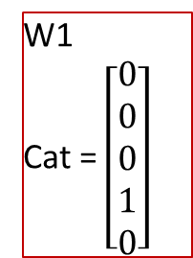
14 Vectorization
https://www.youtube.com/watch?v=xbPXUpRVy_k&list=PL1w8k37X_6L-fBgXCiCsn6ugDsr1Nmfqk&index=14
Vectorization
Vectorization is the Process of encoding text as integers to create Feature Vectors.
Feature Vector: Vector of numerical features that represent an object.
For example: we have a word list [w1, w2, …]. The word w1 = ‘cat’:
If the dictionary has 5 words and the position of cat is fourth, then we can keep fourth as 1 and rest as 0.
The ‘cat’ is a feature vector.
W1
Cat = $\left[\begin{aligned}0 \\ 0 \\ 0 \\ 1 \\ 0\end{aligned}\right]$

Slide 5
14 Vectorization
https://www.youtube.com/watch?v=xbPXUpRVy_k&list=PL1w8k37X_6L-fBgXCiCsn6ugDsr1Nmfqk&index=14
Count Vectorization
Let’s see the dictionary with 100 words.
We have messages (in file SMSSpamCollection).
Each row is a message contains 100 unique words that associate with a label (Spam or Ham).
For the first message: How many times that occurs for w1 is 0, w2 is 2, w3 is 0, and etc. Let say ham is 0, and Spam is 1. If we have ham in this case, we have 0 (Ham) for message 1.
For the second message, we have second message with w1 is 0, w2 is 3, w3 is 1, …, and w100 is 1. We have label 0 (Ham).
For the third message, we have w1 is 4, w2 is 0, w3 is 3, …, and w100 is 0, the label is 1 (Spam).
w1 | w2 | w3 | … | w100 | Label
0 | 2 | 0 | … | 1 | 0
0 | 3 | 1 | … | 1 | 0
4 | 0 | 3 | … | 0 | 1

Slide 6
14 Vectorization
https://www.youtube.com/watch?v=xbPXUpRVy_k&list=PL1w8k37X_6L-fBgXCiCsn6ugDsr1Nmfqk&index=14
Count Vectorization
This technique is called Count Vectorization.
A Count vectorization uses a matrix to represent count of word list and label.
The cell values are actually representing the count of that word in the particular message.
The matrix with cell values (count of word list) and label is called Document Matrix or Document Term Matrix.
What is vectorization? We can represent all the messages into a document matrix.
The matrix is a list of word with count with label.
w1 | w2 | w3 | … | w100 | Label
0 | 2 | 0 | … | 1 | 0
0 | 3 | 1 | … | 1 | 0
4 | 0 | 3 | … | 0 | 1

Slide 7
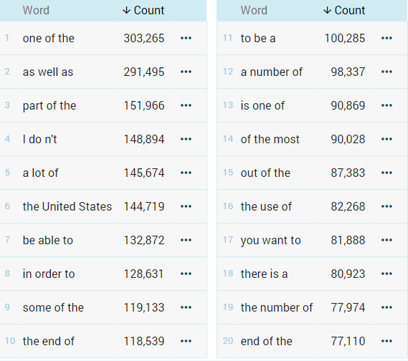
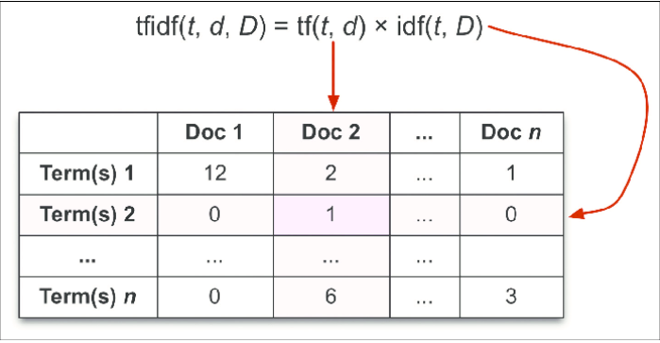
14 Vectorization
w1 | w2 | w3 | … | w100 | Label
0 | 2 | 0 | … | 1 | 0
0 | 3 | 1 | … | 1 | 0
4 | 0 | 3 | … | 0 | 1
https://www.youtube.com/watch?v=xbPXUpRVy_k&list=PL1w8k37X_6L-fBgXCiCsn6ugDsr1Nmfqk&index=14
Types of Vectorization
Count Vectorization: Each word has counts in each message (each row in the document matrix).
N-grams: n-gram is a contiguous sequence of n items from a given sample of text or speech.
TF-IDF (Term Frequency-Inverse Document Frequency): a numerical statistics that is indented to reflect how important a word to a document in a collection (corpus). It counts the frequency in the other documents.
Note: Each message is a document.

Slide 8
14.1 Quiz

Slide 9
14.1 Quiz
https://www.youtube.com/watch?v=xbPXUpRVy_k&list=PL1w8k37X_6L-fBgXCiCsn6ugDsr1Nmfqk&index=14
Quiz
1. What is vectorization?
Ans: Vectorization is the Process of encoding text as integers to create Feature Vectors
2. What is feature vector?
Ans: Vector of numerical features that represent an object.
3. What is count vectorization?
Ans: A count vectorization uses a matrix to represent count of word list and label.
4. What is Document Matrix?
Ans: The matrix with cell values (count of word list) and label is called Document Matrix or Document Term Matrix.

Slide 10
14.1 Quiz
https://www.youtube.com/watch?v=xbPXUpRVy_k&list=PL1w8k37X_6L-fBgXCiCsn6ugDsr1Nmfqk&index=14
Quiz
5. What is n-grams?
Ans: n-gram is a contiguous sequence of n items from a given sample of text or speech.
6.What is TF-IDF?
Ans: TF-IDF (Term Frequency-Inverse Document Frequency): a numerical statistics that is indented to reflect how important a word to a document in a collection (corpus). It counts the frequency in the other documents.

Slide 11
End of Chapter

