Slide 1

25 Random Forest Classifier
Peter H. Chen

Slide 2
25 Random Forest Classifier
https://www.udemy.com/course/natural-language-processingnlp-with-python-and-nltk/learn/lecture/16695134#overview
Random Forest Classifier
We discuss Random Forest Classifier
Raw Data
Tokenization
Text Cleaning
Spam Filter
ML Algorithm
Vectorization
Prediction
Transform Data

Slide 3
25.1 Read Text

Slide 4
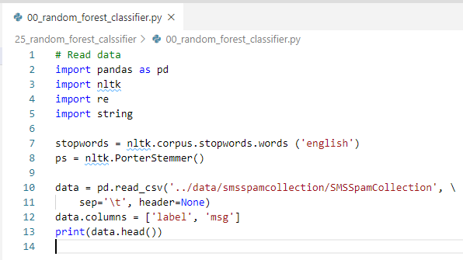
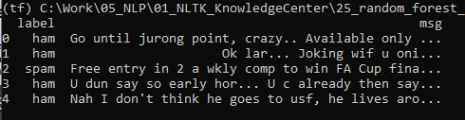
25.1 Read Text
https://www.udemy.com/course/natural-language-processingnlp-with-python-and-nltk/learn/lecture/16695134#overview
Build Random Forest Classifier Model
Read Text

Slide 5
25.2 Columns msg_len and punctuation_%

Slide 6
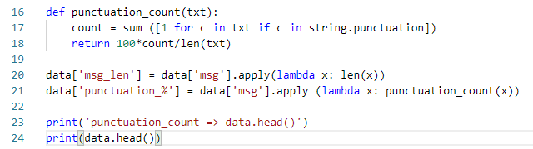
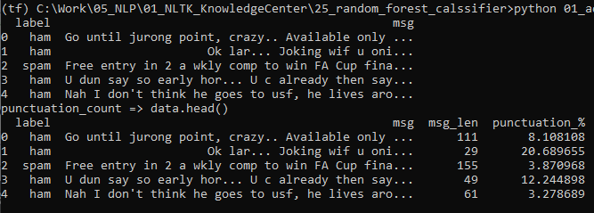
25.2 Columns msg_len and punctuation_%
https://www.udemy.com/course/natural-language-processingnlp-with-python-and-nltk/learn/lecture/16695134#overview
Add Columns msg_len and punctuation_%
Add Features: msg_len and punctuation_%

Slide 7
25.3 Clean and Vectorized Msg

Slide 8
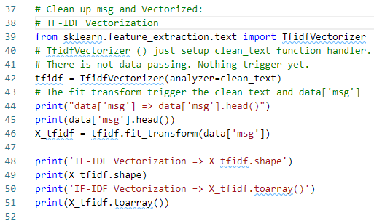
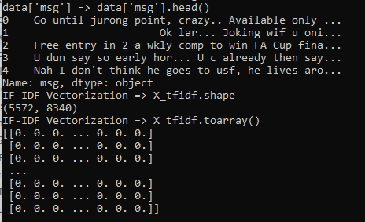
25.3 Clean and Vectorized Msg
https://www.udemy.com/course/natural-language-processingnlp-with-python-and-nltk/learn/lecture/16695134#overview
Clean up msg and vectorized msg
Clean up the msg and then vectorized the msg.

Slide 9
25.4 Combine len, pun, and msg

Slide 10
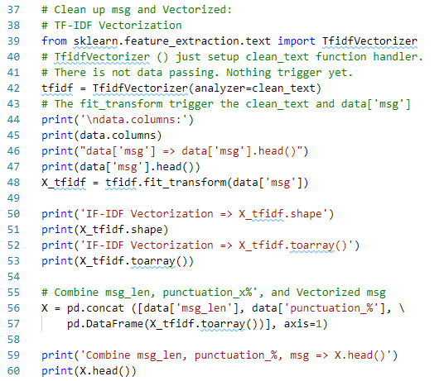
25.4 Combine len, pun, and msg
https://www.udemy.com/course/natural-language-processingnlp-with-python-and-nltk/learn/lecture/16695134#overview
Combine msg_len, punctuation_%, and msg
Vectorized X
y
 |  |  | msg
doc # | msg_len | punc_% | 0 | 1 | … | label
0 | 111 | 8.1 | 0 | 1 | … | H
1 | 29 | 20.6 | 1 | 1 | .. | S
2 | 115 | 3.8 | 1 | 0 | … | H
… | … | … | … | … | … | …

Slide 11
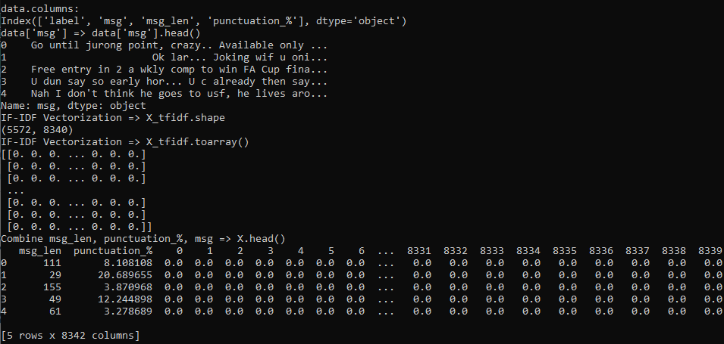
25.4 Combine len, pun, and msg
https://www.udemy.com/course/natural-language-processingnlp-with-python-and-nltk/learn/lecture/16695134#overview
Combine msg_len, punctuation_%, and msg
Vectorization: generate Title columns and frequencies

Slide 12
25.4 Combine len, pun, and msg
https://www.udemy.com/course/natural-language-processingnlp-with-python-and-nltk/learn/lecture/16695134#overview
Msg: document index and columns ID.
Data from 0 to 8339
Document index from 0 to 5571

Slide 13
25.5 Classifier and Cross-Validation

Slide 14
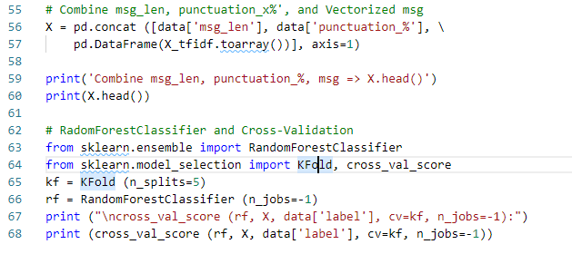
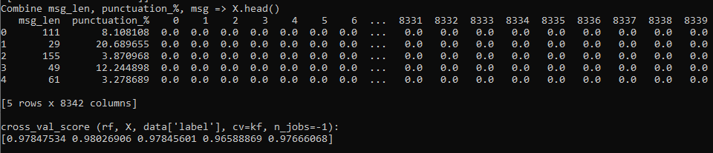
25.5 Classifier and Cross-Validation
https://www.udemy.com/course/natural-language-processingnlp-with-python-and-nltk/learn/lecture/16695134#overview
Random Forest Classifier and Cross-Validation
Vectorized X

Slide 15
25.5 Classifier and Cross-Validation
https://www.udemy.com/course/natural-language-processingnlp-with-python-and-nltk/learn/lecture/16695134#overview
Random Forest Classifier and Cross-Validation
Label: y

Slide 16
25.5 Classifier and Cross-Validation
https://www.udemy.com/course/natural-language-processingnlp-with-python-and-nltk/learn/lecture/16695134#overview
Random Forest Classifier and Cross-Validation
KFold = 5
Repeat 5 times Cross-validation

Slide 17
25.6 Create More Labels

Slide 18
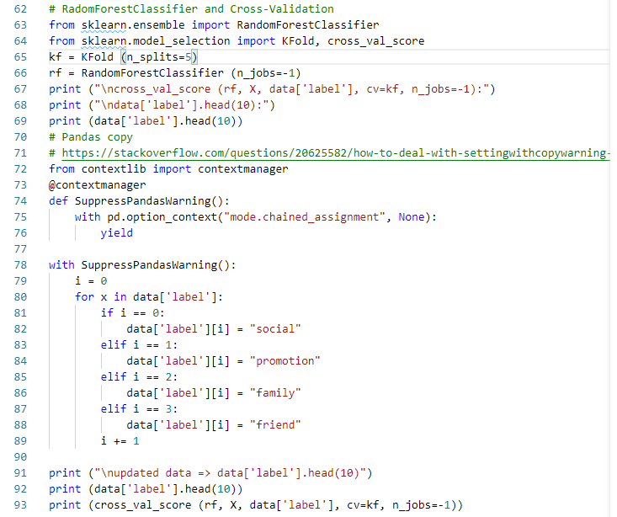
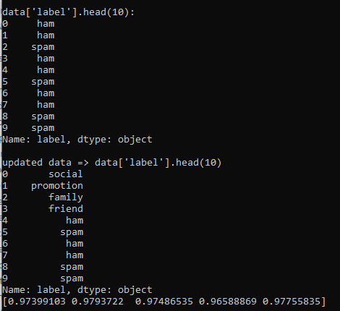
25.6 Create More Labels
https://www.udemy.com/course/natural-language-processingnlp-with-python-and-nltk/learn/lecture/16695134#overview
Create More Labels for Classification

Slide 19
25.7 Quiz

Slide 20
25.7 Quiz
https://www.udemy.com/course/natural-language-processingnlp-with-python-and-nltk/learn/lecture/16695134#overview
Quiz
1. What statements for read text and put label?
Ans:
data = pd.read_csv('../data/smsspamcollection/SMSSpamCollection’, \
sep='\t', header=None)
data.columns = ['label', 'msg’]
2. What statements for add features of message length and punctuation %?
Ans:
def punctuation_count(txt):
count = sum ([1 for c in txt if c in string.punctuation])
return 100*count/len(txt)
data['msg_len'] = data['msg'].apply(lambda x: len(x))
data['punctuation_%'] = data['msg'].apply (lambda x: punctuation_count(x))

Slide 21
25.7 Quiz
https://www.udemy.com/course/natural-language-processingnlp-with-python-and-nltk/learn/lecture/16695134#overview
Quiz
3. What statements for Clean up message and perform vectorization?
Ans:
# clean data by fit_tranform(data['msg’])
def clean_text(txt):
#print ('clean_text:', txt)
txt = "".join([c for c in txt if c not in string.punctuation])
tokens = re.split('\W+', txt)
txt = [ps.stem(word) for word in tokens if word not in stopwords]
return txt
#
from sklearn.feature_extraction.text import TfidfVectorizer
tfidf = TfidfVectorizer(analyzer=clean_text)
# The fit_transform trigger the clean_text and data['msg’]
X_tfidf = tfidf.fit_transform(data['msg'])

Slide 22
25.7 Quiz
https://www.udemy.com/course/natural-language-processingnlp-with-python-and-nltk/learn/lecture/16695134#overview
Quiz
4. What statements for Combine message length, punctionation%, and X ?
Ans:
X = pd.concat ([data['msg_len'], data['punctuation_%'], \
pd.DataFrame(X_tfidf.toarray())], axis=1)

Slide 23
25.6 Quiz
https://www.udemy.com/course/natural-language-processingnlp-with-python-and-nltk/learn/lecture/16695134#overview
Quiz
4. What statements for repeat 5 times of Random Forest Classifier and Cross-Validation?
Ans:
from sklearn.model_selection import KFold, cross_val_score
kf = KFold (n_splits=5)
rf = RandomForestClassifier (n_jobs=-

Slide 24
End of Chapter

