Slide 1

15 Count Vectorization
Peter H. Chen

Slide 2
15 Count Vectorization
https://www.youtube.com/watch?v=6ZPDU8Lrqv0&list=PL1w8k37X_6L-fBgXCiCsn6ugDsr1Nmfqk&index=15
Count Vectorization
We have seen the vectorization. Let’s start with the simplest technique, i.e., Count Vectorization.
Raw Data
Tokenization
Text Cleaning
Stem Texts
Spam Filter
ML Algorithm
Vectorization
Numbers

Slide 3
15 Count Vectorization
https://www.youtube.com/watch?v=6ZPDU8Lrqv0&list=PL1w8k37X_6L-fBgXCiCsn6ugDsr1Nmfqk&index=15
Count Vectorization
Create a Document–Term Matrix
> from sklearn.feature_extraction.text import CountVectorizer
> cv = CountVectorizer (analyzer = <text_cleaning fn>)
We already clean the text with removing punctuation, stop words, and tokenization.
We get a list of words and we count how times occurred in the entire corpus (collection).
Then write the corresponding frequencies in each documents. This matrix is called document-term matrix.
Note: each row is a document.
 | w1 | w2 | w3 | … | w100 | Label
doc1 | 0 | 2 | 0 | … | 1 | 0
doc2 | 0 | 3 | 1 | … | 1 | 0
doc3 | 4 | 0 | 3 | … | 0 | 1

Slide 4
15 Count Vectorization
https://www.youtube.com/watch?v=6ZPDU8Lrqv0&list=PL1w8k37X_6L-fBgXCiCsn6ugDsr1Nmfqk&index=15
Count Vectorization
The Count vectorization
Create a document-term matrix.
Generate the frequency of the word for word in the particular document.
In order to use count vectorization, we will
> from sklearn.feature_extraction.text import CountVectorizer
> cv = CountVectorizer (analyzer = <text_cleaning fn>)
 | w1 | w2 | w3 | … | w100 | Label
doc1 | 0 | 2 | 0 | … | 1 | 0
doc2 | 0 | 3 | 1 | … | 1 | 0
doc3 | 4 | 0 | 3 | … | 0 | 1

Slide 5
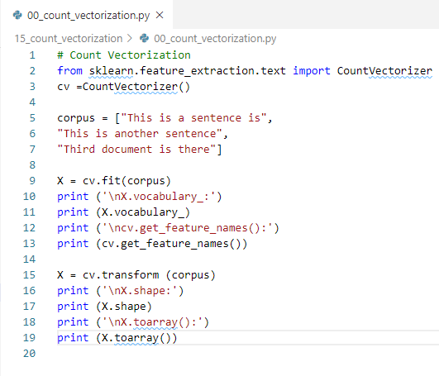
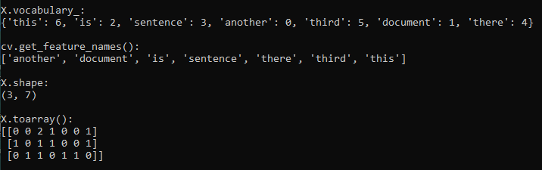
15 Count Vectorization
https://www.youtube.com/watch?v=6ZPDU8Lrqv0&list=PL1w8k37X_6L-fBgXCiCsn6ugDsr1Nmfqk&index=15
Count Vectorization
 | another | document | is | sentence | there | Third | this
doc1 | 0 | 0 | 2 | 1 | 0 | 0 | 1
doc2 | 1 | 0 | 1 | 1 | 0 | 0 | 1
doc3 | 0 | 1 | 1 | 0 | 1 | 1 | 0

Slide 6
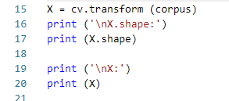
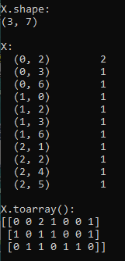
15 Count Vectorization
https://www.youtube.com/watch?v=6ZPDU8Lrqv0&list=PL1w8k37X_6L-fBgXCiCsn6ugDsr1Nmfqk&index=15
Count Vectorization: Print non-zero matrix
 | another | document | is | sentence | there | Third | this
doc1 | 0 | 0 | 2 | 1 | 0 | 0 | 1
doc2 | 1 | 0 | 1 | 1 | 0 | 0 | 1
doc3 | 0 | 1 | 1 | 0 | 1 | 1 | 0

Slide 7
15.1 Count Vectorization on Pandas

Slide 8
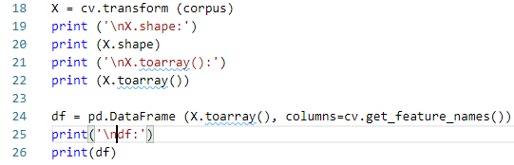
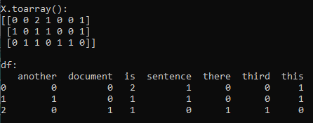
15.1 Count Vectorization on Pandas
https://www.youtube.com/watch?v=6ZPDU8Lrqv0&list=PL1w8k37X_6L-fBgXCiCsn6ugDsr1Nmfqk&index=15
Count Vectorization:
Transform the vector into pandas DatFrame.
 | another | document | is | sentence | there | Third | this
doc1 | 0 | 0 | 2 | 1 | 0 | 0 | 1
doc2 | 1 | 0 | 1 | 1 | 0 | 0 | 1
doc3 | 0 | 1 | 1 | 0 | 1 | 1 | 0

Slide 9
15.2 Count Vectorization on SMS Spam

Slide 10
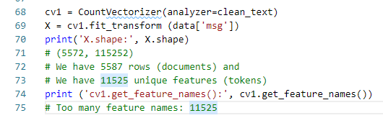
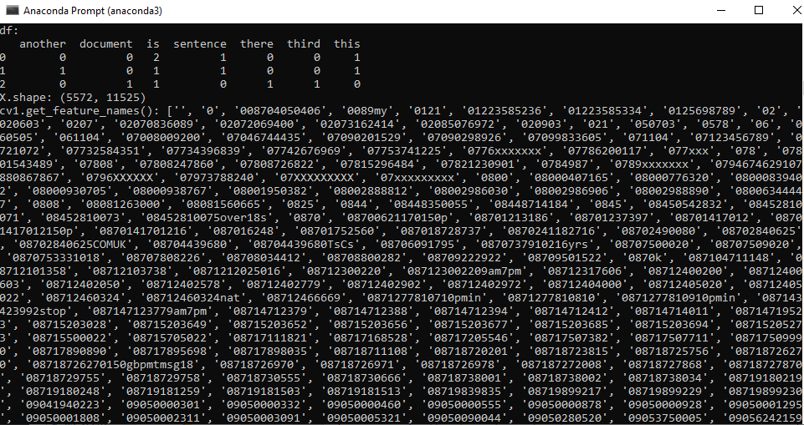
15.2 Count Vectorization on SMS Spam
https://www.youtube.com/watch?v=6ZPDU8Lrqv0&list=PL1w8k37X_6L-fBgXCiCsn6ugDsr1Nmfqk&index=15
Count Vectorization on SMS Spam Collection
We have 11525 features. It is useless since too many features.

Slide 11
15.3 Reduce SMS Spam to 10 Rows

Slide 12
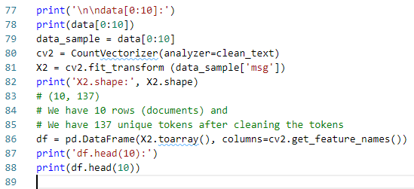
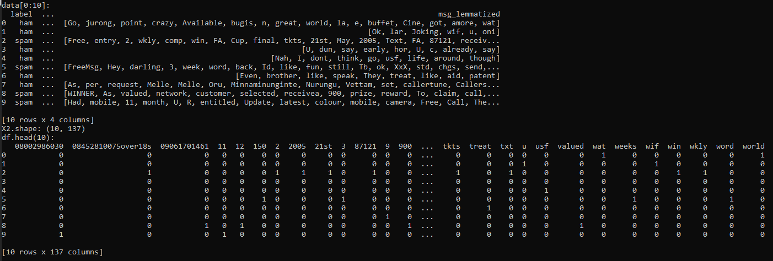
15.3 Reduce SMS Spam to 10 Rows
https://www.youtube.com/watch?v=6ZPDU8Lrqv0&list=PL1w8k37X_6L-fBgXCiCsn6ugDsr1Nmfqk&index=15
Reduce SMS Spam to 10 Rows
Reduce SMS Spam to 10 rows. Still have 137 features. It is useless since too many features.

Slide 13
15.4 Summary

Slide 14
15.4 Summary
https://www.youtube.com/watch?v=6ZPDU8Lrqv0&list=PL1w8k37X_6L-fBgXCiCsn6ugDsr1Nmfqk&index=15
Summary
It is too many features.
How to reduce more garbage features?

Slide 15
15.5 Quiz

Slide 16
15.5 Quiz
https://www.youtube.com/watch?v=6ZPDU8Lrqv0&list=PL1w8k37X_6L-fBgXCiCsn6ugDsr1Nmfqk&index=15
Quiz
1. What is the import statement for count vectorization?
Ans: from sklearn.feature_extraction.text import CountVectorizer
2. What is the function call for count vectorization?
Ans: cv = CountVectorizer (analyzer = <text_cleaning fn>)

Slide 17
15.5 Quiz
https://www.youtube.com/watch?v=6ZPDU8Lrqv0&list=PL1w8k37X_6L-fBgXCiCsn6ugDsr1Nmfqk&index=15
Quiz
Give an array corpus = ["This is a sentence is", "This is another sentence“, "Third document is there"] and cv=CountVectizer()
3. How to get the vocabulary statistics of corpus?
Ans: X = cv.vocabulary_
4. How to get the shape of corpus?
Ans:
X = cv.transfor(corpus)
print(X.shape)
5. How to get the documents matrix?
Ans: print(X.toarray)
6. How to get pandas data frame?
Ans:
> df = pd.DataFrome(X.toarray(), columns = cv.get_feature_names())
> print(df)

Slide 18
End of Chapter

