Slide 1

6 Transmission Media
Peter H. Chen

Slide 2
6 Transmission Media
  https://www.tutorialspoint.com/communication_technologies/communication_technologies_transmission_media.htm
For any networking to be effective, raw stream of data is to be transported from one device to other device over some medium.
Various transmission media can be used to transfer data, The transmission may be two types:
Guided: data travel through the cable. For example, copper wires, fiber optic wire, and etc.
Unguided: Data travel through the free in form of electromagnetic signal. For example radio waves, lasers, and etc.

Slide 3
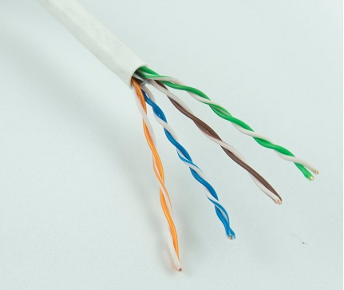
6 Transmission Media
  https://www.tutorialspoint.com/communication_technologies/communication_technologies_transmission_media.htm
Twisted Pair Cable
Copper wire are the most common wires used for transmitting signals because of good performance at low costs.
They are commonly sed in telephone lines.
If two or more wires are lying together, thy can interface with each other’s signals.
To reduce the electromagnetic interference, pair of copper wires are twisted together in helical shape, like a DNA molecule. Such twisted wires are called twisted pair.
To reduce interference between nearby twisted pairs, the twist rates are different for each other pair.

Slide 4
6 Transmission Media
  https://www.tutorialspoint.com/communication_technologies/communication_technologies_transmission_media.htm
Twisted Pair Cable
Up to 25 twisted pair are put together in a protective covering to form twisted pair cables that are the backbone of telephone systems are Ethernet networks.
Advantage of Twisted Pair Cable
Twisted pair cables are the oldest and most popular cables all over the world. This is due to the many advantages that they offer:
  Trained personnel easily available due to shallow learning curve
  Can be used for both analog and digital transmissions
  Least expensive for short distances
  Entire network does not go down if a part of network is damaged
Disadvantages of twisted pair cable
With its many advantages, twisted pair cables offer some disadvantages too −
  Signal cannot travel long distances without repeaters
  High error rate for distances greater than 100m
  Very thin and hence breaks easily
  Not suitable for broadband connections

Slide 5
6 Transmission Media
  https://www.tutorialspoint.com/communication_technologies/communication_technologies_transmission_media.htm
Shielding Twisted Pair Cable
To counter the tendency of twisted pair cables to pick up noise signals, wires are shielded in the following three ways −
  Each twisted pair is shielded.
  Set of multiple twisted pairs in the cable is shielded.
  Each twisted pair and then all the pairs are shielded.
Such twisted pairs are called shielded twisted pair (STP) cables. The wires that are not shielded but simply bundled together in a protective sheath are called unshielded twisted pair (UTP) cables. These cables can have maximum length of 100 meters.
Shielding makes the cable bulky, so UTP are more popular than STP. UTP cables are used as the last mile network connection in homes and offices.

Slide 6
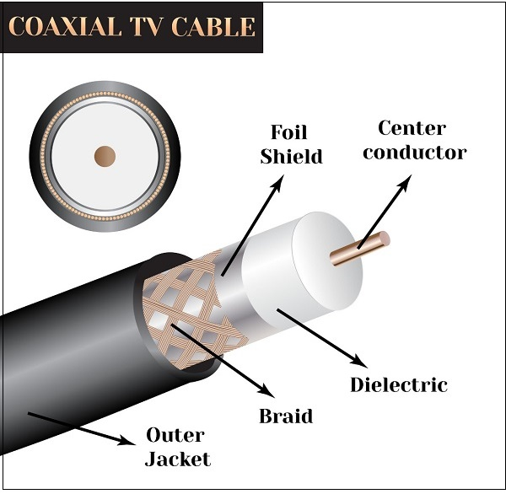
6 Transmission Media
  https://www.tutorialspoint.com/communication_technologies/communication_technologies_transmission_media.htm
Coaxial Cable
Coaxial cables are copper cables with better shielding than twisted pair cables, so that transmitted signals may travel longer distances at higher speeds.
A coaxial cable consists of these layers, starting from the innermost −
  Stiff copper wire as core
  Insulating material surrounding the core
  Closely woven braided mesh of conducting material surrounding the insulator
  Protective plastic sheath encasing the wire
Coaxial cables are widely used for cable TV connections and LANs.

Slide 7
6 Transmission Media
  https://www.tutorialspoint.com/communication_technologies/communication_technologies_transmission_media.htm
Coaxial Cable
Advantages of Coaxial Cables
These are the advantages of coaxial cables −
  Excellent noise immunity
  Signals can travel longer distances at higher speeds, e.g. 1 to 2 Gbps for 1 Km cable
  Can be used for both analog and digital signals
  Inexpensive as compared to fiber optic cables
  Easy to install and maintain
Disadvantages of Coaxial Cables
These are some of the disadvantages of coaxial cables −
  Expensive as compared to twisted pair cables
  Not compatible with twisted pair cables

Slide 8
6 Transmission Media
  https://www.tutorialspoint.com/communication_technologies/communication_technologies_transmission_media.htm
Optical Fiber
Thin glass or plastic threads used to transmit data using light waves are called optical fiber.
Light Emitting Diodes (LEDs) or Laser Diodes (LDs) emit light waves at the source, which is read by a detector at the other end.
Optical fiber cable has a bundle of such threads or fibers bundled together in a protective covering.

Slide 9
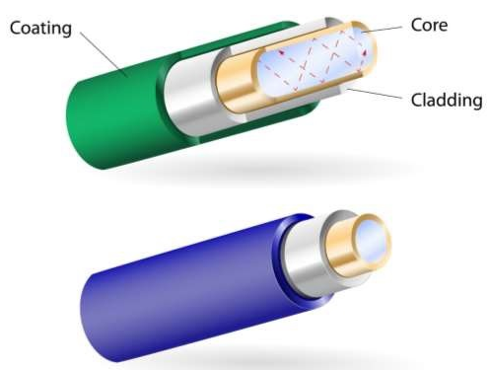
6 Transmission Media
  https://www.tutorialspoint.com/communication_technologies/communication_technologies_transmission_media.htm
Optical Fiber
Each fiber is made up of these three layers, starting with the innermost layer −
  Core made of high quality silica glass or plastic
  Cladding made of high quality silica glass or plastic, with a lower refractive index than the core
  Protective outer covering called buffer
Note that both core and cladding are made of similar material.
However, as refractive index of the cladding is lower, any stray light wave trying to escape the core is reflected back due to total internal reflection.

Slide 10
6 Transmission Media
  https://www.tutorialspoint.com/communication_technologies/communication_technologies_transmission_media.htm
Optical Fiber
Optical fiber is rapidly replacing copper wires in telephone lines, internet communication and even cable TV connections because transmitted data can travel very long distances without weakening.
Single node fiber optic cable can have maximum segment length of 2 kms and bandwidth of up to 100 Mbps.
Multi-node fiber optic cable can have maximum segment length of 100 kms and bandwidth up to 2 Gbps.
Advantages of Optical Fiber
Optical fiber is fast replacing copper wires because of these advantages that it offers −
  High bandwidth
  Immune to electromagnetic interference
  Suitable for industrial and noisy areas
  Signals carrying data can travel long distances without weakening

Slide 11
6 Transmission Media
  https://www.tutorialspoint.com/communication_technologies/communication_technologies_transmission_media.htm
Optical Fiber
Disadvantages of Optical Fiber
Despite long segment lengths and high bandwidth, using optical fiber may not be a viable option for every one due to these disadvantages −
  Optical fiber cables are expensive
  Sophisticated technology required for manufacturing, installing and maintaining optical fiber cables
  Light waves are unidirectional, so two frequencies are required for full duplex transmission

Slide 12
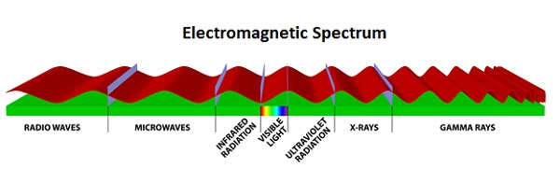
6 Transmission Media
  https://www.tutorialspoint.com/communication_technologies/communication_technologies_transmission_media.htm
Infrared
Low frequency infrared waves are used for very short distance communication like TV remote, wireless speakers, automatic doors, hand held devices etc.
Infrared signals can propagate within a room but cannot penetrate walls. However, due to such short range, it is considered to be one of the most secure transmission modes

Slide 13
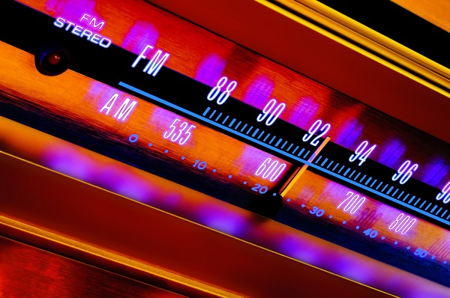
6 Transmission Media
  https://www.tutorialspoint.com/communication_technologies/communication_technologies_transmission_media.htm
Radio Wave
Transmission of data using radio frequencies is called radio-wave transmission.
We all are familiar with radio channels that broadcast entertainment programs.
Radio stations transmit radio waves using transmitters, which are received by the receiver installed in our devices.
Both transmitters and receivers use antennas to radiate or capture radio signals.
These radio frequencies can also be used for direct voice communication within the allocated range.
This range is usually 10 miles.

Slide 14
6 Transmission Media
  https://www.tutorialspoint.com/communication_technologies/communication_technologies_transmission_media.htm
Radio Wave
Advantages of Radio Wave
These are some of the advantages of radio wave transmissions −
  Inexpensive mode of information exchange
  No land needs to be acquired for laying cables
  Installation and maintenance of devices is cheap
Disadvantages of Radio Wave
These are some of the disadvantages of radio wave transmissions −
  Insecure communication medium
  Prone to weather changes like rain, thunderstorms, etc.

Slide 15
End of Chapter

