Slide 1

10 Network Protocol
Peter H. Chen

Slide 2
10 Network Protocol
  https://www.tutorialspoint.com/communication_technologies/communication_technologies_network_protocols.htm
Network Protocols are a set of rules governing exchange of information in an easy, reliable and secure way.
The most common protocols used to transmit and receive data over a network, we need to understand how a network is logically organized or designed.
The most popular model used to establish open communication between two systems is the Open Systems Interface (OSI) model proposed by ISO.

Slide 3
10 Network Protocol
  https://www.tutorialspoint.com/communication_technologies/communication_technologies_network_protocols.htm
OSI Model
OSI model is not a network architecture because it does not specify the exact services and protocols for each layer.
It simply tells what each layer should do by defining its input and output data.
It is up to network architects to implement the layers according to their needs and resources available.
These are the seven layers of the OSI model −
Physical layer − It is the first layer that physically connects the two systems that need to communicate. It transmits data in bits and manages simplex or duplex transmission by modem. It also manages Network Interface Card’s hardware interface to the network, like cabling, cable terminators, topography, voltage levels, etc.
Data link layer − It is the firmware layer of Network Interface Card. It assembles datagrams into frames and adds start and stop flags to each frame. It also resolves problems caused by damaged, lost or duplicate frames.

Slide 4
10 Network Protocol
  https://www.tutorialspoint.com/communication_technologies/communication_technologies_network_protocols.htm
OSI Model
Network layer − It is concerned with routing, switching and controlling flow of information between the workstations. It also breaks down transport layer datagrams into smaller datagrams.
Transport layer − Till the session layer, file is in its own form. Transport layer breaks it down into data frames, provides error checking at network segment level and prevents a fast host from overrunning a slower one. Transport layer isolates the upper layers from network hardware.
Session layer − This layer is responsible for establishing a session between two workstations that want to exchange data.
Presentation layer − This layer is concerned with correct representation of data, i.e. syntax and semantics of information. It controls file level security and is also responsible for converting data to network standards.
Application layer − It is the topmost layer of the network that is responsible for sending application requests by the user to the lower levels. Typical applications include file transfer, E-mail, remote logon, data entry, etc.

Slide 5
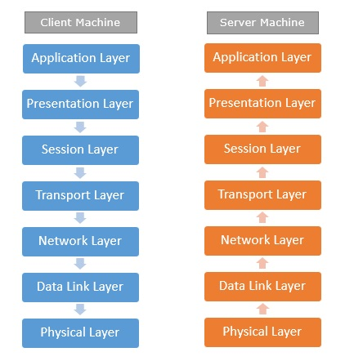
10 Network Protocol
  https://www.tutorialspoint.com/communication_technologies/communication_technologies_network_protocols.htm
OSI Model
It is not necessary for every network to have all the layers.
For example, network layer is not there in broadcast networks.
When a system wants to share data with another workstation or send a request over the network, it is received by the application layer.
Data then proceeds to lower layers after processing till it reaches the physical layer.

Slide 6
10 Network Protocol
  https://www.tutorialspoint.com/communication_technologies/communication_technologies_network_protocols.htm
OSI Model
At the physical layer, the data is actually transferred and received by the physical layer of the destination workstation.
There, the data proceeds to upper layers after processing till it reaches application layer.
At the application layer, data or request is shared with the workstation.
So each layer has opposite functions for source and destination workstations.
For example, data link layer of the source workstation adds start and stop flags to the frames but the same layer of the destination workstation will remove the start and stop flags from the frames.
Let us now see some of the protocols used by different layers to accomplish user requests.

Slide 7
10 Network Protocol
  https://www.tutorialspoint.com/communication_technologies/communication_technologies_network_protocols.htm
TCP/IP
TCP/IP stands for Transmission Control Protocol/Internet Protocol.
TCP/IP is a set of layered protocols used for communication over the Internet.
The communication model of this suite is client-server model.
A computer that sends a request is the client and a computer to which the request is sent is the server.

Slide 8
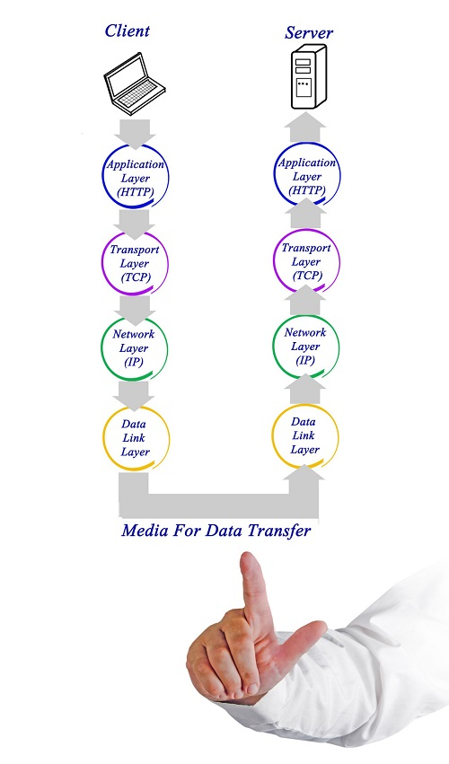
10 Network Protocol
  https://www.tutorialspoint.com/communication_technologies/communication_technologies_network_protocols.htm
TCP/IP has four layers
Application layer − Application layer protocols like HTTP and FTP are used.
Transport layer − Data is transmitted in form of datagrams using the Transmission Control Protocol (TCP). TCP is responsible for breaking up data at the client side and then reassembling it on the server side.
Network layer − Network layer connection is established using Internet Protocol (IP) at the network layer. Every machine connected to the Internet is assigned an address called IP address by the protocol to easily identify source and destination machines.
Data link layer − Actual data transmission in bits occurs at the data link layer using the destination address provided by network layer.
TCP/IP is widely used in many communication networks other than the Internet.

Slide 9

10 Network Protocol
  https://www.tutorialspoint.com/communication_technologies/communication_technologies_network_protocols.htm
FTP
In the beginning, the need for network came up primarily to facilitate sharing of files between researchers.
Today, file transfer remains one of the most used facilities.
The protocol that handles these requests is File Transfer Protocol or FTP
Using FTP to transfer files is helpful in these ways −
Easily transfers files between two different networks
Can resume file transfer sessions even if connection is dropped, if protocol is configure appropriately
Enables collaboration between geographically separated teams

Slide 10
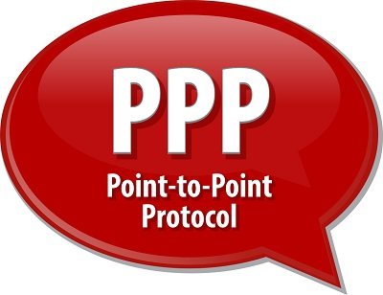
10 Network Protocol
  https://www.tutorialspoint.com/communication_technologies/communication_technologies_network_protocols.htm
PPP
Point to Point Protocol or PPP is a data link layer protocol that enables transmission of TCP/IP traffic over serial connection, like telephone line.

Slide 11
10 Network Protocol
  https://www.tutorialspoint.com/communication_technologies/communication_technologies_network_protocols.htm
PPP
To do this, PPP defines these three things −
  A framing method to clearly define end of one frame and start of another, incorporating errors detection as well.
  Link control protocol (LCP) for bringing communication lines up, authenticating and bringing them down when no longer needed.
  Network control protocol (NCP) for each network layer protocol supported by other networks.
  Using PPP, home users can avail Internet connection over telephone lines.

Slide 12
End of Chapter

