Slide 1

17 Firewall
Peter H. Chen

Slide 2
17 Firewall
  https://www.tutorialspoint.com/communication_technologies/communication_technologies_firewall.htm
There exist multiple approaches to counter or at least reduce security threats. Some of these are −
  Authenticating users accessing a service
  Providing access to authorized users
  Using encrypted passwords for remote log on
  Using biometric authorization parameters
  Restricting traffic to and from

Slide 3
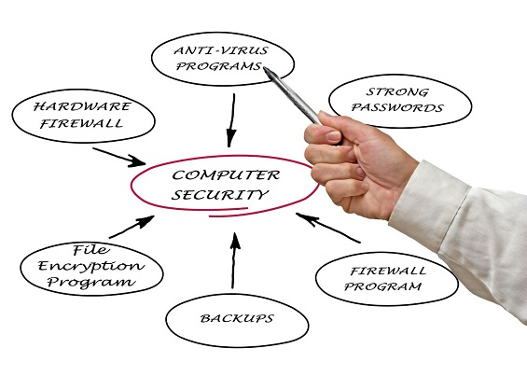
17 Firewall
  https://www.tutorialspoint.com/communication_technologies/communication_technologies_firewall.htm
Firewalls are the first line of defense against unauthorized access to private networks.
They can be used effectively against virus, Trojan or worm attacks.

Slide 4
17 Firewall
  https://www.tutorialspoint.com/communication_technologies/communication_technologies_firewall.htm
How Firewalls Work
Dictionary defines firewall as a wall or partition designed to inhibit or prevent spread of fire.
In networks, a system designed to protect an intranet from unauthorized access is called firewall.
A private network created using World Wide Web software is called an intranet. Firewall may be implemented in both hardware and software.
All traffic to and from the network is routed through the firewall.
The firewall examines each message and blocks those that does not meet the pre-defined security criteria.

Slide 5
17 Firewall
  https://www.tutorialspoint.com/communication_technologies/communication_technologies_firewall.htm
How Firewalls Work
These are some of the prevalent techniques used by firewalls −
  Packet level filtering:
  Here each packet is examined depending on user-defined rules.
  It is very effective and transparent to users, but difficult to configure.
  Also, as IP address is used to identify users, IP spoofing by malicious parties can prove counterproductive.
  Circuit level filtering:
  Like good old telephone connections, circuit level filtering applies security mechanisms while connection between two systems is being established.
  Once the connection is deemed secure, data transmission can take place for that session.

Slide 6
17 Firewall
  https://www.tutorialspoint.com/communication_technologies/communication_technologies_firewall.htm
How Firewalls Work
  Application level filtering:
  Here, security mechanisms are applied to commonly used applications like Telnet, FTP servers, storage servers, etc. This is very effective but slows down performance of the applications.
  Proxy server:
  As the name suggests, proxy server is used to interrupt all incoming and outgoing messages and mask the true server address.
A firewall may use a combination of two or more techniques to secure the network, depending on extent of security required.

Slide 7
End of Chapter

