Slide 1

20 Security Act and Law
Peter H. Chen

Slide 2
20 Security Act and Law
  https://www.tutorialspoint.com/communication_technologies/communication_technologies_security_acts_and_laws.htm
Cyber Crimes
Any unlawful activity involving or related to computer and networks is called cybercrime.
Dr. K. Jaishankar, Professor and Head of the Department of Criminology, Raksha Shakti University (Inida), and Dr. Debarati Halder, lawyer and legal researcher, define cybercrime thus −
Offences that are committed against individuals or groups of individuals with a criminal motive to intentionally harm the reputation of the victim or cause physical or mental harm, or loss, to the victim directly or indirectly, using modern telecommunication networks such as Internet (networks including but not limited to Chat rooms, emails, notice boards and groups) and mobile phones (Bluetooth/SMS/MMS).

Slide 3
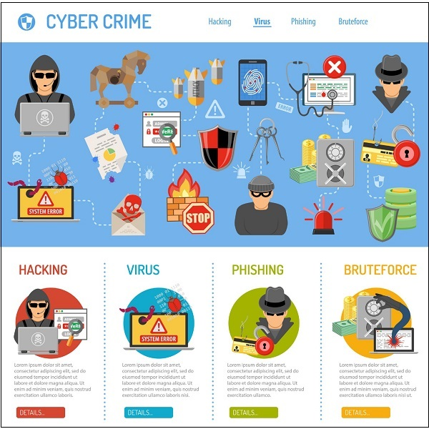
20 Security Act and Law
  https://www.tutorialspoint.com/communication_technologies/communication_technologies_security_acts_and_laws.htm
Cyber Crimes
This definition implies that any crime perpetrated (carry out harmful action) on the Internet or using computers is a cybercrime.

Slide 4
20 Security Act and Law
  https://www.tutorialspoint.com/communication_technologies/communication_technologies_security_acts_and_laws.htm
Examples of cybercrimes include −
  Cracking
  Identity theft
  Hate crime
  E-commerce fraud
  Credit card account theft
  Publishing obscene content
  Child pornography
  Online stalking (illegal following or watching)
  Copyright infringement (Law Violation)
  Mass surveillance
  Cyber terrorism
  Cyber warfare

Slide 5
20 Security Act and Law
  https://www.tutorialspoint.com/communication_technologies/communication_technologies_security_acts_and_laws.htm
Cyber Law
Cyber law is a term that encompasses legal issues related to use of Internet and cyberspace.
It is a broad term that covers varied issues like freedom of expression, internet usage, online privacy, child abuse, etc.
Most of the countries have one or the other form of cyber law in place to tackle the growing menace of cybercrimes.
A major issue here is that in any crime perpetrator, victim and instruments used might be spread across multiple locations nationally as well as internationally.
Investigating the crime needs close collaboration between computer experts and multiple government authorities, sometimes in more than one country.

Slide 6
20 Security Act and Law
  https://www.tutorialspoint.com/communication_technologies/communication_technologies_security_acts_and_laws.htm
IT Act
Information Technology Act, 2000 is the primary Indian law dealing with cybercrime and e-commerce.
The law, also called ITA-2000 or IT Act, was notified on 17th October 2000 and is based on the United Nations Model Law on Electronic Commerce 1996 recommended by the UN General Assembly on 30th January 1997.
The IT Act covers whole of India and recognizes electronic records and digital signatures. Some of its prominent features include −
  Formation of Controller of Certifying Authorities to regulate issuance of digital signatures
  Establishment of Cyber Appellate Tribunal to resolve disputes due to the new law
  Amendment in sections of Indian Penal Code, Indian Evidence Act, Banker’s Book Evidence Act and RBI Act to make them technology compliant

Slide 7
20 Security Act and Law
  https://www.tutorialspoint.com/communication_technologies/communication_technologies_security_acts_and_laws.htm
IT Act
The IT Act was framed to originally to provide legal infrastructure for e-commerce in India. However, major amendments were made in 2008 to address issues like cyber terrorism, data protection, child pornography, stalking, etc.
It also gave authorities the power to intercept, monitor or decrypt any information through computer resources.

Slide 8
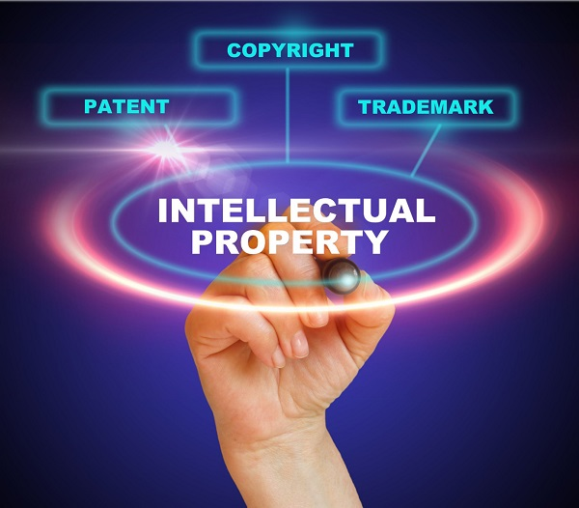
20 Security Act and Law
  https://www.tutorialspoint.com/communication_technologies/communication_technologies_security_acts_and_laws.htm
IPR Issues
IPR stands for Intellectual Property Rights.
IPR is legal protection provided to creators of Intellectual Property (IP).
IP is any creation of the intellect or mind, like art, music, literature, inventions, logo, symbols, tag lines, etc.
Protecting the rights of intellectual property creators is essentially a moral issue. However, law of the land does provide legal protection in case of violation of these rights.

Slide 9
20 Security Act and Law
  https://www.tutorialspoint.com/communication_technologies/communication_technologies_security_acts_and_laws.htm
IPR Issues
Intellectual Property Rights include −
  Patents
  Copyrights
  Industrial design rights
  Trademarks
  Plant variety rights
  Trade dress
  Geographical indications
  Trade secrets

Slide 10
20 Security Act and Law
  https://www.tutorialspoint.com/communication_technologies/communication_technologies_security_acts_and_laws.htm
IPR Issues
Violation of Intellectual Property Rights is called infringement in case of patents, copyrights and trademarks, and misappropriation in case of trade secrets.
Any published material that you view or read on the Internet is copyright of its creator and hence protected by IPR (Intellectual Property Rights).
You are legally and morally obliged not to use it and pass it off as your own.
That would be infringement of creator’s copyright and you may incur legal action.

Slide 11
End of Chapter

