Slide 1

2 Data Frame
Peter H. Chen

Slide 2
2 Data Frame
https://www.youtube.com/watch?v=zmdjNSmRXF4&list=PL-osiE80TeTsWmV9i9c58mdDCSskIFdDS&index=2
Data Frame
We read csv files into data frame with row and column format.
We read the survey_results_public and then survery_results_schema.
We then use set_option to set the max columns and max rows of display.
df is the data frame. We can df.head() to return the 5 rows of the data frame.
The data frame “Hobbyist”. To see the question of hobbyist, check the survey_results_schema.

Slide 3
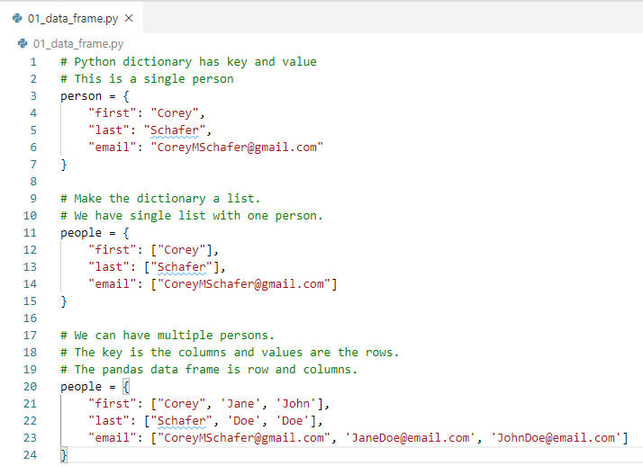
2 Data Frame
https://www.youtube.com/watch?v=zmdjNSmRXF4&list=PL-osiE80TeTsWmV9i9c58mdDCSskIFdDS&index=2
Data Frame
We can use Python to store the JSON format dictionary data.
The key is the columns and the values are the rows.

Slide 4
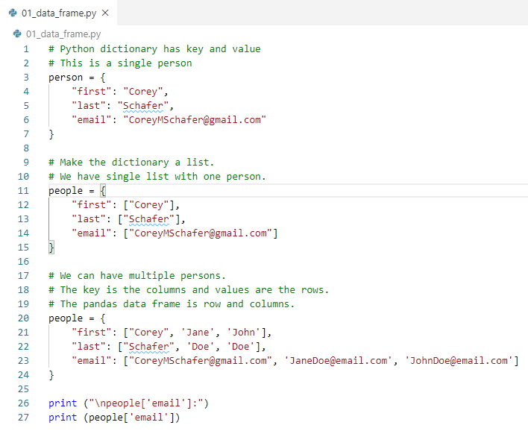
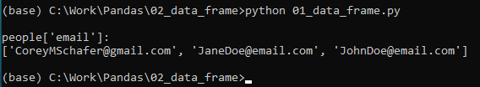
2 Data Frame
https://www.youtube.com/watch?v=zmdjNSmRXF4&list=PL-osiE80TeTsWmV9i9c58mdDCSskIFdDS&index=2
Data Frame
To print the values (rows data), use key to access the column.
> people[‘email’]

Slide 5
2.1 Parse JSON into Row/Column

Slide 6
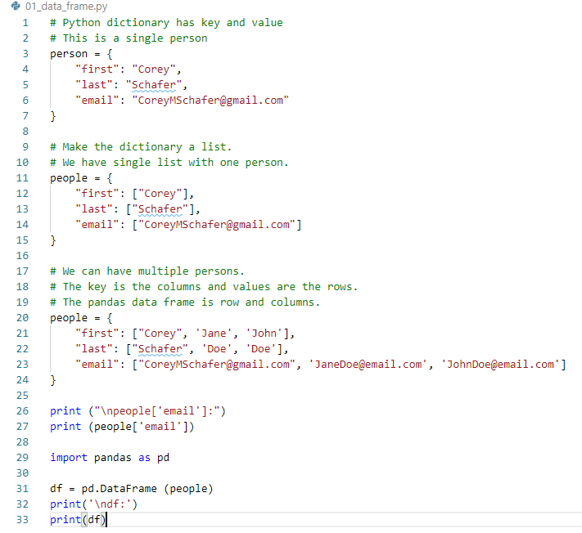
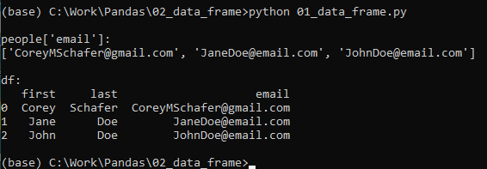
2.1 Parse JSON into Row/Column
https://www.youtube.com/watch?v=zmdjNSmRXF4&list=PL-osiE80TeTsWmV9i9c58mdDCSskIFdDS&index=2
Data Frame: > import pandas as pd
> df = pd.DataFrame (people)

Slide 7
2.1 Parse JSON into Row/Column
https://www.youtube.com/watch?v=zmdjNSmRXF4&list=PL-osiE80TeTsWmV9i9c58mdDCSskIFdDS&index=2
Data Frame:
DataFrame can parse the JSON key-value format into row/column.
We also have the index 0, 1, 2 on the left.

Slide 8
2.2 Access Value of Data Frame

Slide 9
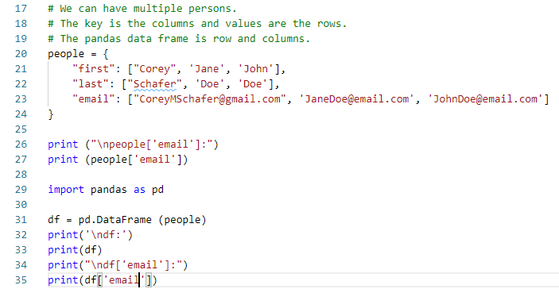
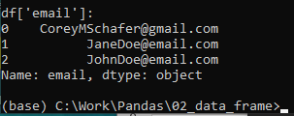
2.2 Access Value of Data Frame
https://www.youtube.com/watch?v=zmdjNSmRXF4&list=PL-osiE80TeTsWmV9i9c58mdDCSskIFdDS&index=2
Access the Value of Data Frame:
We can access the Values of single column just like the key of dictionary in JSON format.
> print (df[‘email’])
That is not access by key. That is access by column of data frame.

Slide 10
2.2 Access Value of Data Frame
https://www.youtube.com/watch?v=zmdjNSmRXF4&list=PL-osiE80TeTsWmV9i9c58mdDCSskIFdDS&index=2
Access the Value of Data Frame:
Data Frame is much more than key-value of dictionary.
> print (type (df[‘email’]))
>> pandas.core.series.Series
It is a series of data which is different from JSON format.

Slide 11
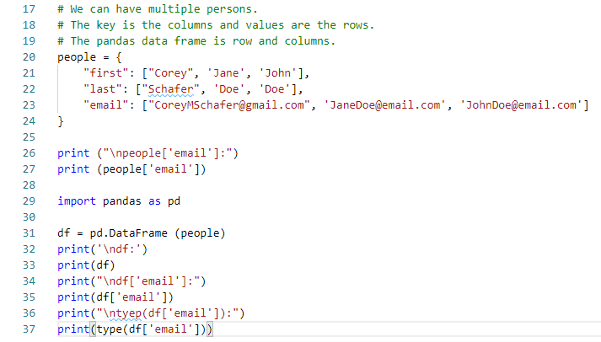

2.2 Access Value of Data Frame
https://www.youtube.com/watch?v=zmdjNSmRXF4&list=PL-osiE80TeTsWmV9i9c58mdDCSskIFdDS&index=2
Access the Value of Data Frame:
Data Frame is much more than key-value of dictionary.
> print (type (df[‘email’]))
>> pandas.core.series.Series
It is a series of Object which is different from JSON format.

Slide 12
2.2 Access Value of Data Frame
https://www.youtube.com/watch?v=zmdjNSmRXF4&list=PL-osiE80TeTsWmV9i9c58mdDCSskIFdDS&index=2
What is a Series?
A series is a list of data. Just like the data frame. Series object includes more functionality, not only the data itself.
The Series are rows of single columns.
The Data Frame is a containers for multiple of these series of objects.
Data Frame is two dimensional. Data Frame has rows and columns.
Data Frame: Containers
Two dimensional Rows and Columns
Series:
Single column of data frame
Multiple Rows

Slide 13
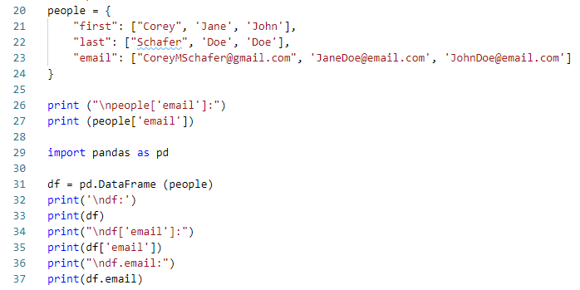
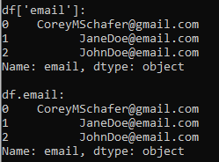
2.2 Access Value of Data Frame
https://www.youtube.com/watch?v=zmdjNSmRXF4&list=PL-osiE80TeTsWmV9i9c58mdDCSskIFdDS&index=2
What is a Series?
You can access single column of Data Frame by
> df[‘email’]
Or
> df.email

Slide 14
2.2 Access Value of Data Frame
https://www.youtube.com/watch?v=zmdjNSmRXF4&list=PL-osiE80TeTsWmV9i9c58mdDCSskIFdDS&index=2
What is a Series?
The first way (df[‘email’]) is preferred.
The second way (df.email) sometimes is conflict with data frame attribute and give you the error, for example, data frame has a attribute ‘count’. If you have a column named count and you access the df.count will give you the error.
You need to know these two ways since some people uses df.column to access.

Slide 15
2.3 Access Multiple Columns

Slide 16
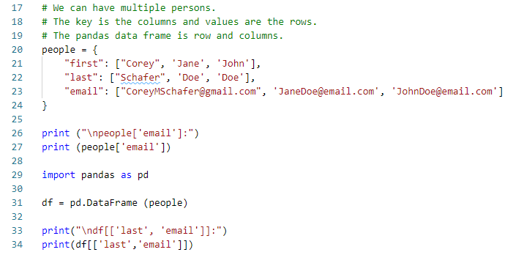

2.3 Access Multiple Columns
https://www.youtube.com/watch?v=zmdjNSmRXF4&list=PL-osiE80TeTsWmV9i9c58mdDCSskIFdDS&index=2
Access Multiple Columns
To access the multiple columns, we put bracket list inside the df[].
> df([[‘last’, ‘email’]])
We have multiple columns (last and email columns).

Slide 17
2.3 Access Multiple Columns
https://www.youtube.com/watch?v=zmdjNSmRXF4&list=PL-osiE80TeTsWmV9i9c58mdDCSskIFdDS&index=2
Access Multiple Columns
We pass a list inside the df[]. So there are two pairs of bracket, df [[‘last’, ‘email’]].
You cannot leave off the inner bracket.
Now, we get a multiple columns. This is no longer a Series.
A Series is a single columns of rows.
When we get the multiple columns, it is another Data Frame. It is not a Series.
The multiple columns selection is filter out the specific columns in the data frame. We filter out the first name column and select the last and email columns. They are data frame.

Slide 18
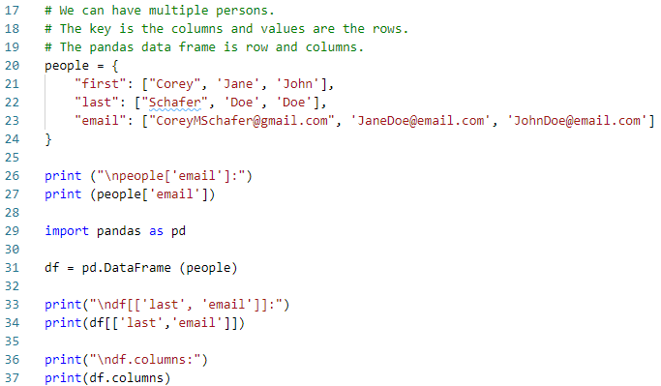

2.3 Access Multiple Columns
https://www.youtube.com/watch?v=zmdjNSmRXF4&list=PL-osiE80TeTsWmV9i9c58mdDCSskIFdDS&index=2
Access Multiple Columns
If we have a lot of columns, we can use ‘df.columns’ to see all the columns title.
The columns are indexed.

Slide 19
2.4 Access Rows

Slide 20
2.4 Access Rows
https://www.youtube.com/watch?v=zmdjNSmRXF4&list=PL-osiE80TeTsWmV9i9c58mdDCSskIFdDS&index=2
Access Rows
How do we access the rows.
We can use ‘loc’ and ‘iloc’
First, we look at ‘iloc’.
The ‘iloc’ allow us to access rows by integer location.

Slide 21
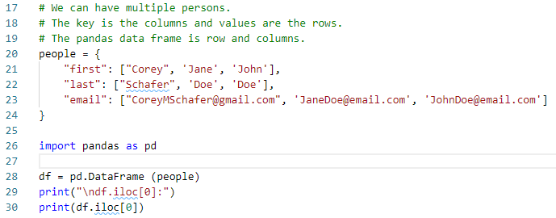
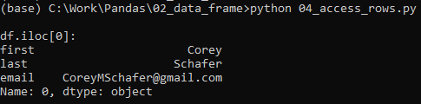
2.4 Access Rows
https://www.youtube.com/watch?v=zmdjNSmRXF4&list=PL-osiE80TeTsWmV9i9c58mdDCSskIFdDS&index=2
Access Rows
If I want to access the first row, we can use df.iloc[0].
> df.iloc[0]
Give us the first row.

Slide 22
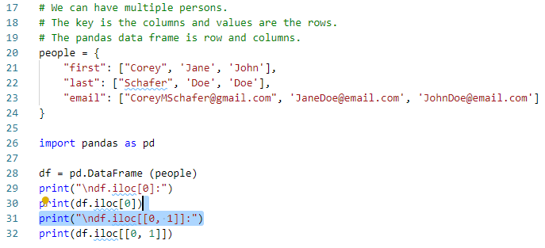
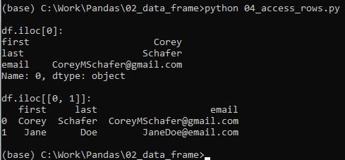
2.4 Access Rows
https://www.youtube.com/watch?v=zmdjNSmRXF4&list=PL-osiE80TeTsWmV9i9c58mdDCSskIFdDS&index=2
Access Rows
If we want to access multiple rows, we need extra brackets for a list of rows.
> df.iloc[[0, 1]]
Now, we got the first two rows of data.

Slide 23
2.4 Access Rows
https://www.youtube.com/watch?v=zmdjNSmRXF4&list=PL-osiE80TeTsWmV9i9c58mdDCSskIFdDS&index=2
Access Rows
We have inner list bracket inside the df.iloc([]).
Now, we got the multiple rows of iloc.

Slide 24
2.5 Access Multiple Rows and Columns

Slide 25
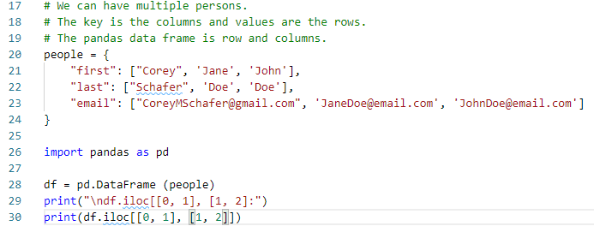
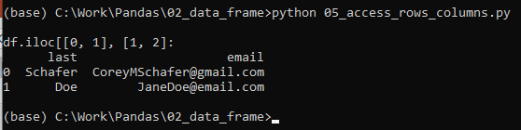
2.5 Access Multiple Rows and Columns
https://www.youtube.com/watch?v=zmdjNSmRXF4&list=PL-osiE80TeTsWmV9i9c58mdDCSskIFdDS&index=2
Access Multiple Rows and Columns
We can pass in row as the first argument and column at the second argument.
The iloc() only take the integer as the index. Row index and columns indexes are started from 0.
The loc is used for string index.

Slide 26
2.6 Use Label for Rows and Columns

Slide 27
2.6 Use Label for Rows and Columns
https://www.youtube.com/watch?v=zmdjNSmRXF4&list=PL-osiE80TeTsWmV9i9c58mdDCSskIFdDS&index=2
Access Multiple Rows and Columns
> df
See all the row and columns
Row was label by (0, 1, 2, …)
> df.loc[0]
Will display the first row.

Slide 28
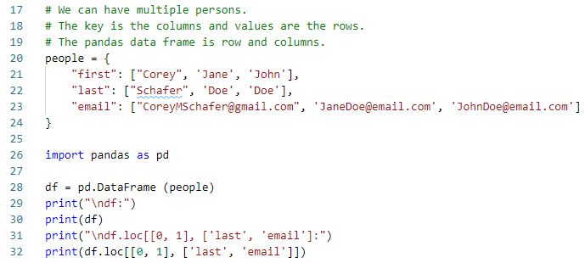
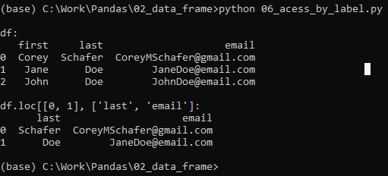
2.6 Use Label for Rows and Columns
https://www.youtube.com/watch?v=zmdjNSmRXF4&list=PL-osiE80TeTsWmV9i9c58mdDCSskIFdDS&index=2
Access Multiple Rows and Columns
If we want to access multiple rows and columns by label, we can use:
> df.loc[[0, 1], [‘last’, ‘email’].
The row index are given by the label ‘0’, ‘1’, and etc.

Slide 29
2.6 Use Label for Rows and Columns
https://www.youtube.com/watch?v=zmdjNSmRXF4&list=PL-osiE80TeTsWmV9i9c58mdDCSskIFdDS&index=2
Access Multiple Rows and Columns
> df.iloc ()
Is for integer location.
> df.loc()
Is for label location access. The row indexes are label by the data frame.

Slide 30
2.7 Dataset Value Counts for Column

Slide 31
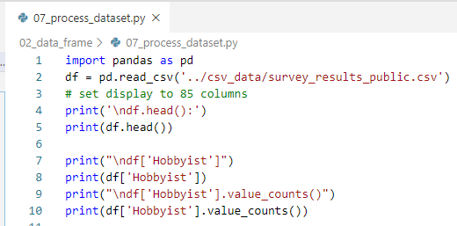
2.7 Dataset Value Counts for Column
https://www.youtube.com/watch?v=zmdjNSmRXF4&list=PL-osiE80TeTsWmV9i9c58mdDCSskIFdDS&index=2
Process CVS Dataset
> df[‘Hobbyist’].value_count():

Slide 32
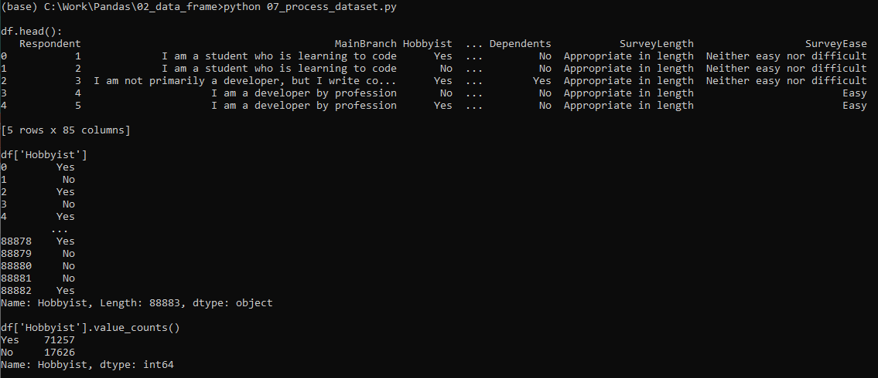
2.7 Dataset Value Counts for Column
https://www.youtube.com/watch?v=zmdjNSmRXF4&list=PL-osiE80TeTsWmV9i9c58mdDCSskIFdDS&index=2
Process CVS Dataset
Display the value_counts(). We can plot the output really easy.

Slide 33
2.8 Dataset iloc and loc

Slide 34
2.8 Dataset iloc and loc
https://www.youtube.com/watch?v=zmdjNSmRXF4&list=PL-osiE80TeTsWmV9i9c58mdDCSskIFdDS&index=2
Process CVS Dataset
> df.shape
See how many rows and columns (88883 x 85)
> df[‘Hobbyist’]
See the ‘Hobbyist’ columns.
> df[‘Hobbyist].value_counts()
>> Yes 71257
>> No 17626

Slide 35
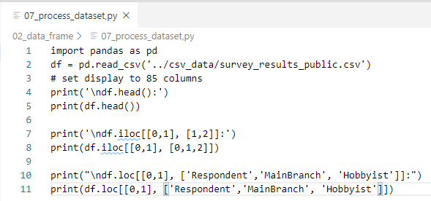
2.8 Dataset iloc and loc
https://www.youtube.com/watch?v=zmdjNSmRXF4&list=PL-osiE80TeTsWmV9i9c58mdDCSskIFdDS&index=2
Process CVS Dataset
We process dataset by iloc() and loc()

Slide 36
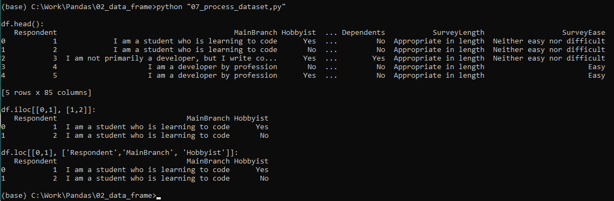
2.8 Dataset iloc and loc
https://www.youtube.com/watch?v=zmdjNSmRXF4&list=PL-osiE80TeTsWmV9i9c58mdDCSskIFdDS&index=2
Process CVS Dataset
Display the result:

Slide 37
2.9 Dataset loc Range

Slide 38
2.9 Dataset loc Range
https://www.youtube.com/watch?v=zmdjNSmRXF4&list=PL-osiE80TeTsWmV9i9c58mdDCSskIFdDS&index=2
Process CVS Dataset by loc range
> df.columns
> df.loc (0:2, ‘Repondent’:’Hobbyist’)

Slide 39
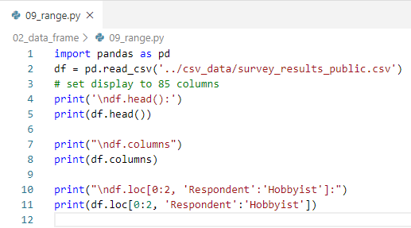
2.9 Dataset loc Range
https://www.youtube.com/watch?v=zmdjNSmRXF4&list=PL-osiE80TeTsWmV9i9c58mdDCSskIFdDS&index=2
Process CVS Dataset
We process range by label by loc()

Slide 40
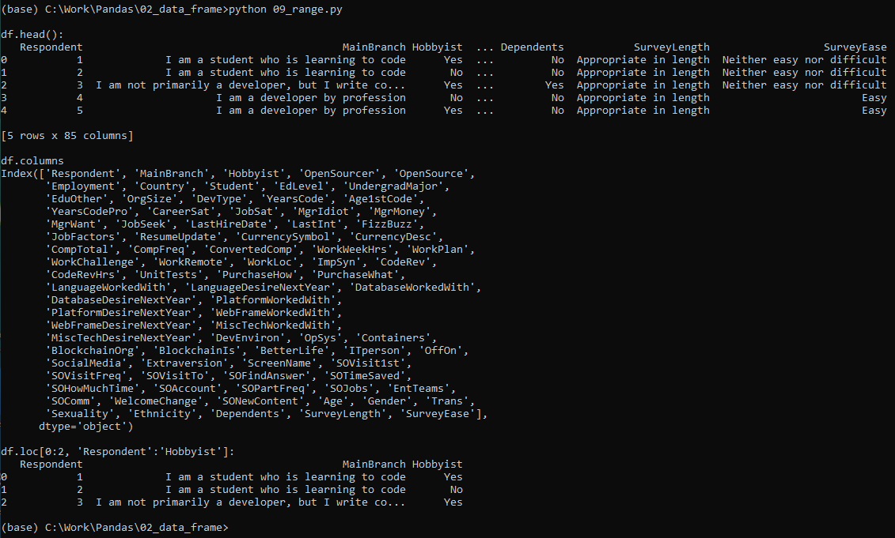
2.9 Dataset loc Range
https://www.youtube.com/watch?v=zmdjNSmRXF4&list=PL-osiE80TeTsWmV9i9c58mdDCSskIFdDS&index=2
Process CVS Dataset
Display the result:

Slide 41
End of Chapter

