Slide 1

4 Filter
Peter H. Chen

Slide 2
4 Filter
https://www.youtube.com/watch?v=Lw2rlcxScZY&list=PL-osiE80TeTsWmV9i9c58mdDCSskIFdDS&index=4
Filter
We filter the data from data frame and series objects.

Slide 3
4.1 last name filter

Slide 4
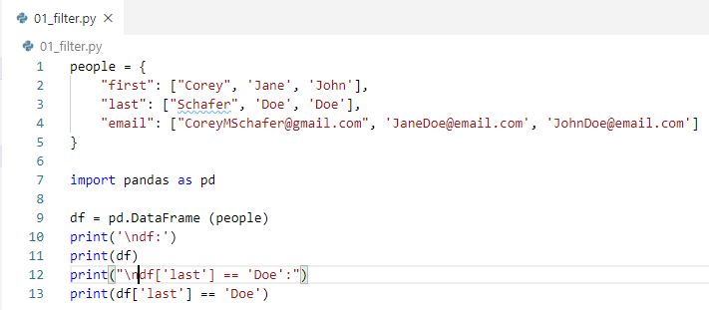
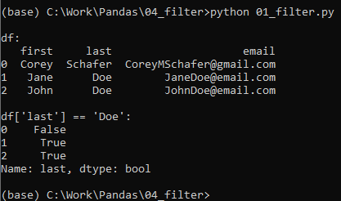
4.1 last name filter
https://www.youtube.com/watch?v=Lw2rlcxScZY&list=PL-osiE80TeTsWmV9i9c58mdDCSskIFdDS&index=4
Method 1: Match last name ‘Doe’
> df[‘last’] == ‘Doe’
It return True or false for the data frame.

Slide 5
4.2 loc filter

Slide 6


4.2 loc filter
https://www.youtube.com/watch?v=Lw2rlcxScZY&list=PL-osiE80TeTsWmV9i9c58mdDCSskIFdDS&index=4
Method 2: Loc Filter
This is a preferred way.
> fil = (df[‘last’] == ‘Doe’)
> df.loc[fil]
We got the same result as Method 1.
This is why people is confusing about several ways to get different or same results.
The df.loc is use to look up rows and columns by label but if you pass in a series of Boolean (fil) like we did here. We can also filter data out.
We like to use df.loc here because we also can get specific columns as well.

Slide 7
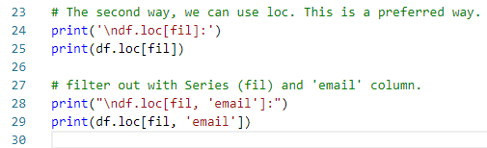
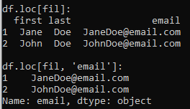
4.2 loc filter
https://www.youtube.com/watch?v=Lw2rlcxScZY&list=PL-osiE80TeTsWmV9i9c58mdDCSskIFdDS&index=4
Filter out with Series (row fil) and ‘email’ column
> df.loc[fil, ‘email’]

Slide 8
4.3 filter operator &

Slide 9
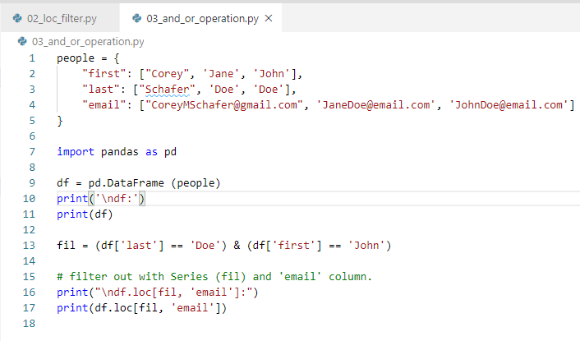
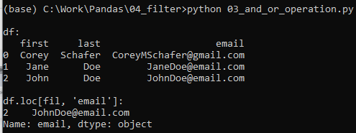
4.3 filter operator &
https://www.youtube.com/watch?v=Lw2rlcxScZY&list=PL-osiE80TeTsWmV9i9c58mdDCSskIFdDS&index=4
Filter Operator &
We apply the & operation for filter.

Slide 10
4.4 filter operator |

Slide 11
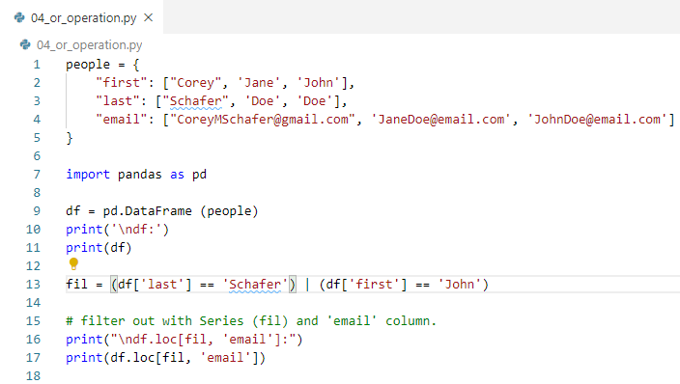
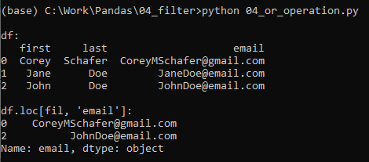
4.4 filter operator |
https://www.youtube.com/watch?v=Lw2rlcxScZY&list=PL-osiE80TeTsWmV9i9c58mdDCSskIFdDS&index=4
Filter Operation: & |
We apply the | operation for filter.

Slide 12
4.5 filter operator ~

Slide 13
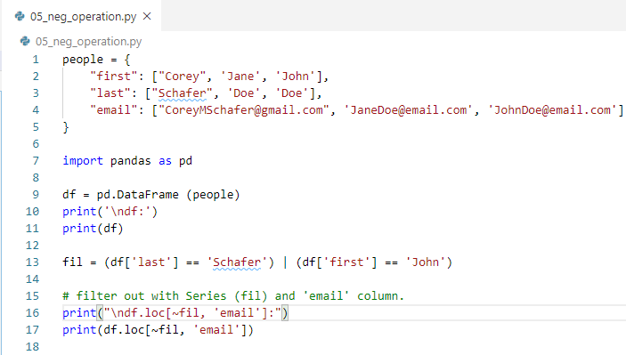
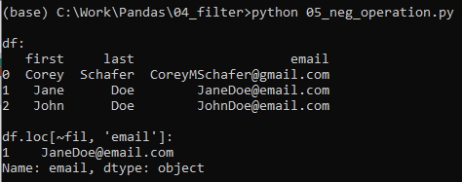
4.5 filter operator ~
https://www.youtube.com/watch?v=Lw2rlcxScZY&list=PL-osiE80TeTsWmV9i9c58mdDCSskIFdDS&index=4
Filter Operation: & |
We apply the ~ operation for filter.

Slide 14
4.6 filter operator on Big Dataset

Slide 15
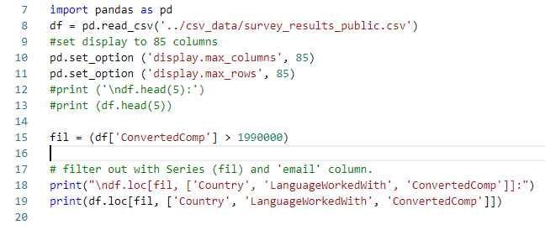
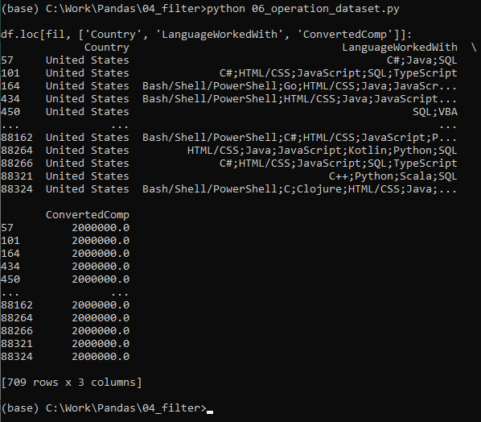
4.6 filter operator on Big Dataset
https://www.youtube.com/watch?v=Lw2rlcxScZY&list=PL-osiE80TeTsWmV9i9c58mdDCSskIFdDS&index=4
Filter operator on Big Dataset
We want to look for people with salary with certain amount or what language make what salaries?
We can use schema data frame to see the column title.
The “ConvertedComp” for converted compensation over 1,900,000.
List the country, programming language, and compensation.

Slide 16
4.7 filter countries on Big Dataset

Slide 17
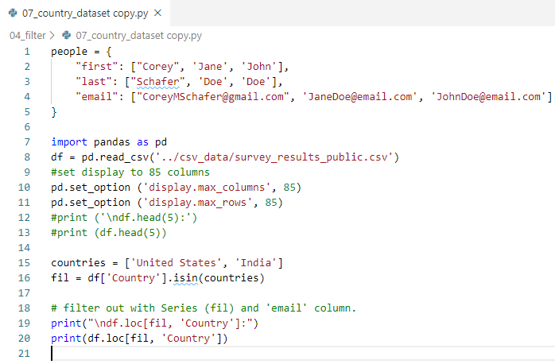
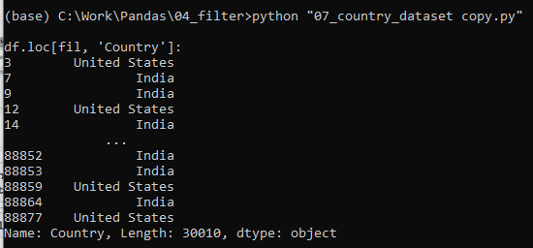
4.7 filter countries on Big Dataset
https://www.youtube.com/watch?v=Lw2rlcxScZY&list=PL-osiE80TeTsWmV9i9c58mdDCSskIFdDS&index=4
Filter operator on Big Dataset
> countries = [United States’, ‘India’]
> fil = df[‘Country’].isin(countries)
> df.loc[fil, ‘Country’]

Slide 18
End of Chapter

