Slide 1

3 Index
Peter H. Chen

Slide 2
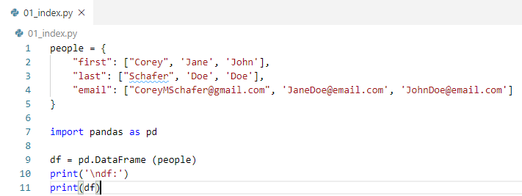
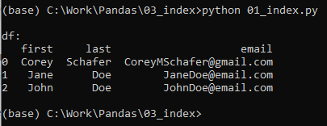
3 Index
https://www.youtube.com/watch?v=W9XjRYFkkyw&list=PL-osiE80TeTsWmV9i9c58mdDCSskIFdDS&index=3
Index
We discuss index. The index (0, 1, 0r 2) in front of each row is an index.
Sometimes, we may have different identifier (unique label) for each row.

Slide 3
3 Index
https://www.youtube.com/watch?v=W9XjRYFkkyw&list=PL-osiE80TeTsWmV9i9c58mdDCSskIFdDS&index=3
Index
Pandas sometimes do not have unique index for each row but most of the time index will be unique values.
What would be the good index for this data? Maybe the email address is a good index since email can be unique for most people.
> df[‘email]
Will display the email columns.
How do we assign the email as our index?
> df.set_index(‘email’)

Slide 4
3.1 Set Index

Slide 5
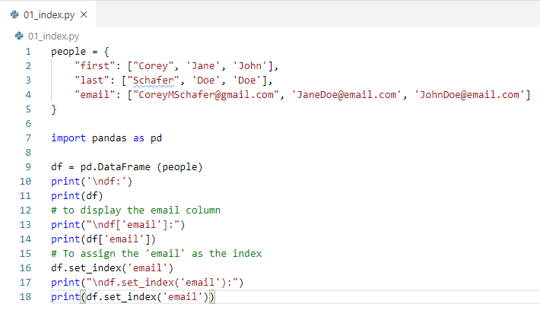
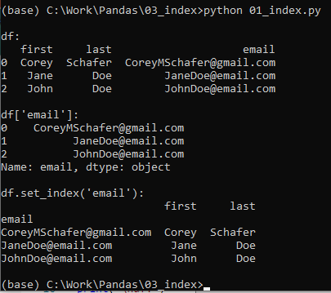
3.1 Set Index
https://www.youtube.com/watch?v=W9XjRYFkkyw&list=PL-osiE80TeTsWmV9i9c58mdDCSskIFdDS&index=3
To set email as the index
> df.set_index('email')

Slide 6
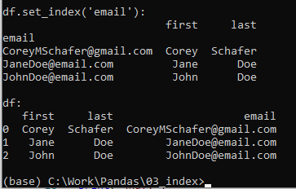
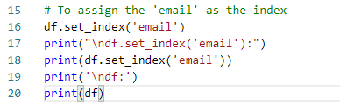
3.1 Set Index
https://www.youtube.com/watch?v=W9XjRYFkkyw&list=PL-osiE80TeTsWmV9i9c58mdDCSskIFdDS&index=3
To set email as the index
These email address become the same column of index as we set it.
If we look at the data frame again
> df
We can see the data frame did not change.

Slide 7
3.2 Replace Index in the Data Frame

Slide 8
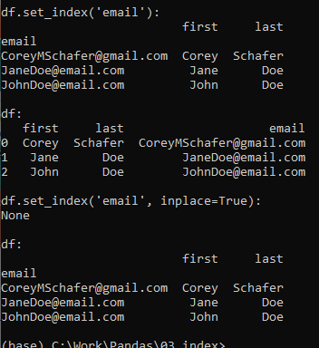
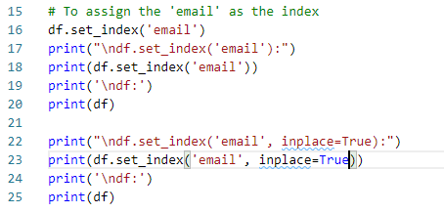
3.2 Replace Index in the Data Frame
https://www.youtube.com/watch?v=W9XjRYFkkyw&list=PL-osiE80TeTsWmV9i9c58mdDCSskIFdDS&index=3
Replace the index in the data frame.
> df.set_index(‘email’, inplace=True)
Now, we can see the data frame is replaced to email address.

Slide 9
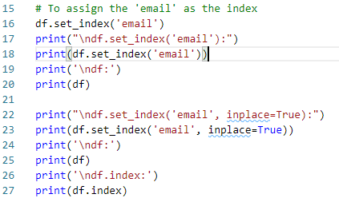
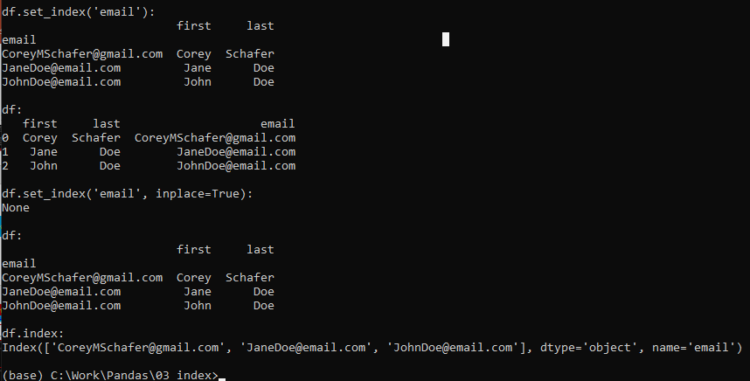
3.2 Replace Index in the Data Frame
https://www.youtube.com/watch?v=W9XjRYFkkyw&list=PL-osiE80TeTsWmV9i9c58mdDCSskIFdDS&index=3
Replace the index in the data frame.
> df.index
We see the index is change into email. The column name is also changed to ‘email’.

Slide 10
3.3 Use loc with Email

Slide 11
3.3 Use loc with Email
https://www.youtube.com/watch?v=W9XjRYFkkyw&list=PL-osiE80TeTsWmV9i9c58mdDCSskIFdDS&index=3
Why this is so important for us?
The email address give us an unique identifier for our row.
We use df.loc () to search for the data frame by label.
The indexes are the labels for the rows. Before, we use the default range index but now, we can find a specific row by email address.

Slide 12

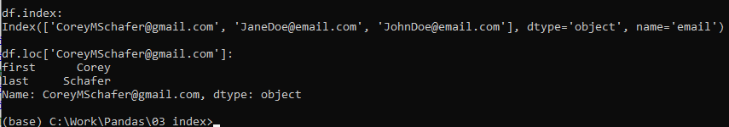
3.3 Use loc with Email
https://www.youtube.com/watch?v=W9XjRYFkkyw&list=PL-osiE80TeTsWmV9i9c58mdDCSskIFdDS&index=3
Use loc with Email
Before: > df.loc[0]
Now:
> df.loc [‘CoretMSchafer@gmail.com’]

Slide 13
3.3 Use loc with Email
https://www.youtube.com/watch?v=W9XjRYFkkyw&list=PL-osiE80TeTsWmV9i9c58mdDCSskIFdDS&index=3
Use loc with Email
Find the last name column with email address (row).
> df.loc [‘CoretMSchafer@gmail.com’, ‘last’]

Slide 14
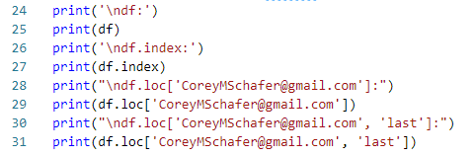
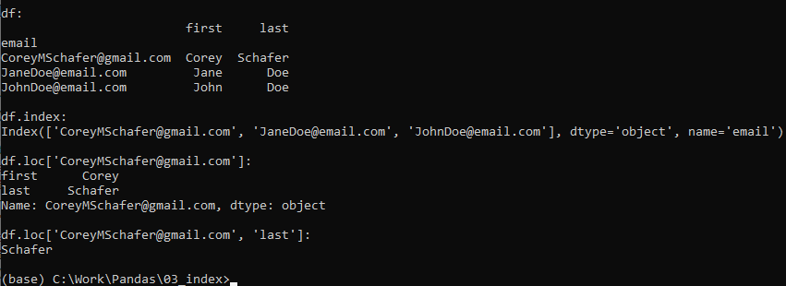
3.3 Use loc with Email
https://www.youtube.com/watch?v=W9XjRYFkkyw&list=PL-osiE80TeTsWmV9i9c58mdDCSskIFdDS&index=3
Use loc with Email
Find the last name column with email address (row).
> df.loc [‘CoretMSchafer@gmail.com’, ‘last’]

Slide 15
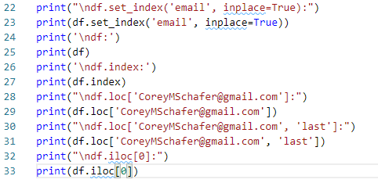
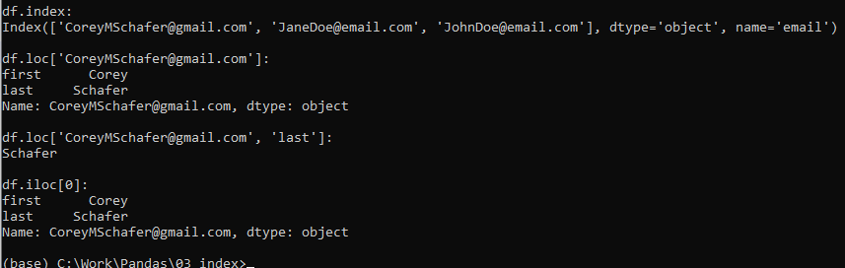
3.3 Use loc with Email
https://www.youtube.com/watch?v=W9XjRYFkkyw&list=PL-osiE80TeTsWmV9i9c58mdDCSskIFdDS&index=3
Use loc with Email
Display the first row.
> df.iloc [0]

Slide 16
3.4 reset_index(inplace=True)

Slide 17
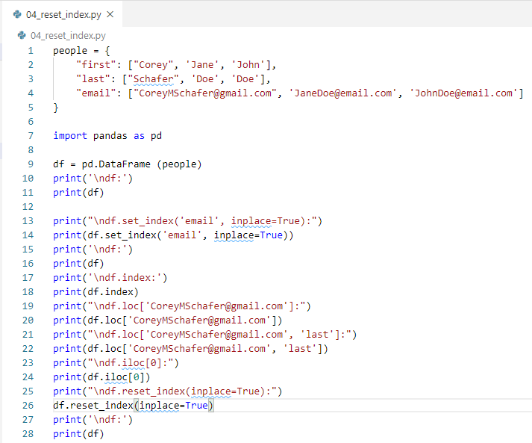
3.4 reset_index(inplace=True)
https://www.youtube.com/watch?v=W9XjRYFkkyw&list=PL-osiE80TeTsWmV9i9c58mdDCSskIFdDS&index=3
reset_index(inplace=True)

Slide 18
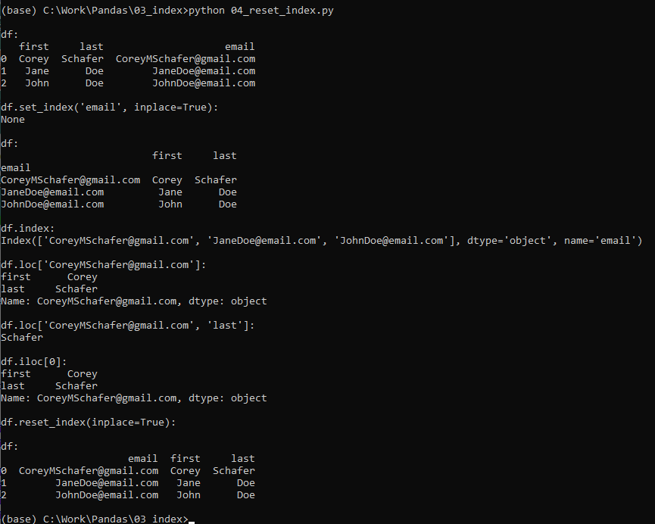
3.4 reset_index()
https://www.youtube.com/watch?v=W9XjRYFkkyw&list=PL-osiE80TeTsWmV9i9c58mdDCSskIFdDS&index=3
reset_index(inplace=True)

Slide 19
3.5 Process CSV Data

Slide 20
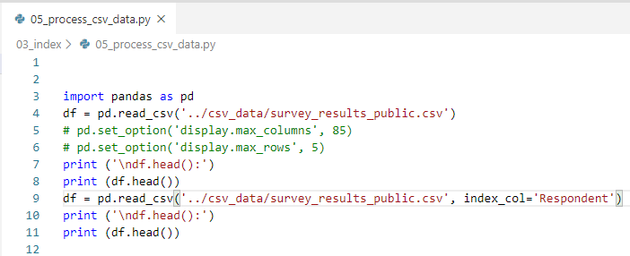
3.5 Process CSV Data
https://www.youtube.com/watch?v=W9XjRYFkkyw&list=PL-osiE80TeTsWmV9i9c58mdDCSskIFdDS&index=3
Process CSV Data

Slide 21
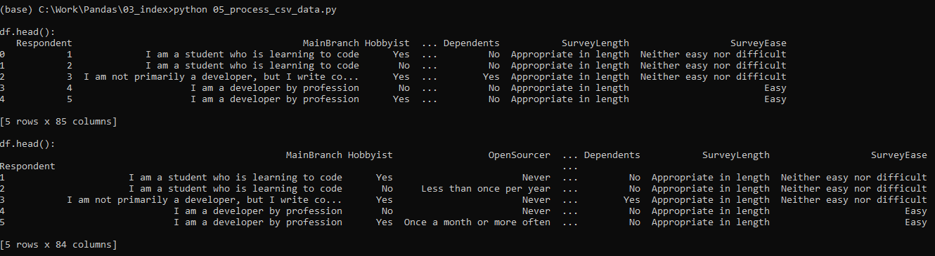
3.5 Process CSV Data
https://www.youtube.com/watch?v=W9XjRYFkkyw&list=PL-osiE80TeTsWmV9i9c58mdDCSskIFdDS&index=3
Process CSV Data

Slide 22
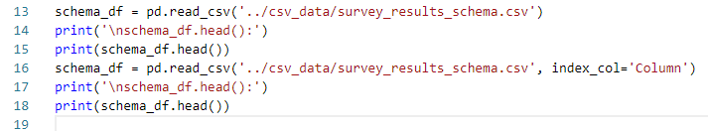
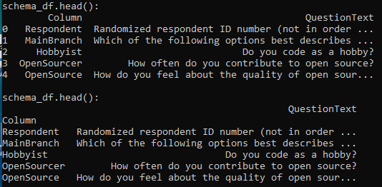
3.5 Process CSV Data
https://www.youtube.com/watch?v=W9XjRYFkkyw&list=PL-osiE80TeTsWmV9i9c58mdDCSskIFdDS&index=3
Process CSV Data: survey_results_schema.csv

Slide 23
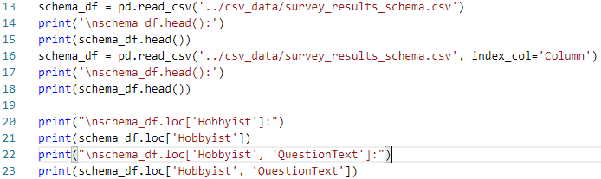
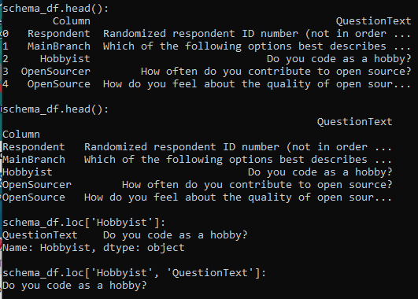
3.5 Process CSV Data
https://www.youtube.com/watch?v=W9XjRYFkkyw&list=PL-osiE80TeTsWmV9i9c58mdDCSskIFdDS&index=3
Process CSV Data: survey_results_schema.csv

Slide 24
3.6 Select Row and Column

Slide 25
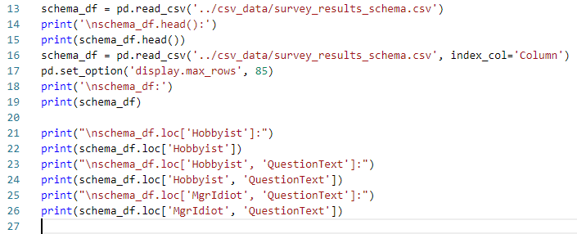
3.6 Select Row and Column
https://www.youtube.com/watch?v=W9XjRYFkkyw&list=PL-osiE80TeTsWmV9i9c58mdDCSskIFdDS&index=3
Select Row and Column

Slide 26
3.7 sort_index()

Slide 27

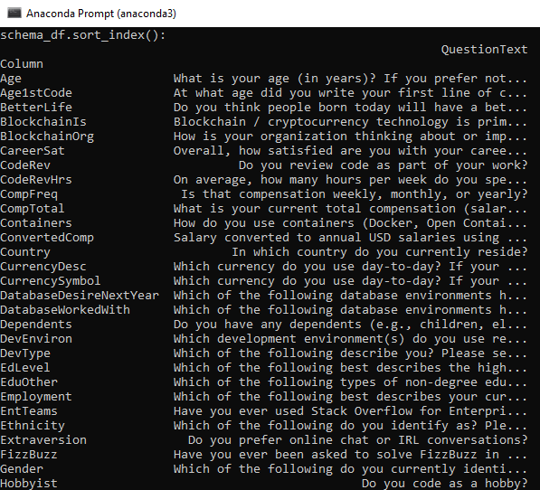
3.7 sort_index()
https://www.youtube.com/watch?v=W9XjRYFkkyw&list=PL-osiE80TeTsWmV9i9c58mdDCSskIFdDS&index=3
Sort Index

Slide 28

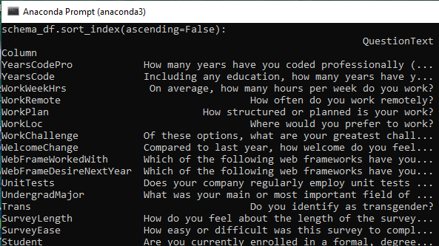
3.7 sort_index()
https://www.youtube.com/watch?v=W9XjRYFkkyw&list=PL-osiE80TeTsWmV9i9c58mdDCSskIFdDS&index=3
sort_index(ascending=False)

Slide 29
3.8 sort_index(inplace=True)

Slide 30
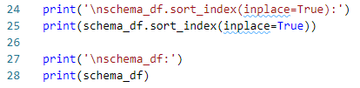
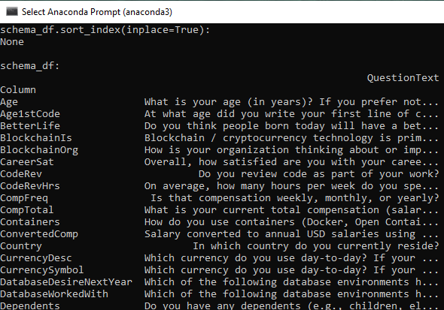
3.8 sort_index(inplace=True)
https://www.youtube.com/watch?v=W9XjRYFkkyw&list=PL-osiE80TeTsWmV9i9c58mdDCSskIFdDS&index=3
sort_index (inplace=True)

Slide 31
End of Chapter

