Slide 1

1 Get Start
Peter H. Chen

Slide 2
01 Get Start
https://www.youtube.com/watch?v=ZyhVh-qRZPA&list=PL-osiE80TeTsWmV9i9c58mdDCSskIFdDS&index=1
Get Start
Pandas is a Data Analysis Library for read and work with different types of data.
We can use Pandas to analyze CSV files, Excel files, and some other similar formats.
If you are in data science field, these libraries are essential to learn.
Pandas is one of the most download packages for Python.
Pandas allow us to easily read in and analyze data and great performance since it built on top of numpy.
We will discuss how to use Pandas.

Slide 3
1.1 Install Pandas

Slide 4
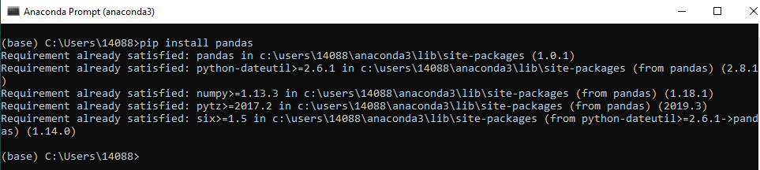
1.1 Install Pandas
https://www.youtube.com/watch?v=ZyhVh-qRZPA&list=PL-osiE80TeTsWmV9i9c58mdDCSskIFdDS&index=1
Get Start
Under the windows, search for “anaconda environment”
> pip install pandas

Slide 5
1.2 Install Jupyter

Slide 6
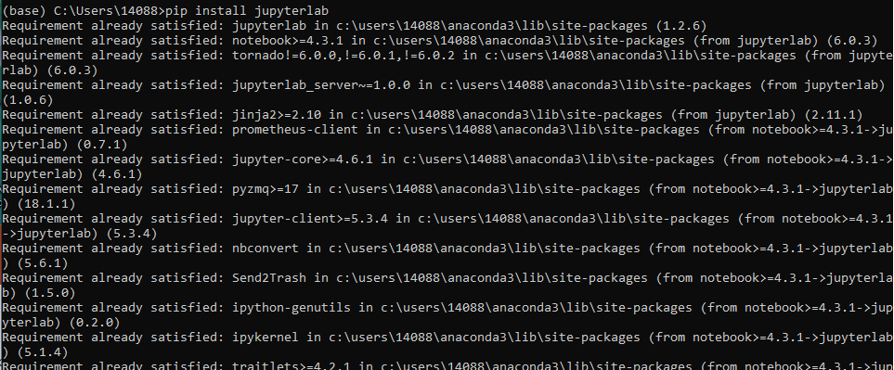
1.2 Install Jupyter
https://www.youtube.com/watch?v=ZyhVh-qRZPA&list=PL-osiE80TeTsWmV9i9c58mdDCSskIFdDS&index=1
Get Start
You can install Jupyter. Jupyter works under browser and make it easier to print and visualize data.
> pip install jupyterlab

Slide 7
1.3 Download Csv Data

Slide 8
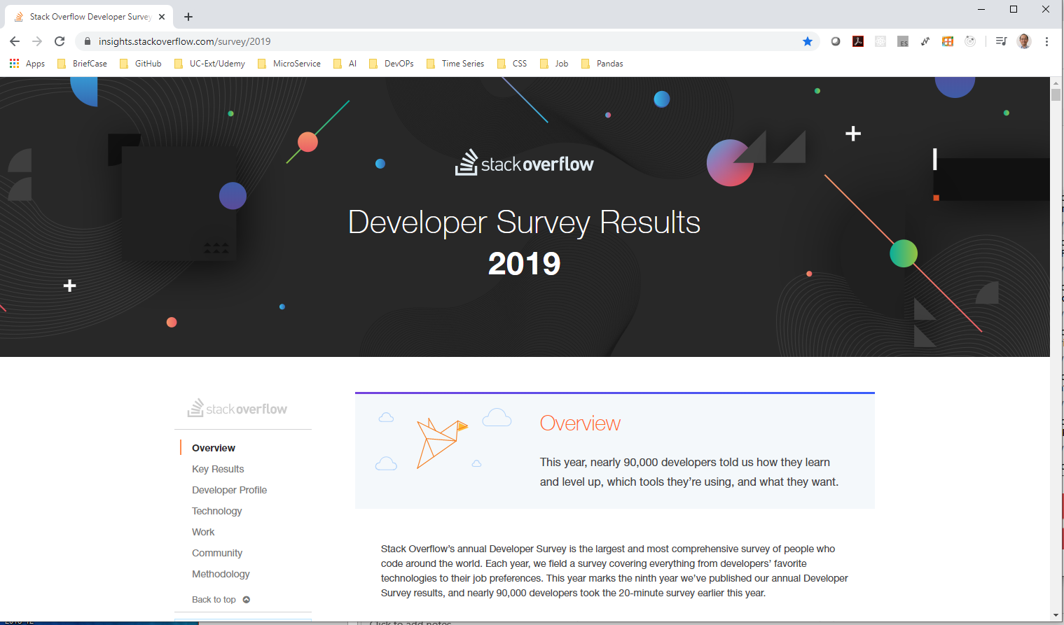
1.3 Download Csv Data
https://www.youtube.com/watch?v=ZyhVh-qRZPA&list=PL-osiE80TeTsWmV9i9c58mdDCSskIFdDS&index=1
Get Start
We use stackoverflow real world data

Slide 9
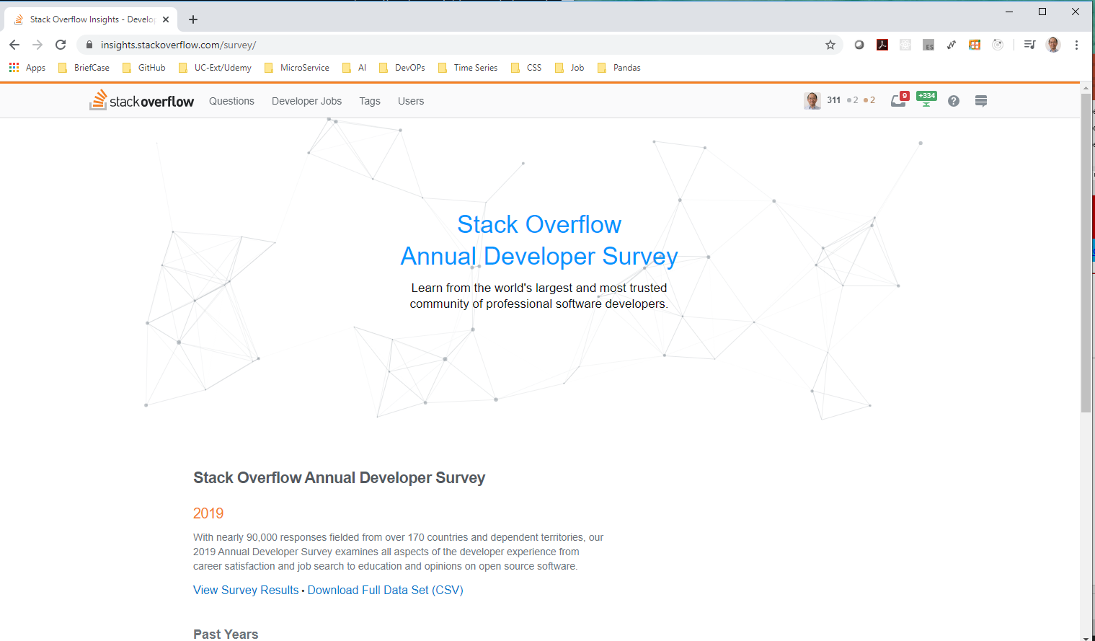
1.3 Download Csv Data
https://www.youtube.com/watch?v=ZyhVh-qRZPA&list=PL-osiE80TeTsWmV9i9c58mdDCSskIFdDS&index=1
Get Start
Search “stackoverflow survery csv data”
https://insights.stackoverflow.com/survey/

Slide 10
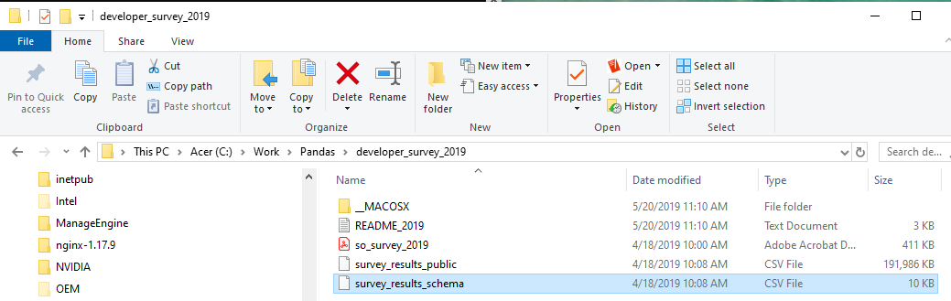
1.3 Download Csv Data
https://www.youtube.com/watch?v=ZyhVh-qRZPA&list=PL-osiE80TeTsWmV9i9c58mdDCSskIFdDS&index=1
Get Start
Unzipped. Move to your working directory and rename to shorter name “csv_data”.
“survey_results_public.csv”: contains main survey result, one response per row, one column per answer.
“survey_results_schema.csv”: contains question for each column name and results.

Slide 11
1.4 Browse Csv Data by Excel

Slide 12
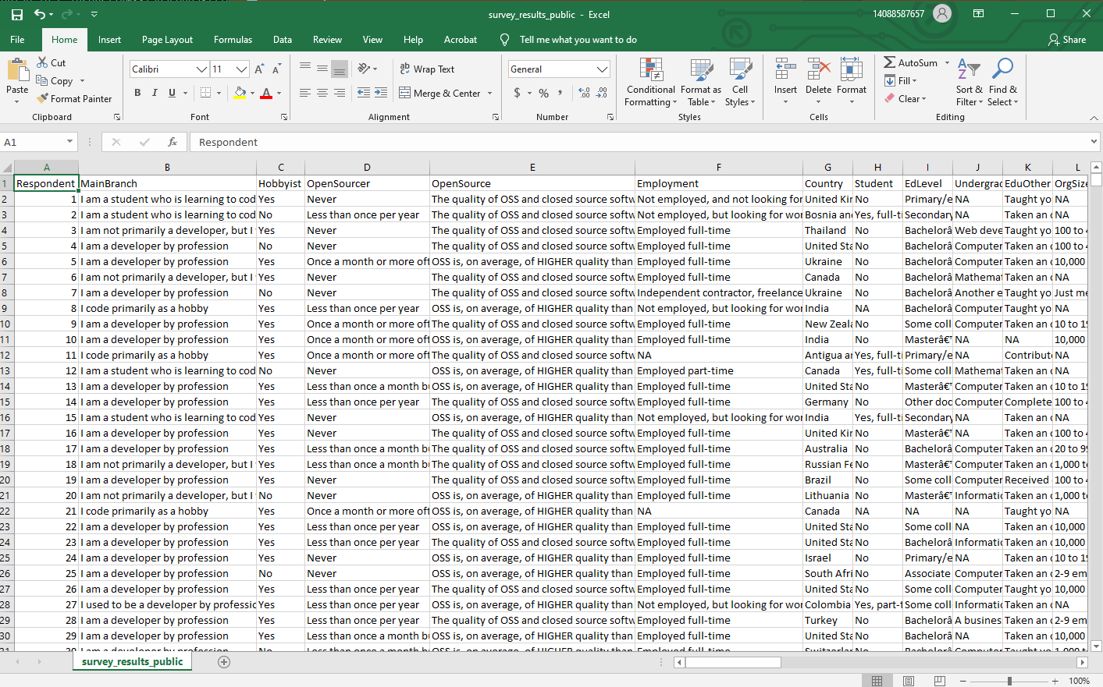
1.4 Browse Csv Data by Excel
https://www.youtube.com/watch?v=ZyhVh-qRZPA&list=PL-osiE80TeTsWmV9i9c58mdDCSskIFdDS&index=1
Get Start
“survey_results_public.csv”: contains main survey result, one response per row, one column per answer.

Slide 13
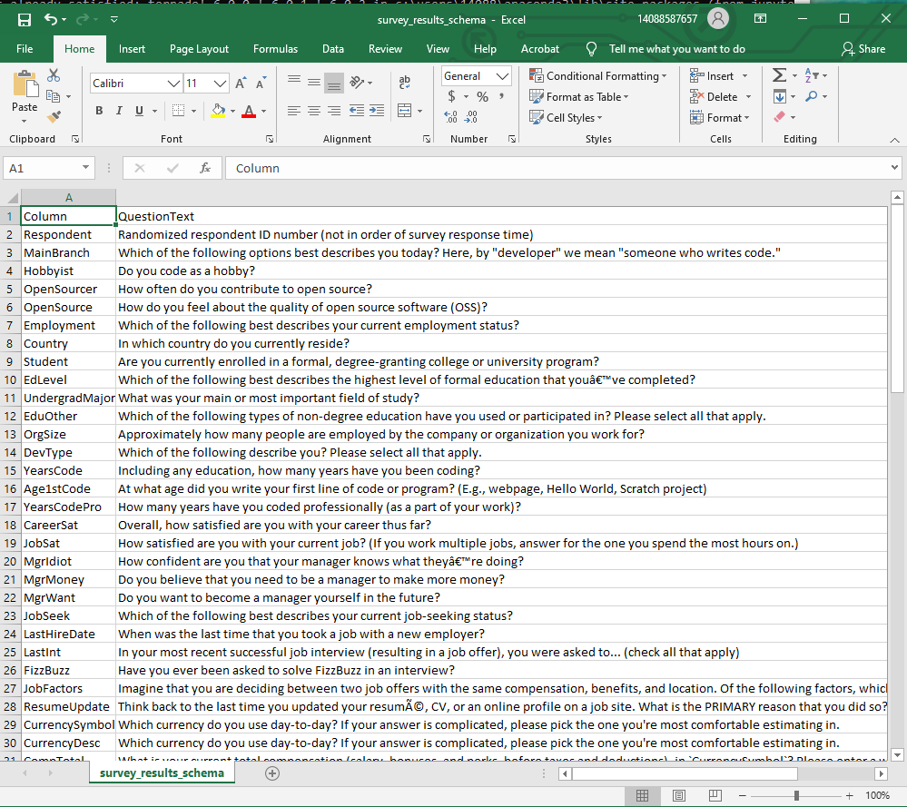
1.4 Browse Csv Data by Excel
https://www.youtube.com/watch?v=ZyhVh-qRZPA&list=PL-osiE80TeTsWmV9i9c58mdDCSskIFdDS&index=1
Get Start
“survey_results_schema.csv”: contains question for each column name and results.

Slide 14
1.5 Start Jupyter Notebook

Slide 15
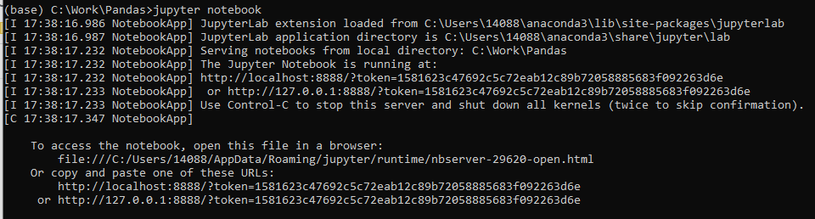
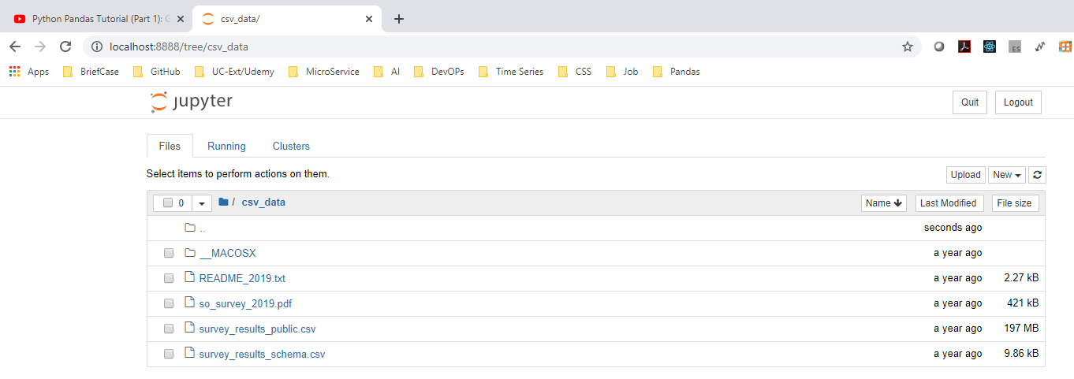
01 Get Start
https://www.youtube.com/watch?v=ZyhVh-qRZPA&list=PL-osiE80TeTsWmV9i9c58mdDCSskIFdDS&index=1
Get Start
Start Jupyter notebook:
> jupyter notebbok

Slide 16
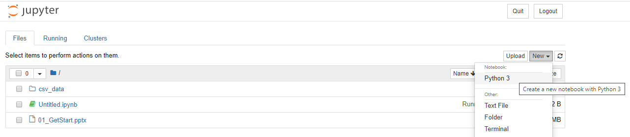
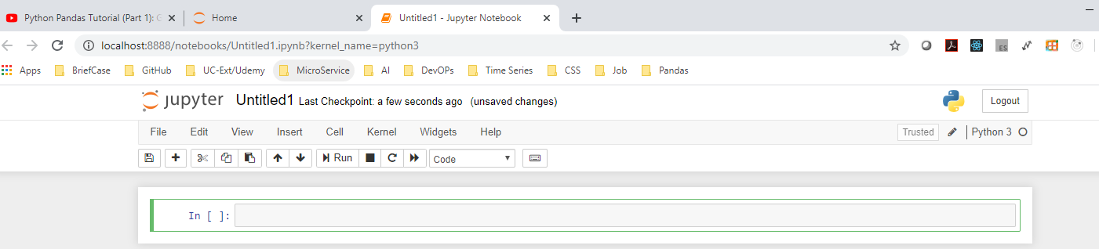
1.5 Start Jupyter Notebook
https://www.youtube.com/watch?v=ZyhVh-qRZPA&list=PL-osiE80TeTsWmV9i9c58mdDCSskIFdDS&index=1
Get Start
> new > python 3
Start Python code

Slide 17
1.5 Start Jupyter Notebook
https://www.youtube.com/watch?v=ZyhVh-qRZPA&list=PL-osiE80TeTsWmV9i9c58mdDCSskIFdDS&index=1
Get Start
I will use VS Code Python code.

Slide 18
1.6 Import pandas and Print

Slide 19
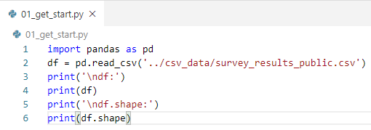
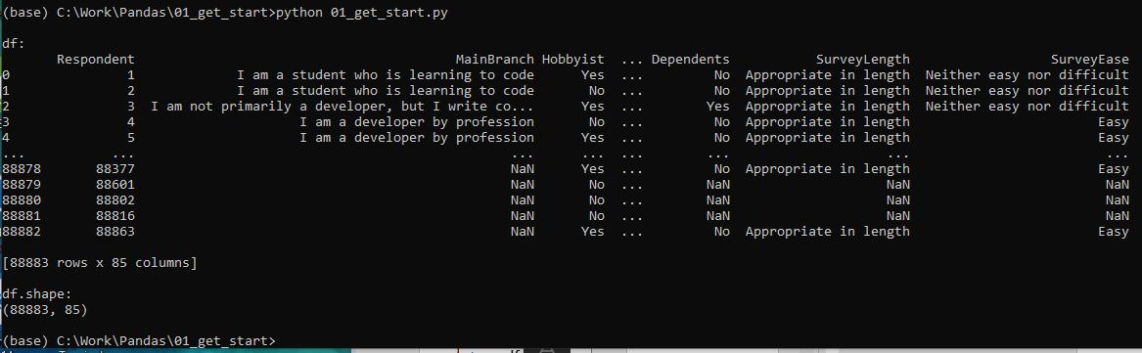
1.6 Import pandas and Print
https://www.youtube.com/watch?v=ZyhVh-qRZPA&list=PL-osiE80TeTsWmV9i9c58mdDCSskIFdDS&index=1
Import Pandas and Print
> import pandas as pd
> df = pd.read_csv (‘../cvs_data/survey_results_public.csv’)
> df.shape # shape is an attribute, not a method.

Slide 20
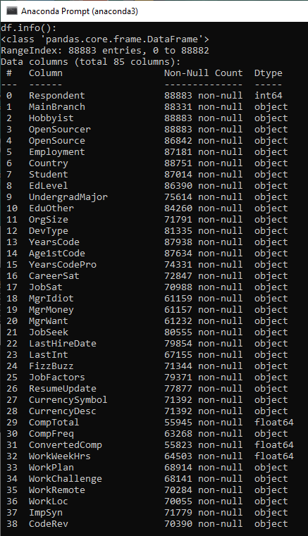
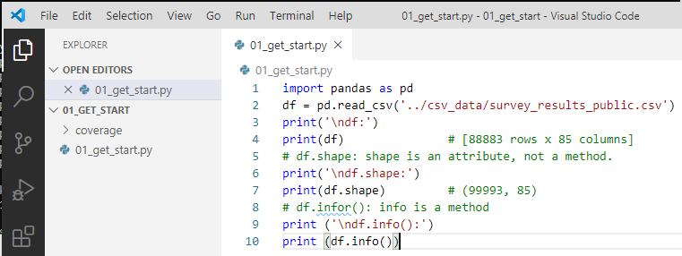
1.6 Import pandas and Print
https://www.youtube.com/watch?v=ZyhVh-qRZPA&list=PL-osiE80TeTsWmV9i9c58mdDCSskIFdDS&index=1
Import Pandas and Print
> df.info()
We have 88883 rows and 85 columns
The data type object, most of them means string, int64, flaot64.

Slide 21
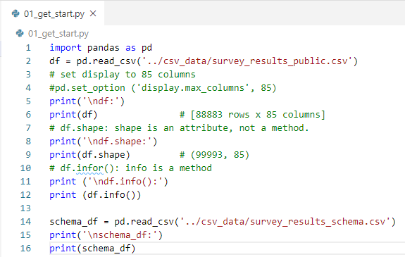
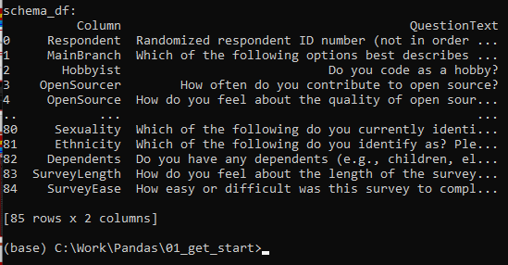
1.6 Import pandas and Print
https://www.youtube.com/watch?v=ZyhVh-qRZPA&list=PL-osiE80TeTsWmV9i9c58mdDCSskIFdDS&index=1
> schemas_df = pd.read_csv (‘../csv_data/survey_results_schema.csv’)
To see the column and QuestionText.

Slide 22

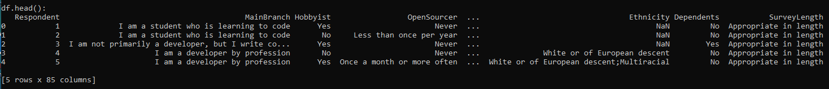
1.6 Import pandas and Print
https://www.youtube.com/watch?v=ZyhVh-qRZPA&list=PL-osiE80TeTsWmV9i9c58mdDCSskIFdDS&index=1
> df.head() # print first 5 rows.
> df.head(10) # print first 10 rows
> df.tail() # print last 5 rows.

Slide 23
End of Chapter

