Slide 1

01 Introduction
Peter H. Chen

Slide 2
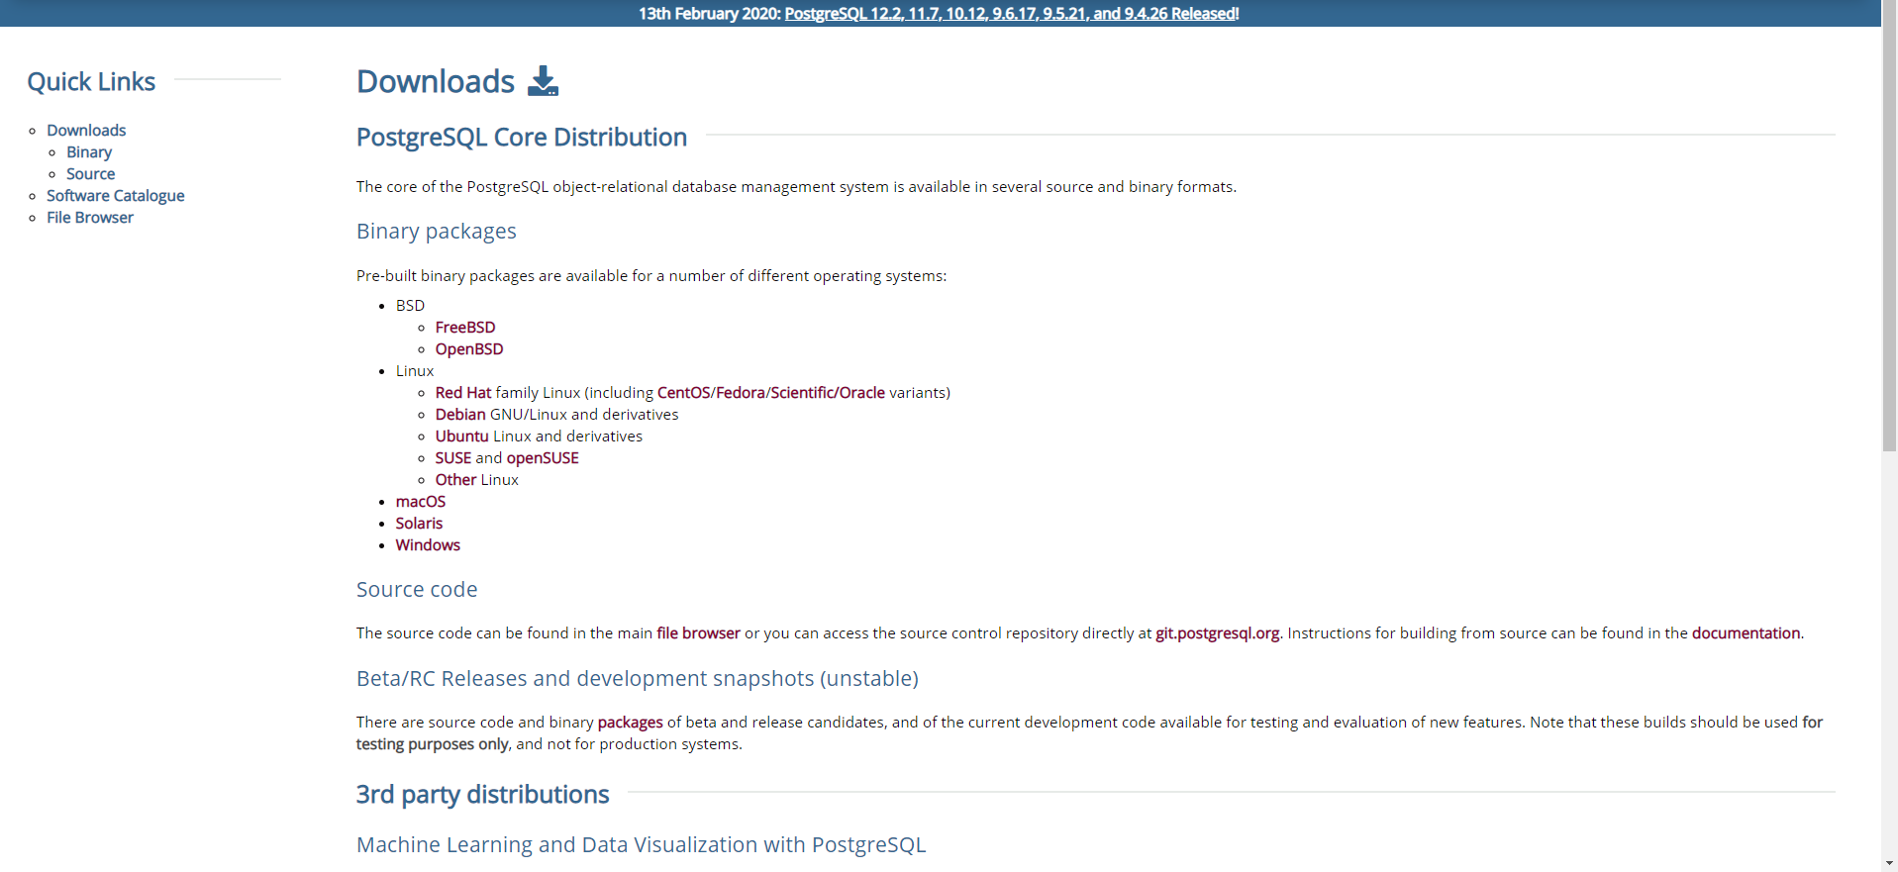
01 Introduction
https://www.youtube.com/watch?v=oUuwBGZVcQQ&list=PL6XPp3__UNY4WZUcMrcIyT5PPAx3Af5Px
PostgreSQL download

Slide 3
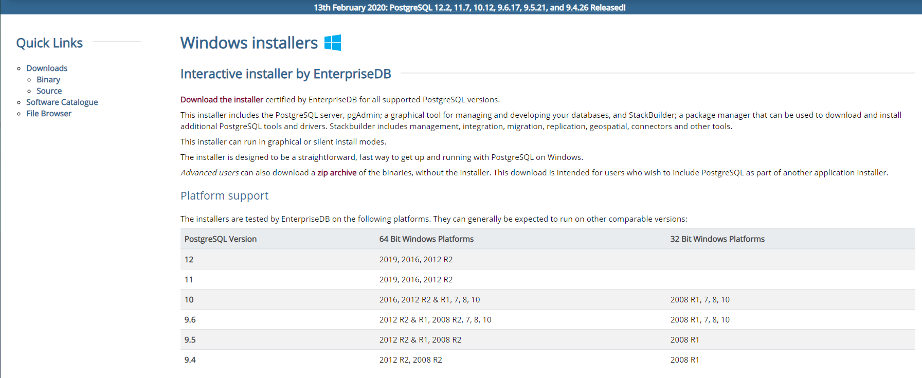
01 Introduction
https://www.youtube.com/watch?v=oUuwBGZVcQQ&list=PL6XPp3__UNY4WZUcMrcIyT5PPAx3Af5Px
PostgreSQL download

Slide 4
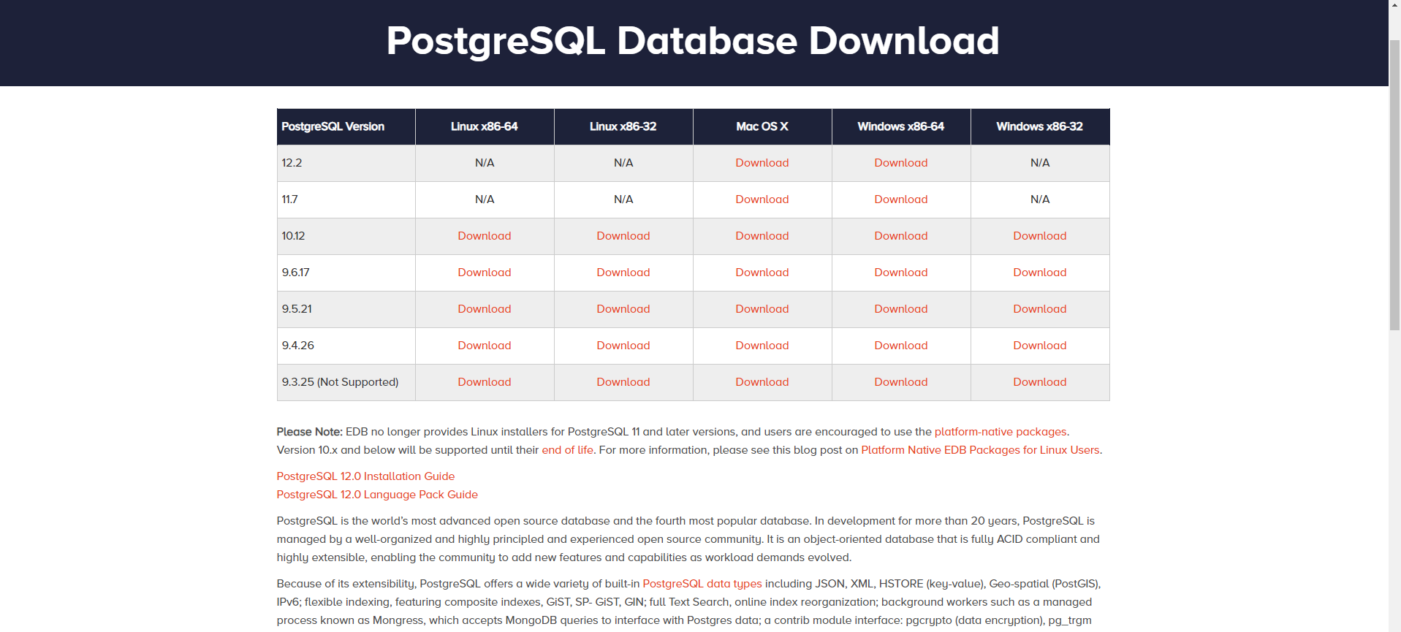
01 Introduction
https://www.youtube.com/watch?v=oUuwBGZVcQQ&list=PL6XPp3__UNY4WZUcMrcIyT5PPAx3Af5Px
PostgreSQL download

Slide 5
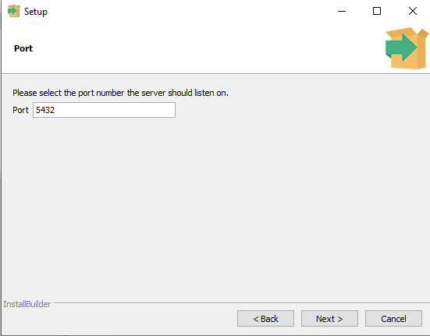
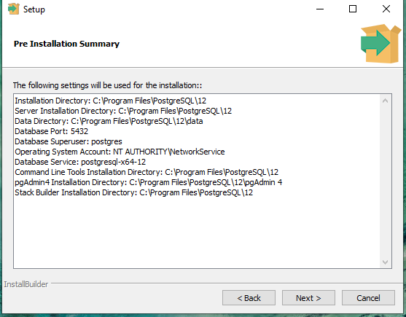
01 Introduction
https://www.youtube.com/watch?v=oUuwBGZVcQQ&list=PL6XPp3__UNY4WZUcMrcIyT5PPAx3Af5Px
Port: 5432, Locale: [Default locale]

Slide 6
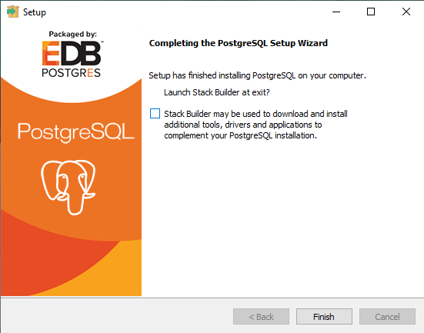
01 Introduction
https://www.youtube.com/watch?v=oUuwBGZVcQQ&list=PL6XPp3__UNY4WZUcMrcIyT5PPAx3Af5Px
Turn off the “Stack Builder maybe used to download and install additional tools, drivers, and applications to complement your PostgreSQL installation.”

Slide 7
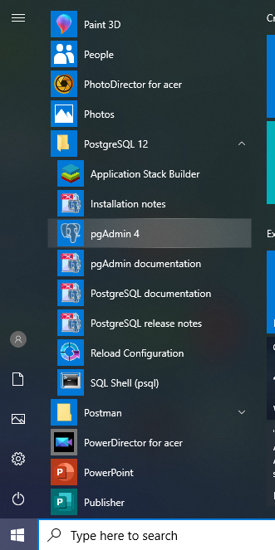
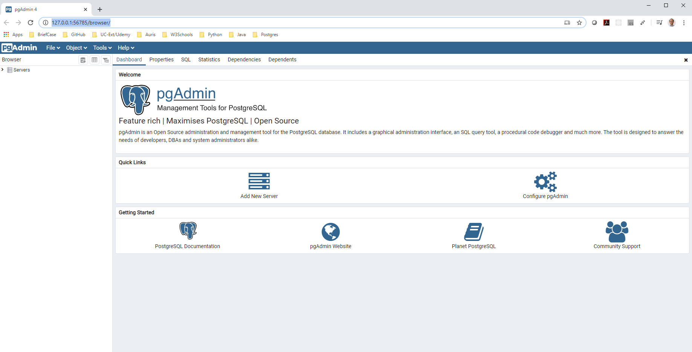
01 Introduction
https://www.youtube.com/watch?v=oUuwBGZVcQQ&list=PL6XPp3__UNY4WZUcMrcIyT5PPAx3Af5Px
Select “pgAdmin 4”

Slide 8
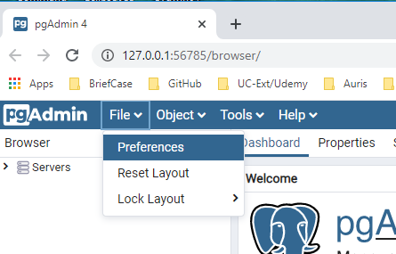
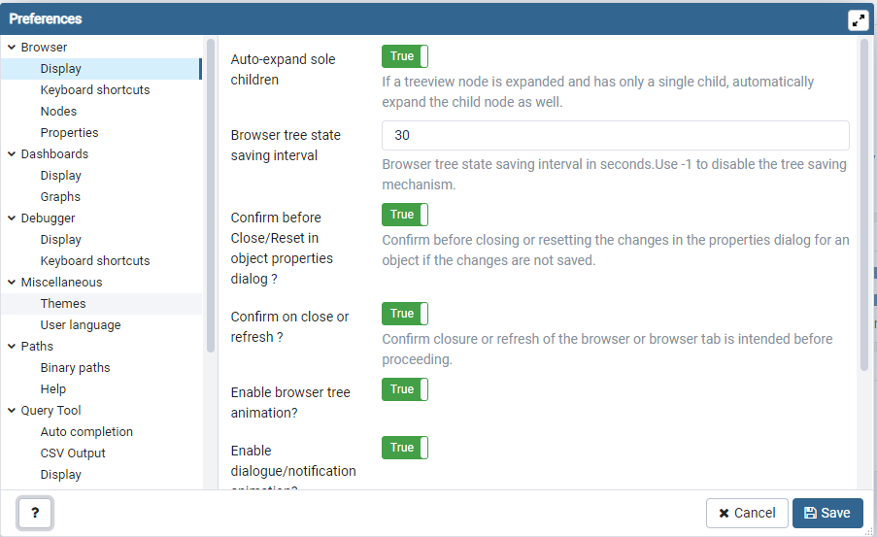
01 Introduction
https://www.youtube.com/watch?v=oUuwBGZVcQQ&list=PL6XPp3__UNY4WZUcMrcIyT5PPAx3Af5Px
File > Preferences: Theme

Slide 9
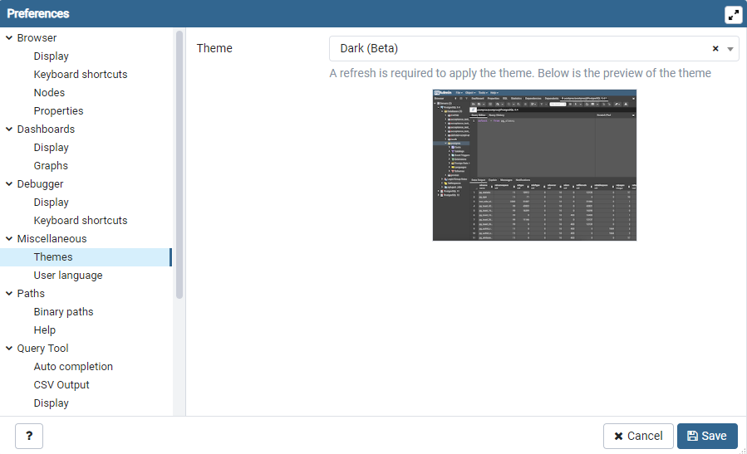
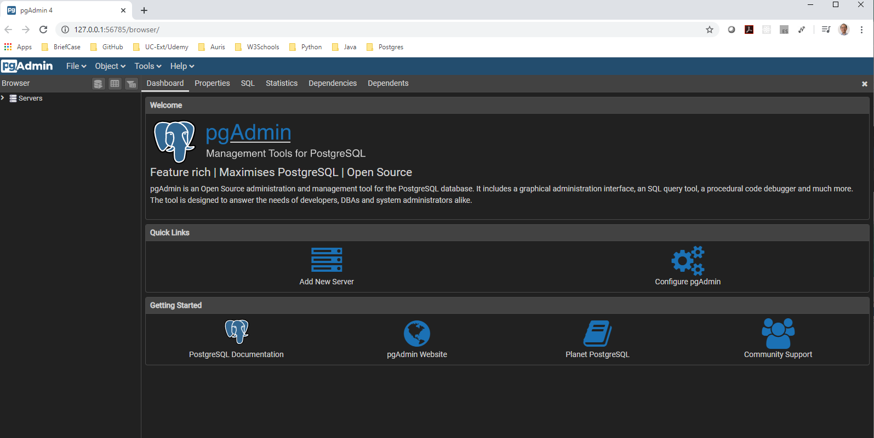
01 Introduction
https://www.youtube.com/watch?v=oUuwBGZVcQQ&list=PL6XPp3__UNY4WZUcMrcIyT5PPAx3Af5Px
Theme: Dark (Beta)

Slide 10
End of Chapter

