Slide 1

02 Create DB (pgAdmin4)
Peter H. Chen

Slide 2
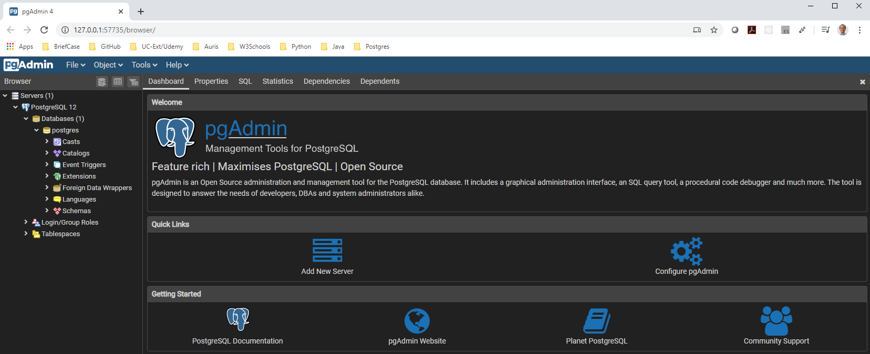
02 Create DB (pgAdmin4)
https://www.youtube.com/watch?v=BI7OWaNv3_M&list=PL6XPp3__UNY4WZUcMrcIyT5PPAx3Af5Px&index=2
Create Database by pgAdmin4: expand ProstgreSQL > Database
You can see there is a database “posgres”

Slide 3
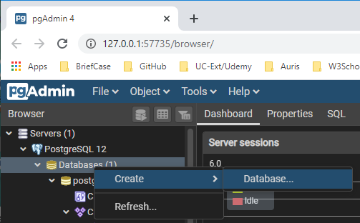
02 Create DB (pgAdmin4)
https://www.youtube.com/watch?v=BI7OWaNv3_M&list=PL6XPp3__UNY4WZUcMrcIyT5PPAx3Af5Px&index=2
We will not use database “postgres”. We will create our own database called “database1”.
Select database. RMB: Database > create > Database …

Slide 4
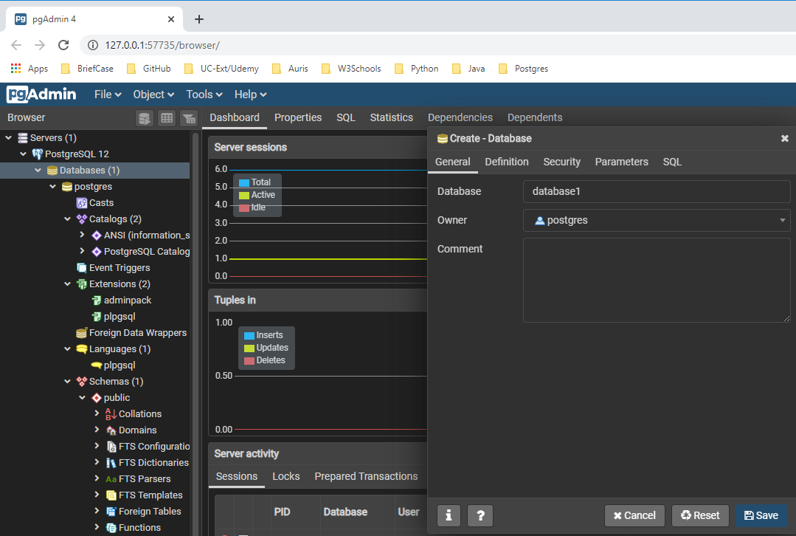
02 Create DB (pgAdmin4)
https://www.youtube.com/watch?v=BI7OWaNv3_M&list=PL6XPp3__UNY4WZUcMrcIyT5PPAx3Af5Px&index=2
Create – Database
Database: database1

Slide 5
End of Chapter

