Slide 1

02 Create Table (pgAdmin4)
Peter H. Chen

Slide 2
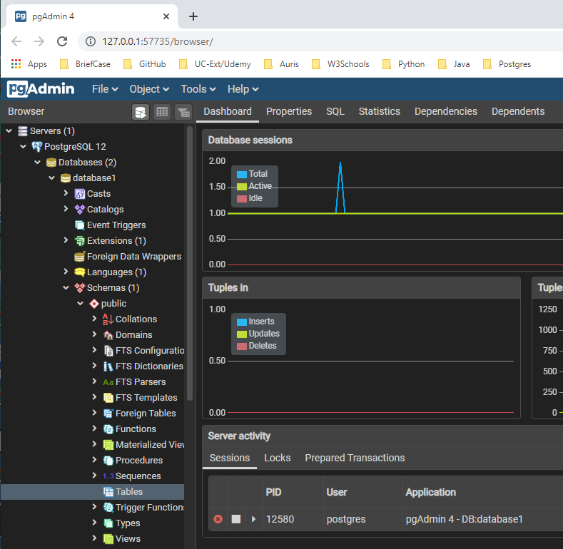
02 Create Table (pgAdmin4)
https://www.youtube.com/watch?v=fbwkw0tKB5A&list=PL6XPp3__UNY4WZUcMrcIyT5PPAx3Af5Px&index=3
Create Table:
Check the scheme > Tables: There is no table and no columns.

Slide 3
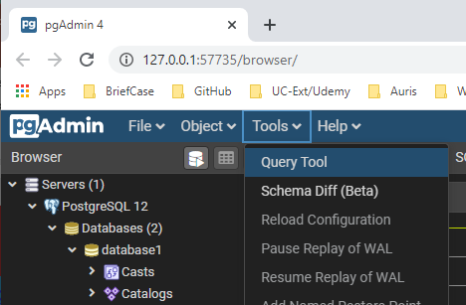
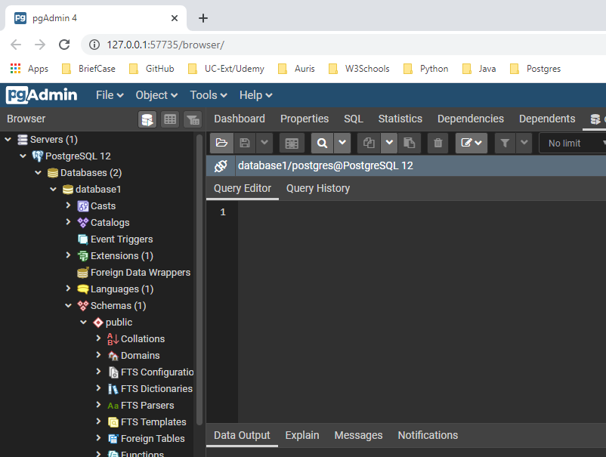
02 Create Table (pgAdmin4)
https://www.youtube.com/watch?v=fbwkw0tKB5A&list=PL6XPp3__UNY4WZUcMrcIyT5PPAx3Af5Px&index=3
Click the Tools > Query Tool:

Slide 4
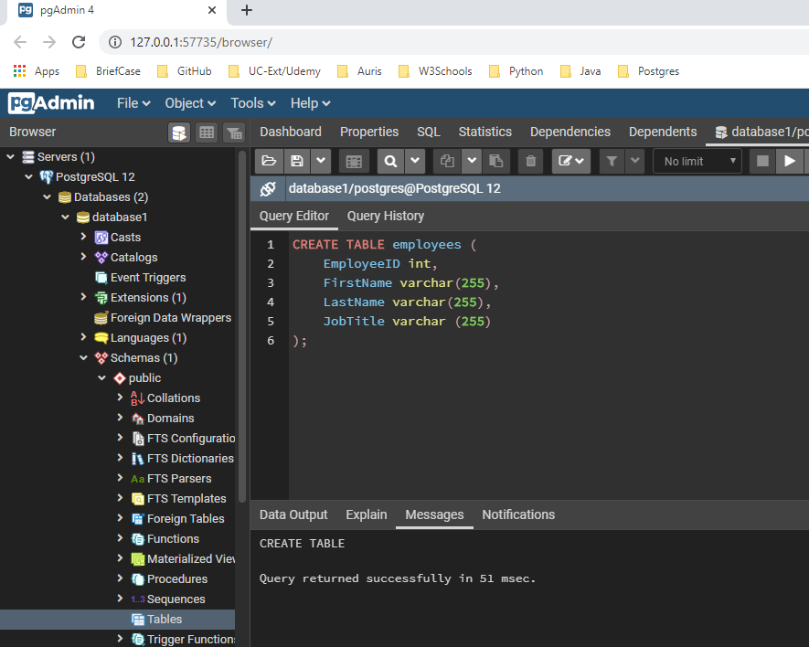
02 Create Table (pgAdmin4)
https://www.youtube.com/watch?v=fbwkw0tKB5A&list=PL6XPp3__UNY4WZUcMrcIyT5PPAx3Af5Px&index=3
Enter scheme:
> CREATE TABLE employees (
> EmployeeID int,
> FirstName varchar (250),
> LastName varchar(250),
> JobTitle varchar (250)
>);
Click “Run”.
Message:
Query returned successfully in 51 msec

Slide 5
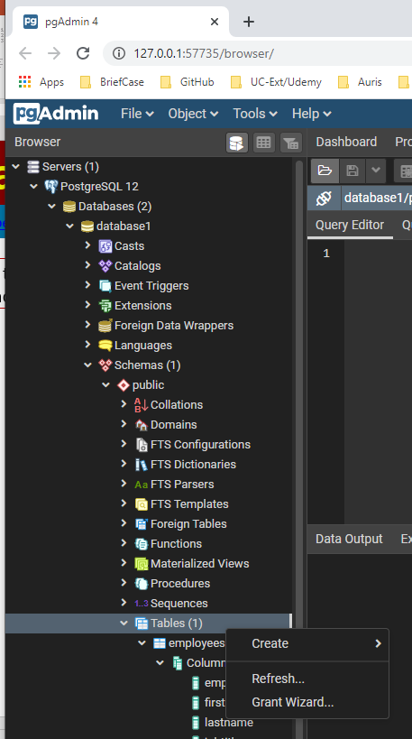
02 Create Table (pgAdmin4)
https://www.youtube.com/watch?v=fbwkw0tKB5A&list=PL6XPp3__UNY4WZUcMrcIyT5PPAx3Af5Px&index=3
RMB and click Refresh to upload the database to see the table and columns.

Slide 6
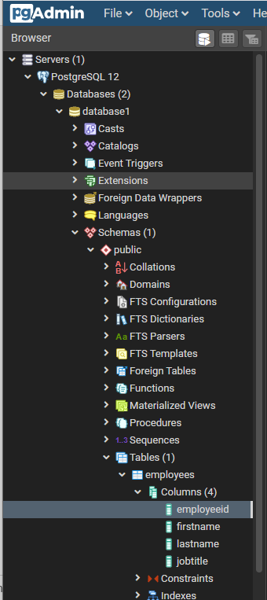
02 Create Table (pgAdmin4)
https://www.youtube.com/watch?v=fbwkw0tKB5A&list=PL6XPp3__UNY4WZUcMrcIyT5PPAx3Af5Px&index=3
Refresh the pyAdmin4, we can see the empployees table and associated columns: employeeid, firstname, lastname, and jobtitle has been created.

Slide 7
End of Chapter

