Slide 1

05 Alter Table (pgAdmin4)
Peter H. Chen

Slide 2
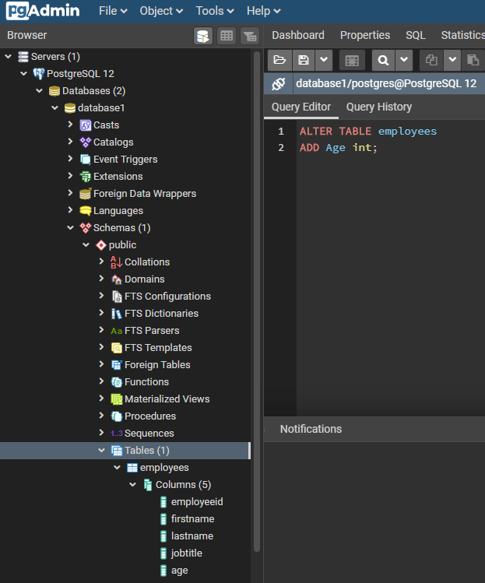
05 Alter Table (pgAdmin4)
https://www.youtube.com/watch?v=fbwkw0tKB5A&list=PL6XPp3__UNY4WZUcMrcIyT5PPAx3Af5Px&index=3
> ALTER TABLE employees
> Add Age int;
Run
Click Table; RMB > refresh
Display the “Age” column

Slide 3
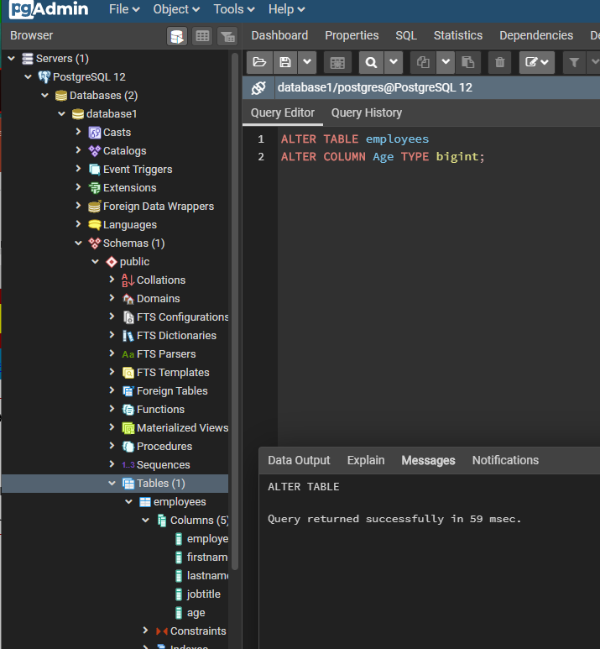
05 Alter Table (pgAdmin4)
https://www.youtube.com/watch?v=fbwkw0tKB5A&list=PL6XPp3__UNY4WZUcMrcIyT5PPAx3Af5Px&index=3
> ALTER TABLE employees
> ALTER COLUMN Age TYPE bigint;
Run
Click Table; RMB > refresh
Display the “Age” column

Slide 4
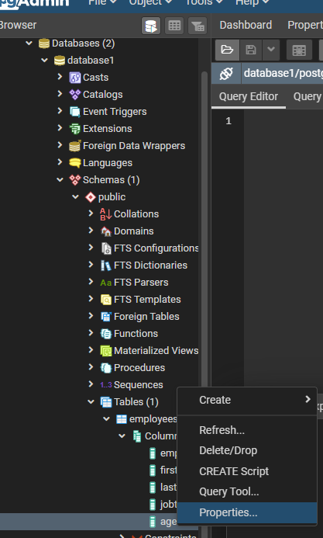
05 Alter Table (pgAdmin4)
https://www.youtube.com/watch?v=fbwkw0tKB5A&list=PL6XPp3__UNY4WZUcMrcIyT5PPAx3Af5Px&index=3
Click “Age”
RMB > Properties

Slide 5
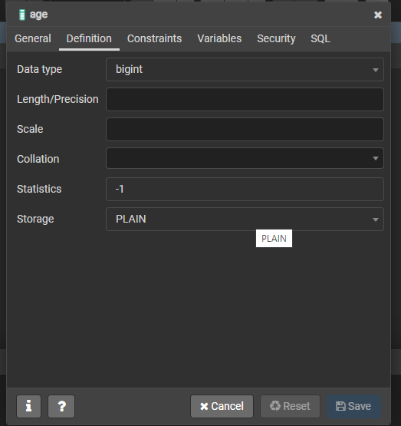
05 Alter Table (pgAdmin4)
https://www.youtube.com/watch?v=fbwkw0tKB5A&list=PL6XPp3__UNY4WZUcMrcIyT5PPAx3Af5Px&index=3
Click “Definition”
You can see Data Type of “Age” is “bigint”.

Slide 6
End of Chapter

