Slide 1

06 NOT NULL (pgAdmin4)
Peter H. Chen

Slide 2
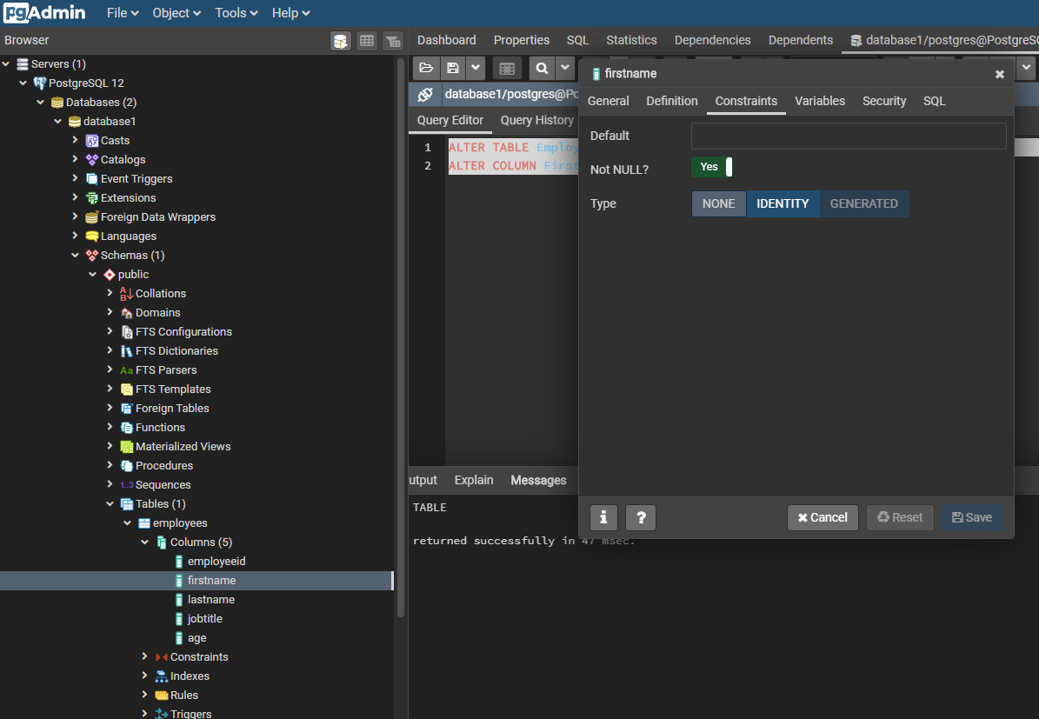
06 SET NOT NULL (pgAdmin4)
https://www.youtube.com/watch?v=aexd80HXgZs&list=PL6XPp3__UNY4WZUcMrcIyT5PPAx3Af5Px&index=6
ALTER TABLE Employees
ALTER COLUMN FirstName SET NOT NULL;
> RUN
FirstName > RMB: > Properties
Click “Constraints”
Not NULL: Yes

Slide 3
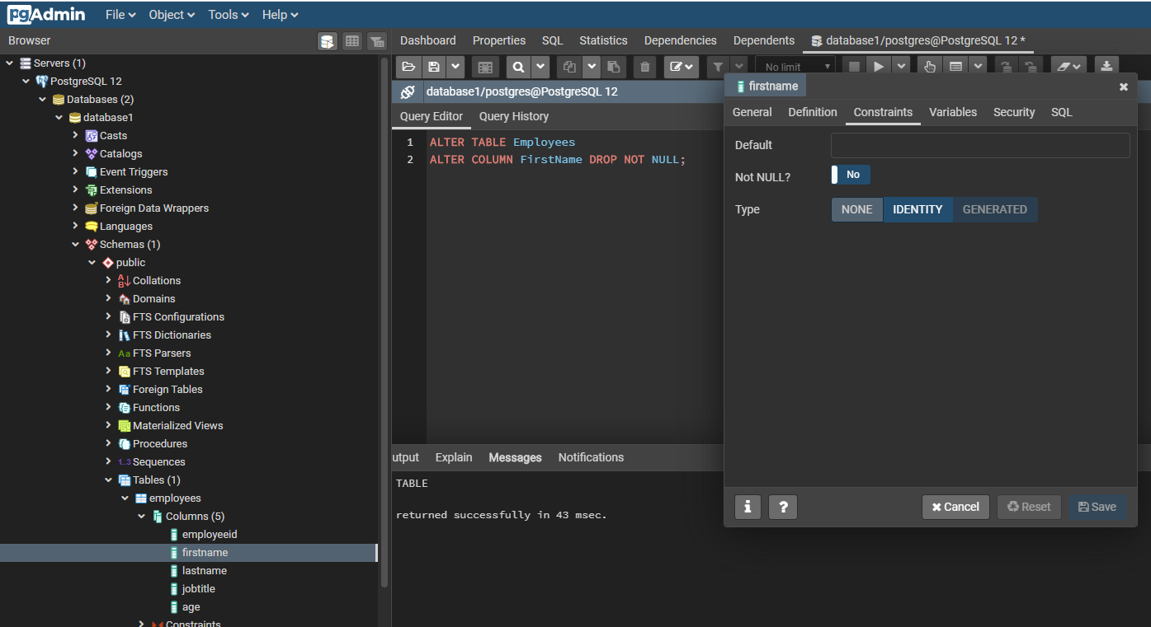
06 DROP NOT NULL (pgAdmin4)
https://www.youtube.com/watch?v=aexd80HXgZs&list=PL6XPp3__UNY4WZUcMrcIyT5PPAx3Af5Px&index=6
ALTER TABLE Employees
ALTER COLUMN FirstName DROP NOT NULL;
> RUN
FirstName > RMB: > Properties
Click “Constraints”
Not NULL: No

Slide 4
End of Chapter

