Slide 1

07 UNIQUE (pgAdmin4)
Peter H. Chen

Slide 2
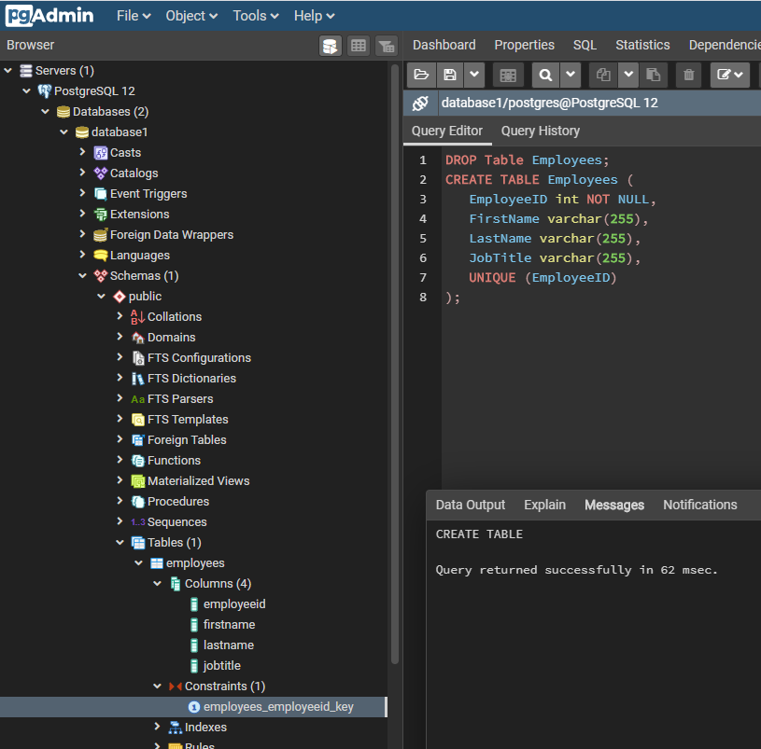
07 UNIQUE (pgAdmin4)
https://www.youtube.com/watch?v=HWaZyHa_zjQ&list=PL6XPp3__UNY4WZUcMrcIyT5PPAx3Af5Px&index=7
DROP Table Employees
CREATE TABLE Employees (
EmployeeID int NOT NULL,
FirstName varchar(255),
LastName varchar(255),
JobTitle varchar(255),
UNIQUE (EmployeeID)
);
> RUN
> employees > Constraints > employees_employeeid_key

Slide 3
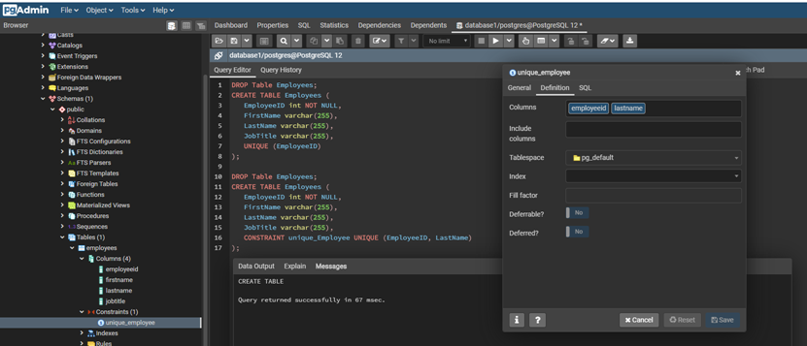
07 UNIQUE (pgAdmin4)
https://www.youtube.com/watch?v=HWaZyHa_zjQ&list=PL6XPp3__UNY4WZUcMrcIyT5PPAx3Af5Px&index=7
DROP Table Employees
CREATE TABLE Employees (
EmployeeID int NOT NULL,
FirstName varchar(255),
LastName varchar(255),
JobTitle varchar(255),
CONSTRAINT unique_employee UNIQUE (EmployeeID, LastName)
);
> RUN
> employees > Constraints > unique_employee

Slide 4
End of Chapter

