Slide 1

08 PRIMARY KEY (pgAdmin4)
Peter H. Chen

Slide 2
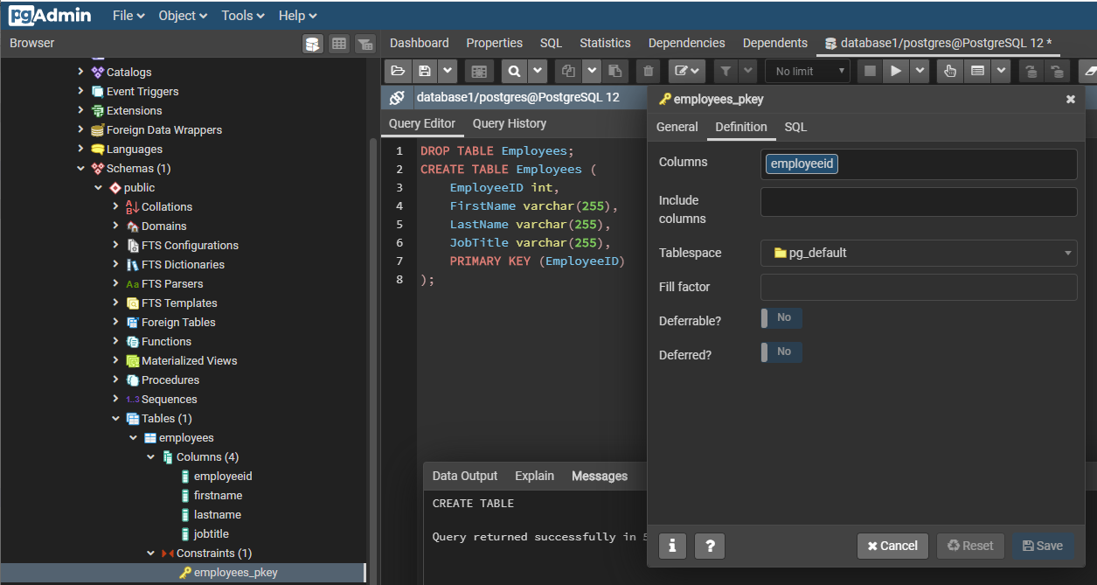
08 PRIMARY KEY (pgAdmin4)
https://www.youtube.com/watch?v=OXbtgRV-sjk&list=PL6XPp3__UNY4WZUcMrcIyT5PPAx3Af5Px&index=8
DROP TABLE Employees;
CREATE TABLE Employees (
EmployeeID int,
FirstName varchar(255),
LastName varchar(255),
JobTitle varchar(255),
PRIMARY KEY (EmployeeID)
);
> RUN
> employees > Constraints > employees_pkey

Slide 3
08 PRIMARY KEY (pgAdmin4)
https://www.youtube.com/watch?v=OXbtgRV-sjk&list=PL6XPp3__UNY4WZUcMrcIyT5PPAx3Af5Px&index=8
ALTER TABLE Employees
ADD CONSTRAINT primary_key_employee PRIMARY_KEY (EmployeeID);

Slide 4
End of Chapter

