Slide 1

09 FOREIGN KEY (pgAdmin4)
Peter H. Chen

Slide 2
09 FOREIGN KEY (pgAdmin4)
https://www.youtube.com/watch?v=3jyPcAr49bM&list=PL6XPp3__UNY4WZUcMrcIyT5PPAx3Af5Px&index=9
As we assign the primary key in the table.
If we join the data in the multiple tables, we need the foreign key for multiple tables.
A Foreign key is a column or a group of columns in a table that links to the primary key of another table.
We will create two tables, the first table is employees table. The second table contains the store that company has with foreign key.

Slide 3
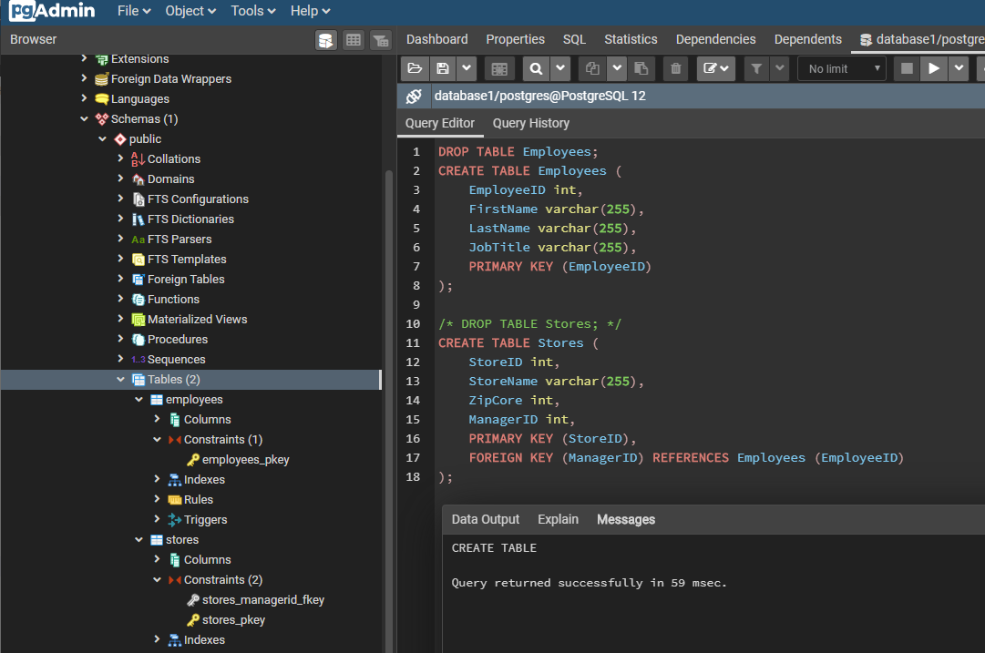
09 FOREIGN KEY (pgAdmin4)
https://www.youtube.com/watch?v=3jyPcAr49bM&list=PL6XPp3__UNY4WZUcMrcIyT5PPAx3Af5Px&index=9
Store Manager ID (in the Store table) is the Foreign Key which is reference to Primary key Employee ID (in the Employees table).

Slide 4
End of Chapter

