Slide 1

13 Insert (pgAdmin4)
Peter H. Chen

Slide 2
13 Insert (pgAdmin4)
https://www.youtube.com/watch?v=CDnk9MGbbvs&list=PL6XPp3__UNY4WZUcMrcIyT5PPAx3Af5Px&index=13
DROP TABLE Stores;
DROP TABLE Employees CASCADE;
CREATE TABLE Employees (
EmployeeID int PRIMARY KEY,
FirstName varchar(255) NOT NULL,
LastName varchar(255) NOT NULL,
JobTitle varchar(255) DefauLT 'Sales Assistant'
);
INSERT INTO Employees (EmployeeID, FirstName, LastName, JObTitle)
VALUES (100, 'Bob', 'Smith', 'CEO');
SELECT * FROM Employees;

Slide 3
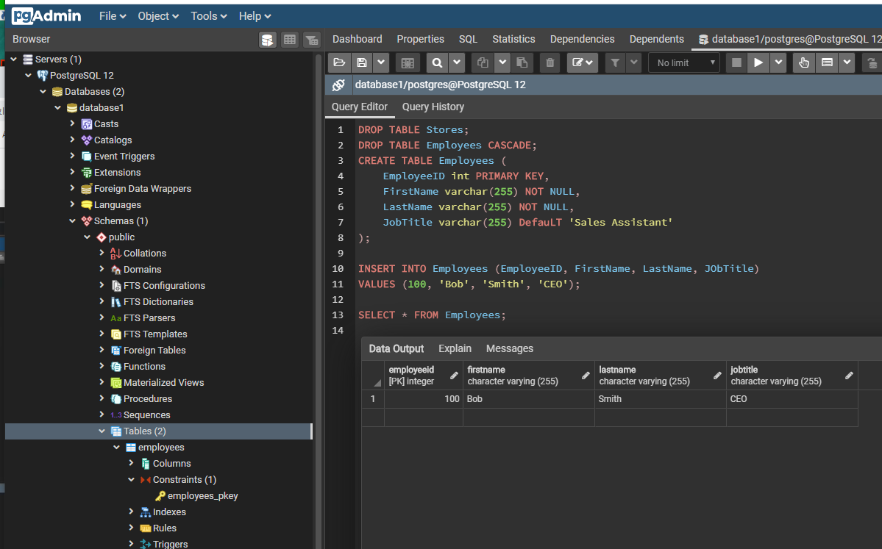
13 Insert (pgAdmin4)
https://www.youtube.com/watch?v=CDnk9MGbbvs&list=PL6XPp3__UNY4WZUcMrcIyT5PPAx3Af5Px&index=13
RUN

Slide 4
End of Chapter

