Slide 1

01 Python C Extension
Peter H. Chen

Slide 2
01 Python C Extension
https://www.journaldev.com/31907/calling-c-functions-from-python
For Python to call C function, the easiest way is to use Linux platform.
If you are the window users, the easiest way is to install the Cygwin. The Cygwin come with gcc compiler and python.

Slide 3
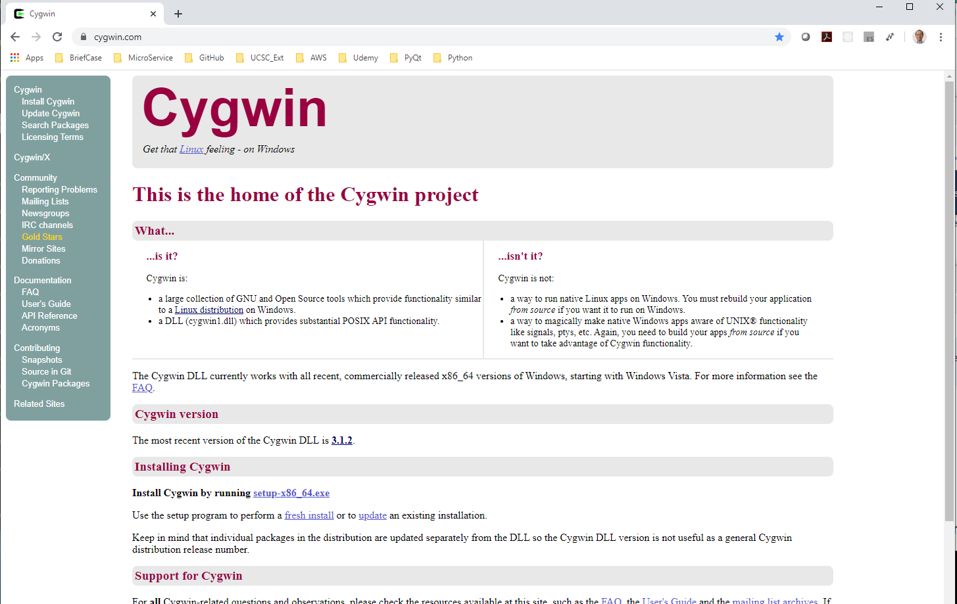
01 Python C Extension
https://www.journaldev.com/31907/calling-c-functions-from-python
Go to cygwin.com.
Download and install cygwin.exe and install cygwin.

Slide 4
01.01 Create C Function

Slide 5
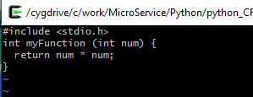
01.01 Create C Function
https://docs.python.org/2/extending/extending.html
> vi func.c
Create a myFunction () as follow:
# include <stdio.h>
int myFunction (int num) {
Return num * num;
}

Slide 6
01.02 Compile Shared Library

Slide 7
01.02 Compile Shared Library
https://docs.python.org/2/extending/extending.html
Compile the shared library.
> gcc –fPIC –shared –o libfun.so func.c
-fPIC: Generate PIC (Position Independent Code) Dynamic Linked Library for target machine.
-o: Output file
Checked the compiled shared library.
> ls -l libfun.so

Slide 8
01.03 Create Python Code

Slide 9
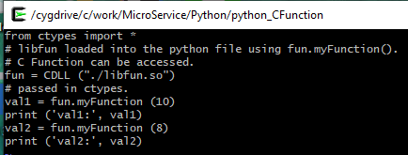
01.03 Create Python Code
https://docs.python.org/2/extending/extending.html
> vi function.py
Edit code as follow:
from ctypes import *
fun = CDLL (“./libfun.so”) # load generated shared library
val1 = fun.myFunction (10) # call the external C Function myFunction ()
print (‘val1: ‘, val1)
val2 = fun.myFunction (8) # call the external C Function myFunction ()
print (‘val2: ‘, val2)

Slide 10
01.04 Run Python to C Function

Slide 11

01.04 Run Python to C Function
https://docs.python.org/2/extending/extending.html
> python function.py

Slide 12
01.05 Summary

Slide 13
01.05 Summary
https://docs.python.org/2/extending/extending.html
Use Python call C Function can be easily implemented by cygwin environment
Create a C file
Complied C code into shared library.
Create a Python Code.
Use CDLL to call shared library.
Use CDLL object to access the C Function.

Slide 14
End of Chapter

