Slide 1

1 Linked List
Peter H. Chen

Slide 2
12 Linked List
  https://stackabuse.com/linked-lists-in-detail-with-python-examples-single-linked-lists/
A linked list is a dynamic data structure which means that the memory reserved for the link list can be increased or reduced at runtime.
No memory is allocated for a linked list data structure in advance.
Whenever a new item is required to be added to the linked, the memory for the new node is created at run time. On the other hand, in case of the array, memory has to be allocated in advance for a specific number of items.
In cases where sufficient items are not available to fill all array index, memory space is wasted.
Since arrays require contiguous memory locations, it is very difficult to remove or insert an item in an array since the memory locations of a large number of items have to be updated.
On the other hand, linked list items are not stored in a contiguous memory location, therefore you can easily update linked lists.
Owing to its flexibility, a linked list is more suitable for implementing data structures like stacks, queues, and lists.

Slide 3
1.1 LinkedList() and Insert_at_end()

Slide 4
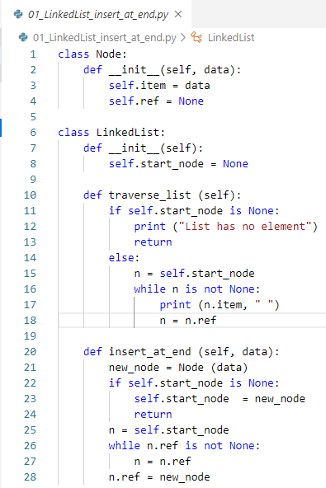
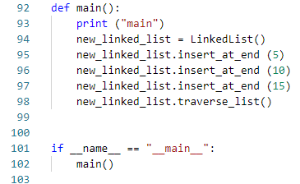
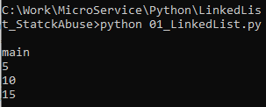
1.1 LinkedList() and Insert_at_end()
  https://www.tutorialspoint.com/python_data_structure/python_linked_lists.htm
Create Linked List, insert_at_end, traverse_list:

Slide 5
1.2 Insert_at_start()

Slide 6
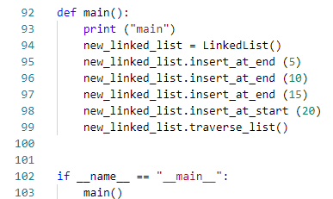
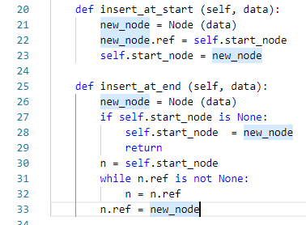
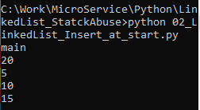
1.2 Insert_at_start()
  https://www.tutorialspoint.com/python_data_structure/python_linked_lists.htm
Create Linked List, insert_at_start, traverse_list:

Slide 7
1.3 Insert_after_item()

Slide 8
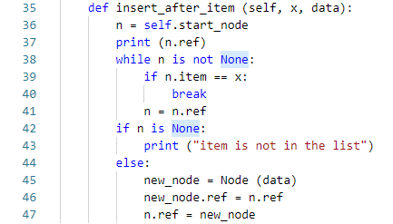
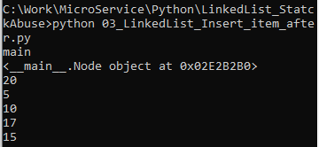
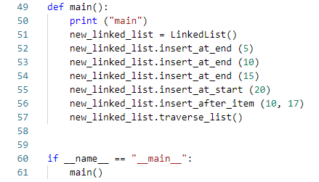
1.3 Insert_after_item()
  https://www.tutorialspoint.com/python_data_structure/python_linked_lists.htm
Create insert_after_item():

Slide 9
1.4 Insert_before_item()

Slide 10
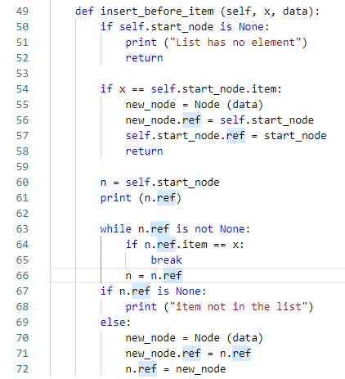
1.4 Insert_before_item()
  https://www.tutorialspoint.com/python_data_structure/python_linked_lists.htm
Create insert_before_item():

Slide 11
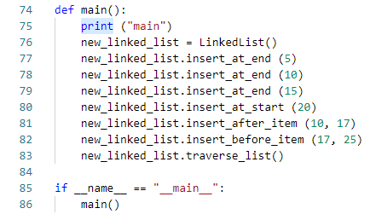
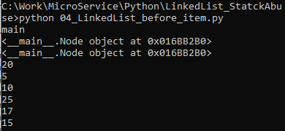
1.4 Insert_before_item()
  https://www.tutorialspoint.com/python_data_structure/python_linked_lists.htm
Create insert_before_item():

Slide 12
1.5 Insert_at_index()

Slide 13
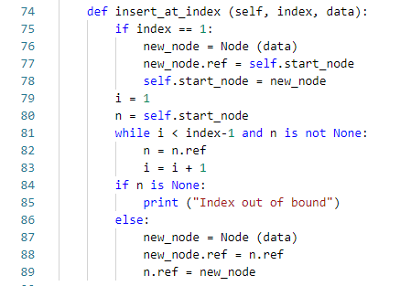
1.5 Insert_at_index()
  https://www.tutorialspoint.com/python_data_structure/python_linked_lists.htm
Create insert_at_index():

Slide 14
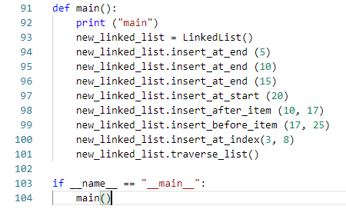
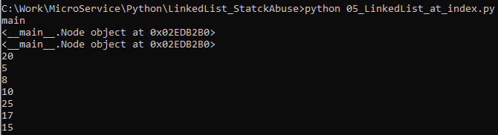
1.5 Insert_at_index()
  https://www.tutorialspoint.com/python_data_structure/python_linked_lists.htm
Create insert_at_index():

Slide 15
1.6 get_count ()

Slide 16
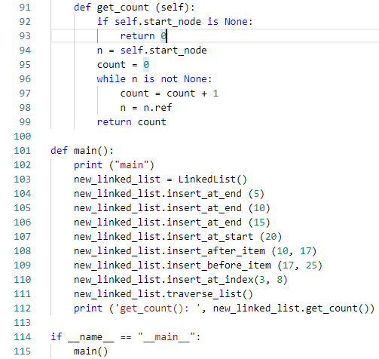
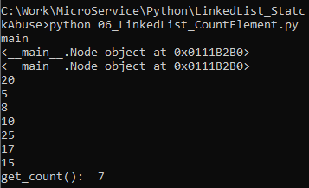
1.6 get_count()
  https://www.tutorialspoint.com/python_data_structure/python_linked_lists.htm
get_count():

Slide 17
1.7 search_item()

Slide 18
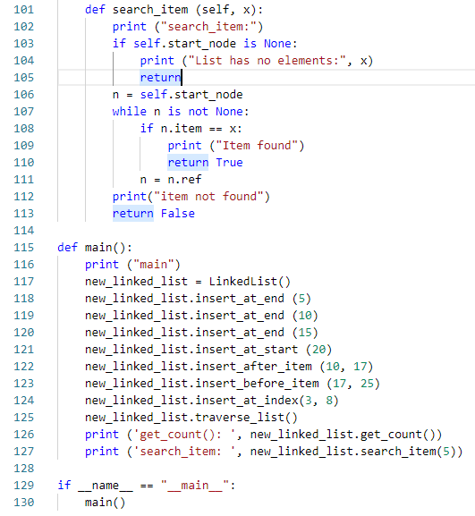
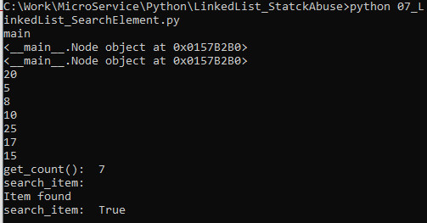
1.7 search_item()
  https://www.tutorialspoint.com/python_data_structure/python_linked_lists.htm
Search_item():

Slide 19
End of Chapter

